Slide 1

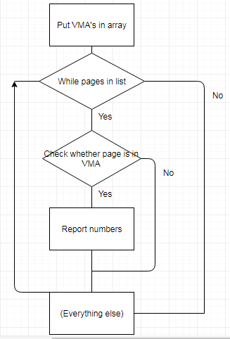
QoS-Aware Virtualization (using SSD and disk)
Christopher Feener
Advisor: Xuechen Zhang
Motivations
Results and Data
Data
SSD has high performance, and is becoming increasingly economical and efficient.
SSD can be an extension of DRAM.
Disk is very cheap and durable.
Overall, writes to SSD were reduced by 16 - 40% without hurting performance greatly ( -0.8 – 7.1%).
Memcached writes were reduced by 37%, though performance decreased slightly by 0.8%.
ImageMagick had 40% fewer writes, 4.6% more performance. Had the largest reduction of writes.
Correlation Computation had 22% fewer writes, 7.1% more performance. Had the best improvement in performance.
Matrix Inverse had 16% fewer writes, 0.5% more performance.
Using Sequences: Hybrid Swap had 49% fewer page faults than SSD-swap, and 39% fewer than RAID-swap, due to finding page access patterns.
Memory Size: However, throughput testing in Memcached showed Hybrid Swap to use more throughput than RAID-swap. (22% for 512 MB sizes, and identical for 2 GB)
Performance: Hybrid Swap's run time was about the same as SSD-swap's and much better than RAID-swap's. The number of major faults in Hybrid Swap was better than both the others'. This is partly due to better disk efficiency.
Concurrency: Hybrid Swap's performance was better than both SSD-swap's (by 20%) and RAID-swap's (43%).
Bounds for penalty ratio: Hybrid Swap follows limits on ratio of page fault penalty to runtime, unlike SSD- and RAID-swap.
Challenges
This shows the average number of pages in each of 15 VMA's.
Speed of SSD is fast, but not durable.
Disk is durable, but slow.
(Last attempt of “Hybrid Swapping” was done on Linux kernel 2.6, and many parts of the kernel have since changed.)
(Lack of documentation.)
Immediate goal: Spatial Locality
Setup
Our Approach
Started with Qemu program, booting from kernel source code inside.
Tested with ImageMagick on a large image of a galaxy. This forced the computer to have page faults and use swap.
Coded inside function shrink_page_list().
The “Hybrid Swap” method was meant to use both spatial and temporal locality.
Spatial locality deals with how close addresses from a sequence are.
By iterating through processes from the current task, virtual memory areas (VMA's) were put in an array.
As the function iterated through pages, each page was checked to all the VMA's, using page_address_in_vma().
Each “match” had its information printed.
These matches could be saved and recorded in another array for future use, such as analyzing the average distance between page addresses.
“Hybrid Swapping” could use the advantages of both speed and limited swapping. It did this by swapping only page faults to disk.
Only minor additions were made to linux kernel 4.11, specifically in the function shrink_page_list().
Debugging: No major program/method was used other than dmesg and printk statements.
Conclusion
First
Second

