Slide 1
CFEngine

Slide 2

Quotes
“
CFEngine offers a highly scalable approach with a pull-based, distributed architecture.
”
“
CFEngine is different from its competitors because it is pull-based only.
”
“
CFEngine has a large installed base in its community version (over 10,000 enterprises).
”

Slide 3
CFEngine at a Glance
We Help IT-organizations:
Roll out Changes Quickly
Ensure Changes remain in compliance
Focus on agility and cost
Massive Adoption
>10,000,000 Servers
>10,000 Companies
>100 Countries
The Company:
Offices in Europe and USA
Venture Backed, Solid Financials
Solid Technology
20 year record of Security- FIPS 140-2 Compliant
200K Server-installation- 5000 servers per hub
Fault-tolerant and self-healing

Slide 4












Users and customers of CFEngine

Slide 5



Increase business value through Automation
We help IT-organizations become more agile while reducing costs
Global changes in minutes
Unlimited scale and complexity
Remove human bottlenecks
Productivity
Reduced need for labor
Reduced costs related to instability/outages
Reduced license costs
Costs
Billions of compliance checks per day
Real-time compliance repairs
Granular and pattern based
Security
Notes:
Roll out new changes
Ensure changes remain compliant
3) At large scale and in complex environments Automation is the only way to stay competitive. We represent the next generation automation tool
IT will go through the same revolution we saw in the Automotive industry. JIT, Eliminate time-waste, Machines do the work (correct division of labor), Human focus on “why”

Slide 6
CFEngine – Low-level examples
Build new nodes: PXE boot & Kickstart, VMs, Cloud
Deploy software (package manager)
Manage local passwords
Manage network settings
Manage services (start, stop, disable)
Manage applications (verify, start, stop)
Manage permissions (ACLs)
File change management (change detection, file diff)
Manage database and registries
Manage hypervisors and virtual guests
Manage black-, grey- and white-lists
Manage configuration settings
Create compliance reports
Monitor overall performance
BUILD
DEPLOY
POLICY
AUDIT
MANAGE

Slide 7
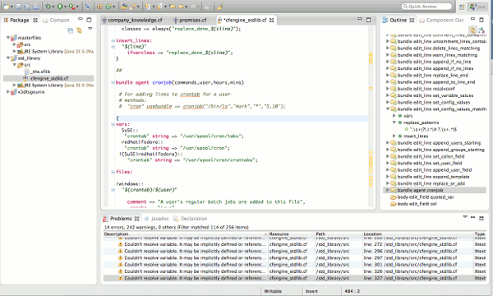
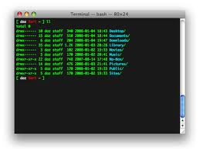




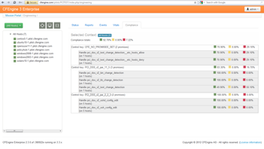


CFEngine – high level illustration
1. Describe Desired State of IT-Services
2. Ensure
Desired State
Design Center
Policy Hub
State DB
State DB
3. Verify Actual State of IT-Services
CFE Agents
Knowledge Center

Slide 8

Continuous maintenance is needed
Examples:
NIC fixes 2,23% hosts repaired last 24 hrs.
AIX group exists 3.00% hosts repaired last 24 hrs.
NTP 1.39% hosts repaired last 24 hrs.
Tivoli Processes 1.08% hosts repaired last 24 hrs.
Total repairs on 4K hosts in one week: 367,433
> 2,3 billion checks daily
> 0,5% settings change
> 50 S.As to fix drift
“70% - 80% of outages are caused by unplanned and manual changes”,
How many unplanned changes did you experience the last 24 hours?
Notes:
Butterfly effect. A small initial change yield diverging outcomes making long term prediction impossible. Deterministic systems not predictable (chaos theory)
Physics, economics, biology and engineering
- Systems drift towards failure. Dev has continuous build, test, deploy. Now time for Ops to get on the stage

Slide 9
CFEngine 3 Enterprise
What we do really well
High-Availability (Agents fail-over & Hub replica)
Highly Scalable (5,000 Agents per Hub, Horizontal Hub scaling)
Highly Secure (20 years with outstanding security record)
Extremely Cheap on Resources (CPU, Memory, Network traffic)
Easy to maintain (few dependencies, automatic updates)
Saving money when used in the Cloud (due to less resource consumption)
Lightning fast (1-2 seconds, updates 4,000 servers in less than 1 minute)
Best at Complexity (superior granular modeling capabilities)
Granular Reporting (flexible filtering & powerful data aggregation capabilities)

Slide 10
Appendix

