Slide 1
Project 3:
Detecting, segmenting and recognizing descriptive regions in ID cards
Carlos Ferreira Escudero

Slide 2
1 - Third party usage
The program will be executed by the user through the command line interface (CLI)
It won’t receive any argument
In any case, an extra file (apart from the code file itself) will be necessary for the correct operation of the program. This file is attached to the rest of the practice
The steps that the user must perform to run the program are as follows:
1) Navigate to the folder where the python script and the XML file are located
2) Once there, a command prompt must be open
3) Type and execute the following:
python p3.py

Slide 3
1 - Third party usage: reading of the ID on both sides
Once the program has started, it will open a window displaying the content captured by the webcam. The user must show his/her ID card over a uniform and dark background (in my case this document was pasted on a black cardboard).
Once the detection of the front part of the document is complete, the program will prompt the user to press a key, which will close the previous window and open new windows, one for each of the fields of the DNI that have been segmented.
Once all the windows are closed, the user must turn his ID card around and show it to the camera again, so that it is visible in the new open window.
The program will read the back of the document in the same way as before, so that after processing the collected images it will ask the user to press a key in order to display, in separate windows, each of the fields that have been segmented from the global image.
All fields that have been segmented will be stored, in separate images, in a folder called "Imagenes" that will be created (if it does not exist) within the original directory.

Slide 4
2 - Code explaining: detectionID function
The function will work with one of the frames captured by the camera (input parameter).
A blur is applied to the grayscale converted frame, and then the Canny edge detection algorithm is used to find edges in the image.
Contours are found in the edge-detected image using cv2.findContours(). Each contour is approximated by a polygon, and bounding rectangles are calculated for each polygon.
Then a loop iterates through the detected contours. If a contour has an area above a certain threshold (10000), it is considered a potential DNI. The function then sets various global variables (redo, messageID, cont_frame…) based on the DNI detection conditions.
If the contour area is below the threshold, redo is set to True, and the loop breaks.
The original frame with potentially drawn rectangles around detected DNIs is returned.

Slide 5
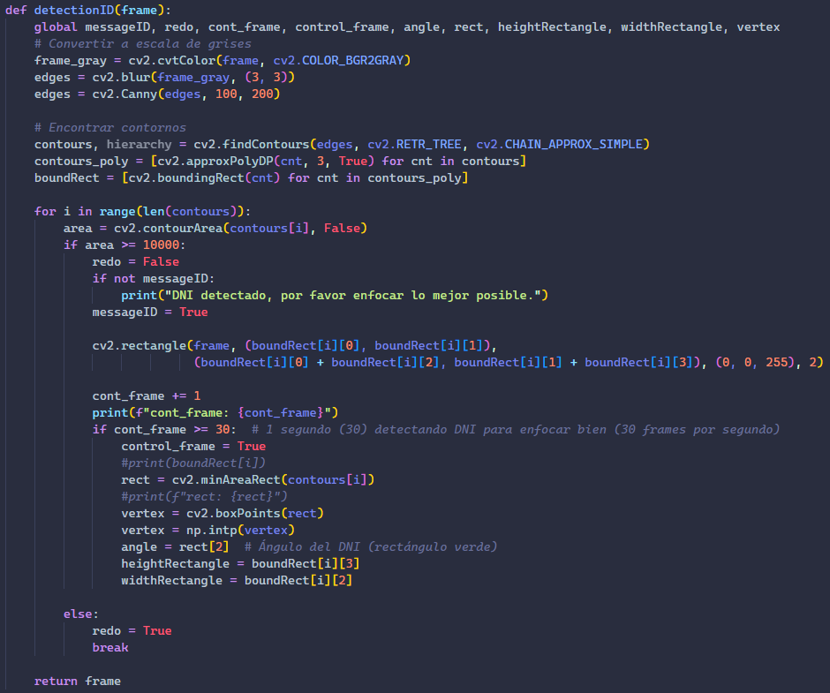
2 - Code explaining: detectionID function
In summary, the detectionID function processes a video frame to detect a potential DNI, draws a rectangle around it, and sets various global variables based on the detection conditions. The DNI detection is based on contour area, and additional actions are taken if enough frames show a consistent DNI presence.

Slide 6
2 - Code explaining: IDrescale function
The function will work with a rotated image (input parameter).
The function converts the turned image to grayscale and applies a blur followed by Canny edge detection.
After that, it detects contours in the edge-detected image.
If a contour has an area above the threshold (10000), it is considered a potential DNI. The function then calculates the minimum bounding rectangle (rect) and the vertices of the rectangle (vertex_aux). It also updates the maximum and minimum coordinates.
If the maximum and minimum coordinates are still at their initial values, no DNI was detected. The function prints an error message and exits the program.
The maximum and minimum coordinates are updated based on the vertices of the bounding rectangle.
FInally, we crop the original turned image based on the updated coordinates and resize it to a fixed size (425x270). We return this rescaled image.

Slide 7
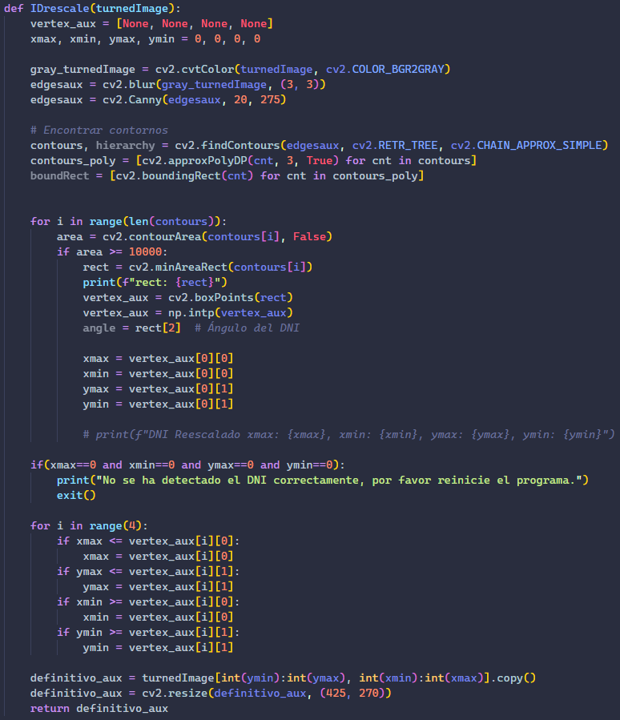
2 - Code explaining: IDrescale function
In summary, the IDrescale function takes a turned image (potentially a DNI) and performs contour analysis to detect the DNI, updates the bounding rectangle coordinates, crops the DNI, and finally resizes it to a fixed size. The function returns the rescaled DNI image. If no DNI is detected, an error message is printed, and the program exits.

Slide 8
2 - Code explaining: functions to extract DNI fields
8 different functions: faceExtract, surnameExtract, nameExtract, numberExtract, signatureExtract, dueDateExtract, birthdayExtract and mrzExtract.
The first seven functions extract information from the front of the ID card (that’s why their input parameter is the processed front part of the document), while the eighth reads the MRZ code from the back of the DNI (that’s why its input parameter is the backside of the document).
All these functions work in the same way: since they receive the DNI already cropped and precisely oriented, they simply extract specific (and constant) areas of the images they work with and return these fragments.

Slide 9
2 - Code explaining: main function
The function is divided into 2 very similar loops, responsible for processing the front and back parts of the DNI separately. That is why we will address the explanation of the loop relative to the front of the document, and it is understood that the extraction of the MRZ field present on the back of the aforementioned document is analogous to the previous processes.
FIrst of all, the function captures frames from the webcam and calls the detectionID function for DNI detection on the front side, and then displays the video feed with bounding rectangles around detected IDs. The function will exit the loop if the control_frame flag is set or if a key is pressed.
After that, it calculates the coordinates of the bounding rectangle based on the vertices obtained during front side ID detection.

Slide 10
2 - Code explaining: main function
The function crops the front side ID using the calculated bounding rectangle coordinates. It also writes the cropped ID image to a file and performs further processing steps.
As we mentioned earlier, a loop structure similar to the front side one is used to detect and process the back side of the ID.
Finally, the function will call several functions to extract and display specific information from the processed ID images.
In summary, the main function orchestrates the entire ID processing pipeline, from detection to information extraction, for both front and back sides of the ID. The script interacts with the user through the display of video feeds and extracted information.

Slide 11
3 - Execution example: ID card frontside
First of all a new window opens up, and the user must show to the camera (visible in this new window) his/her DNI. The program then recognizes it and tries to enclose it in a red rectangle (bounding box).
After that the program already knows there is a DNI, so it freezes the recording and extracts the last frame.
Once the user presses any key, this window is closed and some cropped images are shown. The ID card section where there is a picture of the user is also segmented.
Once all these windows are closed, 6 new ones open up, containing the ID number, name, surname, signature, expiry date and birthday.

Slide 12
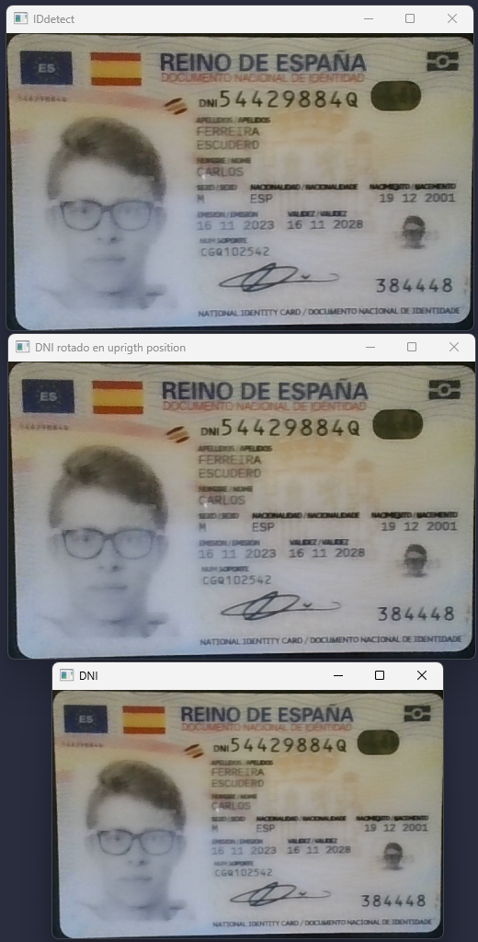


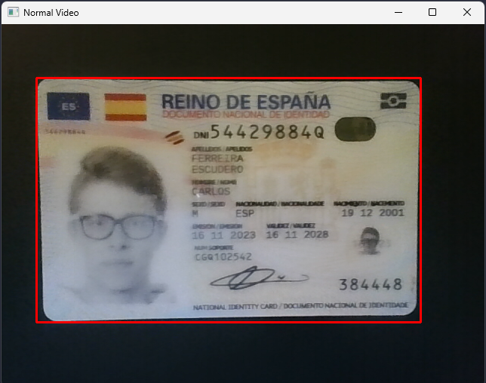



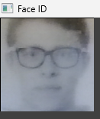

3 - Execution example: ID card frontside
Step 2
Step 3
Step 4

Slide 13
3 - Execution example: ID card backside
The behavior for the backside is almost the same as for the frontside. First of all, a new window opens up, and the user must show to the camera (visible in this new window) his/her DNI. The program then recognizes it and tries to enclose it in a red rectangle (bounding box).
After that the program already knows there is a DNI, so it freezes the recording and extracts the last frame.
Once the user presses any key, this window is closed and some cropped images are shown. The ID card section where there is the MRZ code is also segmented.

Slide 14
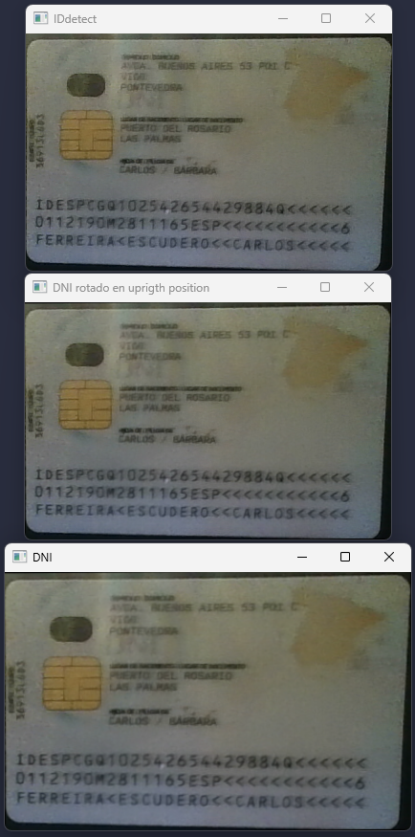
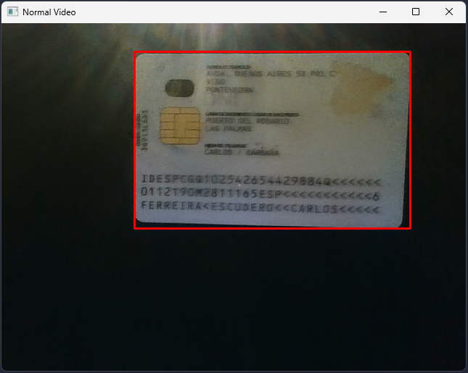
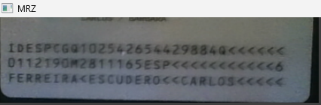
3 - Execution example: ID card backside
Step 2
Step 3

Slide 15
4 - Operating conditions
At the moment the program works properly with 3 different ID cards. In any case, all of them are examples of the most recent version of DNI.
For different versions of an identification document (for example, from another country), the program will behave incorrectly.
Obviously, and as can be seen in the photos on the previous slides, the quality of the camera used to collect the DNI images will greatly influence the correct (and even pleasant) post-segmentation reading of the document fields.
For information purposes, the camera used in my case is of a quality that could be greatly improved, and that is why, despite seeing the images with sufficient clarity to allow them to be read correctly, a little more resolution is missing, especially in those small-sized fields, such as the date of birth for example.
In tests with one of the DNI used, I decided to connect the camera of a mobile phone (this being of much better quality) to the computer used through the "Droid Cam" application, so that the images collected had a much greater degree of detail.

Slide 16
END

