Slide 1

Drupal and Source Control Management (SCM) using Git/SVN
David Thorne
For Cambridge Drupal Users Group - March ’12
Notes:
WARNING: Traditionally SCM is a geek heavy topic. Even if we skirt over the non git bits, it’s long and complex. At best this will introduce you to the wonderful world of SCM, at worst you won’t need any Nytol tonight and the IoA security team will have a shock in the morning finding you all asleep here! This is designed as an introduction to svn/git, some basic Drupal related mechanisms for git.

Slide 2

Contents (Or an idea of)
What is Source Control (Referencing Git and Subversion/SVN)
Why use Source Control (Referencing Git and SVN)
Why Drupal chose Git (Summary)
SVN basics
Git basics
Git workflows (Advanced topic, basic ideas)
Q & A
Notes:
That said what am I going to talk about? Mostly git and SVN. I will go over basic source control ideas (System agnostic) for those new to it, but this is a git and SVN talk, therefore I will talk git/SVN. I welcome questions about other SCM’s and how to use them, but I am more versed in Git than others. I used to use SVN so I am able to answer questions about that but am rusty - so some help may be appreciated from other SVN users if I come unstuck! BTW I am not an advanced git user! WHat I know barely scratches the surface of git!

Slide 3

What is Source Control (a)
Simply put Source Control is an easy way to help prevent screwing up when working in teams!
Notes:
SCM - An easy concept but difficult to do well! Teams screw things over. Plain and simple!

Slide 4
What is Source Control Example 1
Jeff does modules
Anthony does themes
Jeff spots violation of HTML5 and corrects it
No SCM = Overwrite
Notes:
For example Anthony and Jeff work on a site. Jeff = Modules, Anthony = Themes. HOWEVER Jeff spots a violation of the HTML5 standard and changes it for Anthony. No SCM = overwrite. When Anthony uploads his work, all Jeff’s changes are lost, kittens die, all round sadness *Sad geek face*

Slide 5
:-(
Notes:
Sad geek :-(

Slide 6
What is Source Control Example 1
Jeff does modules
Anthony does themes
Jeff spots violation of HTML5 and corrects it
No SCM = Overwrite
Notes:
With SCM = Patches merges and all round happiness, kittens are born (Although please note they still die if you use the WRONG SCM - The right/wrong SCM will be explained later...)

Slide 7
What is Source Control Example 1
Jeff does modules
Anthony does themes
Jeff spots violation of HTML5 and corrects it
SCM = Merge
Notes:
Merge FTW

Slide 8
:-)
Notes:
*do your little geek dance*

Slide 9
What is Source Control
Simply put Source Control is an easy way to help prevent screwing up when working in teams!
It’s a form of backup
It’s essential
Notes:
Form of backup - easy way to get back what you overwrote (Like that working function from 4PM on Friday when it’s 8PM and site should have been live 2 hours ago...) IT SHOULD NOT HOWEVER BE CONSIDERED A FORM OF BACKUP! (Just saves on attrib’s like module_name_wtf_please_f-ing_work)
It’s essential - no arguments - it is!

Slide 10
What is Source Control (b)
In software development there are 2 primary forms:
  Distributed (git, hg, bzr)
  Centralised (svn, CVS)
  Other types exist but out of scope
Notes:
2 primary types of SCM Distrib and central. Git (Linux Kernel, Drupal, PHP, important things) hg (Growl, Mozilla, Java, Vi) bzr (er yeah... ubuntu - the forgotten few *hang head in remembrance*) SVN - some public projects (Trac, Subversion itself, ?Apache?) but mostly now appears to be in use in private companies. CVS er yeah Eclipse? Although their migrating to Git!

Slide 11
Why Git
Why not?
It’s distributed
It’s Linus’ beast
GITHUB!
branches
Drupal uses it
Notes:
The last point says it all!

Slide 12
Why Git (b)
It’s over complicated
It’s Linus’ beast (I’m smart - you’re not attitude)
Steep learning curve (See above!)
Notes:
complicated - so called 2 stage commit (git add . && git commit -m “message” ;; git fetch {remote}/{branch} ;; git merge {remote/branch} {branch} etc )
Linus’ attitude very much “I’m smart you’re not - live with it”

Slide 13
Why Git (c)
Linus’ reasoning (Everything else is stupid)
  http://youtu.be/4XpnKHJAok8 (An hour long!)

Slide 14
Why Drupal chose Git
It was git vs Bzr
http://groups.drupal.org/node/48818?page=2#comment-133893 (summary)
  coders were leaving for github
  larger community
Notes:
OK I knew people were going to ask this so I stuck a few slides in - but it really was very long, very complex. In fact if I remember rightly Jeff was a regular commenter on the issue!

Slide 15
SVN Basics
svn checkout {url} (svn co)
svn add {file}
svn commit (svn ci)
svn delete (svn del svn rm)
svn tag
svn branch
Notes:
Tags say it all

Slide 16
Git Basics
git clone {url}
git add {file list} // git rm {file list} (DIFFERENT MEANING)
git commit {file list}
git push {remote} {branch}:{branch}
git pull {remote} {branch}:{branch}
git branch {branch name} (Or git checkout -b {branch} {commit})
git tag
Notes:
explain tags - explain add/rm needs to be before EVERY commit. Explain there are other ways of doing it but beyond scope of project. Explain what a remote is - give example of origin, but further explanation is out of scope

Slide 17
Git Workflows
Look at http://progit.org (Online ebook)
Centralised - AKA “The one ring” (SVN, to a degree)
Notes:
Online ebook by Scott Chacon. Jeff - forgive me here - I am minimising how Drupal uses Git, but it’s about as simple as I can get!

Slide 18
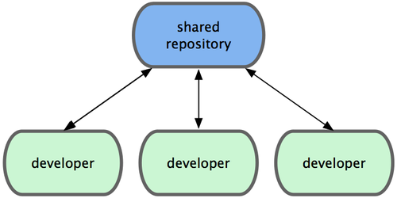
Git Workflows - Centralised
Text
Text
Photo credit: http://progit.org/book/ch5-1.html CC NC Sharealike 3 license

Slide 19
Git Workflows
Look at http://progit.org (Online ebook)
Centralised - AKA “The one ring” (SVN, to a degree)
Integration Manager (Blessed, Drupal to a degree)
Notes:
Online ebook by Scott Chacon. Jeff - forgive me here - I am minimising how Drupal uses Git, but it’s about as simple as I can get!

Slide 20
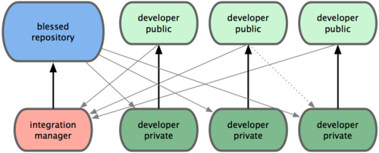
Git Workflows - Integration
Photo credit: http://progit.org/book/ch5-1.html CC NC Sharealike 3 license
Notes:
This is a bit like a lot of Drupal modules, if you imagine the integration manager as the maintainer/co-maintainer. So the integration manager takes the patches, and commits them to the main repo.

Slide 21
Git Workflows
Look at http://progit.org (Online ebook)
Centralised - AKA “The one ring” (SVN, to a degree)
Integration Manager (Blessed, Drupal to a degree)
Dictator and Leuitennant (Blessed with few key commiters - Drupal Core, to a degree)
Notes:
Online ebook by Scott Chacon. Jeff - forgive me here - I am minimising how Drupal uses Git, but it’s about as simple as I can get!

Slide 22
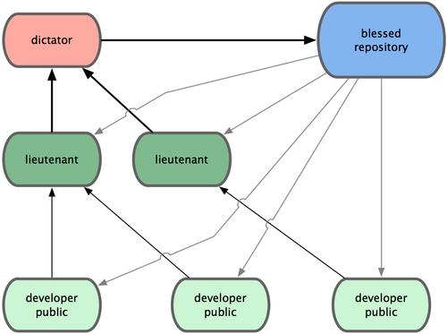
Git Workflows - BDFL
Photo credit: http://progit.org/book/ch5-1.html CC NC Sharealike 3 license
Notes:
This is a bit like D8, With lieutenants being the Inititive leaders (Gábor Hojtsy, Kris “EclipseGC” Vanderwater, etc) and the dictator being Dries, or Nat “Catch” Catchpole

Slide 23
Q & A
Over to you...

Slide 24
THANK YOU!
https://github.com/cferthorney/Drupal-SCM-Presentation.git
Twitter - http://twitter.com/cferthorney
Email: david@cferthorney.com

