Slide 1
Report: Olympic Swimmers’ Measurements and Medal Status
By Charlotte fettes

Slide 2
Contents
Review of Hypotheses and Approach
Entity Relationship Diagram
Initial findings
Descriptive statistics findings
Deeper analysis
Predicting future medal status
Hypotheses results
Current limitations and future considerations

Slide 3
Review of Hypotheses
Since 1960, there has been a significant increase in the heights, weights and ages of male and female Olympic swimmers (medallists and non-medallists).
From 1960 to the present, male and female Olympic swimmer medallists have had significantly higher heights, weights and ages compared to non-medallists
Since 1960, BMI of female and male medallist Olympic swimmers is higher than non-medallists in general

Slide 4
Review of Approach
The data was split by gender and by medal status (medallists and non-medallists).
Two-sample one-sided Z tests were conducted for females and males for weight, height, age and BMI in 1960 and 2016, and comparing consecutive games years.
Two-sample one-sided Z tests were conducted for females and males for the data overall and for each games year since 1960 for weight, height, age and BMI.
(Z-scores used as the data used contains the entire population under study rather than a sample – all Olympic swimmers’ data - and so it can be assumed that the standard deviation of the population under study is known)

Slide 5
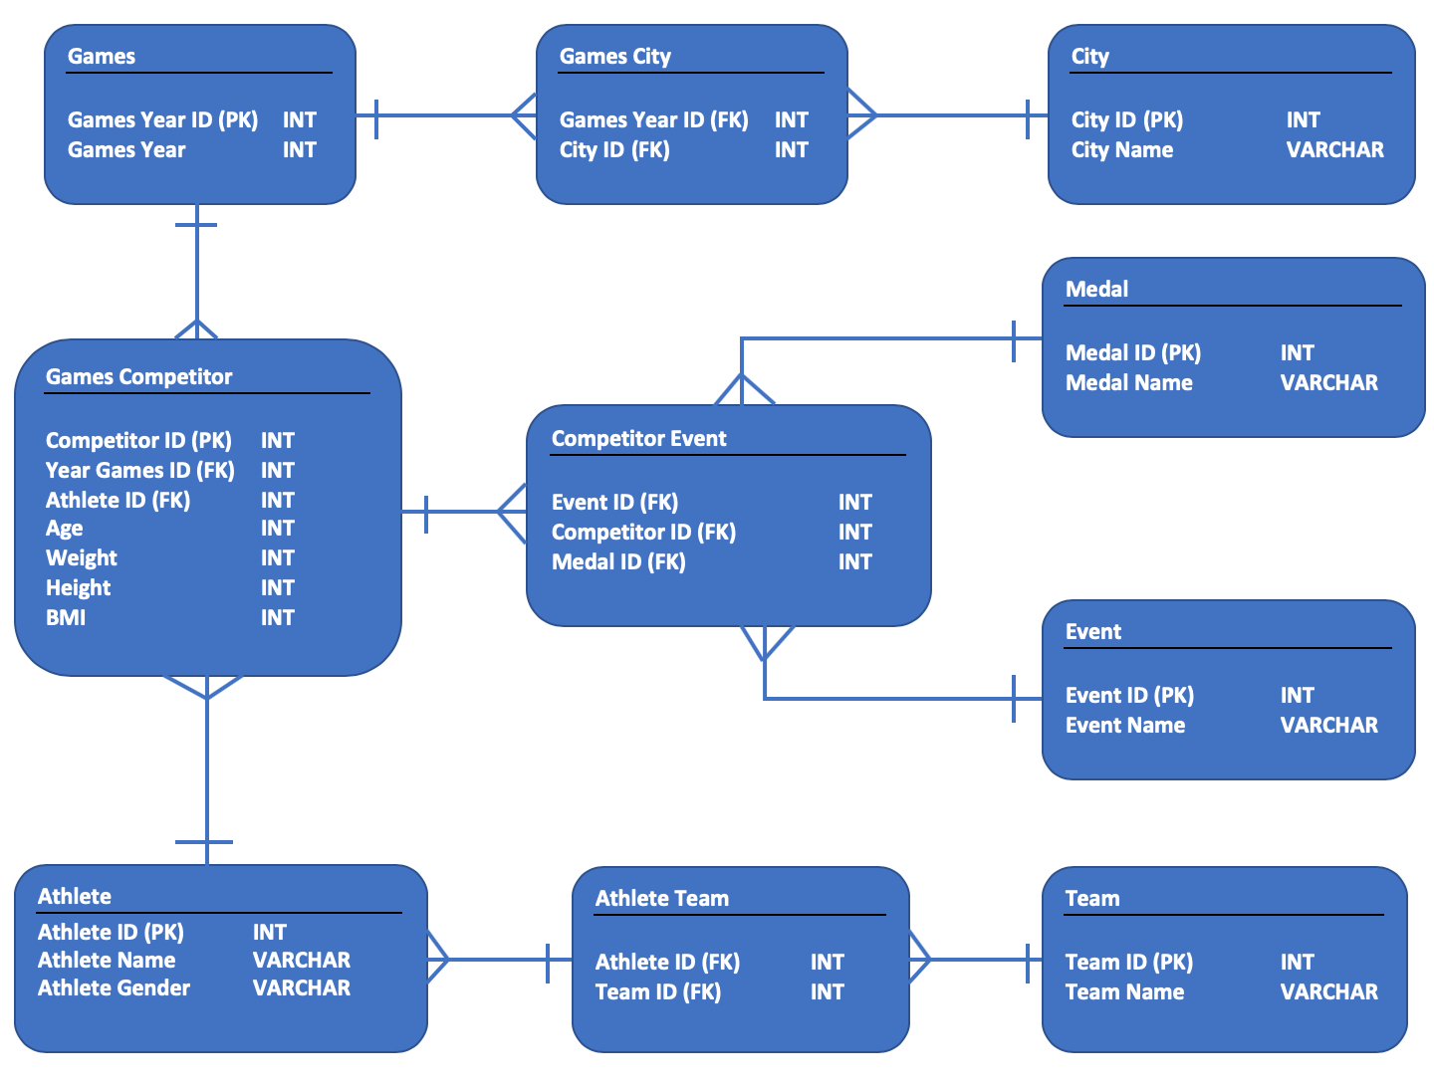
Entity Relationship Diagram (ERD)

Slide 6
Initial Findings
Line plots of games year against mean athlete measurement (females and males plotted separately) showed clear separation between medalists and non-medalists for height, age and weight, especially since 1960.
These line plots also showed that for all athletes – male, female, medalist and non-medalist – for age, weight and height there was a general upward trend from 1960 to 2016 (most recent games with data available)
BMI was more questionable – although in general medalists had a higher BMI than non-medalists, there was a great deal of fluctuation; also the long-term trend was not clear, again with a lot of fluctuation

Slide 7
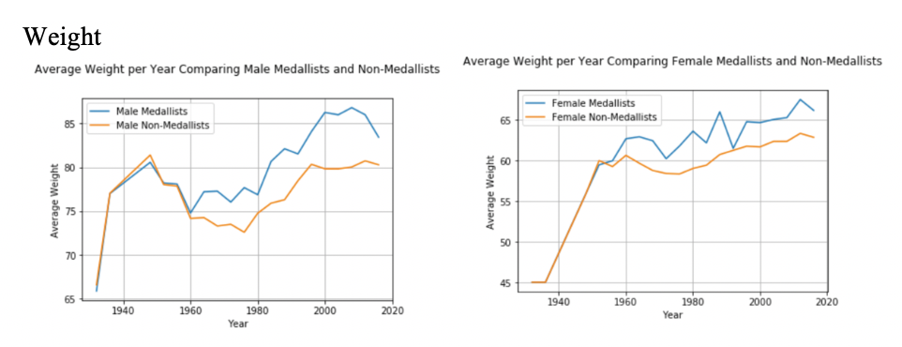
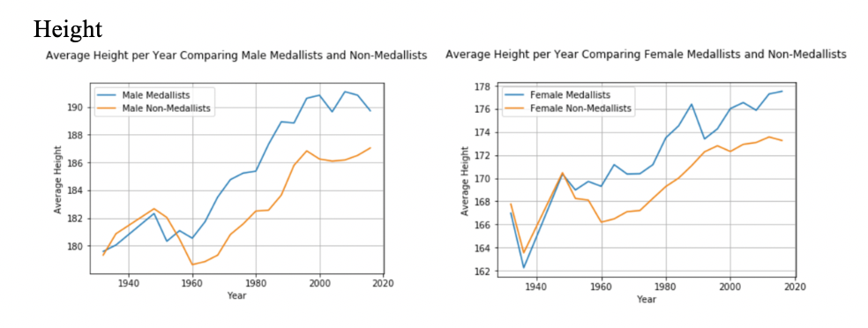
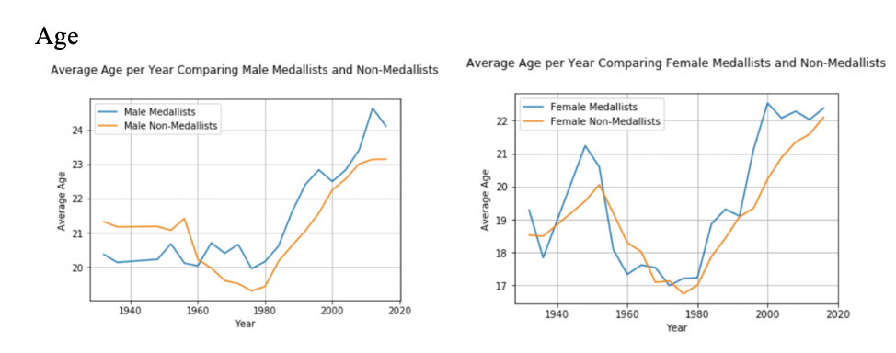
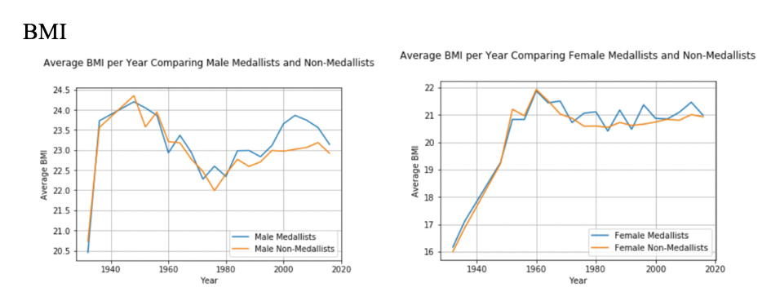
Initial Findings cont…

Slide 8
Descriptive Statistics Findings
On comparing the differences in mean athlete measurements between medalists and non-medalists per games year, the majority of descriptive statistics were positive, which indicates that for most measurements the mean for medalists is higher than for non-medalists. Only male age and male BMI contained negative min value, which suggests that for at least one games year, non-medalists are higher in age and BMI on average than medalists.
Descriptive statistics on all male and all female athletes separately by year for weight, height and age indicate an increasing trend for min, max and quartile values, which suggests the increasing mean values observed are due to a general population increase in these athlete measurements over time. Standard deviations remained fairly stable, suggesting mean value trends are not due to outliers skewing the data.
BMI descriptive statistics for males, females, medalists and non-medalists are all quite stable, which indicates that over time BMI changed very little if at all.

Slide 9
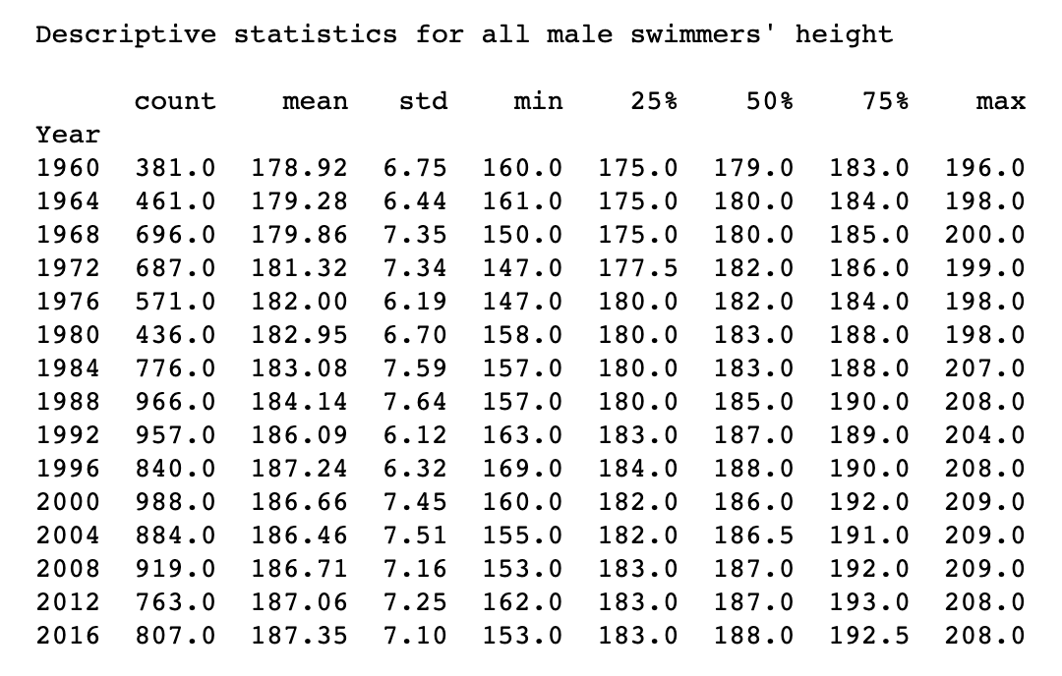
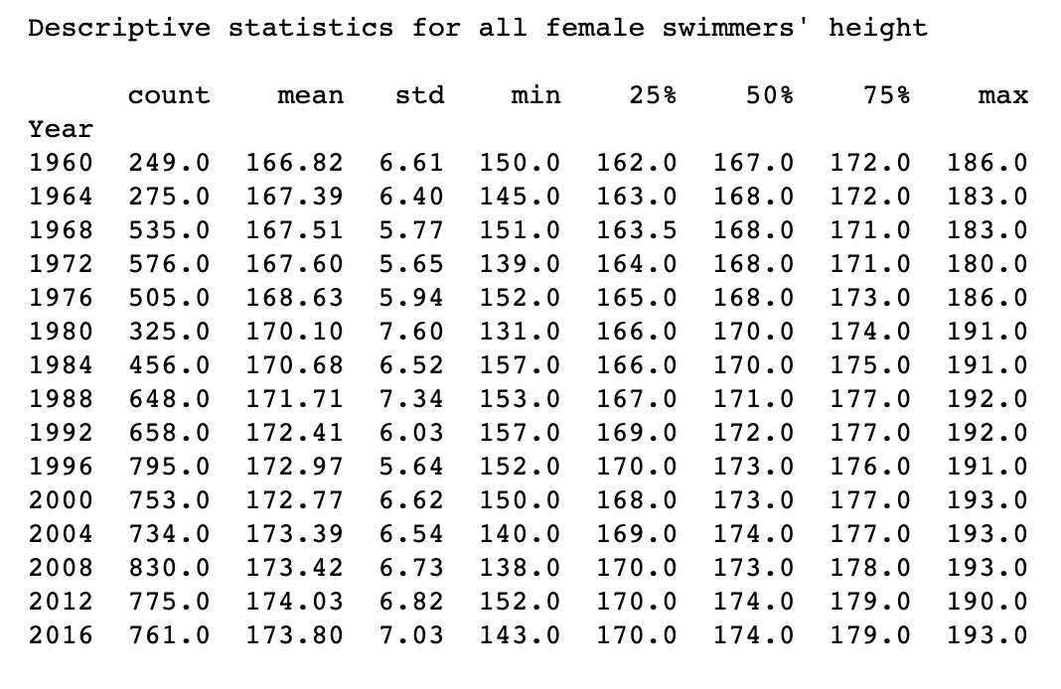
Descriptive Statistics Findings cont…
An example of the overall trends in descriptive statistics for athlete height:

Slide 10
Deeper Analysis
When comparing 1960 to 2016 for athlete measurements, for both males and females overall weight, height and age have a significant p-value, therefore the null hypothesis can be rejected.
When comparing athlete measurements for consecutive games years, for both males and females overall, weight, height and age, the majority do not have a significant p-value, therefore the null hypothesis can be accepted.
The above points suggest that although overall the change in athlete weight, height and age in swimming is significant in the long-run, in the shorter term the difference is not that great.

Slide 11
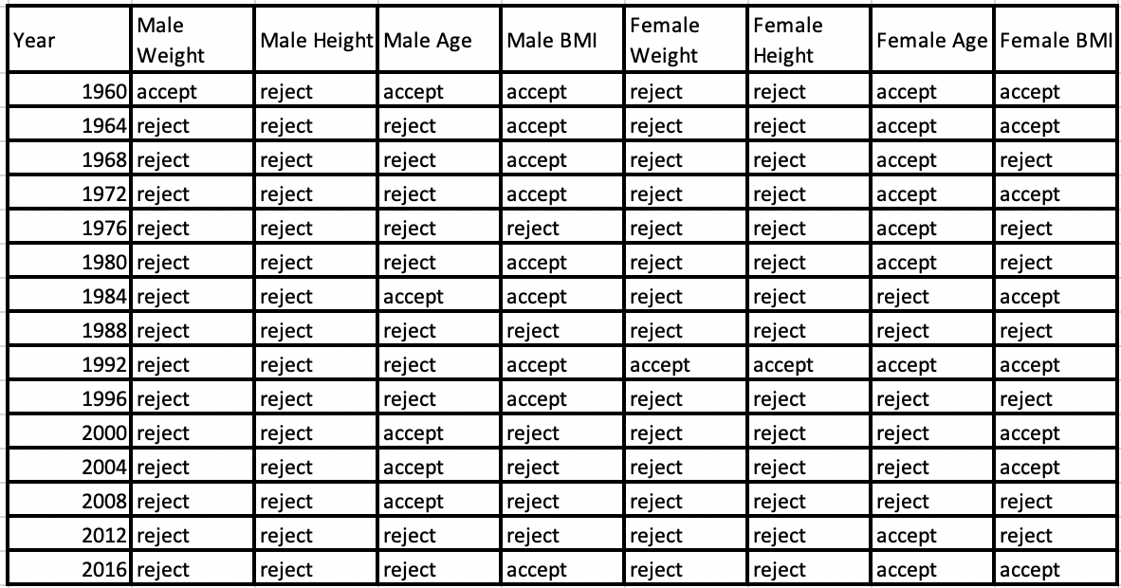
Deeper Analysis cont…
In comparing weight, height and age of medalists and non-medalists (females and males separately) for each games year since 1960, the following was found (table notes if null is accepted or rejected):

Slide 12
Deeper Analysis cont…
To find out if the Team variable (country of the athlete) is an intervening or determining variable in medal status, the data was grouped, with mean weight, height, age and BMI measurements per country per games year being calculated, as well as medal count per games year. For both male and female athletes, no correlations were observed in this data. This suggests that country is not a strong determinant of height, weight and age. However, from the data, some countries consistently win the higher number of medals per year (this was later determined with the regression model).
There are, as expected, strong correlations between height and weight – as athletes get taller, their weight also increases. This correlation is, however, stronger for both female and male medallists compared to non-medallists (0.79 vs 0.77 for males; 0.79 vs 0.72 for females).
There are weak positive correlations between Year and age, weight and height of athletes, which supports the hypothesis that since 1960 athlete height, weight and age have increased. Once again, these correlations are stronger for male and female medallists compared to non-medallists (e.g. for the correlation between year and weight, female medallists vs non-medallists is 0.43 vs 0.23, and male medallists vs non-medallists is 0.43 vs 0.32).
A very interesting correlation finding is that of year with the difference in the mean athlete measurements; these are positive and of medium strength, being stronger for females (except age). For example, the correlation of year with difference between mean weight of medallists and non-medallists for males is 0.59 and for females is 0.83. This suggests that over time, the gap between mean athlete measurements of medallists and non-medallists is increasing.

Slide 13
Predicting future medal status
As there are observed relationships between medal status and height, age and weight, as well as the increase over time, a classification model was developed in an attempt to predict whether an athlete would be a medal winner or not (binary – 0 for no medal, 1 for medal (gold, silver or bronze)).
Year cannot be used as a feature, as for future predictions the model would not have data related to the year it was predicting for, so percentile features for weight, height, age and BMI were created (these were percentiles per year and per gender). In addition, given that although team was not found to be strongly linked to athlete measurements, it does appear as though certain countries have a higher medal count consistently every games year, team was a feature that was retained.
With 2016 used as the test set, XGBClassifier performed the best at predicting athlete medal status in 2016, achieving an accuracy of 91%, but given the unbalanced nature of the prediction problem, it had quite a high false positive rate (it predicted quite a large number of athletes that would win a medal, who in fact did not in 2016).
The feature importance function available with XGBoost was used. This showed that although athlete measurement percentiles, gender and actual measurements were important in predictions, the most important features in predicting athlete medal status was if they belonged to certain teams (these were United States, Australia, East Germany, Soviet Union (more distant years) and Germany), who have the highest medal count overall.

Slide 14
Hypotheses Results
Since 1960, there has in fact been a significant increase in the heights, weights and ages of male and female Olympic swimmers (medallists and non-medallists). However, this is a long-term significance, which although is a relationship shown in the data, there are not significant increases between consecutive games years.
From 1960 to the present, male and female Olympic swimmer medalists have had significantly higher heights, weights and ages compared to non-medalists for the majority of games years. Although, as shown on the table under deeper analysis although medallists tend to have higher measurements than non-medallists this is not a significant difference in all games years. Age in particular has fewer significant differences, suggesting for swimmers an upper age limit
Since 1960, BMI of female and male medallist Olympic swimmers is higher than non-medallists in general. However, generally the difference is not significant. Although, in more recent games years there are increasingly more significant results suggesting increasingly that medalists have significantly higher BMI than non-medalists for males and females
The results of the model to generate medal status predictions indicates that although weight, height and age of an athlete are clearly important, other features must be taken into consideration

Slide 15
Recommendations
That the difference between the BMI of medalists and non-medalists is more frequently significant, and that the weight of medalists is significantly higher than the weight of non-medalists are important messages for personal trainers, fitness enthusiasts and those dispensing fitness advice to utilize – as shown by Olympic swimmers, being of a lower weight has proven to be less successful for performance. We should take a healthier approach to fitness, avoiding being at low weights.

Slide 16
Thank you

