Slide 1
Linkage Plus Solution
Byte Guru

Slide 2
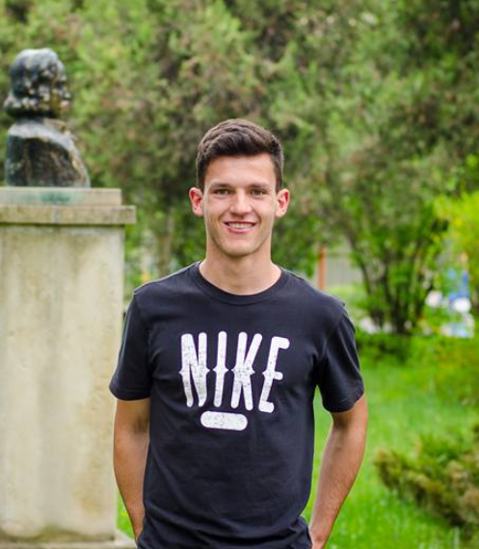

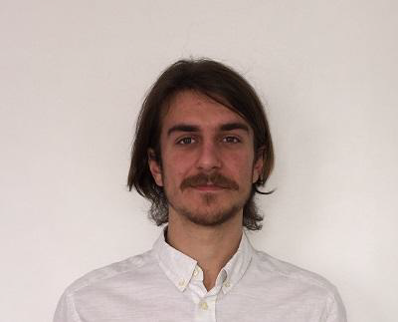

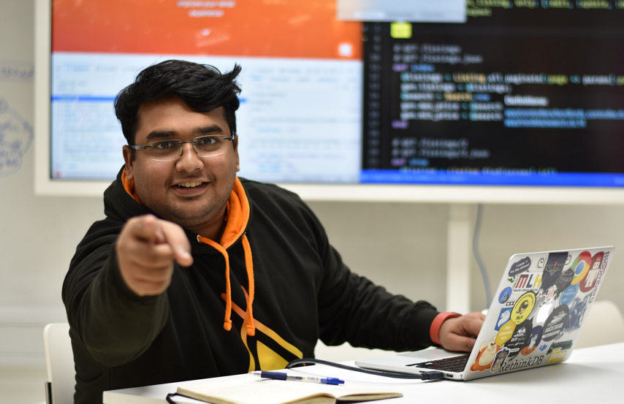

Mihai
Cosmin
Razvan
Vishnu R Menon
Beniamin
Jieni Wang

Slide 3

Our process is simple
My app
API
(server)
My tracker

Slide 4

Easy to use APP

Slide 5
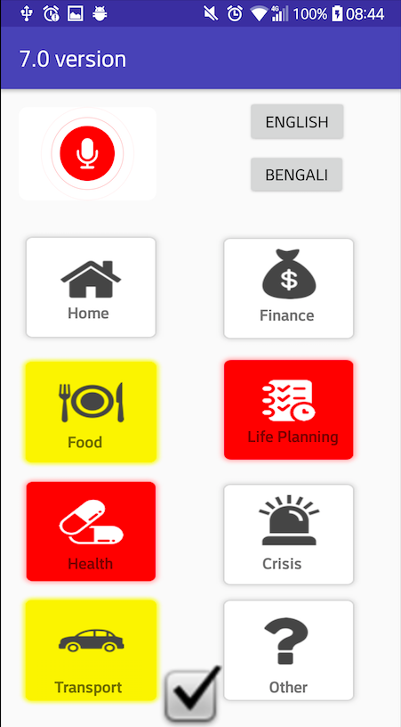

1. My app
30sec referral

Slide 6

My app
Voice or buttons

Slide 7

My app
Colour coded

Slide 8
My app
Website

Slide 9



My tracker
2.
Temperature sensor
Step Tracker
Website
Detect falling motion
Notes:
Temperature sensor
Detect falling motion → urgent message to website

Slide 10

CHEAP

Slide 11
Website
3.
Gather information from API
Data monitor and visualization by Linkage plus

Slide 12
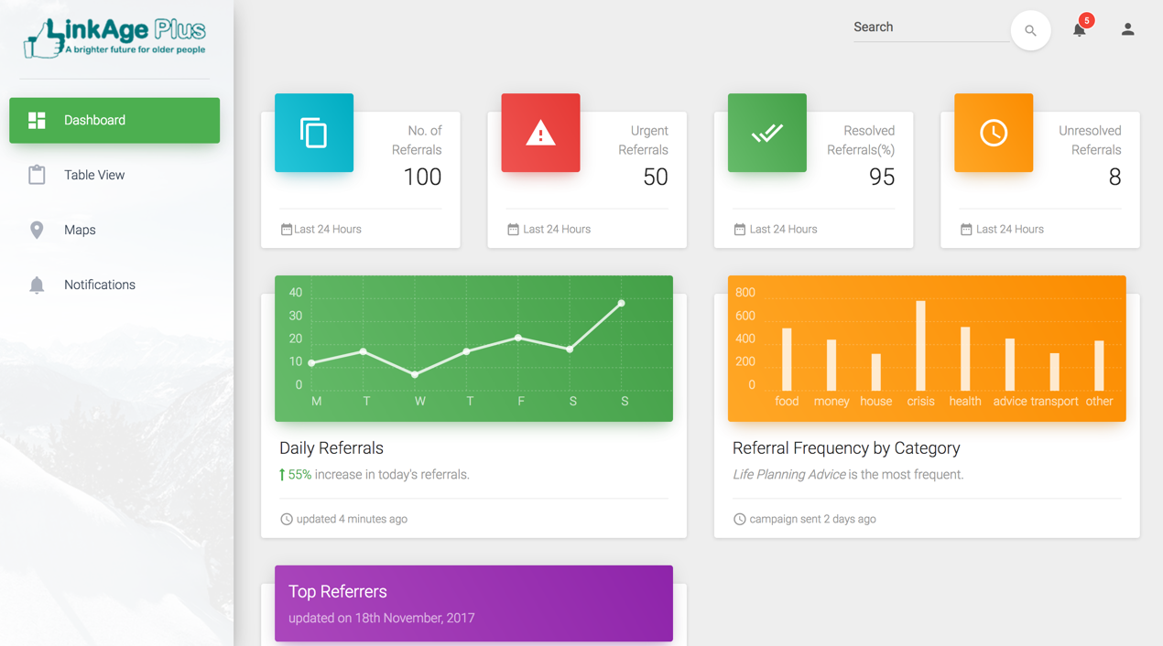

Slide 13
Our solution provides easy, continuous, cheap access for the care of the elderlies in the neighbourhood with just a few taps!

Slide 14
Demo

Slide 15
Future
Better data representation
Smoke detection
Social platform
Pulse monitoring
Multiple languages
Personalised care
Text based alert

