Slide 1
Troubleshooting Workbooks and Automating Excel Applications
Chapter 10

Slide 2
Chapter Introduction
Information system
Collects, organizes, and processes data
Communicates and distributes coordinated results
Decision support system (DSS)
Helps managers model business scenarios, especially through what-if analysis
Minimizing data-entry errors in Excel workbooks
Documenting workbooks and troubleshooting worksheet errors

Slide 3
Chapter Introduction (continued)
Automating tasks to further enhance usefulness and reliability of workbooks
To go to Level 1, click here
To go to Level 2, click here
To go to Level 3, click here

Slide 4
Tools Covered in This Chapter
Comments
custom macro buttons
custom ribbon tabs and groups
Data validation
Formula auditing
Macro recorder
Visual Basic Editor
Worksheet and workbook protection

Slide 5
Level 1 Objectives: Preparing Error-Free Workbooks
Plan an Excel application
Control data-entry errors
Protect worksheets and workbooks
Document workbooks

Slide 6
Planning an Excel Application
Workbooks designed so others can use them
Usually a decision support system
Support decisions by allowing what-if analysis and other types of data analysis
Typically provide an easy-to-use interface
Custom buttons
Clearly written documentation
Instructions for entering data and performing calculations
Level 1 home

Slide 7
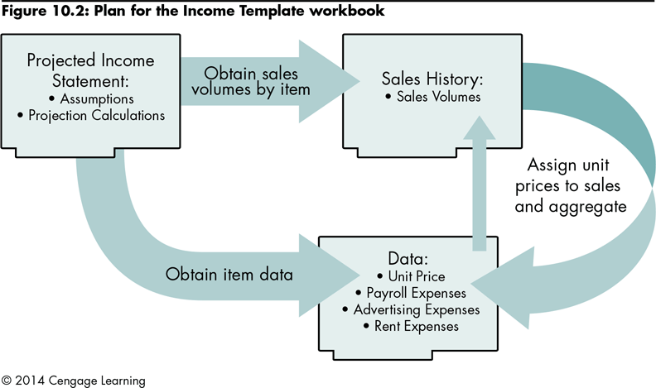
Planning an Excel Application (continued)
Level 1 home

Slide 8
Controlling Data-Entry Errors Using the Data Validation Tool
Data validation tool | Creates rules that define what data is valid in a particular cell
Validation rule | Specifies the type of data that is appropriate Specifies the range of acceptable values
Input message | Identifies the kind of data users should enter
Error alert | Displays a message of varying severity
Level 1 home

Slide 9
Controlling Data-Entry Errors Using the Data Validation Tool (continued)
To validate data using the Data Validation tool:
Set up the data validation rule
Create the input message
Specify the error alert style and message
Level 1 home

Slide 10
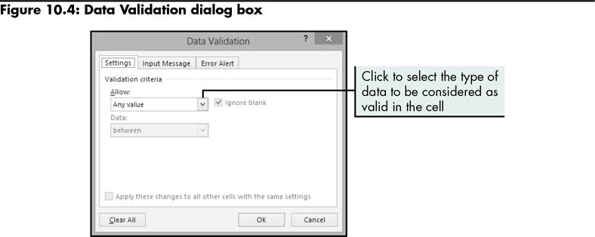
Controlling Data-Entry Errors Using the Data Validation Tool (continued)
Setting up a data validation rule
Level 1 home

Slide 11
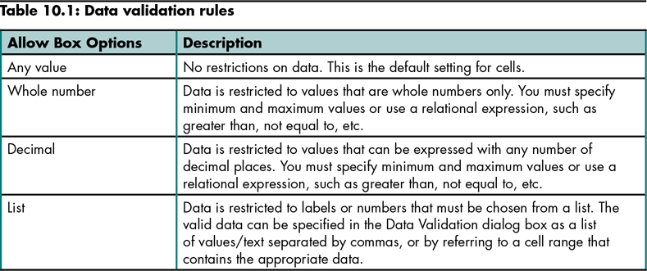
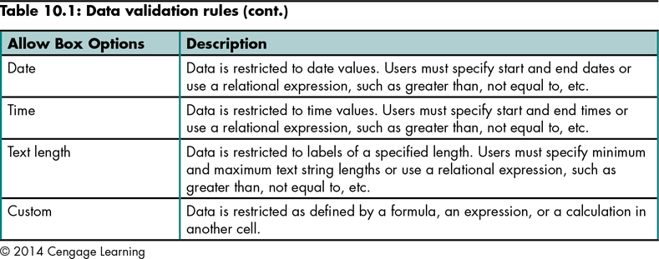
Controlling Data-Entry Errors Using the Data Validation Tool (continued)
Level 1 home

Slide 12
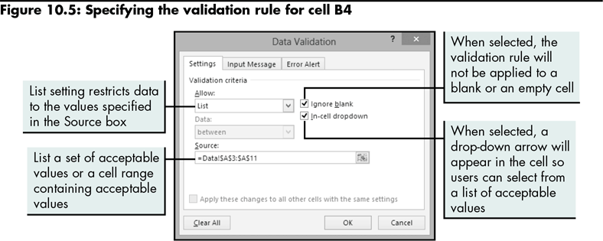
Controlling Data-Entry Errors Using the Data Validation Tool (continued)
Level 1 home

Slide 13
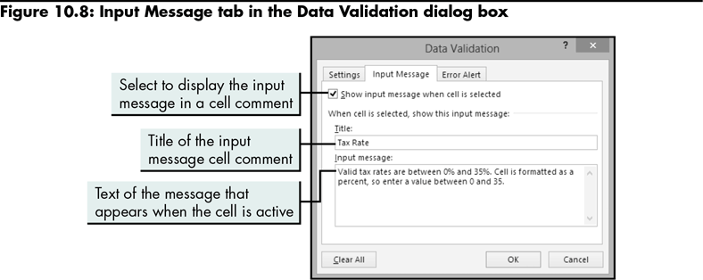
Controlling Data-Entry Errors Using the Data Validation Tool (continued)
Creating an input message
Level 1 home

Slide 14
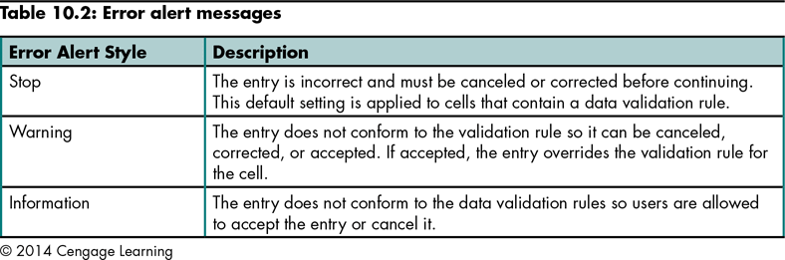
Controlling Data-Entry Errors Using the Data Validation Tool (continued)
Level 1 home

Slide 15
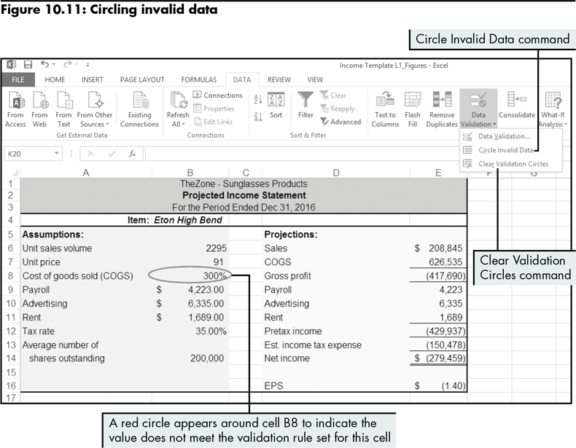
Controlling Data-Entry Errors Using the Data Validation Tool (continued)
This tool finds and marks cells containing data that do not meet validation criteria
Level 1 home

Slide 16
Protecting Workbooks
Ways to protect workbooks:
Lock cells so that users cannot change their contents
Hide cells so that users cannot see them
Restrict actions users can perform on specified portions of specified worksheets
Allow only certain users or user groups to access ranges that are normally locked
Prevent a worksheet from being deleted from a workbook
Select the appropriate level of protection (worksheet, workbook, file)
Level 1 home

Slide 17
Protecting Workbooks (continued)
To allow users to change the contents of unlocked cells, but not the contents of locked cells:
Unlock the cells you want users to change (Locked property of a cell)
Protect the worksheet to engage the Locked property of the cells
Level 1 home

Slide 18
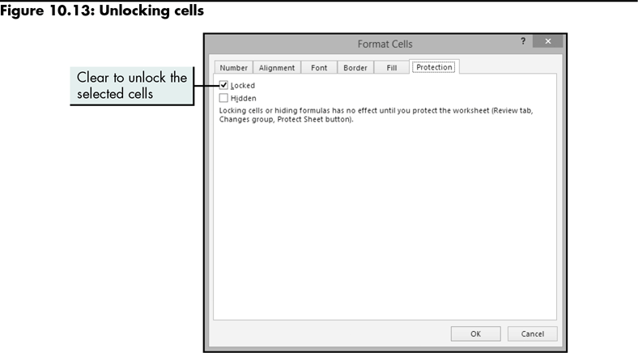
Protecting Workbooks (continued)
Level 1 home

Slide 19
Protecting Workbooks (continued)
Protecting a worksheet
Users cannot change the content of locked cells
Specify what users can do in the worksheet (e.g., format, enter data)
Specify passwords so that users can enter a case-sensitive password before they remove protection
Level 1 home

Slide 20
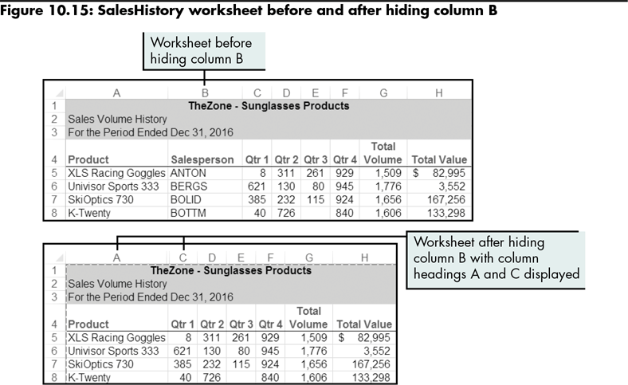
Protecting Workbooks (continued)
Hiding and displaying rows and columns
Level 1 home

Slide 21
Protecting Workbooks (continued)
Protect a workbook to prohibit users from adding, renaming, or deleting worksheets in the workbook
Secure the workbook structure or its windows
Structure (cannot insert, delete, or rename worksheets)
Windows (Excel windows are the same size and position each time the workbook opens)
You can specify that users enter a case-sensitive password before they remove protection
Level 1 home

Slide 22
Documenting Workbooks
Documentation
All records that describe how and why a system has been developed, and how it should be used
A tremendous timesaver
Can be included within a workbook or printed (documentation worksheet or workbook’s formulas)
Level 1 home

Slide 23
Documenting Workbooks (continued)
Types of documentation for Excel applications:
Basic information (workbook author, date of creation, purpose)
Step-by-step instructions for entering data and performing calculations
Notes or comments that identify the source of data
Notes or comments that define terms, explain calculations, or describe assumptions
Level 1 home

Slide 24
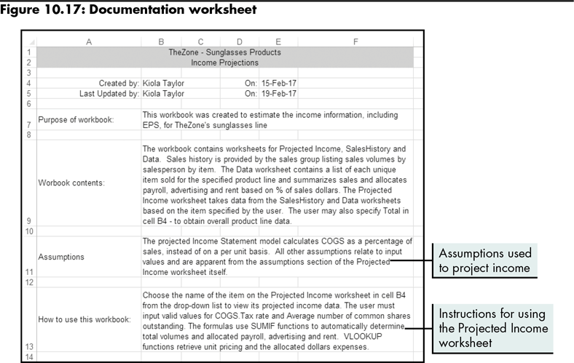
Documenting Workbooks (continued)
Level 1 home

Slide 25
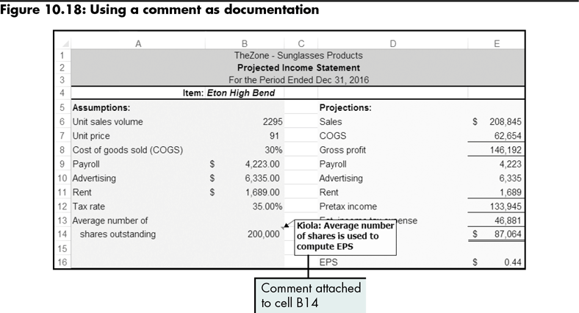
Documenting Workbooks (continued)
Level 1 home

Slide 26
Level 1 Summary
Planning an Excel application that others can use
Validating data entry
Protecting a workbook
Providing thorough documentation for users
Documentation worksheet
Cell comments

Slide 27
Level 2 Objectives: Identifying and Correcting Formula Errors
Audit formulas for accuracy and validity
Evaluate and trace formula errors
Identify, analyze, and correct errors
Set error-checking options

Slide 28
Types of Formula Errors
Taking advantage of more sophisticated Excel tools that help find and respond to formula errors
Address error messages caused by problems with the formulas in the workbook
Audit formulas
Level 2 home

Slide 29
Tools for Solving Formula Errors
Fix obvious errors
Use the Error Alert button
Examine the formula
Level 2 home

Slide 30
Tools for Solving Formula Errors (continued)
Formula auditing tools
Permit the review of the structure and behavior of a formula
Can result in false positives and false negatives
Formula auditing group on the ribbon
Some tools may display tracer arrows
Precedent cells (contain a value used in a formula)
Dependent cells (contain a formula that refers to other cells)
Level 2 home

Slide 31
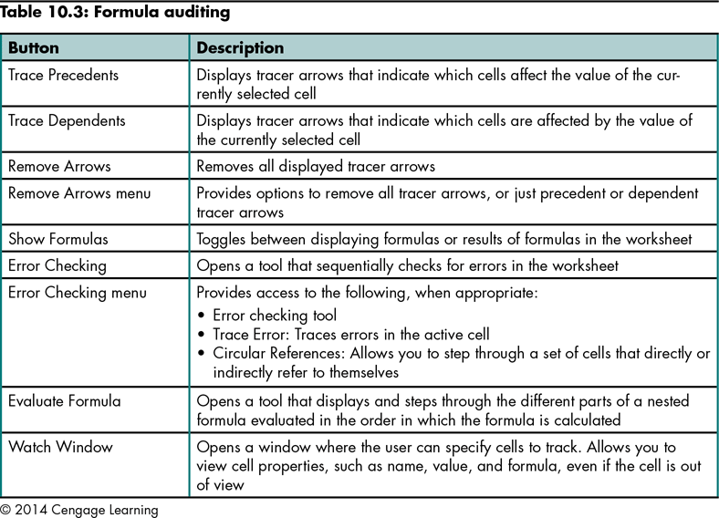
Tools for Solving Formula Errors (continued)
Level 2 home

Slide 32
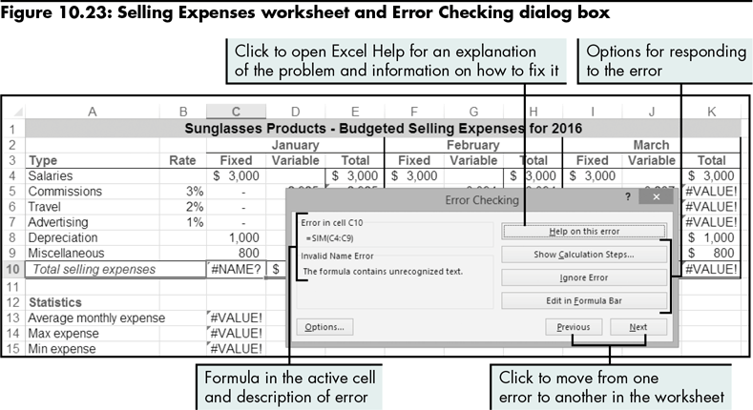
Tracing and Solving Formula Errors
Level 2 home

Slide 33
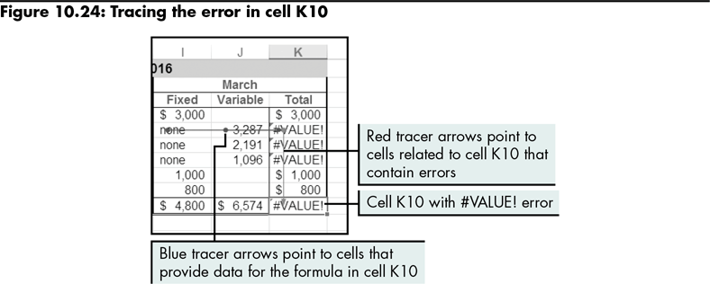
Tracing and Solving Formula Errors (continued)
Level 2 home

Slide 34
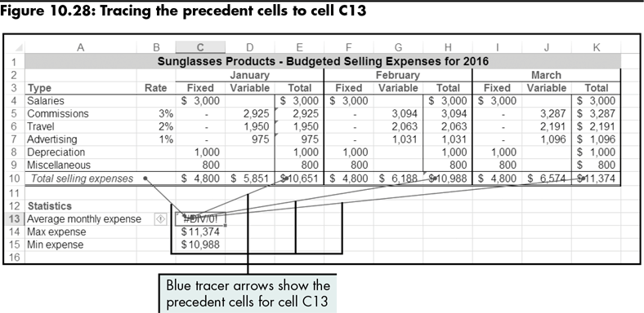
Tracing and Solving Formula Errors (continued)
Level 2 home

Slide 35
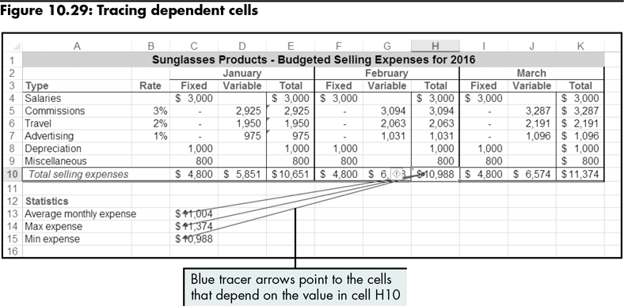
Tracing and Solving Formula Errors (continued)
Traces components of a formula that references other cells
Level 2 home

Slide 36
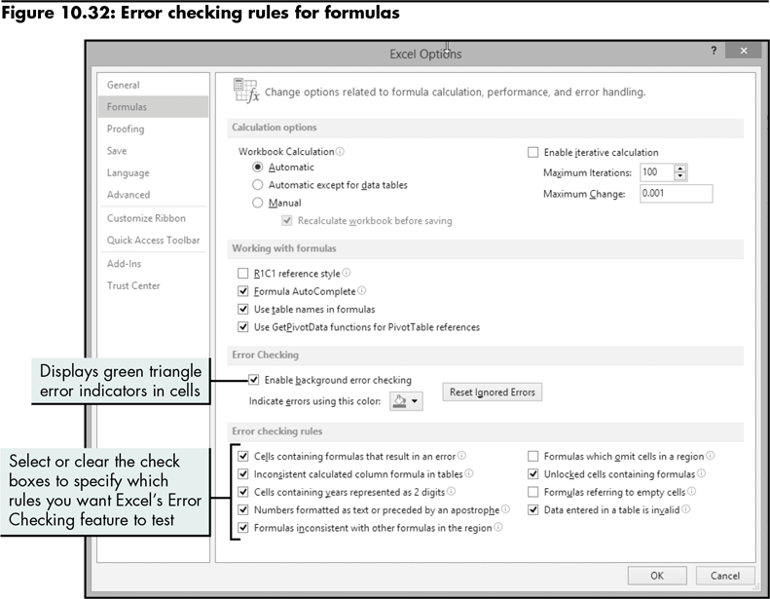
Tracing and Solving Formula Errors (continued)
Level 2 home

Slide 37
Level 2 Summary
Using Excel formula auditing tools to trace and correct errors
Auditing formulas
Evaluating error messages in cells

Slide 38
Level 3 Objectives: Automating Excel Tasks
Plan and record macros
Run and test macros
Customize ribbon tabs
Add macro buttons to a ribbon tab
Add custom buttons to a worksheet
View macro code using the Visual Basic Editor

Slide 39
Defining Macros
Macro
A series of commands that you store and then run when you need to perform a task
Steps—stored as Visual Basic for Applications (VBA) commands in the macro—are performed in sequence when you run the macro
To create a macro:
Use the macro recorder, or
Write from scratch by entering VBA commands in the Visual Basic Editor
Level 3 home

Slide 40
Creating a Macro
Use the macro recorder to record keystrokes and mouse actions
Assign a macro to a shortcut key
Level 3 home

Slide 41
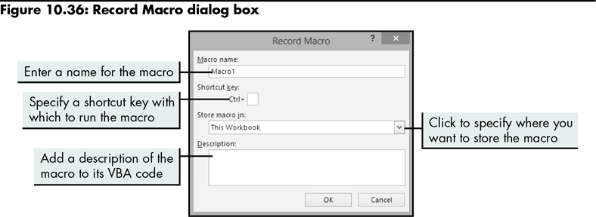
Creating a Macro (continued)
Level 3 home

Slide 42
Running a Macro
Press the shortcut key assigned to the macro, or
Use the Macro dialog box
Level 3 home

Slide 43
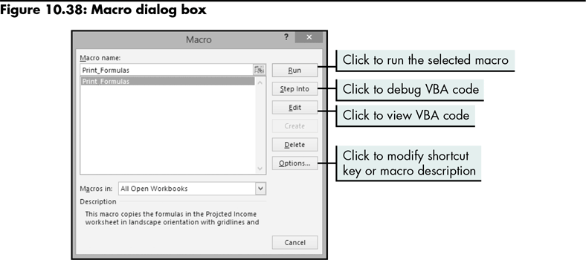
Running a Macro (continued)
Level 3 home

Slide 44
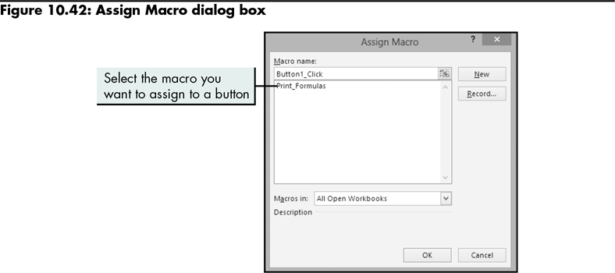
Running a Macro (continued)
Creating a custom button
Level 3 home

Slide 45
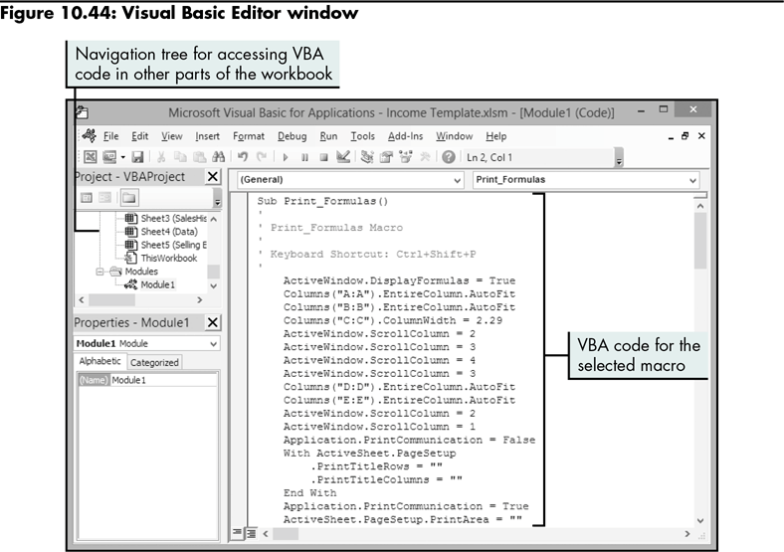
Viewing a Macro in the Visual Basic Editor
Level 3 home

Slide 46
Level 3 Summary
Automating a workbook by creating and running a macro
Assigning a button to the macro to make it easy to use
Working in the Visual Basic Editor window to edit a macro so it runs more efficiently

Slide 47
Chapter Summary
Preparing Error Free Workbooks
Identifying and Correcting Formula Errors
Automating Excel Tasks

