Slide 1
Using Data Tables and Excel Scenarios for What-If Analysis
Chapter 8

Slide 2
Chapter Introduction
Data table
Asks a what-if question involving a range of cells
Performs many calculations at once, then compares results on a single worksheet
Runs a simulation with a two-variable data table

Slide 3
Chapter Introduction (continued)
Scenario Manager
Consolidates multiple what-if models in one worksheet
You can switch between scenarios to see how sets of assumptions affect results
To go to Level 1, click here
To go to Level 2, click here
To go to Level 3, click here

Slide 4
Tools/Functions Covered in This Chapter
AVERAGE
data tables
MAX
MIN
RAND
Scenario Manager
STDEV.S
SUMPRODUCT
VLOOKUP

Slide 5
Level 1 Objectives: Using Data Tables to Perform Break-Even and Sensitivity Analyses
Conduct break-even analyses
Conduct sensitivity analyses
Create, format, and interpret one-variable data tables
Create, format, and interpret two-variable data tables

Slide 6
Conducting Break-Even and Sensitivity Analyses
Break-even analysis
A type of what-if analysis that concentrates on an activity at or around the point at which a product breaks even
Sensitivity analysis
A type of what-if analysis that attempts to examine how sensitive the results of an analysis are to changes in the assumptions
Level 1 home

Slide 7
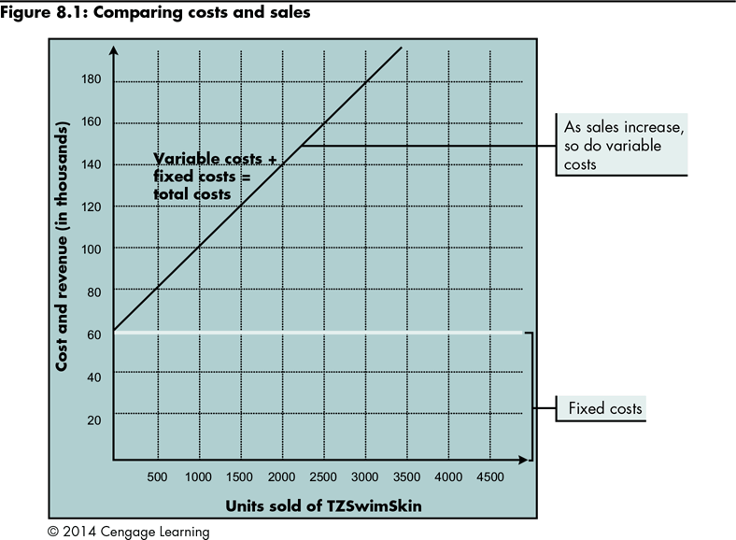
Conducting Break-Even and Sensitivity Analyses (continued)
Break-even point
Level 1 home

Slide 8
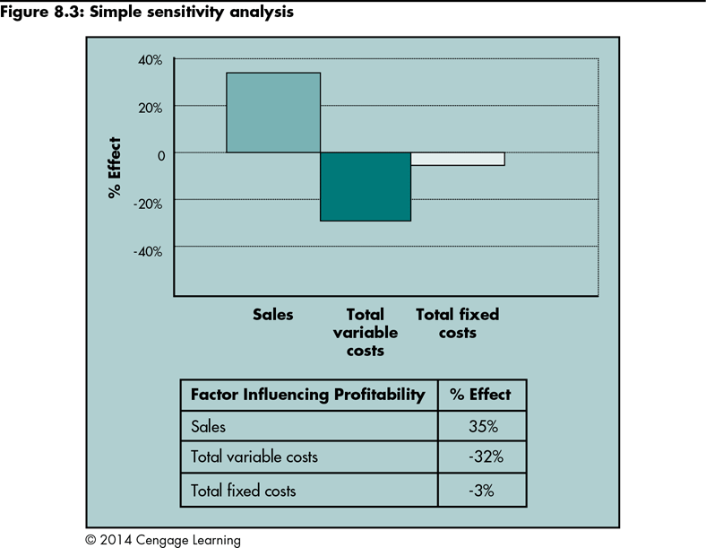
Conducting Break-Even and Sensitivity Analyses (continued)
Level 1 home

Slide 9
Analyzing What-If Results with Data Tables
Data table
A range of cells containing values and formulas
If you change the values, the results change
You can compare the results of many calculations; useful for break-even and sensitivity analyses
Level 1 home

Slide 10
Analyzing What-If Results with Data Tables (continued)
One-variable data tables | Two-variable data tables
One input cell and many result cells A set of input values must be arranged perpendicular to the set of output formulas, with no value or formula located at the intersection of the set of input values and output formulas | Two input cells, only one result cell; determines how two values affect a single result The two sets of input values must be set up perpendicular to each other, and the output formula must be in the cell at the intersection of the two sets of input values
Level 1 home

Slide 11
Analyzing What-If Results with Data Tables (continued)
Preparing a worksheet for data tables
A data table depends on values and formulas used in a worksheet, and must appear on the same worksheet that contains this data
A worksheet must:
Use input cells that contain values you want to modify in a what-if analysis
Use result cells containing formulas that calculate the values you want to analyze
Level 1 home

Slide 12
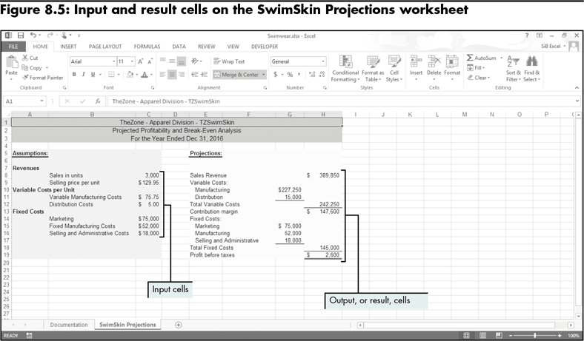
Analyzing What-If Results with Data Tables (continued)
Level 1 home

Slide 13
Varying One Value in a What-If Analysis
Set up the structure for the data table
Create a set of input values you want to use in a what-if analysis
Indicate the results you want to see in the data table
Instruct Excel about how the data table’s structure relates to the input section of the worksheet
Level 1 home

Slide 14
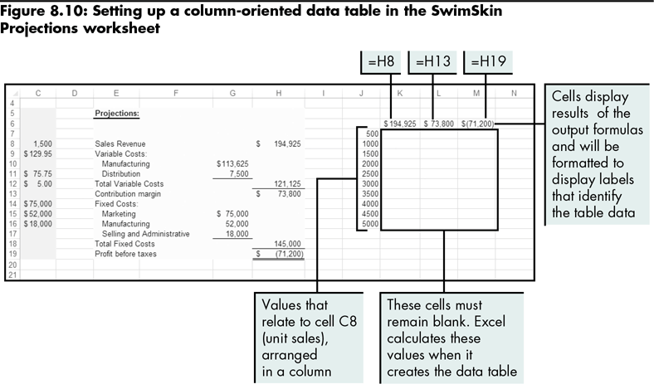
Varying One Value in a What-If Analysis (continued)
Level 1 home

Slide 15
Varying One Value in a What-If Analysis (continued)
Completing a one-variable data table:
Select the range that includes the input and result cells
Specify whether input cells are arranged in a column or row (Table dialog box)
Level 1 home

Slide 16
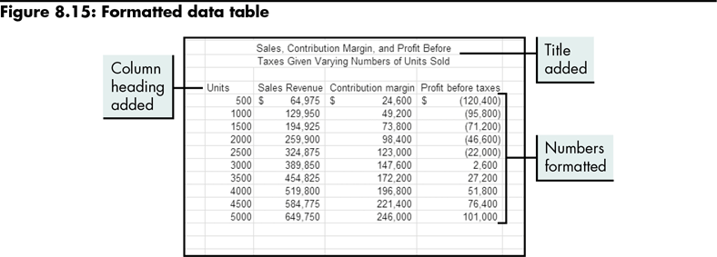
Varying One Value in a What-If Analysis (continued)
Level 1 home

Slide 17
Varying Two Values in a What-If Analysis
Set up the structure for the data table
Indicate how the data table’s structure relates to the input section of the worksheet
Level 1 home

Slide 18
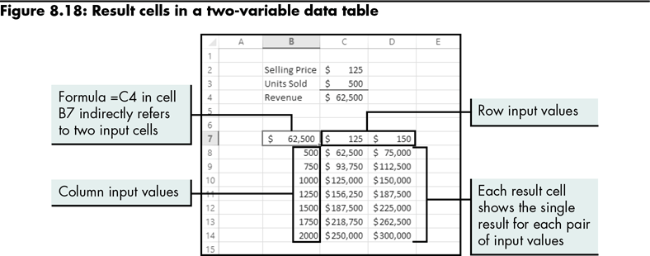
Varying Two Values in a What-If Analysis (continued)
Level 1 home

Slide 19
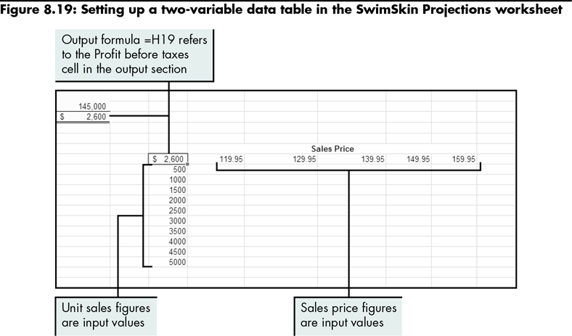
Varying Two Values in a What-If Analysis (continued)
Level 1 home

Slide 20
Varying Two Values in a What-If Analysis (continued)
Select the range that will constitute the completed data
Specify how the data table is structured, and which cells in the worksheet’s input section relate to the table’s values (Data Table dialog box)
Level 1 home

Slide 21
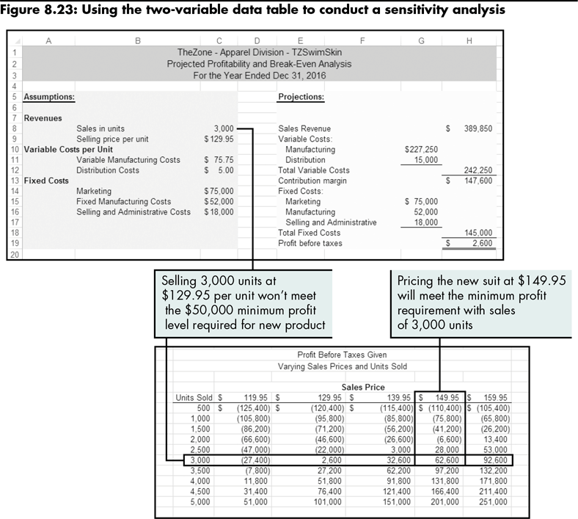
Level 1 home

Slide 22
Level 1 Summary
Using data tables for what-if analysis
One-variable data tables
Two-variable data tables
Setting up the data table’s structure
Specifying how to complete the table by indicating to which cells in the worksheet’s input section the table’s input values relate

Slide 23
Level 2 Objectives: Using Scenarios to Perform What-If Analysis
Understand and plan scenarios
Use the SUMPRODUCT function
Create, edit, and delete scenarios using Scenario Manager
Create and interpret scenario reports

Slide 24
Comparing the Results of Complex Analyses
Excel Scenario Manager
Enables you to perform what-if analysis with more than two input cells
You can define and save sets of values as scenarios; view and change them to produce and compare different results
Requirements for running a scenario:
Well-structured input and output sections
Output depends on input through the use of formulas
Changing cells and result cells must be on the same worksheet; cannot span worksheets
Level 2 home

Slide 25
Planning Scenarios
Prepare the inputs
Prepare the outputs
Set up a scenario
Prepare a worksheet for scenarios
Level 2 home

Slide 26
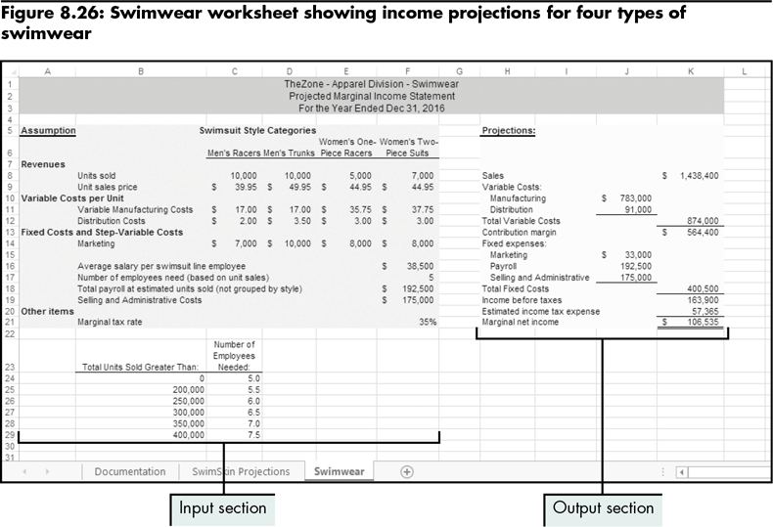
Planning Scenarios (continued)
Level 2 home

Slide 27
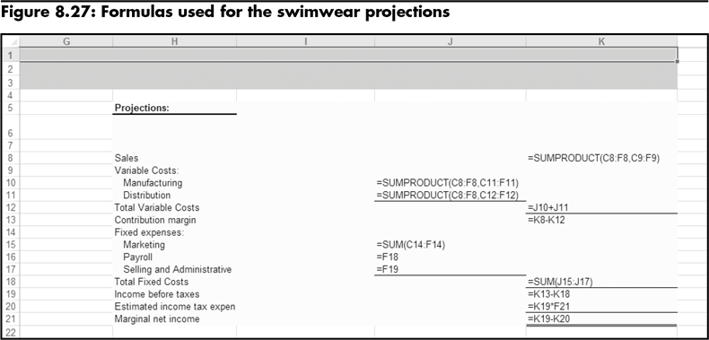
Planning Scenarios (continued)
The SUMPRODUCT function can be used to sum a series of products (the results of a multiplication task)
Level 2 home

Slide 28
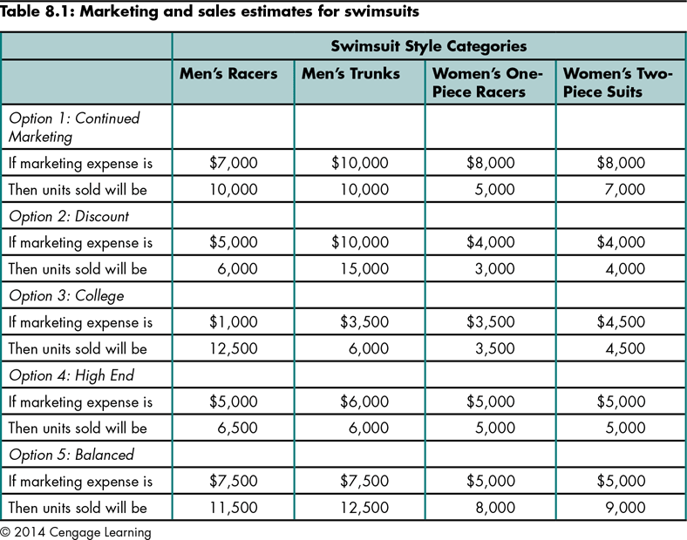
Planning Scenarios (continued)
Level 2 home

Slide 29
Planning Scenarios (continued)
Preparing a worksheet for scenarios:
Determine the changing cells in the worksheet
Name the input and result cells you want to use
Level 2 home

Slide 30
Adding Scenarios to a Worksheet
Use the Add Scenario dialog box in Scenario Manager
Each scenario must have a name
Indicate the scenario’s changing cells in the Changing cells box
Enter the specific assumptions for changing cells in the Scenario Values dialog box
Level 2 home

Slide 31
Adding Scenarios to a Worksheet (continued)
Viewing and analyzing scenarios
Click the scenario name in the Scenario Manager dialog box
Click the Show button
Compare different scenarios
Editing and deleting scenarios
Use the Scenario Manager dialog box
Level 2 home

Slide 32
Generating Scenario Reports
Use Scenario Manager to create two types of scenario reports:
Scenario summary
Scenario PivotTable
Before printing a report, indicate which result cells are of interest
Level 2 home

Slide 33
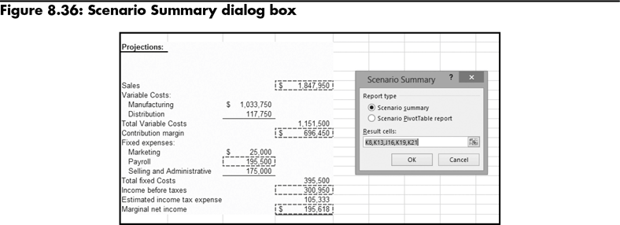
Generating Scenario Reports (continued)
Level 2 home

Slide 34
Generating Scenario Reports (continued)
Creating scenario summaries
Show values for all changing cells and for all indicated result cells for all scenarios in the worksheet
Tabular format makes it easy to compare results
Level 2 home

Slide 35
Generating Scenario Reports (continued)
Creating scenario PivotTable reports
Summarize result cells from a scenario
The view of the data can be changed to see more or fewer details
The report can be edited and formatted
Level 2 home

Slide 36
Level 2 Summary
Using scenarios to save a number of sets of different input values (changing cells), and to switch between scenarios to see the results of different assumptions
Showing selected results on scenario summary reports or scenario PivotTables and PivotCharts
Using the SUMPRODUCT function to sum products of multiplication operations

Slide 37
Level 3 Objectives: Using Excel’s Data Tables to Create a Simulation
Prepare worksheets for simulations using data tables
Run simulations using data tables
Conduct statistical analysis of simulation results
Interpret simulation results

Slide 38
Understanding Simulation in Business
Simulated results
Based on realistic, but not actual, data
Excel functions for comparing simulated results:
RAND
VLOOKUP
You can also create a two-variable data table that contains probable data and generates simulated results
Level 3 home

Slide 39
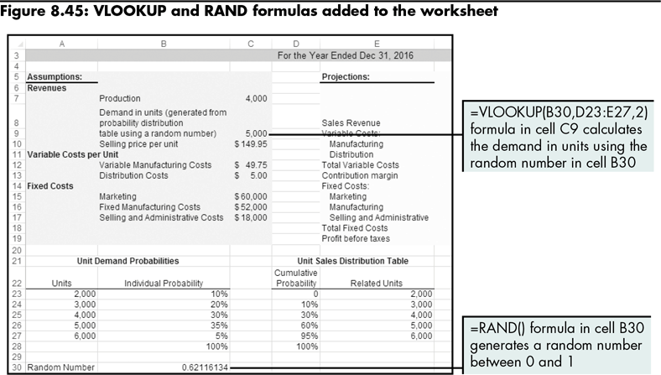
Preparing a Worksheet for a Simulation Using a Data Table
Level 3 home

Slide 40
Developing a Simulation with a Two-Variable Data Table
Structuring a two-variable data table for a simulation
One set of input values must be a sequence of numbers that represent the number of iterations of the simulation
Completing a two-variable data table for a simulation
Highlight the entire table range and tell Excel to which input cells the sets of input values relate
Iteration values are directed to any empty cell in the worksheet
Level 3 home

Slide 41
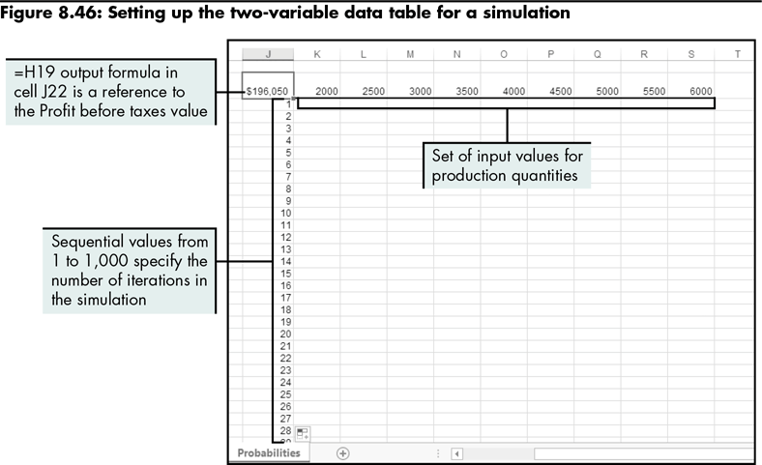
Developing a Simulation with a Two-Variable Data Table (continued)
Level 3 home

Slide 42
Calculating Simulation Statistics
Calculate some statistics about the data
Base the analysis on those statistics, not the raw data itself
Level 3 home

Slide 43
Interpreting Simulation Results
Results can quantify differences in prices and allow you to make more informed decisions
Results can be facilitated using a method of aggregating the data, such as statistics functions
Level 3 home

Slide 44
Level 3 Summary
Using two-variable data tables to run simulations of data models
One set of input values is replaced with a sequence of numbers that determines the number of iterations of the simulation
The replaced input value must be determined by some other means, usually related to a random number generating function, such as RAND
When completing the data table, the sequence of iteration numbers is referred to a blank cell instead of a cell in the input section

Slide 45
Chapter Summary
Using data tables to perform break-even and sensitivity analysis
Using scenarios to perform what-if analysis
Using Excel’s data tables to create a simulation

