Slide 1
Enhancing Decision Making with Solver
Chapter 9
Notes:
Use the quote as a jumping off point for discussion, if desired.

Slide 2
Chapter Introduction
Solver
Determines the optimal set of decision inputs to meet an objective
An excellent tool for determining the best way to apply resources to a particular problem
More powerful than Goal Seek
To go to Level 1, click here
To go to Level 2, click here
To go to Level 3, click here

Slide 3
Tools/Functions Covered in This Chapter
Goal Seek
Solver
SUMPRODUCT

Slide 4
Level 1 Objectives: Solving Product Mix Questions Using Goal Seek and Solver
Understand the differences between Goal Seek and Solver
Analyze data by creating and running a Solver model
Save a Solver solution as a scenario and interpret an answer report

Slide 5
The Other Side of What-If Analysis
Optimization
An analytical method that narrows available options so you can choose the best potential outcome
Before using optimization, consider:
How many resources are there and how many are needed?
How many resources does each decision variable consume?
How much does each decision variable contribute to the objective?
Level 1 home

Slide 6
Performing What-If Analysis Using Goal Seek
Goal Seek
Makes calculations automatically
Lets you specify the desired value in a cell and the cell that should be changed to reach that goal
Finds single answers easily, but is limited to one input and one outcome
Level 1 home

Slide 7
Creating a Solver Model
The objective cell is the cell that you want to maximize, minimize, or set to a specific value
Variable cells produce the desired results in the target cell
Constraints limit how to solve the problem
Level 1 home

Slide 8
Creating a Solver Model (continued)
Mathematical model of a business scenario
Objective function
A mathematical formula that relates the decision variables or changing cells to the desired outcome
Level 1 home

Slide 9
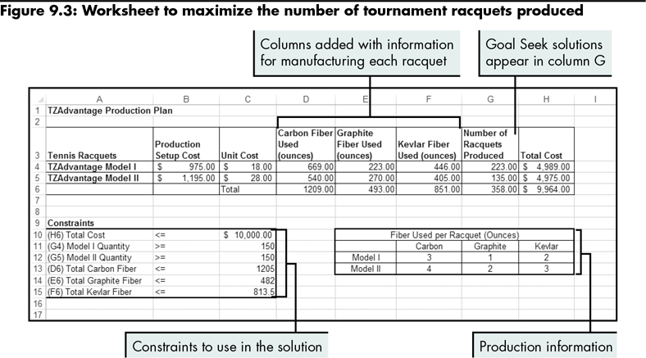
Creating a Solver Model (continued)
Level 1 home

Slide 10
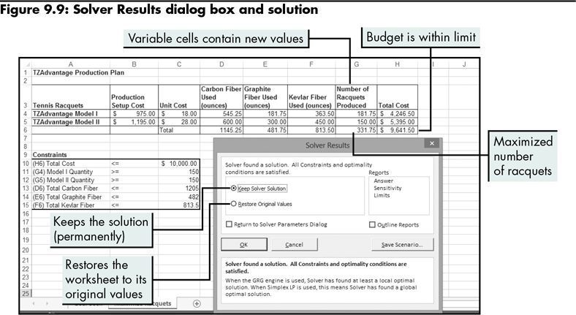
Creating a Solver Model (continued)
Level 1 home

Slide 11
Creating a Solver Model (continued)
To add or change a constraint in a Solver model:
Select the Restore Original Values option in the Solver Results dialog box
Update the Constraints section in the worksheet
Use the Add Constraint dialog box to add a new constraint
Level 1 home

Slide 12
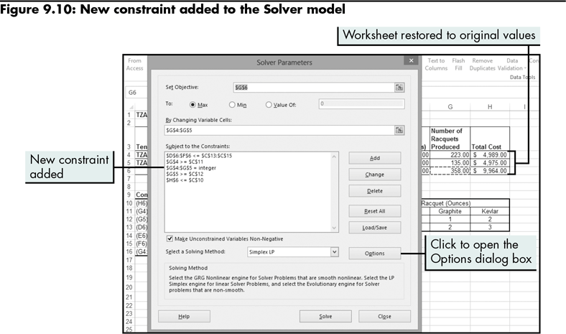
Creating a Solver Model (continued)
Level 1 home

Slide 13
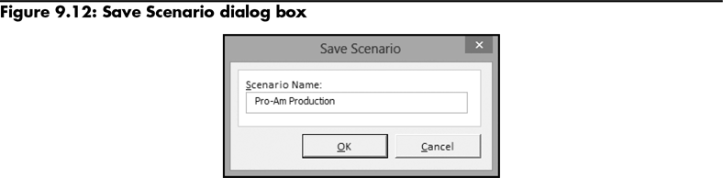
Creating a Solver Model (continued)
Saves the results of a Solver model so you can load them later and compare with another model’s results
Level 1 home

Slide 14
Creating a Solver Model (continued)
Solver report
Documents and describes the solution and identifies the constraints that affected the results
Three different reports:
Answer (most frequently used)
Sensitivity
Limits
Level 1 home

Slide 15
Level 1 Summary
Using Goal Seek
Change the value in one cell by finding the optimal value to include in a related cell
Limited to one input and one outcome
Using Solver
Manage multiple inputs to maximize or minimize the value in a target cell
A powerful tool for optimization problems (determine the best way to arrive at a goal)

Slide 16
Level 2 Objectives: Enhancing the Production Plan with Solver
Expand a Solver model by adding new decision variables to it
Identify feasible, infeasible, and unbounded solutions
Troubleshoot infeasible and unbounded solutions

Slide 17
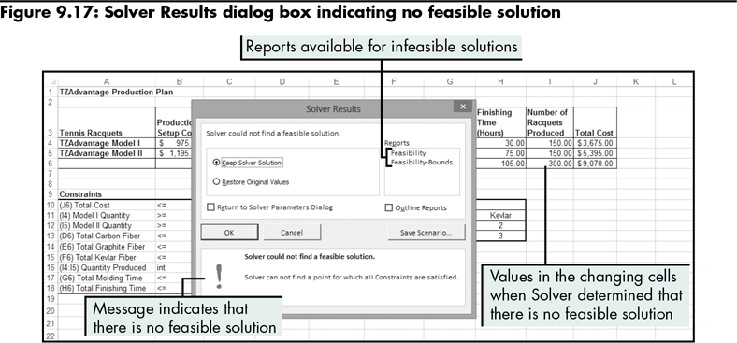
Adding Time Variables to the Production Plan
Level 2 home

Slide 18
Adding Time Variables to the Production Plan (continued)
Infeasible solution
Solver cannot determine the combination of decision variables that satisfies all constraints
Troubleshooting an infeasible solution
Actions:
Identify the criteria that prevent the solution from being feasible
Choices:
Do nothing; declare that there is no solution
Adjust constraints to create a feasible solution (policy constraints versus physical constraints)
Level 2 home

Slide 19
Adding Time Variables to the Production Plan (continued)
Unbounded solution
Occurs when the feasible solution is unrestrained or unlimited on some dimension
Solver attempts the maximum number of iterations without the target cell converging to an answer
Troubleshooting an unbounded solution
Actions:
Add constraints to create a feasible solution
Level 2 home

Slide 20
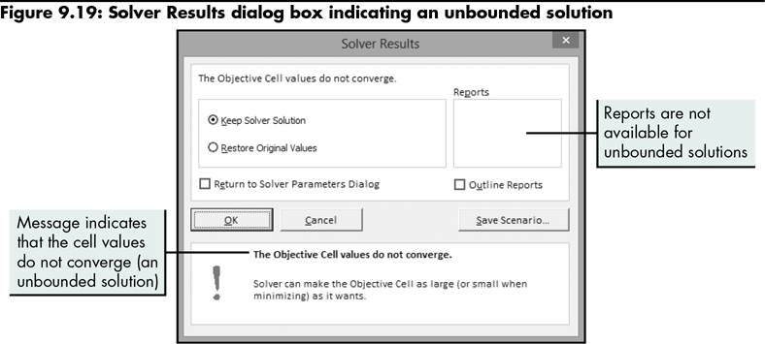
Adding Time Variables to the Production Plan (continued)
Level 2 home

Slide 21
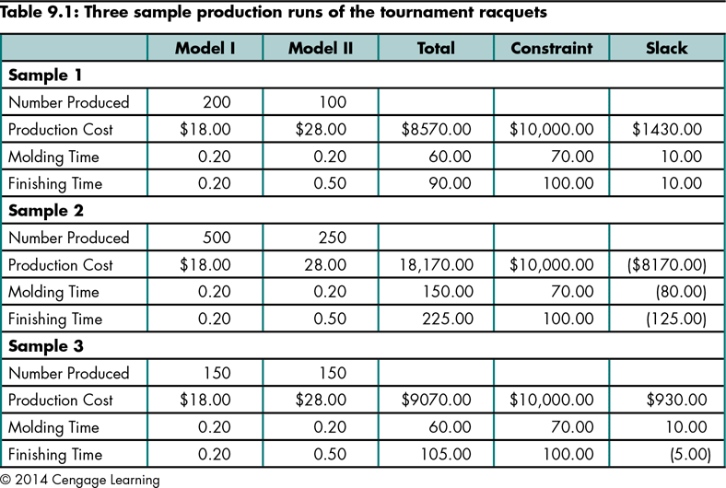
Adding Time Variables to the Production Plan (continued)
Identifying a feasible solution
Level 2 home

Slide 22
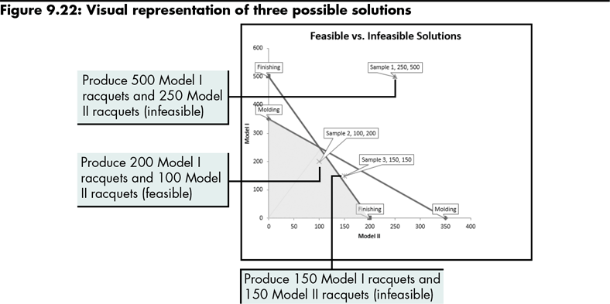
Adding Time Variables to the Production Plan (continued)
Level 2 home

Slide 23
Adding Time Variables to the Production Plan (continued)
To find an optimal solution:
Loosen a constraint in order to find a feasible solution to the problem
Level 2 home

Slide 24
Level 2 Summary
Changing an existing Solver model to include additional decision variables to produce a solution with multiple constraints
Changing an infeasible solution into a feasible solution
Adjust constraints used to define a solution
Create empty columns to deal with supply shortages
Understanding policy and physical constraints, and how they can affect a solution
Understanding unbounded solutions and how to avoid them

Slide 25
Level 3 Objectives: Managing Transportation Problems with Solver
Use arrays and the SUMPRODUCT function
Save and load Solver models
Build a Solver model that uses binary constraints

Slide 26
Developing a Distribution Plan Using Solver
Use Solver to determine the most efficient and cost-effective way to ship goods
Transportation variables:
Shipping costs between different sources and destinations
Supply and demand issues
Constraints that limit how to ship goods
Level 3 home

Slide 27
Developing a Distribution Plan Using Solver (continued)
Identify supply, demand, and shipping costs
Use SUMPRODUCT to sum a series of products in ranges of identical sizes (arrays) that are parallel to each other in a worksheet
Enter the constraints into the Solver model
Level 3 home

Slide 28
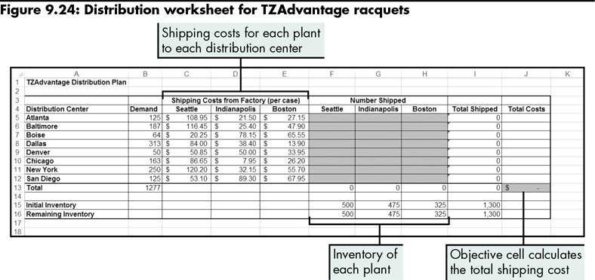
Developing a Distribution Plan Using Solver (continued)
Level 3 home

Slide 29
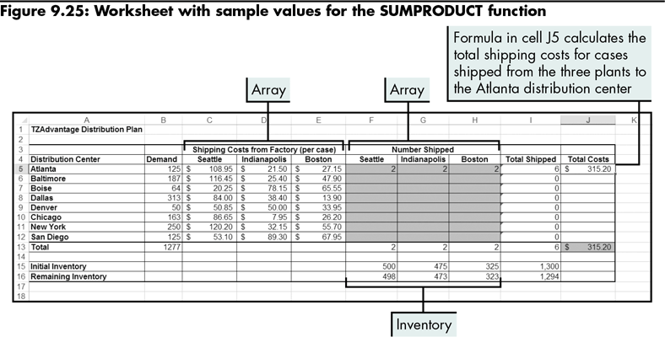
Developing a Distribution Plan Using Solver (continued)
Level 3 home

Slide 30
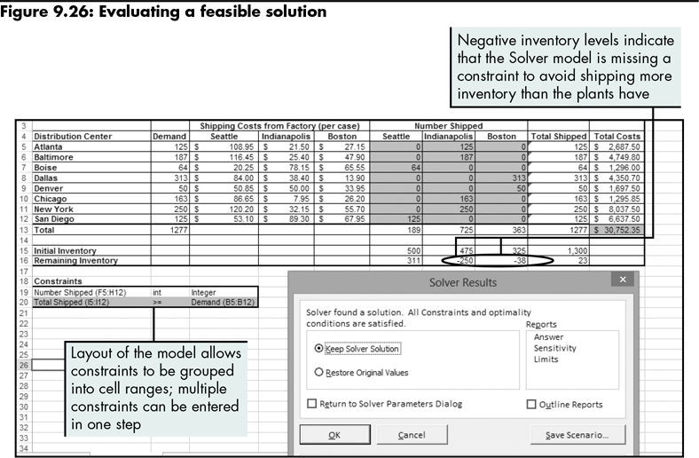
Developing a Distribution Plan Using Solver (continued)
Level 3 home

Slide 31
Developing a Distribution Plan Using Solver (continued)
Saving a Solver model
Saves the Solver parameters that were used in the Solver model so you can load them later
Is different from saving a Solver scenario, which saves only the result of a Solver model
Level 3 home

Slide 32
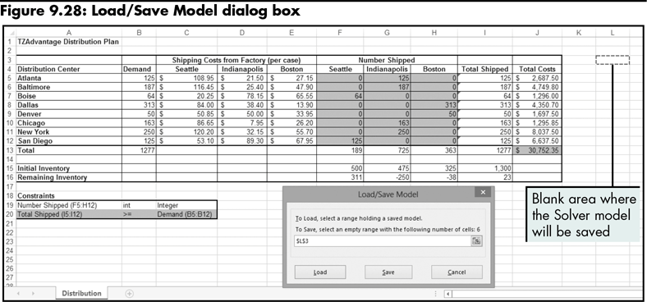
Developing a Distribution Plan Using Solver (continued)
Level 3 home

Slide 33
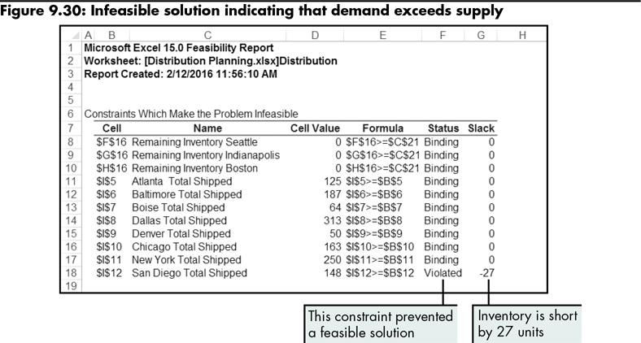
Developing a Distribution Plan Using Solver (continued)
Level 3 home

Slide 34
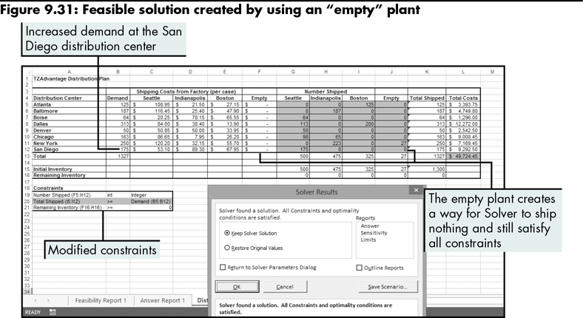
Developing a Distribution Plan Using Solver (continued)
Level 3 home

Slide 35
Assigning Contracts by Using Binary Constraints
Assignment problem
An optimization problem with a one-to-one relationship between a resource and an assignment or a job
Level 3 home

Slide 36
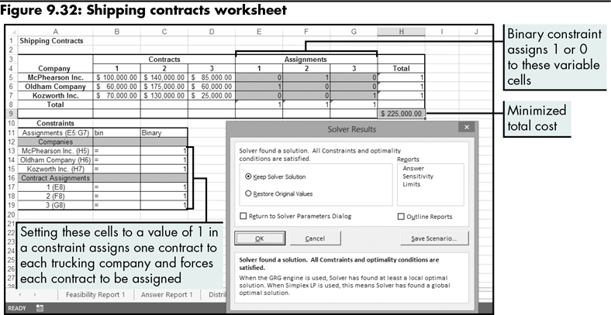
Assigning Contracts by Using Binary Constraints (continued)
Level 3 home

Slide 37
Assigning Contracts by Using Binary Constraints (continued)
Evaluating assignment problems with too many resources
Binary constraints can cause an infeasible solution if Solver cannot satisfy one of the constraints
Create an empty assignment to deal with extra variables
Level 3 home

Slide 38
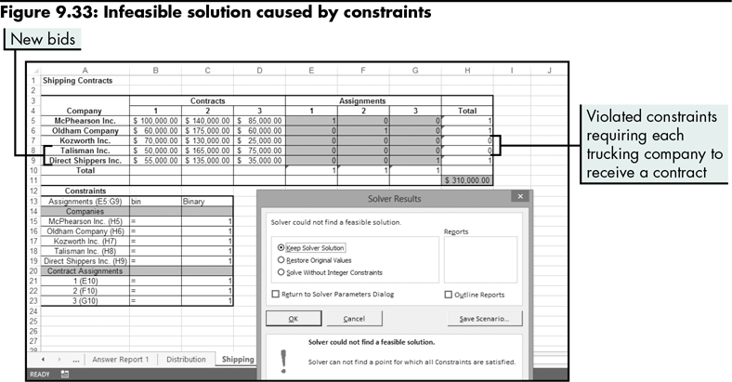
Assigning Contracts by Using Binary Constraints (continued)
Level 3 home

Slide 39
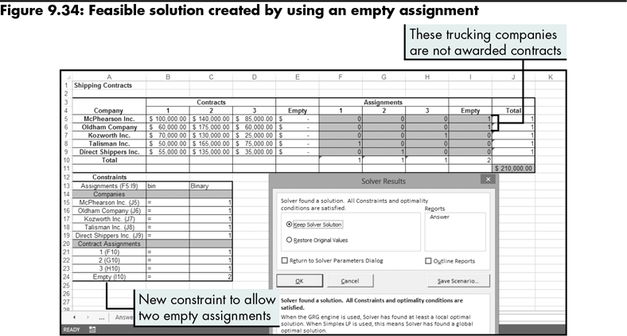
Assigning Contracts by Using Binary Constraints (continued)
Level 3 home

Slide 40
Level 3 Summary
Using binary constraints in a Solver model to solve assignment problems when there is a one-to-one relationship between decision variables
Using empty assignments when there is a disproportionate number of variables
Saving and loading a Solver model

Slide 41
Chapter Summary
Understanding ways to solve problems that include decision variables and goals
Solving product mix questions using Goal Seek and Solver
Enhancing the production plan with Solver
Managing transportation problems with Solver

