Slide 1
Applying Fundamental Excel Skills and Tools in Problem Solving
Chapter 1

Slide 2
Chapter Introduction
Fundamental skills and tools encountered when working with Excel to solve problems and support decision making
Writing formulas in cells to perform calculations
Designing a workbook so that calculations can be automatically updated if input values are changed
Formatting options that can be applied to cells and ranges of cells
Ability to correct spreadsheet errors
Rules that affect how information is displayed and calculations are performed in an Excel worksheet

Slide 3
Chapter Introduction (continued)
Using simple functions (i.e., shortcuts available for predefined tasks)
Results of copying formulas with different kinds of cell references
To go to Level 1, click here
To go to Level 2, click here
To go to Level 3, click here

Slide 4
Functions Covered in This Chapter
AVERAGE
COUNT
COUNTA
MIN
MAX
SUM

Slide 5
Level 1 Objectives: Identifying and Correcting Common Errors in Formatting and Formulas
Define common Excel error messages
Correct basic formatting problems in a worksheet
Correct errors in formulas
Understand precision vs. display of cell values

Slide 6
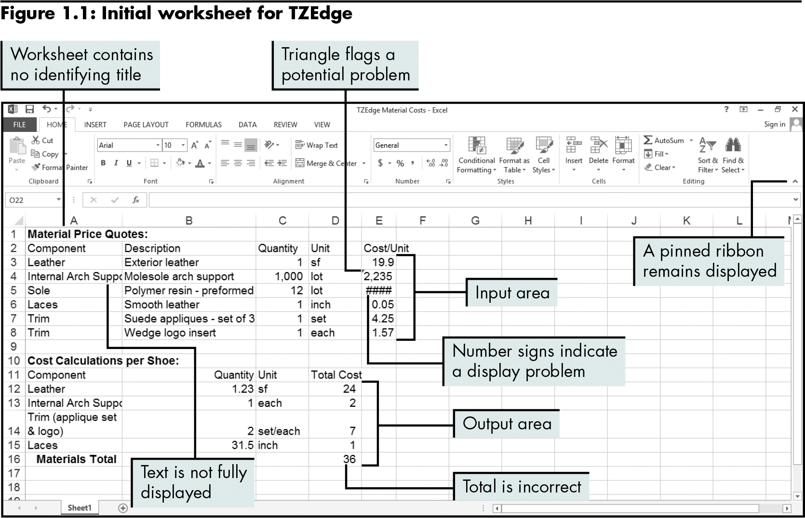
Examining a Basic Worksheet for Errors
Level 1 home

Slide 7
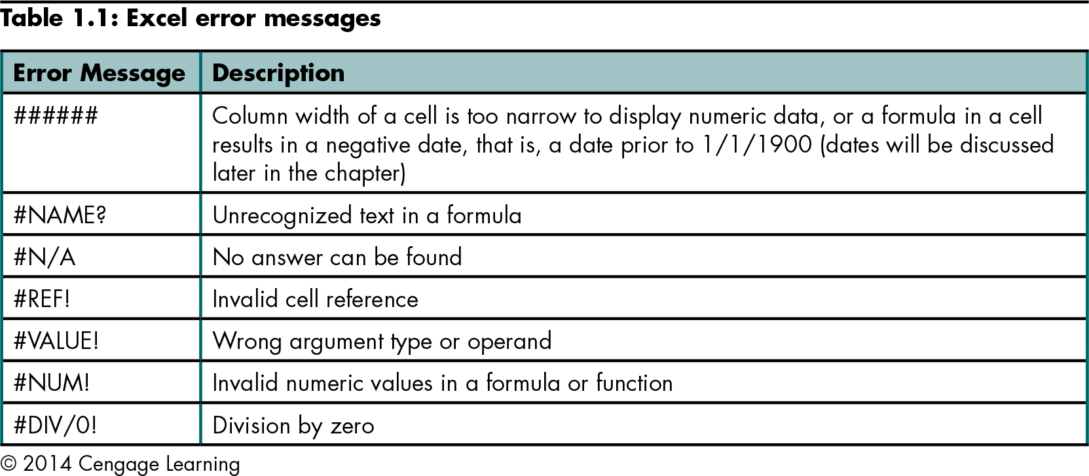
Examining a Basic Worksheet for Errors (continued)
Level 1 home

Slide 8
Correcting Formatting Problems
Modifying column width and row height
Double-click the column dividing line to make the column as wide as the longest entry
Drag the column dividing line to the desired width
Click the Format button in the Cells group on the HOME tab, click Column Width, and type the width in the Column width box
Checking error messages (Error Alert button)
Formatting numbers
Inserting and aligning a title
Level 1 home

Slide 9
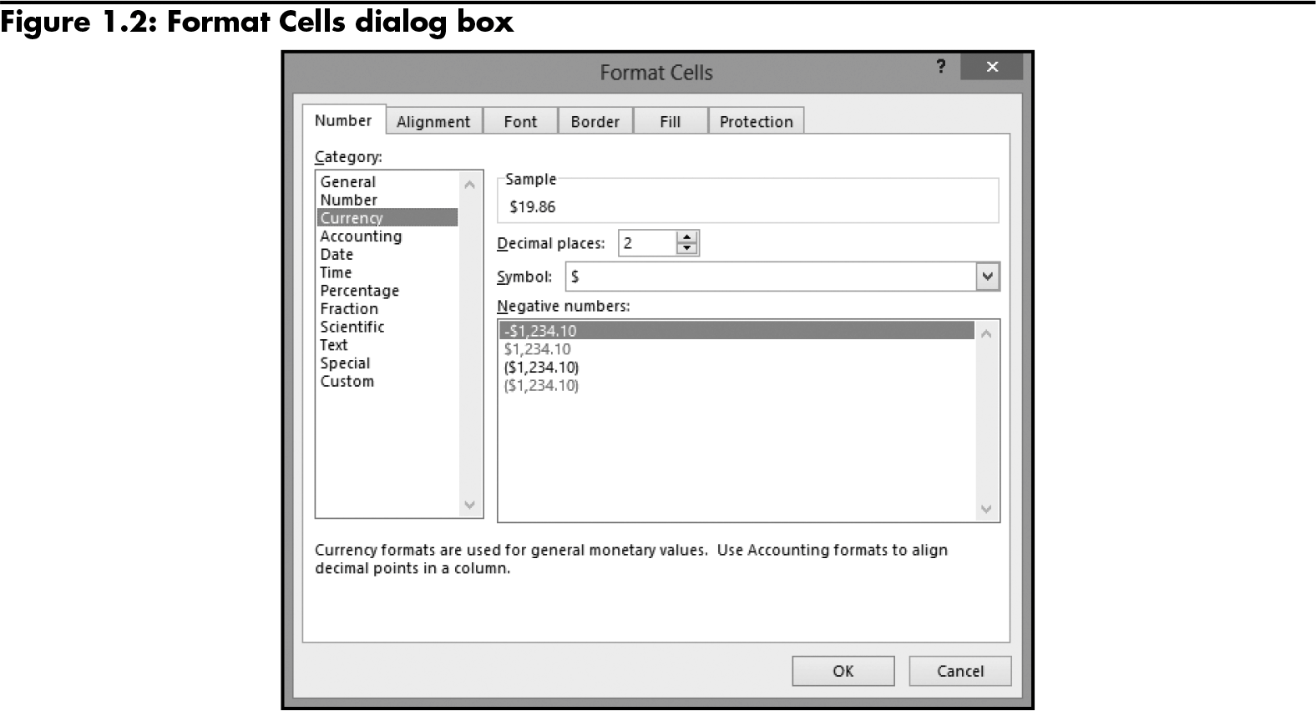
Correcting Formatting Problems (continued)
Level 1 home

Slide 10
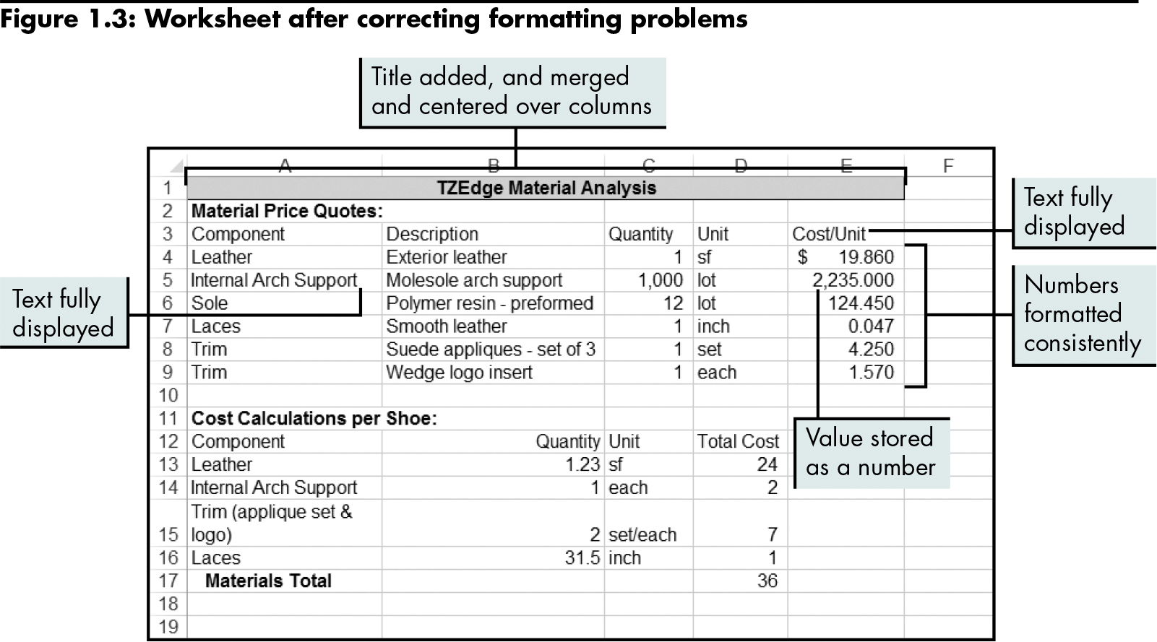
Correcting Formatting Problems (continued)
Level 1 home

Slide 11
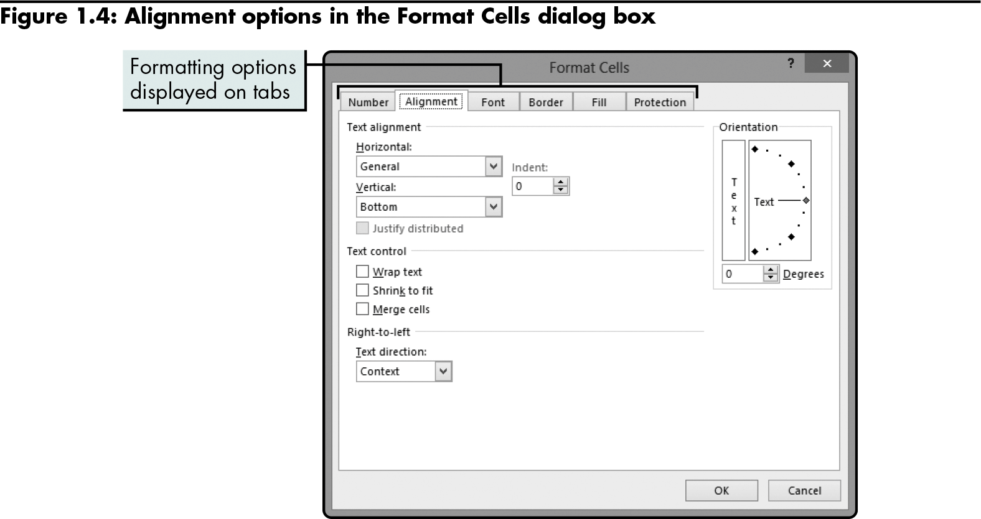
Correcting Formatting Problems (continued)
Level 1 home

Slide 12
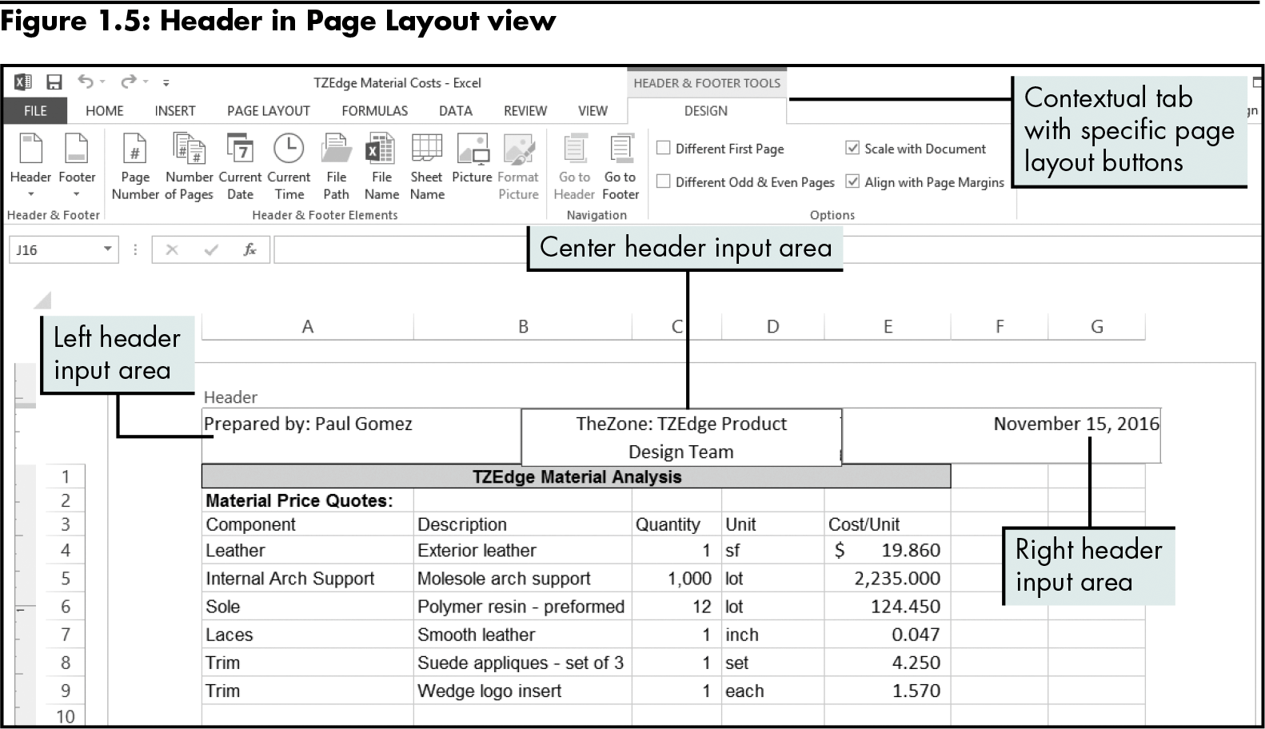
Correcting Formatting Problems (continued)
Level 1 home

Slide 13
Correcting Errors in Formulas
Printing the worksheet in two different formats
Default format (displays values)
Format that displays formulas
Checking simple formulas for accuracy
Using formulas and cell references instead of values
Determining order of precedence
Understanding precision vs. display of cell values
Checking accuracy in formula updates
Level 1 home

Slide 14
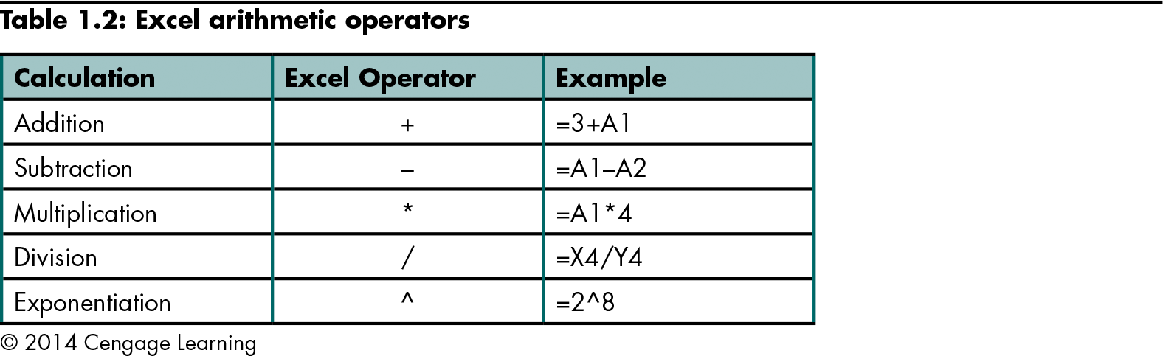
Correcting Errors in Formulas (continued)
Level 1 home

Slide 15
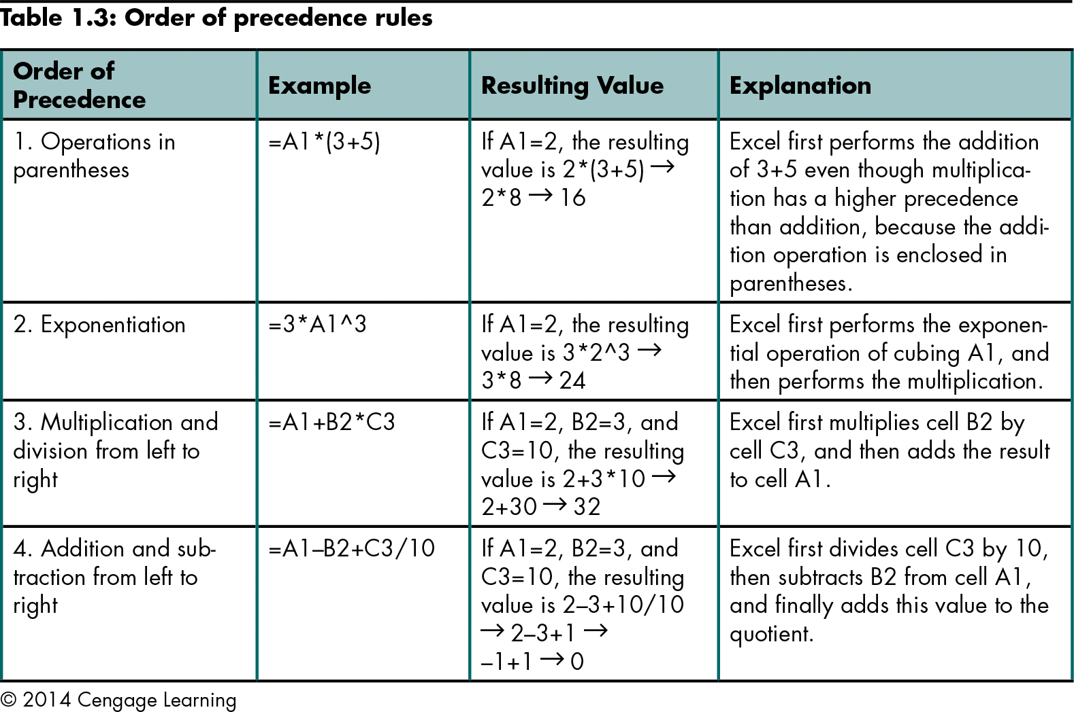
Correcting Errors in Formulas (continued)
Level 1 home

Slide 16
Correcting Errors in Formulas (continued)
Excel can display values in several different formats without changing the precise value stored in the program
Level 1 home

Slide 17
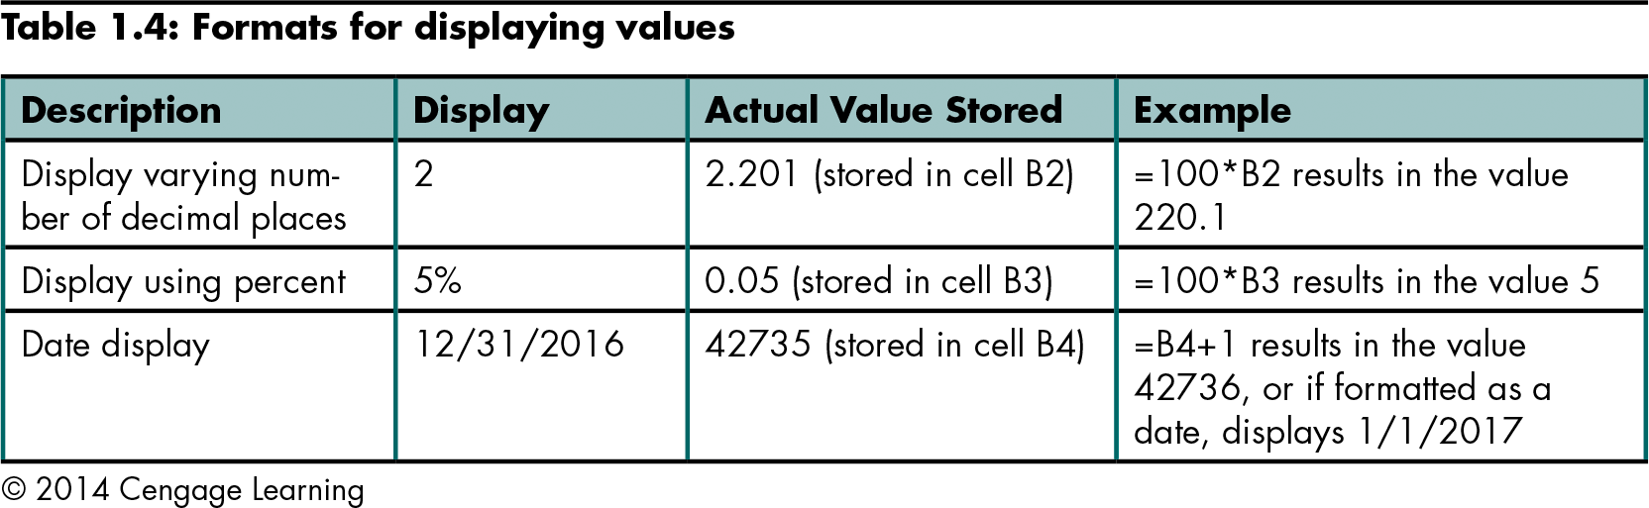
Correcting Errors in Formulas (continued)
Level 1 home

Slide 18
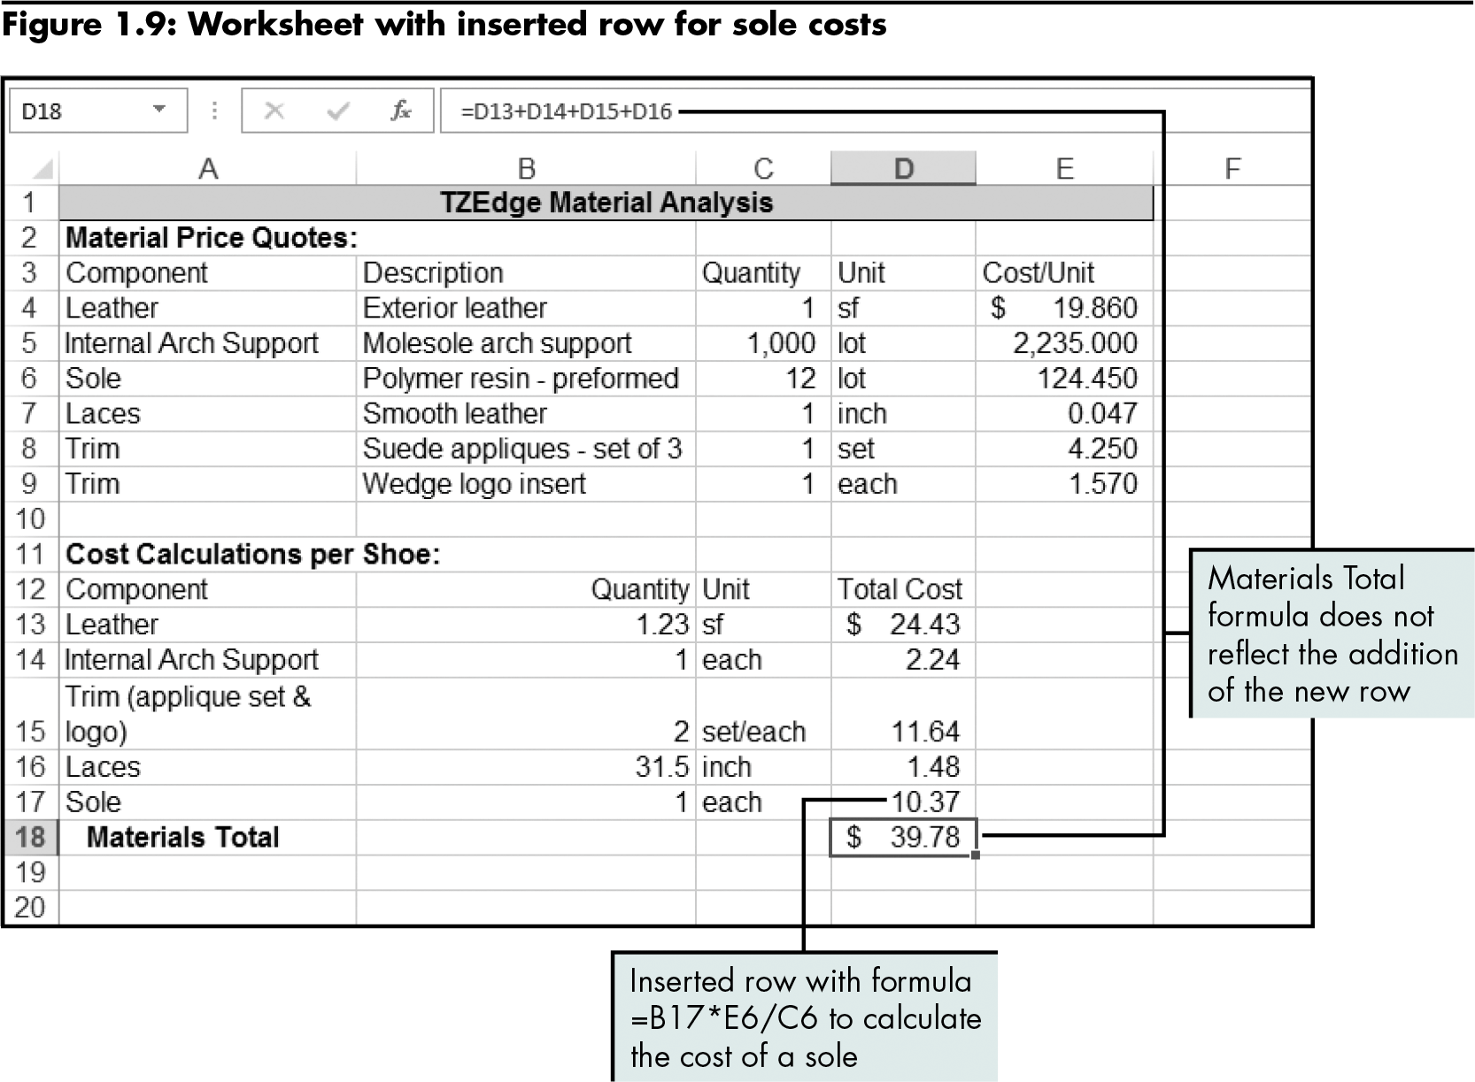
Correcting Errors in Formulas (continued)
Level 1 home

Slide 19
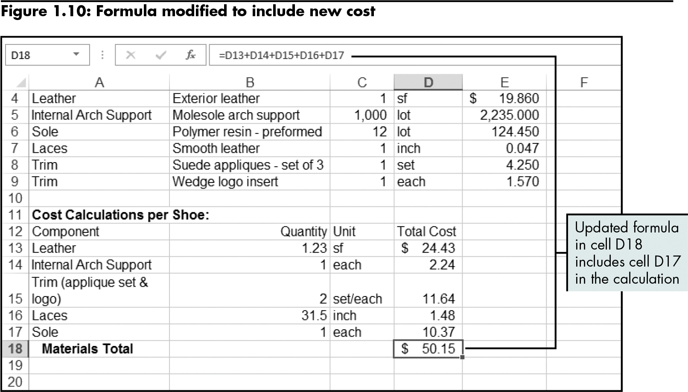
Correcting Errors in Formulas (continued)
Level 1 home

Slide 20
Level 1 Summary
Locating and correcting common errors in formatting or formulas to make the worksheet readable and functional

Slide 21
Level 2 Objectives: Calculating and Comparing Data Using Simple Functions
Work with multiple worksheets
Calculate total, average, minimum, and maximum values with functions
Understand how functions work: syntax, arguments, and algorithms
Use the AutoSum feature to perform calculations quickly
Calculate the number of values using both COUNT and COUNTA

Slide 22
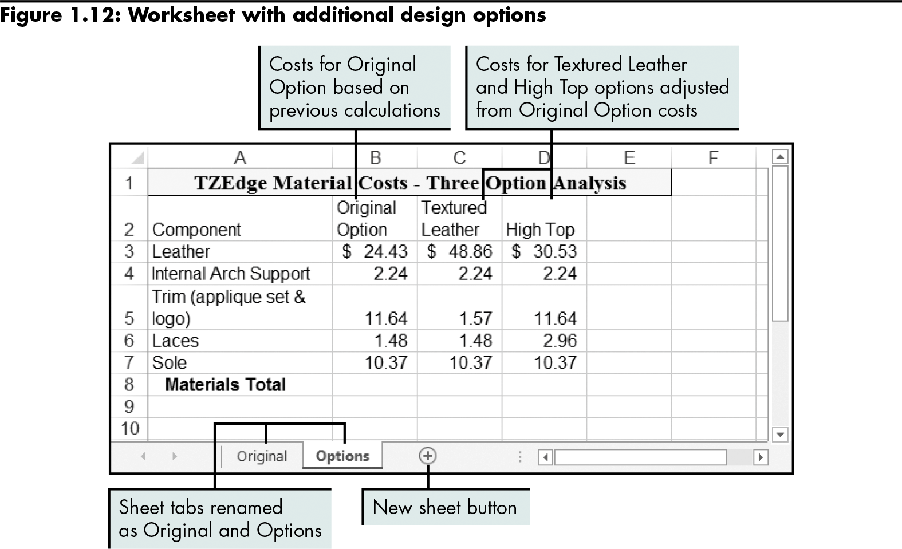
Working with Multiple Worksheets
Level 2 home

Slide 23
Calculating Totals Using the SUM Function
Function
A predefined formula that performs calculations
Structure
Function name and open parenthesis mark
Arguments (list of inputs in a specific order, separated by commas)
Closing parenthesis mark
Has its own syntax (specifies function name and order of arguments)
Behaves according to its algorithm (rules programmed into the function)
Level 2 home

Slide 24
Calculating Totals Using the SUM Function (continued)
SUM function
Adds a list of values and/or cell ranges
Excel has an AutoSum feature for quick calculation
Level 2 home

Slide 25
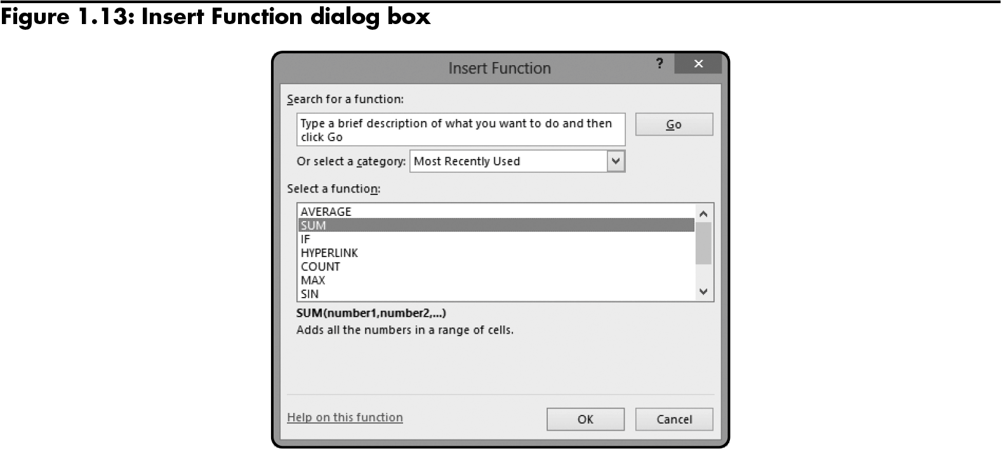
Calculating Totals Using the SUM Function (continued)
Level 2 home

Slide 26
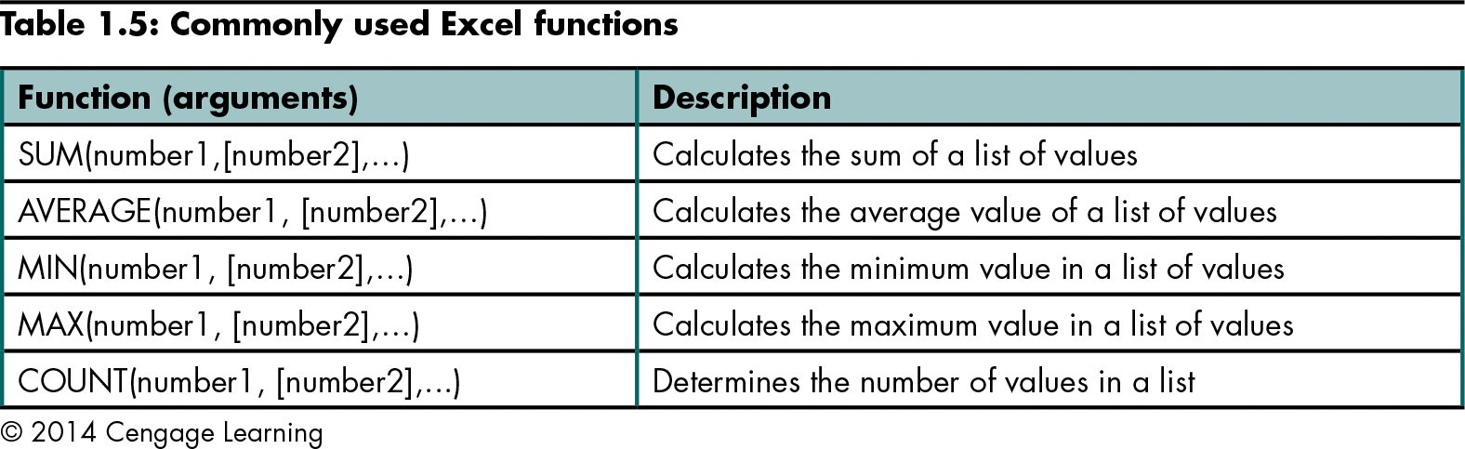
Calculating Totals Using the SUM Function (continued)
Level 2 home

Slide 27
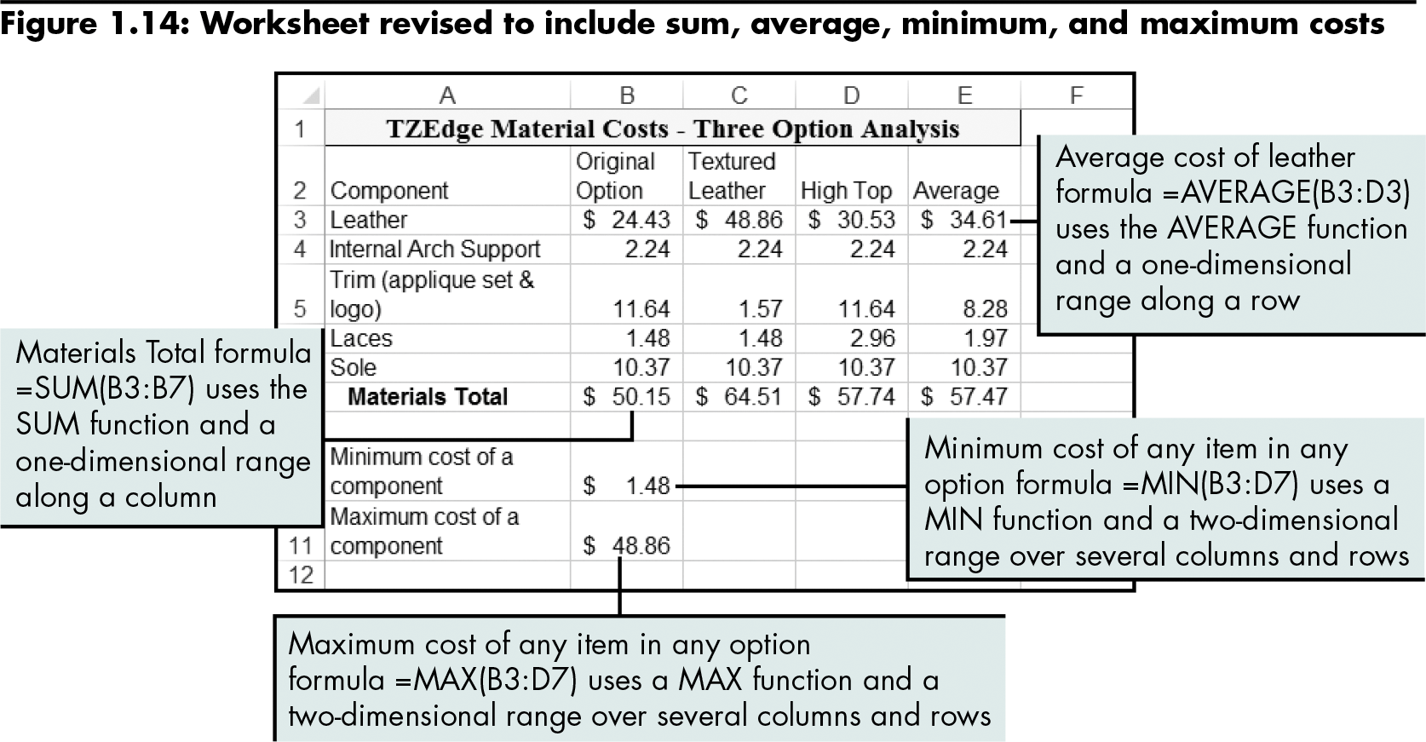
Calculating Average, Minimum, and Maximum Values
The AVERAGE function ignores blank cells and cells with text.
Level 2 home

Slide 28
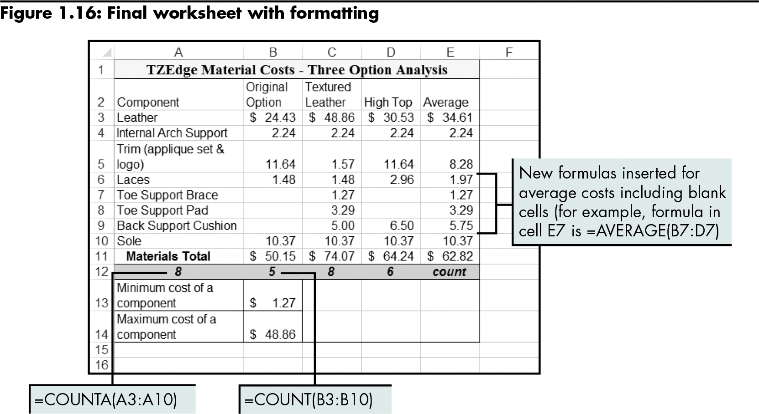
Calculating the Number of Values Using the COUNT and COUNTA Functions
The COUNT function ignores blank cells and cells with text; the COUNTA function does not ignore text cells.
Level 2 home

Slide 29
Level 2 Summary
Simple functions (SUM, AVERAGE) and how to use them in formulas
Syntax of functions and their underlying algorithms
AutoSum tool

Slide 30
Level 3 Objectives: Analyzing Cell References When Writing and Copying Formulas
Organize a workbook
Understand relative, absolute, and mixed cell referencing
Write formulas with different types of cell references
Copy formulas with different types of cell references
Name a cell or cell range

Slide 31
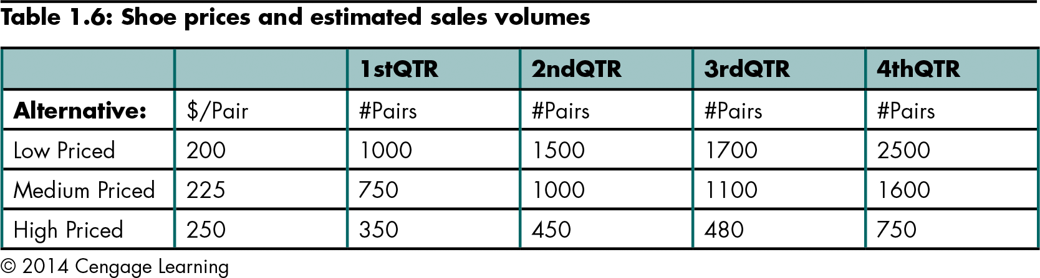
Creating a Budget Workbook
Setting up a preliminary budget
Level 3 home

Slide 32
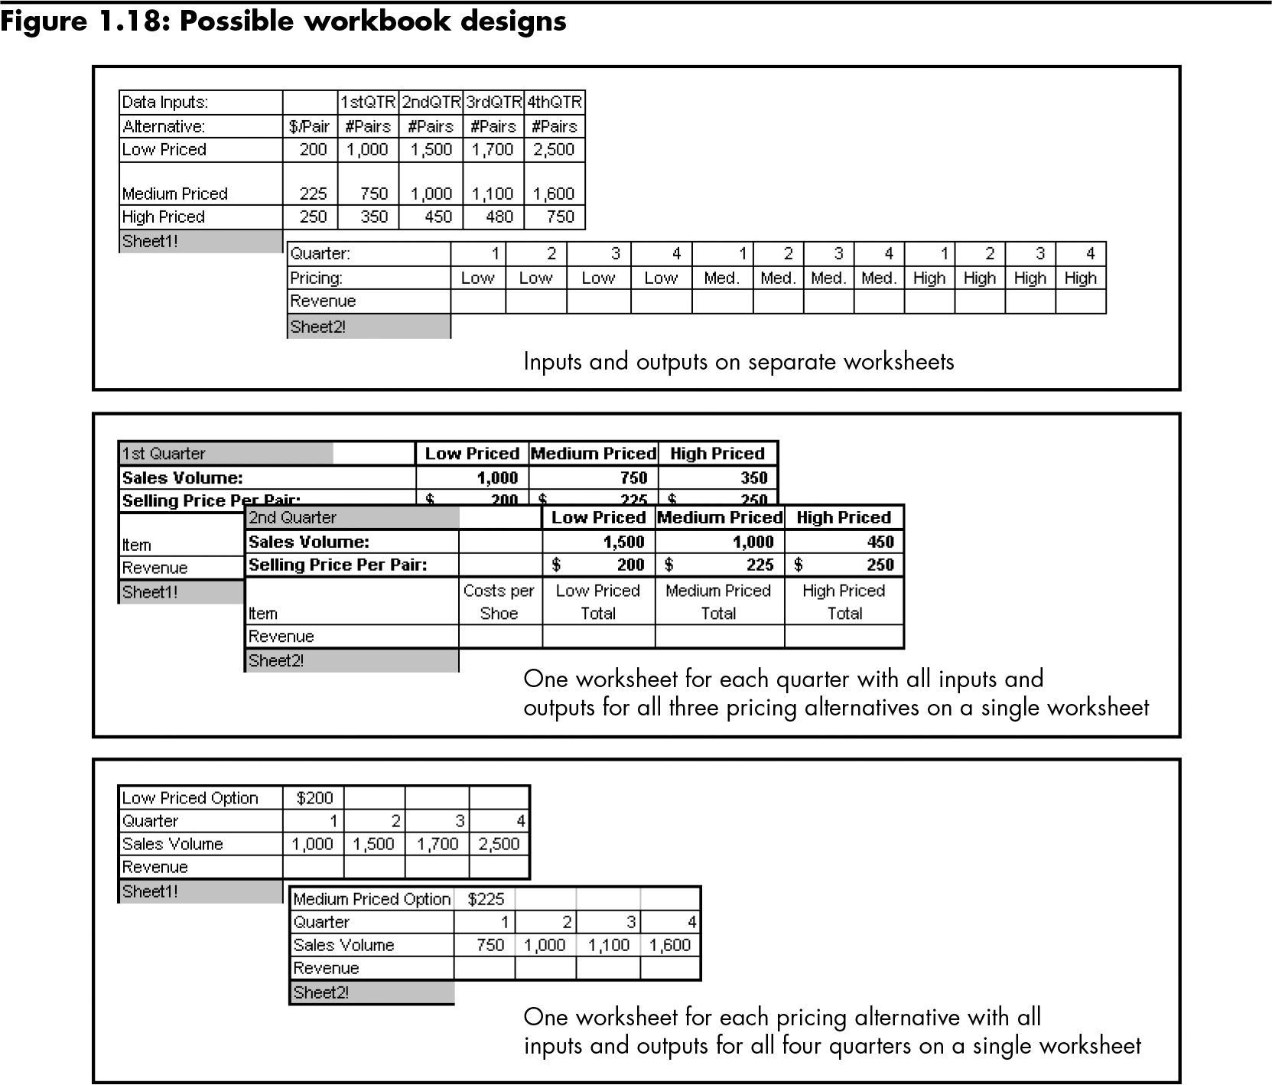
Creating a Budget Workbook (continued)
Inputs and outputs on separate worksheets
One worksheet for each quarter with all inputs and outputs for all three pricing alternatives on a single worksheet
One worksheet for each pricing alternative with all inputs and outputs for all four quarters on a single worksheet
Level 3 home

Slide 33
Understanding Relative Cell Referencing
Relative cell referencing
Allows use of a “general” formula over and over again, but with a different set of numbers
Can also copy formulas using the fill handle
Level 3 home

Slide 34
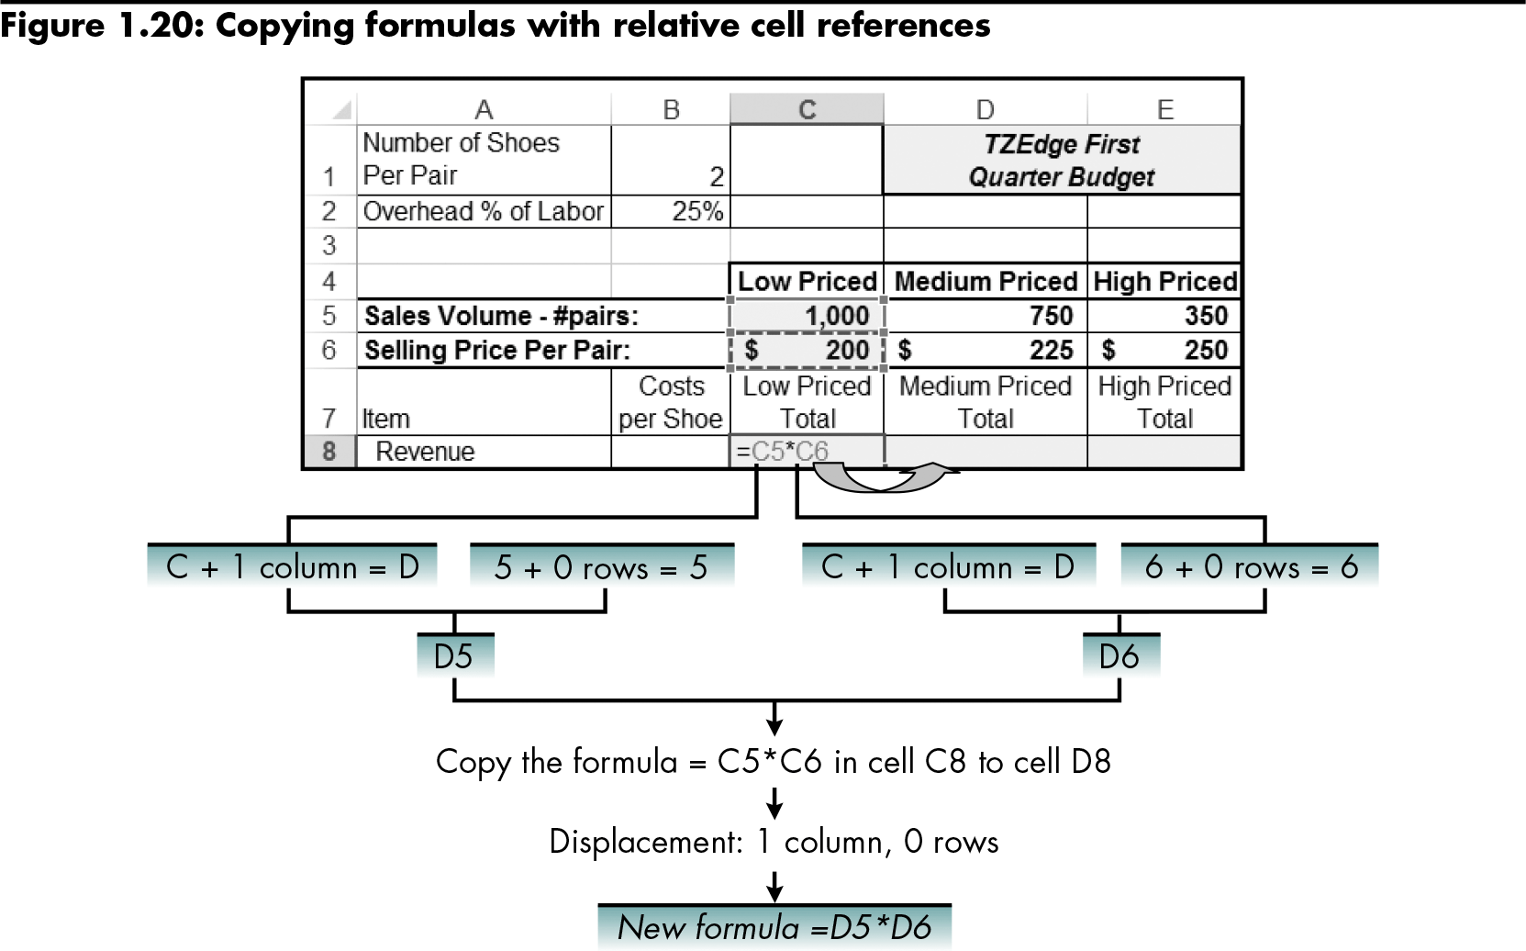
Understanding Relative Cell Referencing (continued)
Excel automatically alters the new formula relative to the location of the original formula.
Level 3 home

Slide 35
Understanding Absolute and Mixed Cell Referencing
Absolute cell referencing
Indicates that a cell reference (both column and row)—or even a part of a cell reference—should remain unchanged when copying
Syntax: $ before column letter, before reference number, or both
Mixed cell reference
A cell reference that has only one $
Common when you need to copy a formula both down a column and across a row at the same time
Level 3 home

Slide 36
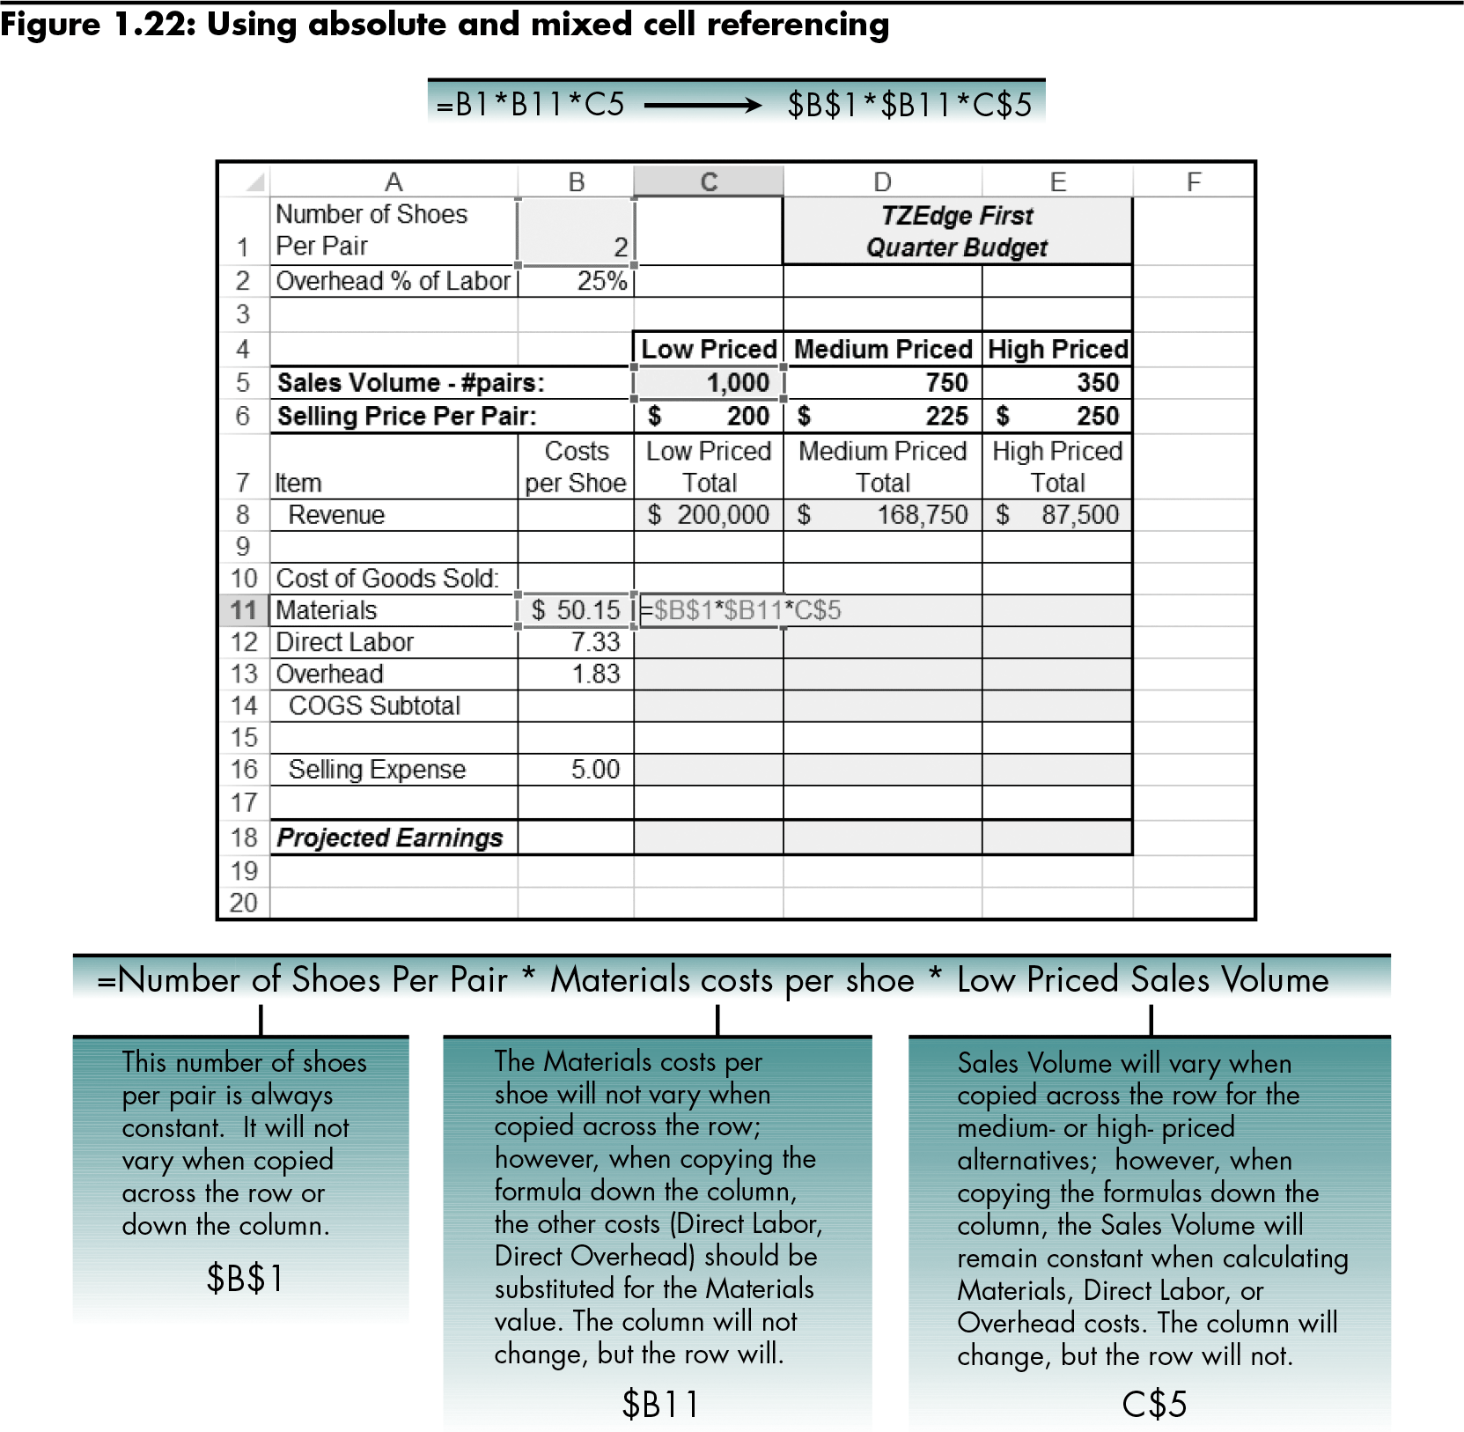
Understanding Absolute and Mixed Cell Referencing (continued)
The formula entered in cell C11 applies absolute and mixed cell referencing.
Level 3 home

Slide 37
Understanding Absolute and Mixed Cell Referencing (continued)
Other cell referencing techniques:
Naming a cell or cell range
Writing a formula to subtotal the cost of goods sold
Writing a formula to calculate selling expense
Writing a formula to calculate projected earnings
Level 3 home

Slide 38
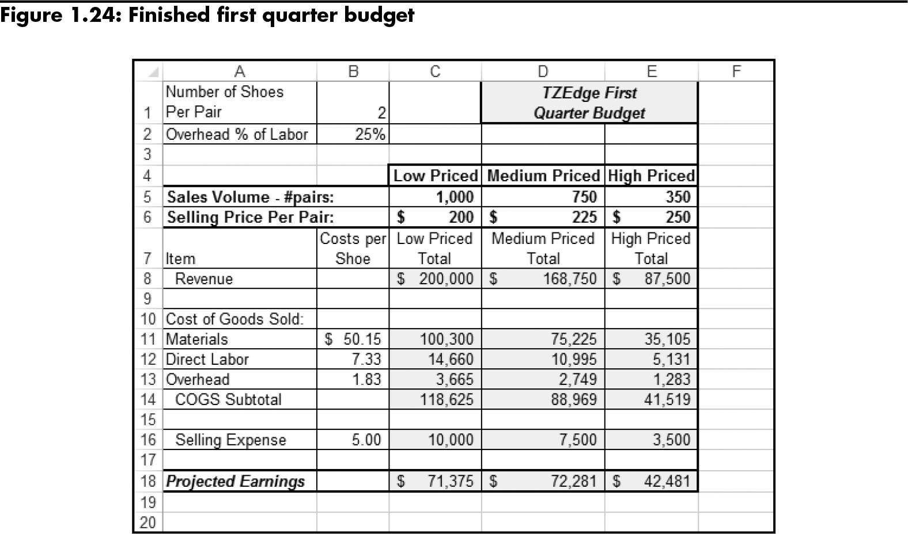
Understanding Absolute and Mixed Cell Referencing (continued)
Level 3 home

Slide 39
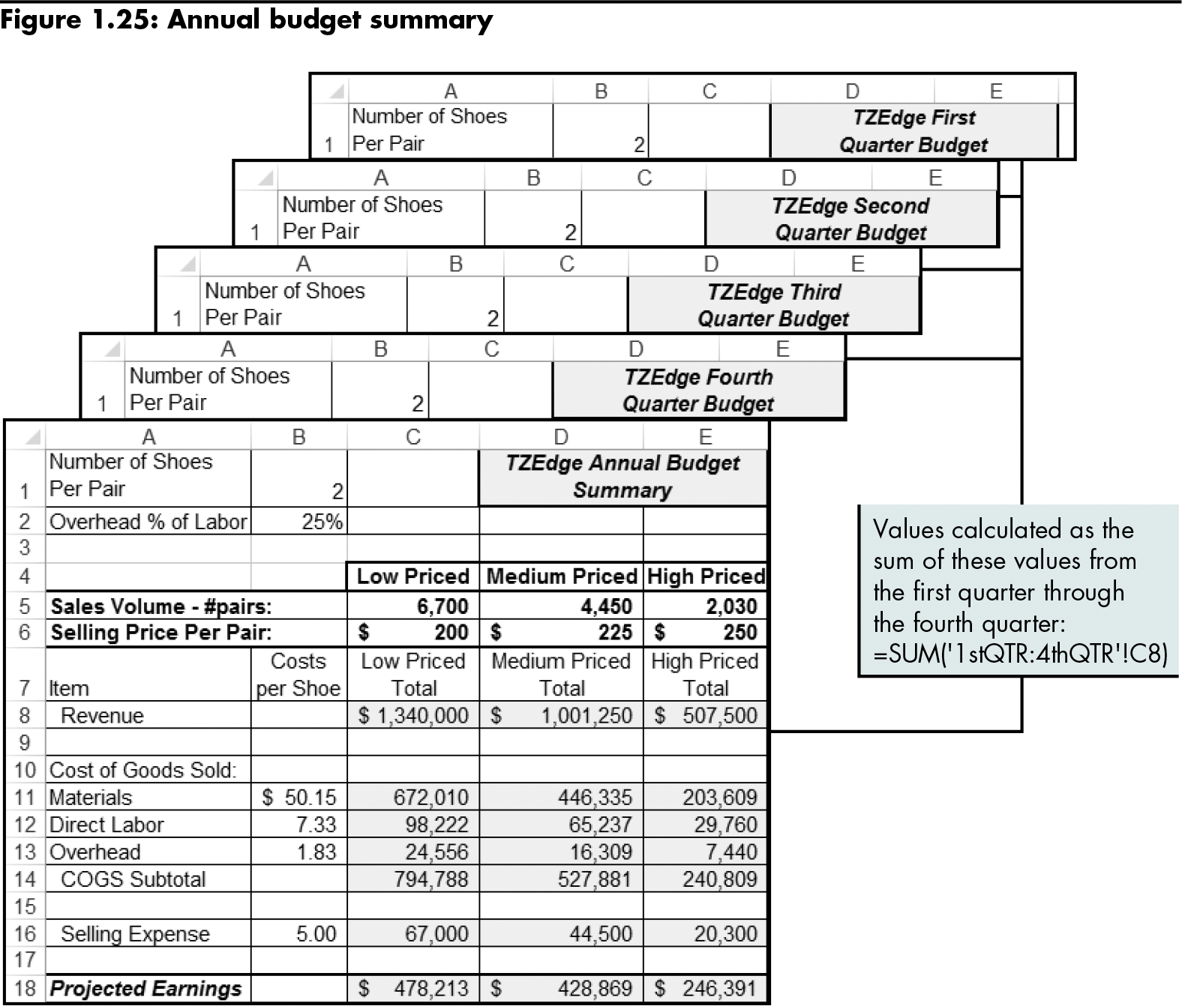
Understanding Absolute and Mixed Cell Referencing (continued)
Level 3 home

Slide 40
Level 3 Summary
Writing and copying formulas
Relative, absolute, and mixed cell references

Slide 41
Chapter Summary
Identifying and correcting common errors in formatting and formulas
Calculating and comparing data using simple functions
Analyzing cell references when writing and copying formulas

