Slide 1
Bibliography
Pro JavaFX 2: A Definitive Guide to Rich Clients with Java Technology
by James Weaver, Weiqi Gao, Stephen Chin, Dean Iverson, Johan Vos
JavaFX 2.0: Introduction by Example
by Carl Dea
Java Tutorial 24-Hour trainer
by Yakov Fain

Slide 2
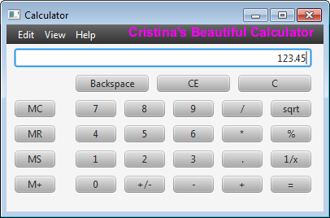
Very Short Introduction To JavaFX

Slide 3
Outline
javafx.application.Application class
Node-Centric UI
javafx.stage.Stage
javafx.scene.Scene
javafx.scene.Node
Builder Classes
Event Handlers
Bibliography

Slide 4
javafx.application.Application class
Methods: launch(), init(), start(), stop(), getParameters(), ...
main() passes the command line args to Application.launch()
the framework invokes the start() method to begin
include C:\Program Files (x86)\Java\jdk1.7.0_51\jre\lib\jfxrt.jar in your project

Slide 5
Node-Centric UI
import javafx.application.Application;
public class Calculator extends Application {
public static void main(String[] args)
{ launch(args); }
@Override
public void start(Stage primaryStage) {
//create Scenes and Nodes
}}

Slide 6
javafx.stage.Stage
Available when the start() method is invoked
Its realization depends on the platform on which it is deployed (e.g. a window on a desktop computer, a rectangular area called applet in a web browser)
Similar to Java Swing API Jframe or JDialog

Slide 7
javafx.scene.Scene
A content pane capable of holding several Node objects
A scene has a scene graph = a tree data structure that models all graphical objects of the application
http://docs.oracle.com/javafx/2/scenegraph/jfxpub-scenegraph.htm

Slide 8
javafx.scene.Node
The fundamental base class of all the components rendered on the scene:
  UI controls
  Shapes
  Text (a type of shape)
  Images
  Media players
  Embedded browsers
  Custom UI components

Slide 9
Builder Classes
Declarative code that defines the user interface
Text text = TextBuilder.create()
.layoutX(150)
.layoutY(15)
.text("Cristina's Beautiful Calculator")
.fill(Color.MAGENTA)
.font(Font.font("SansSerif", FontWeight.BOLD, 16))
.build();

Slide 10
Event Handlers
button.setOnMouseClicked(calcEngine);
class CalculatorEngine implements EventHandler<MouseEvent> {
AdvancedCalculator parent;
@Override
public void handle(MouseEvent arg0) {
Button clickedButton = (Button) arg0.getSource();
...} }

Slide 11
Bibliography
Pro JavaFX 2: A Definitive Guide to Rich Clients with Java Technology
by James Weaver, Weiqi Gao, Stephen Chin, Dean Iverson, Johan Vos
JavaFX 2.0: Introduction by Example
by Carl Dea
Java Tutorial 24-Hour trainer
by Yakov Fain

