Slide 1
Chapter 3: Meet Classes
Java Programming for Kids http://yfain.github.io/Java4Kids/ by Yakov Fain was used to prepare this course

Slide 2
Lesson 1: Classes and Objects

Slide 3
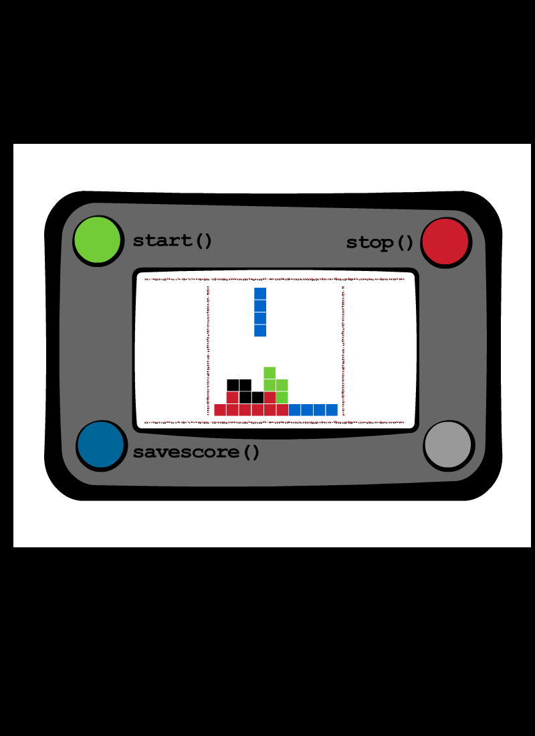
The Class VideoGame
class VideoGame {
int price;
void start () {
// Code to start the game
}
void stop () {
// Code to stop the game
}
}

Slide 4
The Class PlayStation4
class PlayStation4{
int hardDiskSize;
// Some other attributes and methods
void shareOnFacebook(){
// Code to share on Facebook
}
void shareOnTwitter(){
// Code to share on Twitter
}
}

Slide 5
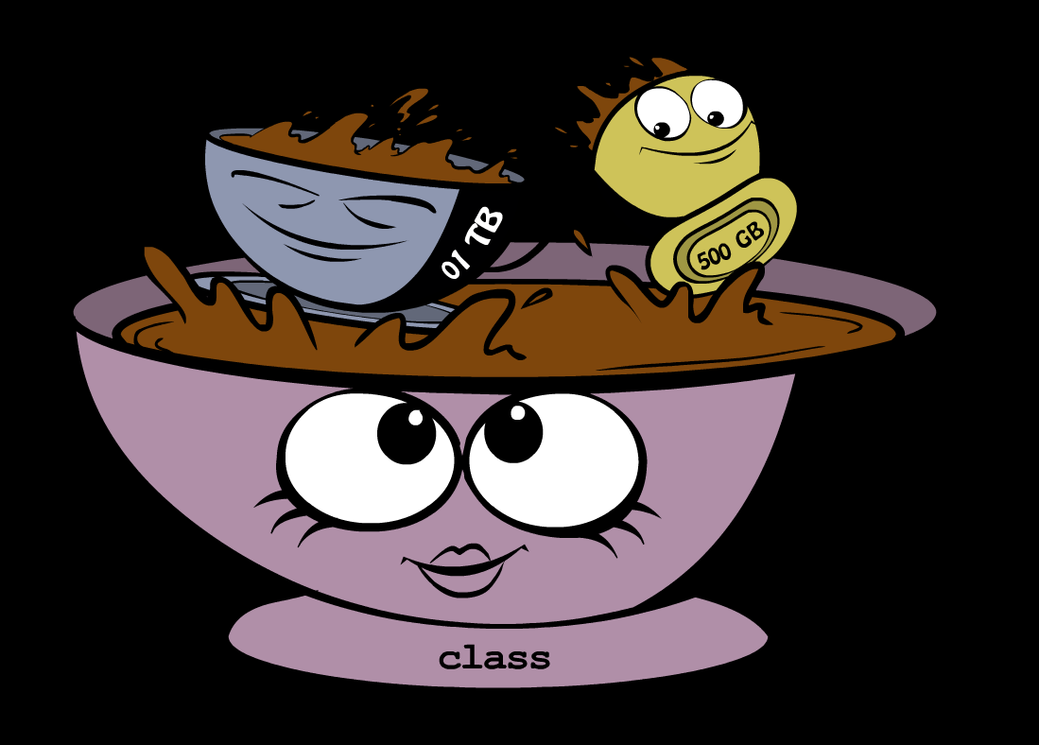
Creating PlayStation Objects
public class CreatePlayStation4Objects {
public static void main(String[] args) {
PlayStation4 firstPlayStation =
new PlayStation4();
firstPlayStation.shareOnFacebook();
}
}

Slide 6
Java Data Types and Variables
We need to declare:
  the variable type
  the variable name
    String theNameOfMyFriend;
    int hardDiskSize;
Notes:
In programming a variable can store a value in computer’s memory so you can access these values from various methods in your classes.
Java variables not only can store numbers, but other types of data as well so we need to declare the variable type, the name, and then assign some value to it. For example, the class attribute that has a value of the disk size can be stored in the variable of type String that’s called hardDiskSize, which canbe declared as shown on the slide.

Slide 7
Java Data Types and Variables
The method parameters (a.k.a. arguments) are also stored in variables.
void saveScore(String playerName, int score);
Notes:
In programming a variable can store a value in computer’s memory so you can access these values from various methods in your classes.
Java variables not only can store numbers, but other types of data as well so we need to declare the variable type, the name, and then assign some value to it. For example, the class attribute that has a value of the disk size can be stored in the variable of type String that’s called hardDiskSize, which canbe declared as shown on the slide.

Slide 8
Java Data Types and Variables
Simple Java data types are called primitives.
    int myScore=5;
    myScore=myScore+1;
Notes:
In programming a variable can store a value in computer’s memory so you can access these values from various methods in your classes.
Java variables not only can store numbers, but other types of data as well so we need to declare the variable type, the name, and then assign some value to it. For example, the class attribute that has a value of the disk size can be stored in the variable of type String that’s called hardDiskSize, which canbe declared as shown on the slide.

Slide 9
Variable Initialization
char grade = 'A';
int chairs = 12;
boolean playSound = false;
float gamePrice = 12.50f;

Slide 10
Classes as Data Types
VideoGame myFirstGame;
Pet myPet;
Integer numberOfPlayers;
Double mySalary;
Boolean mailAlert;
Etc.

Slide 11
Quiz
We’ve used a variable of type int to store the price in the class VideoGame.
Is there a more suitable primitive data type for storing prices?

Slide 12
Objects
public class CreatePlayStation4Objects {
public static void main(String[] args) {
// create one instance of PlayStation4 class
PlayStation4 firstPlayStation = new PlayStation4();
// call the method shareOnFacebook
firstPlayStation.shareOnFacebook();
}
}

Slide 13
Creation of a Pet
public class Pet {
int age;
float weight;
String color;
public String talk(String aWord){
String petResponse = "OK!! OK!! " +aWord;
return petResponse;
}
}

Slide 14

Challenge Yourself!
Create a class Dog
Declare an attribute name in the class Dog
Declare a method bark in the class Dog
Create an instance of the class Dog
Call the method bark

Slide 15
Lesson 2: Inheritance

Slide 16
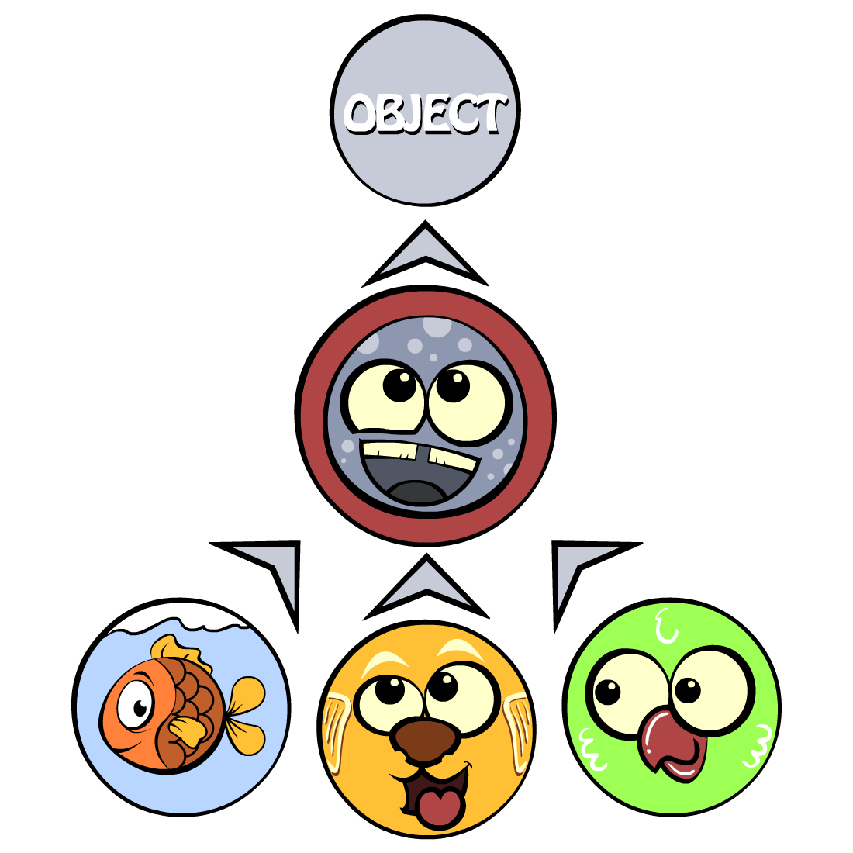
Fish Don't Talk
public String talk(String something){
return "Don't you know that fish do not talk?";
}
class Fish extends Pet{
}

Slide 17
Not all pets can dive
public class Fish extends Pet {
int currentDepth=0;
public int dive(int howDeep){
currentDepth=currentDepth + howDeep;
return currentDepth;
}
}
Notes:
public class Fish extends Pet {
int currentDepth=0;
public int dive(int howDeep){
currentDepth=currentDepth + howDeep;
System.out.println("Diving for " +
howDeep + " feet");
System.out.println("I'm at " + currentDepth +
" feet below sea level");
return currentDepth;
}
}

Slide 18
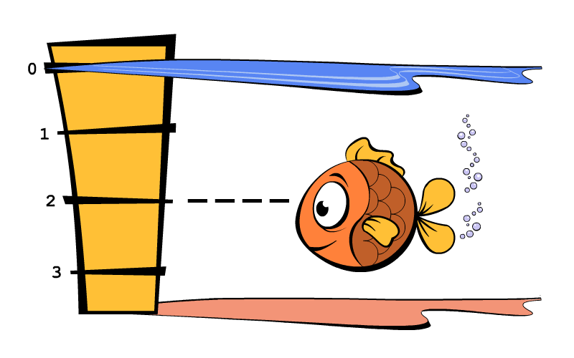
Fish Master
public class FishMaster {
public static void main(String[] args) {
Fish myFish = new Fish();
myFish.dive(2);
myFish.dive(3);
myFish.sleep();
}
}

Slide 19
Method Overriding
public class PetMaster {
public static void main(String[] args) {
String fishReaction;
Fish myFish = new Fish();
fishReaction = myFish.talk("Hello");
System.out.println(fishReaction);
}
}

Slide 20
Challenge Yourself!
Create a Java class Car with the following methods:
  public void start()
  public void stop()
  public int drive(int howlong)
Write another class CarOwner with the method main that creates an instance of the object Car and call its methods. The result of each method call has to be printed using System.out.println();

Slide 21
Challenge Yourself!
3. Create a subclass of Car named JamesBondCar and override the method drive there. Now use the following formula to calculate the distance: distance = howlong*180;
4. Create an instance of the class JamesBondCar in the main method of CarOwner. Re-run the program CarOwner to see that it calls the overridden method.

Slide 22
Extra Challenge
Use FreeTTS, a Java Speech API implementation, to make your pets talk with a human-like voice
http://www.adam-bien.com/roller/abien/entry/merry_christmas1

