Slide 1
Chapter 5: Interfaces, Lambdas, Abstract and
Anonymous Classes
Java Programming for Kids http://yfain.github.io/Java4Kids/ by Yakov Fain was used to prepare this course

Slide 2
Lesson 1: Java Interfaces

Slide 3
Abstract Methods
interface Talker{
public void talk();
}
public class Dog implements Talker {
public void talk(){
System.out.println("Woof! Woof-woof!");}
}
public class Cat implements Talker {
public void talk(){
System.out.println("Meow! Meow!");}
}

Slide 4
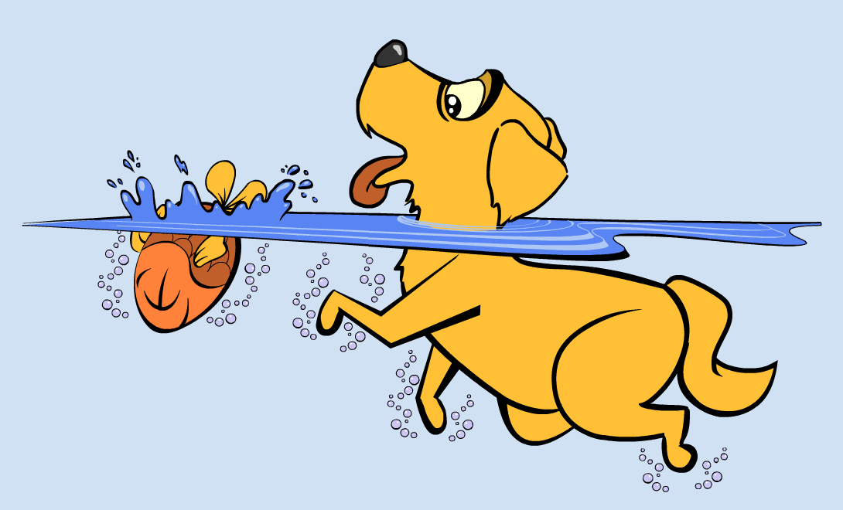
The Interface Swimmer
public interface Swimmer {
public void swim(int howFar);
public void dive(int howDeep);
}

Slide 5
Dogs Can't Dive
public interface Swimmer {
public void swim(int howFar);
public default void dive(int howDeep){
System.out.println("Can't dive, sorry");
};
}
Notes:
Since dogs cannot dive, I would rather not have to write a method “dive” in the class Dog.
Default methods in interfaces come in handy.

Slide 6
Static Methods in Interfaces
// Check if it's summer now
static boolean isSummer()
{
Month month = LocalDate.now().getMonth();
if (month == Month.JULY){
return true;
}
...
}

Slide 7
Hands-on Practice

Slide 8
Lesson 2: Lambda Expressions

