Slide 1
Chapter 5: Interfaces, Lambdas, Abstract and
Anonymous Classes
Java Programming for Kids http://yfain.github.io/Java4Kids/ by Yakov Fain was used to prepare this course

Slide 2
Lesson 1: Java Interfaces

Slide 3
Abstract Methods
interface Talker{
public void talk();
}
public class Dog implements Talker {
public void talk(){
System.out.println("Woof! Woof-woof!");}
}
public class Cat implements Talker {
public void talk(){
System.out.println("Meow! Meow!");}
}

Slide 4
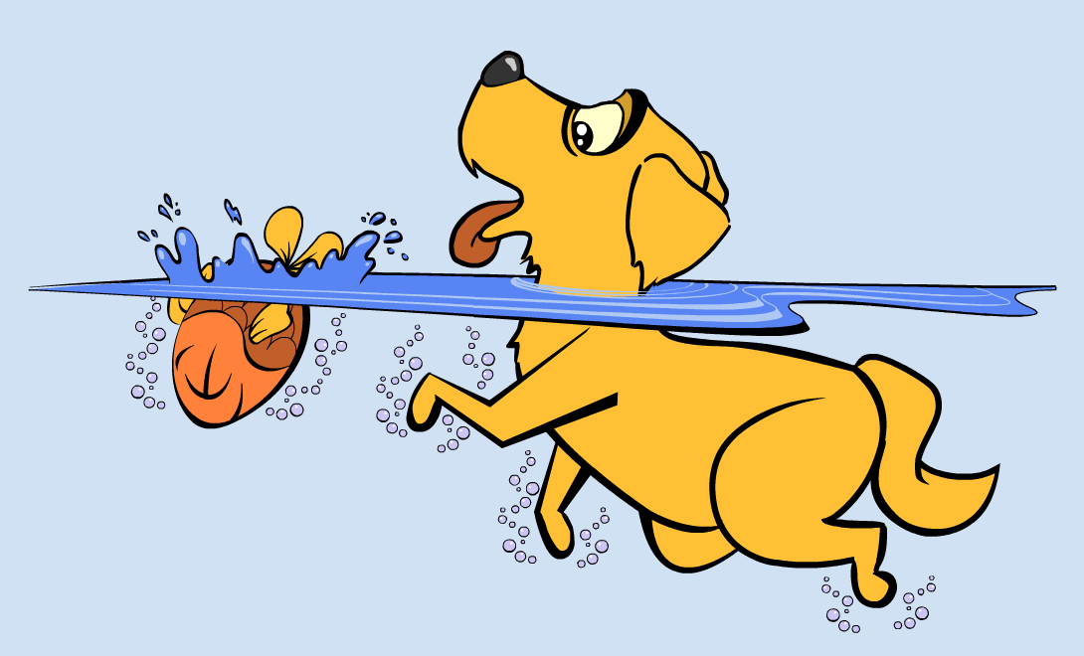
The Interface Swimmer
public interface Swimmer {
public void swim(int howFar);
public void dive(int howDeep);
}

Slide 5
Dogs Can't Dive (Default Methods in Interfaces)
public interface Swimmer {
public void swim(int howFar);
public default void dive(int howDeep){
System.out.println("Can't dive, sorry");
};
}
Notes:
Since dogs cannot dive, I would rather not have to write a method “dive” in the class Dog.
Default methods in interfaces come in handy.

Slide 6
Static Methods in Interfaces
// Check if it's summer now
static boolean isSummer()
{
Month month = LocalDate.now().getMonth();
if (month == Month.JULY){
return true;
}
...
}

Slide 7
Hands-on Practice
Create a new Java project.
Write a program using the class java.time.LocalDate and the enum java.time.Month.
Declare an enum type and write a program using it.
Extra challenge
Print the current month using your locale (format date by locale).

Slide 8
Lesson 2: Lambda Expressions

Slide 9
Functional Interfaces
If an interface has only one abstract method declared (default and static methods don’t count) it’s called functional interface.
public interface ArithmeticOperation {
public double performOperation
(double a, double b);
}

Slide 10
Anonymous Classes
static ArithmeticOperation addition = new
ArithmeticOperation() {
public double performOperation
(double first, double second) {
double result = first + second;
return result;
}
};

Slide 11

Lambda Expressions
static ArithmeticOperation addition=
(first, second) -> {
double result = first + second;
return result;
};

Slide 12
Project- class Dog
public class Dog implements Talker, Swimmer {
public void talk(){
System.out.println("Ham! Ham!");
}
public void swim(int howFar){
System.out.println("Will swim about a half of this distance: " + howFar/2 + "
meters");
}
}

Slide 13
Project- class Fish
public class Fish implements Swimmer {
public void swim(int howFar){
System.out.println("OK, will swim " + howFar + " feet");
}
public void dive(int howDeep){
System.out.println("OK, will dive " + howDeep + " meters");
}
}

Slide 14
Project- interface Swimmer
public interface Swimmer {
public void swim(int howFar);
public default void dive(int howDeep){
System.out.println("Can't dive, sorry");
};
}

Slide 15
Project- interface Talker
interface Talker{
public void talk();
}

Slide 16
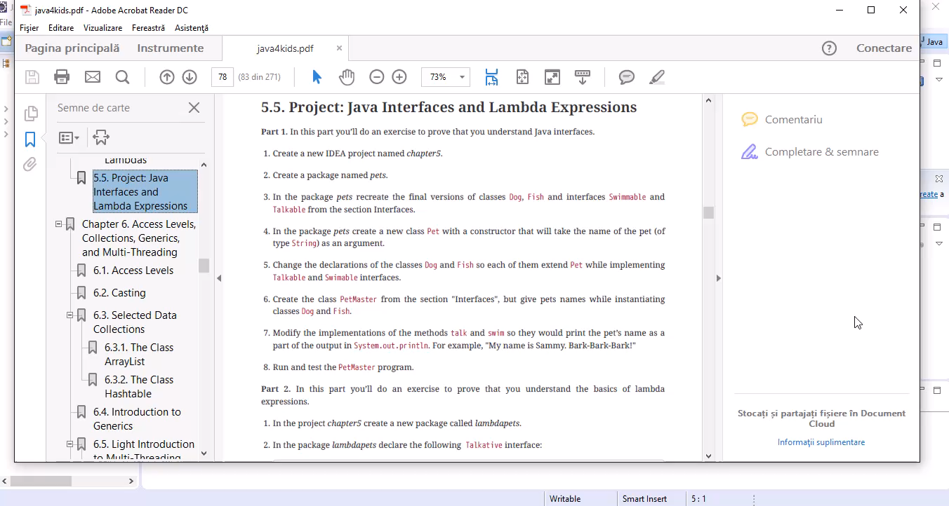

Slide 18
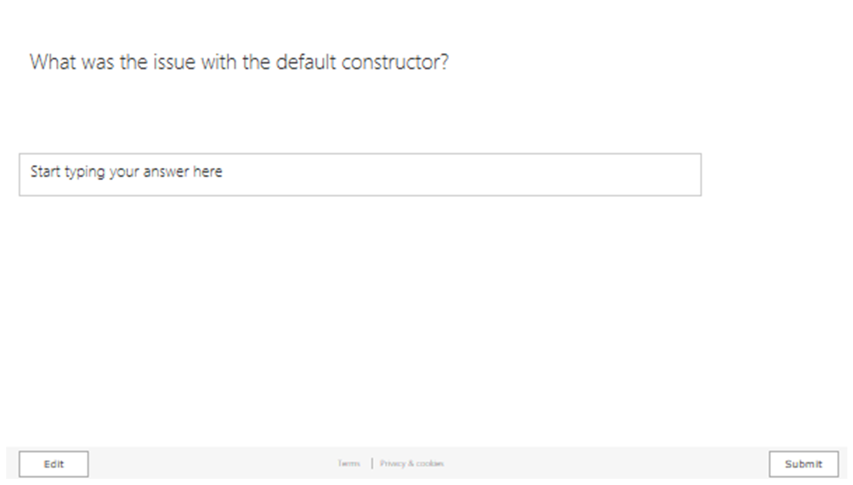
Quiz

