Slide 1




Getting Started with BoxLang
www.intothebox.org

Slide 2









Developer Evangelist
Raymond Camden
@raymondcamden
raymondcamden@gmail.com
@cfjedimaster
BoxLang Developer Evangelist
Enterprise Cat Demo Builder
Blogging at raymondcamden.com

Slide 3




Slide 4
Game Plan
What?
Why?
How?

Slide 5
What is BoxLang?
Lightweight (6MB!) dynamic, loosely typed language
Built on the JVM
Runs everywhere
Extensible
Can replace ColdFusion/Lucee installs
Open Source 🎉
Free 🎉🎉🎉🎉🎉

Slide 6
What?
Subscriptions for additional support
Premium modules
OS ➡️ BoxLang+ ➡️ BoxLang++ ➡️ Custom
Plans - https://www.boxlang.io/plans

Slide 7
What (Soonish)?
BoxLang Admin
Electron app running ColdBox
More modules

Slide 8
Why?
CLIs and tooling
Serverless APIs
Web Applications (with powerful framework)

Slide 9
How?
Install the JDK (21+ minimum)
Install the binaries (Doc)
Install the IDE (Doc)
CLI tools: boxlang, install-bx-module, boxlang-miniserver, install-boxlang

Slide 10

How?
Carefully read the docs
Ensure you understand everything
Then carefully write your first file
or...
Notes:
Ray, switch to editor, show helloWorld.bxs, run it

Slide 11
Language Features
Java interop (very, very deep)
Classes (full OO, interfaces, abstract, static, etc)
Closures + Pure functions (lambdas)
Immutable classes
Interceptors for the language
Case insensitive
Human operators (AND, OR, etc)
Notes:
Can extend java class

Slide 12
Language Features (More)
Member functions
Mostly optional semicolons (but use them cuz I said so)
Multiline strings + Expression Interpolation
Tag islands
Modular (PDF, Mail, Python, and more...)
Arrays that start at freaking 1 because it makes sense!!
Notes:
Can extend java class

Slide 13
Language Features (Types)
Array, Struct, String, Numeric, DateTime
Query, File, XML
List
Full List (Docs)
Notes:
remember that the core types wrap java obs and add stuff on top
show array example - https://boxlang.ortusbooks.com/boxlang-language/reference/types/array

Slide 14
Language Features (More)
Some functionality exposed as components
For example: bx:http .... { subtags }
For example: bx:mail somearg=1 { content }
Notes:
remember that the core types wrap java obs and add stuff on top
show array example - https://boxlang.ortusbooks.com/boxlang-language/reference/types/array

Slide 15
Language Features (Scopes)
variables (all)
server (all)
application, session, form, url (web)
request (web)
this (components)
local, arguments (functions)
More: Docs
Notes:
remember that the core types wrap java obs and add stuff on top
show array example - https://boxlang.ortusbooks.com/boxlang-language/reference/types/array

Slide 16
Language Features (Modules)
Additional functionality
Installed via CLI
install-bx-module modulename
Database, PDF, Markdown, Mail, and more...
Modules
Notes:
remember that the core types wrap java obs and add stuff on top
show array example - https://boxlang.ortusbooks.com/boxlang-language/reference/types/array

Slide 17
BoxLang Files
bxs (scripting)
bxm (tag)
bx (classes)
Notes:
Can extend java class

Slide 18
Demo
Ray, show the tag/class versions of hello world...
Notes:
Can extend java class

Slide 19
Building for the CLI
For interaction, use: cliGetArgs(), cliRead(), cliExit()
Also server.cli.parsed
Positionals and Options
For classes, main is automatically run
https://boxlang.ortusbooks.com/getting-started/running-boxlang/cli-scripting
Notes:
remember that the core types wrap java obs and add stuff on top
show array example - https://boxlang.ortusbooks.com/boxlang-language/reference/types/array

Slide 20
CLI Args - Options
--option (option is true)
--option=X (option is X)
-o=X (shorter)
--!option (option is false)
--no-option (option is false)
Notes:
remember that the core types wrap java obs and add stuff on top
show array example - https://boxlang.ortusbooks.com/boxlang-language/reference/types/array

Slide 21
Demo
Ray, show the cli* files, dadjoke
Notes:
Can extend java class

Slide 22
Building for Serverless
Currently only AWS Lambda (but more coming soon)
BoxLang template (skeleton code, unit tests, GitHub actions)
Template adds automatic event management and response serialization
Can upload a zip or use GitHub Actions 🎉
Notes:
remember that the core types wrap java obs and add stuff on top
show array example - https://boxlang.ortusbooks.com/boxlang-language/reference/types/array

Slide 23
Building for Serverless
Make a new repo based on template and edit settings
Create your Lambda on the AWS side (settings are important!)
Work on code
Use unit test to confirm
Git commit and wait
Notes:
remember that the core types wrap java obs and add stuff on top
show array example - https://boxlang.ortusbooks.com/boxlang-language/reference/types/array

Slide 24
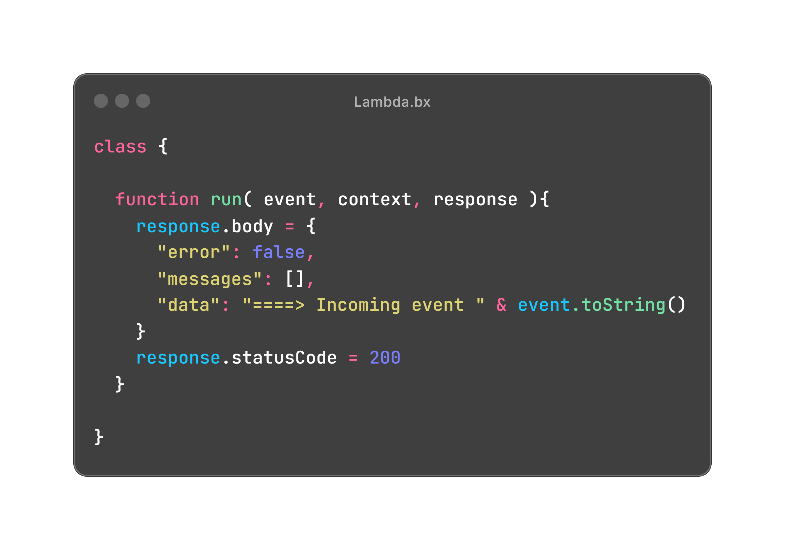
Building for Serverless
Notes:
remember that the core types wrap java obs and add stuff on top
show array example - https://boxlang.ortusbooks.com/boxlang-language/reference/types/array

Slide 25
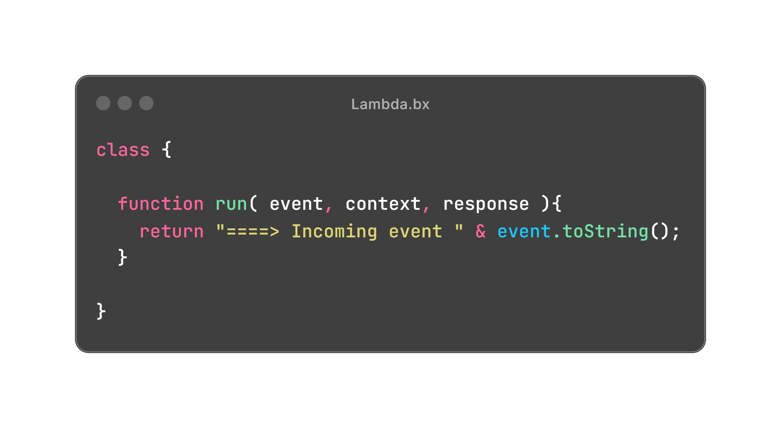
Building for Serverless
Notes:
remember that the core types wrap java obs and add stuff on top
show array example - https://boxlang.ortusbooks.com/boxlang-language/reference/types/array

Slide 26
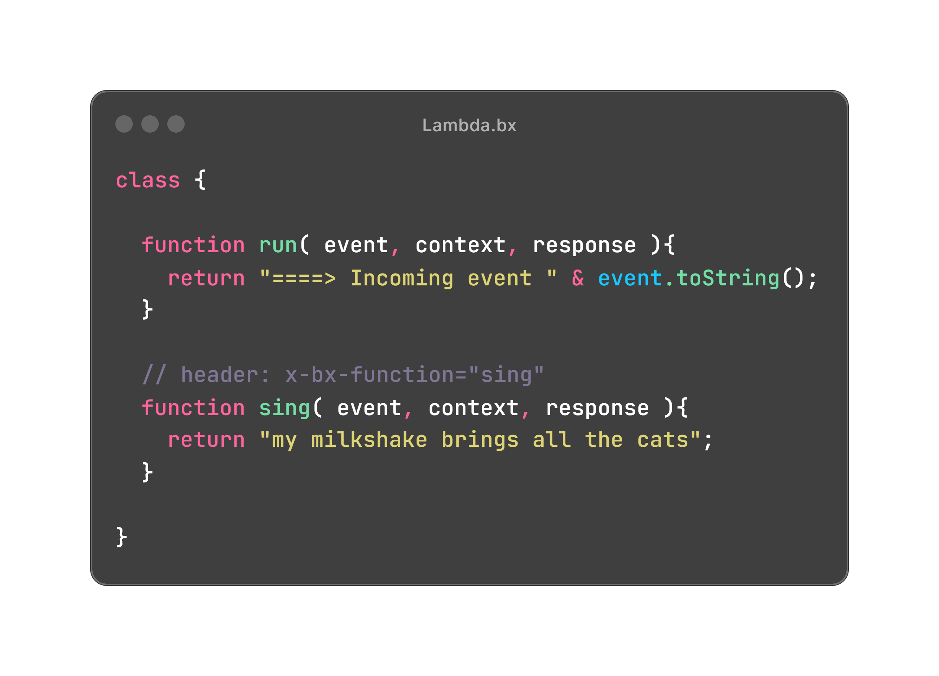
Building for Serverless
Notes:
remember that the core types wrap java obs and add stuff on top
show array example - https://boxlang.ortusbooks.com/boxlang-language/reference/types/array

Slide 27
Demo
Ray, show the local Lambda then the Postman
Notes:
Can extend java class

Slide 28
Building for Serverless
Read the docs: https://boxlang.ortusbooks.com/getting-started/running-boxlang/aws-lambda
Other serverless platforms coming soon
Notes:
remember that the core types wrap java obs and add stuff on top
show array example - https://boxlang.ortusbooks.com/boxlang-language/reference/types/array

Slide 29
Web Apps
Baked In FTW!
Application and Session Management
Application life-cycle event handlers
File-based routing
URL, Form handling (including file uploads)
Classes have additional support for remote operations
Notes:
remember that the core types wrap java obs and add stuff on top
show array example - https://boxlang.ortusbooks.com/boxlang-language/reference/types/array

Slide 30
Web Apps - Defining
Add an Application.bx to the ‘root’ of your app
BoxLang searches for this file when a request is made
Application.bx is run on every request
Notes:
remember that the core types wrap java obs and add stuff on top
show array example - https://boxlang.ortusbooks.com/boxlang-language/reference/types/array

Slide 31
Web Apps - Events
Application Start and End
Session Start and End
Request Start and End
Class Request
Error, Abort, Missing Template
Notes:
remember that the core types wrap java obs and add stuff on top
show array example - https://boxlang.ortusbooks.com/boxlang-language/reference/types/array

Slide 32
Web Apps - Running
CommandBox
MiniServer 🤩
Docker
Notes:
remember that the core types wrap java obs and add stuff on top
show array example - https://boxlang.ortusbooks.com/boxlang-language/reference/types/array

Slide 33
Demo
Ray, show web1
Notes:
Can extend java class

Slide 34
Databases
Available via modules
Derby, HyperSQL, MySQL, MariaDB, SQL Server, Oracle, PostgreSQL, SQLIte
install-bx-module bx-mysql
Notes:
remember that the core types wrap java obs and add stuff on top
show array example - https://boxlang.ortusbooks.com/boxlang-language/reference/types/array

Slide 35
Datasources
Define connection parameters for your database
Defined inline
Defined in Application.bx
Defined in server configuration
Notes:
remember that the core types wrap java obs and add stuff on top
show array example - https://boxlang.ortusbooks.com/boxlang-language/reference/types/array

Slide 36
Code
queryExecute
bx:query
transaction (multiple)
Loop constructs support query objects
Stored procedure support
bx:dbinfo
queryNew
Notes:
remember that the core types wrap java obs and add stuff on top
show array example - https://boxlang.ortusbooks.com/boxlang-language/reference/types/array

Slide 37
Demo
Ray, show db1
Notes:
Can extend java class

Slide 38
Examples
Multi HTTP Tool (shows threading)
PDF Generator (shows modules)
Markdown (shows Java interop)
URL to Image (shows, um, images)
Notes:
remember that the core types wrap java obs and add stuff on top
show array example - https://boxlang.ortusbooks.com/boxlang-language/reference/types/array

Slide 39

Any questions?
Notes:
remember that the core types wrap java obs and add stuff on top
show array example - https://boxlang.ortusbooks.com/boxlang-language/reference/types/array

Slide 40
Thank You!
The Future of Modern Development Starts Here, with you! 🚀

