Slide 1
Getting Started with Boxlang

Slide 2
About Me
Raymond Camden
Developer Evangelist + Advocate
Enterprise Cat Builder
Blogging at raymondcamden.com

Slide 3
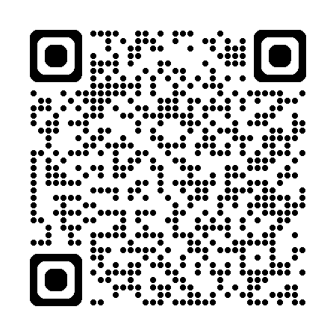
https://github.com/cfjedimaster/bl-preso

Slide 4
Game Plan
What?
Why?
How?

Slide 5
What is Boxlang?
Lightweight (6MB!) dynamic, loosely typed language
Built on the JVM
Runs everywhere
Extensible
Can replace ColdFusion/Lucee installs
Open Source 🎉
Free 🎉🎉🎉🎉🎉

Slide 6
What?
A tool for building CLI applications
A way to create serverless functions
A powerful web application + framework

Slide 7
What?
Subscriptions for additional support
Premium modules
OS ➡️ BoxLang+ ➡️ BoxLang++ ➡️ Custom
Plans - https://www.boxlang.io/plans

Slide 8
What (Soonish)?
BoxLang Admin
Electron app
More modules

Slide 9
Why?
Rapid application development
Available on multiple platforms
Modern, functional, and fluent

Slide 10
How?
Install the JDK (21+ minimum)
Install the binaries
Install the IDE
CLI tools: boxlang, install-bx-module, boxlang-miniserver, install-boxlang
https://boxlang.ortusbooks.com/getting-started/installation
Also – BVM

Slide 11

How?
Carefully read the docs
Ensure you understand everything
Then carefully write your first file
or...

Slide 12
Language features
Java interop (very, very deep)
Classes (full OO, interfaces, abstract, static, etc)
Closures + Pure functions (lambdas)
Immutable classes
Interceptors for the language
Case insensitive
Human operators (AND, OR, etc)

Slide 13
Language Features (more)
Member functions
Mostly optional semicolons (but use them cuz I said so)
Multiline strings + Expression Interpolation
Tag islands
Caching
Arrays that start at freaking 1 because it makes sense!!

Slide 14
Language Features (Types)
Array, Struct, String, Numeric, DateTime
Query, File, XML
List
Full List (https://boxlang.ortusbooks.com/boxlang-language/reference/types)

Slide 15
Language Features (more)
Some functionality exposed as components
For example: bx:http .... { subtags }
For example: bx:mail somearg=1 { content }

Slide 16
Language Features (Scopes)
variables (all)
server (all)
application, session, form, url (web)
request (web)
this (components)
local, arguments (functions)
More: https://boxlang.ortusbooks.com/boxlang-language/syntax/variable-scopes

Slide 17
Language Features (Modules)
Additional functionality
Installed via CLI
install-bx-module modulename
Database, PDF, Markdown, Mail, and more...
https://boxlang.ortusbooks.com/boxlang-framework/modularity

Slide 18
BoxLang Files
bxs (scripting)
bxm (tag)
bx (classes)

Slide 19
Demo
Ray, show the tag/class versions of hello world...

Slide 20
Building for the CLI
For interaction, use: cliGetArgs(), cliRead(), cliExit()
Also server.cli.parsed
Positionals and Options
For classes, main is automatically run
https://boxlang.ortusbooks.com/getting-started/running-boxlang/cli-scripting

Slide 21
CLI Args - Options
--option (option is true)
--option=X (option is X)
-o=X (shorter)
--!option (option is false)
--no-option (option is false)

Slide 22
Demo
Ray, show the cli* files, dadjoke

Slide 23
Building For Serverless
Currently only AWS Lambda (but more coming soon)
BoxLang template (skeleton code, unit tests, GitHub actions)
Template adds automatic event management and response serialization
Can upload a zip or use GitHub Actions 🎉
Recently added URL Routing

Slide 24
Building for Serverless
Make a new repo based on template and edit settings
Create your Lambda on the AWS side (settings are important!)
Work on code
Use unit test to confirm
Git commit and wait

Slide 25
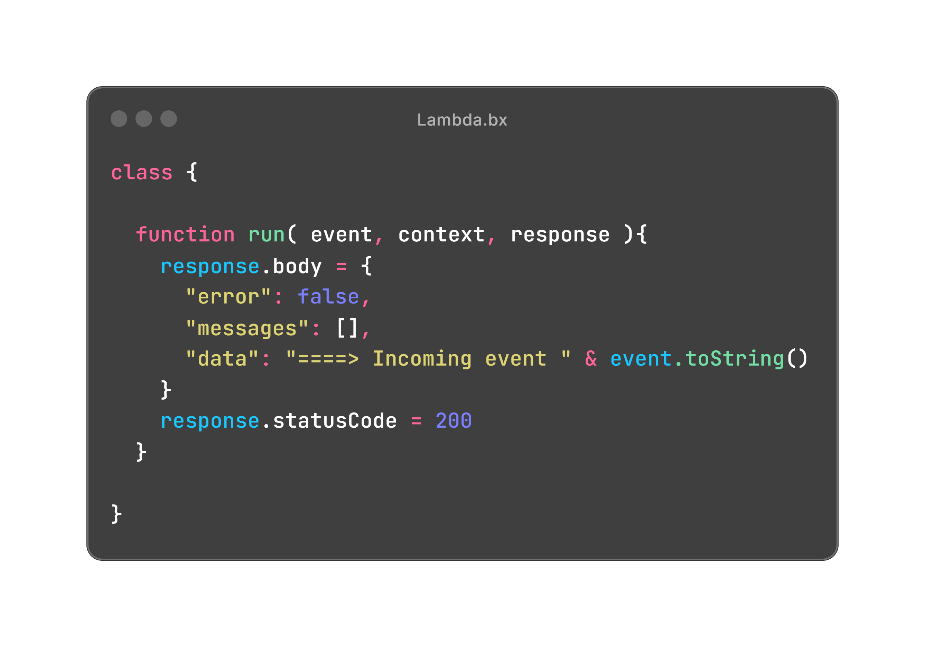
Building for Serverless

Slide 26
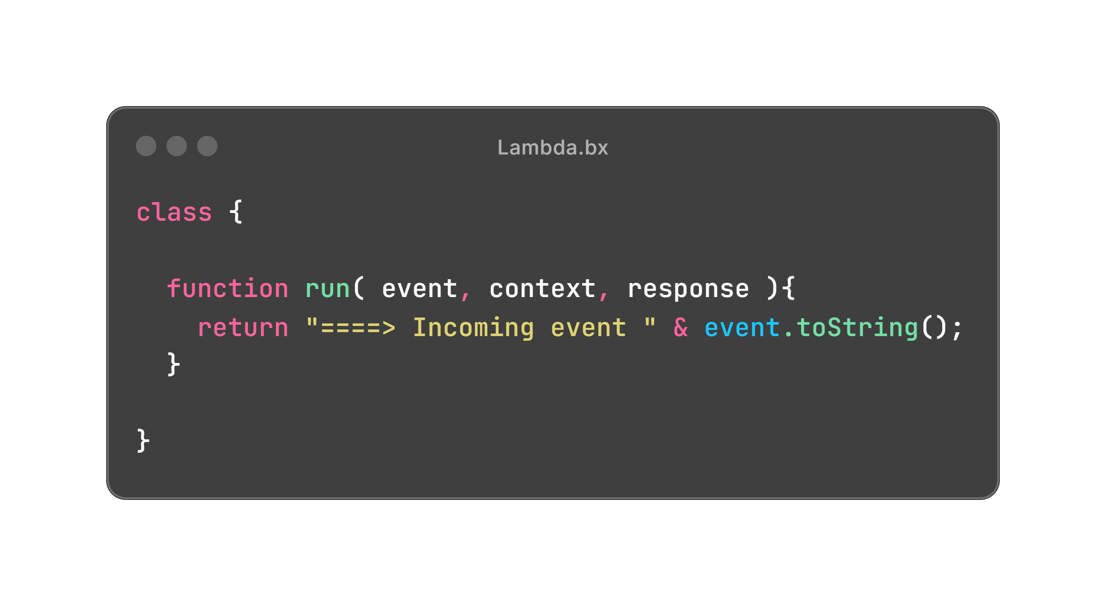
Building for Serverless

Slide 27
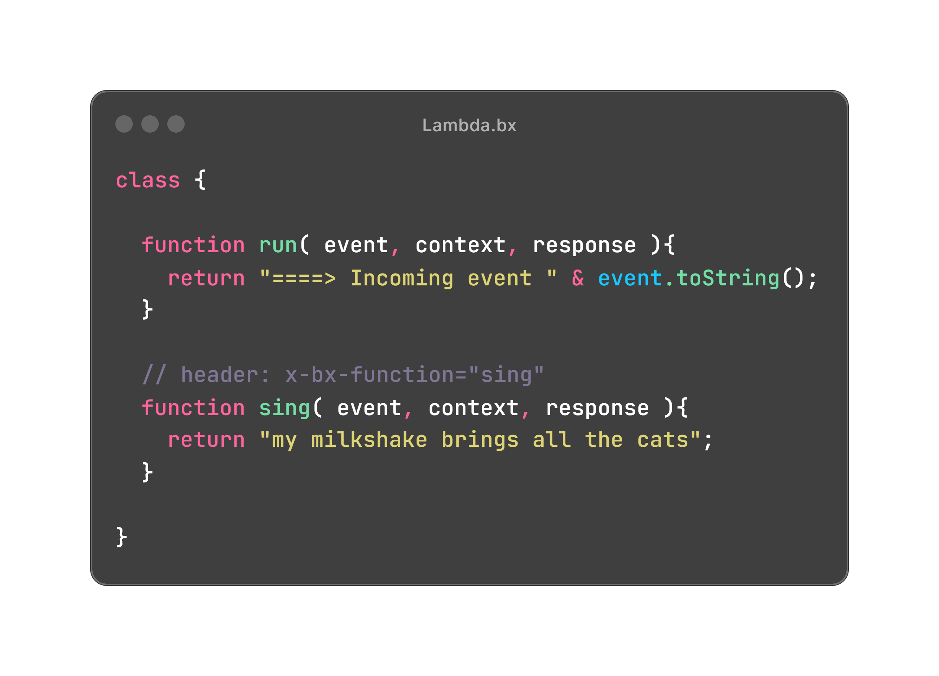
Building for Serverless

Slide 28
Demo
Ray, show the local Lambda then the Postman

Slide 29
Web Apps
Baked In FTW!
Application and Session Management
Application life-cycle event handlers
File-based routing
URL, Form handling (including file uploads)
Classes have additional support for remote operations

Slide 30
Web Apps - Defining
Add an Application.bx to the ‘root’ of your app
BoxLang searches for this file when a request is made
Application.bx is run on every request

Slide 31
Web Apps - Events
Application Start and End
Session Start and End
Request Start and End
Class Request
Error, Abort, Missing Template

Slide 32
Web Apps - Running
CommandBox
MiniServer 🤩
Docker

Slide 33
Demo
Ray, show web1

Slide 34
Modules
System by which developers can add features
Long (and growing) list of supported modules
https://boxlang.ortusbooks.com/boxlang-framework/modularity
Incredibly flexible and deep integration into BoxLang

Slide 35
Modules can do what???
Add new BIFs
Add new components
Add classes that can be loaded via a custom import
Add new Jars
Add new JDBC Drivers
Add interceptors
Create new variable scopes

Slide 36
Demo
Ray, show module_test
Then show: https://www.raymondcamden.com/2025/05/07/a-sneak-peek-at-boxlangs-module-feature

Slide 37
Databases
Available via modules
Derby, HyperSQL, MySQL, MariaDB, SQL Server, Oracle, PostgreSQL, SQLIte
install-bx-module bx-mysql

Slide 38
Datasources
Define connection parameters for your database
Defined inline
Defined in Application.bx
Defined in server configuration

Slide 39
Code
queryExecute
bx:query
transaction (multiple)
Loop constructs support query objects
Stored procedure support
bx:dbinfo
queryNew

Slide 40
Demo
Ray, show db*

Slide 41
Examples
Multi HTTP Tool (shows threading)
PDF Generator (shows modules)
Markdown (shows Java interop)
URL to Image (shows, um, images)

Slide 42
Resources
https://boxlang.ortusbooks.com/
Forums + Slack
https://www.raymondcamden.com/tags/boxlang
https://try.boxlang.io

Slide 43

Any questions?

