Slide 1
A Practical Guide to Bayesian Optimization
Jason King, PhD
Data Scientist, XSOLIS

Slide 2
What led me to Bayesian Optimization?
Like many of you, I compete in Kaggle competitions
For whatever reason, GBMs tend to be the most popular model types
Significantly more hyperparameters to consider compared to GLMs

Slide 3
Hyperparameter comparison
Linear Regression:
fit_intercept, normalize
Ridge:
alpha, fit_intercept, normalize, solver, max_iter
Decision Tree:
criterion, splitter, max_depth, min_samples_split, min_samples_leaf, min_weight_fraction_leaf, max_features, max_leaf_nodes, min_impurity_split, min_impurity_descrease, presort
Random Forest:
above, n_estimators, bootstrap

Slide 4
Hyperparameter comparison
XGBoost:
booster, eta, gamma, max_depth, min_child_weight, max_delta_step, subsample, colsample_bytree, colsample_bylevel, lambda, alpha, tree_method, sketch_eps, scale_pos_weight, updater, refresh_leaf, process_type, grow_policy, max_leaves, max_bin, objective, base_score
Neural Networks:
∞ (get a grad student!)

Slide 5
Zillow Prize
High-cost training
Started seeing a lot of chatter about a smarter automated tuning method
Learning the hyperparameter space
A number of Python implementations
Metric Optimization Engine (MOE)
Bayesian Optimization
Hyperopt
Relatively straightforward to implement in my code
Still required a bounded range to search over
Took less iterations, and new models performed better

Slide 6
Hyperparameter tuning strategies
Grid (naïve)
Insert image here
Random
Insert image here
Subsampling
Insert image here

Slide 7
Objectives
Learn how to implement Bayesian Optimization in your code
Understand the underlying mechanism
Discuss the limitations of the technique
Explore some extended use cases

Slide 8
Simple Regression

Slide 9
Simple Classification

Slide 10
Mercari Price Suggestion

Slide 11
Gaussian Process
A gaussian process uses lazy learning and a measure of similarity between points (kernel function) to predict the value for unseen points
Given a black box function/process, we can obtain a few samples and generate a predicted function with uncertainty
This enables derivative-free optimization
More importantly, if sampling the target function is expensive, we can reduce overall cost

Slide 12
Gaussian Process

Slide 13
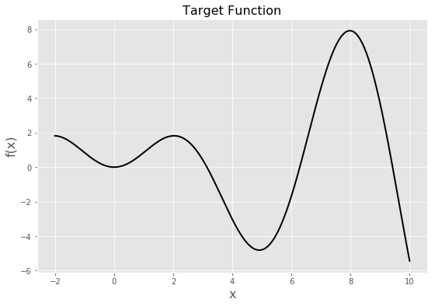

Gaussian Process
Target function: $x\sin{x}$ for $x∈\left[−2,10\right]$

Slide 14
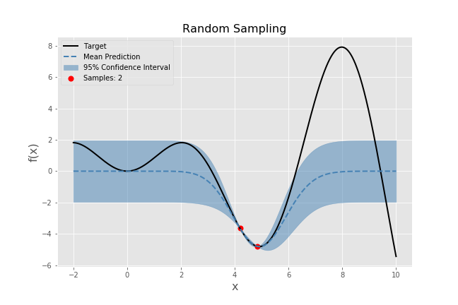
Gaussian Process
Sample two points on x-interval and train GPR

Slide 15
Gaussian Process

Slide 16
Bayesian Optimization

Slide 17
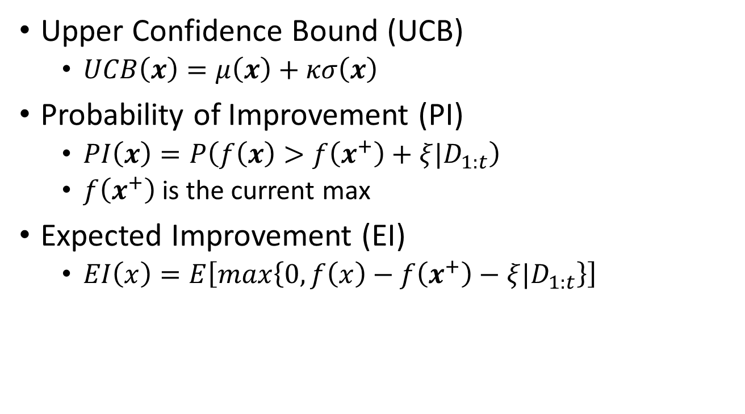
Utility Functions
Upper Confidence Bound (UCB)
$UCB\left(x\right)=μ\left(x\right)+κσ\left(x\right)$
Probability of Improvement (PI)
$PI\left(x\right)=P\left(f\left(x\right)>f\left(x^{+}\right)+ξ|D_{1:t}\right)$
$f\left(x^{+}\right)$is the current max
Expected Improvement (EI)
$EI\left(x\right)=E\left[max\left\{0,f\left(x\right)−f\left(x^{+}\right)−ξ{|D}_{1:t}\right\}\right]$

Slide 18
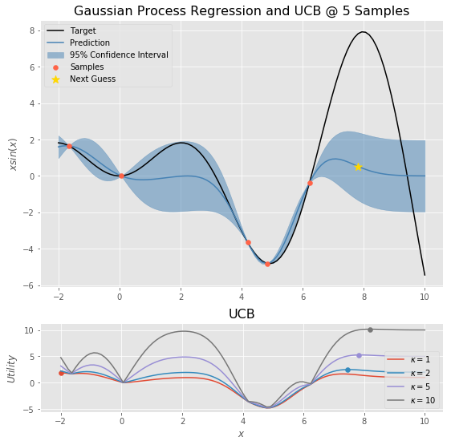
Utility Functions

Slide 19
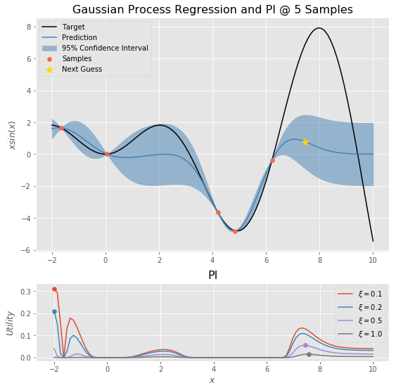
Utility Functions

Slide 20
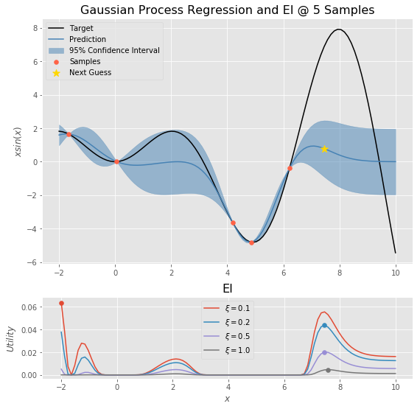
Utility Functions

Slide 21
Limitations
Overhead
Lazy learner
Retrain Gaussian process regressor every iteration
(Hyper)-Hyperparameters
Kernel choice
Scaling
Sequential (traditionally)
Smarter initialization
Efficient sampling
Bounds
Not unique to Bayesian Optimization

Slide 22
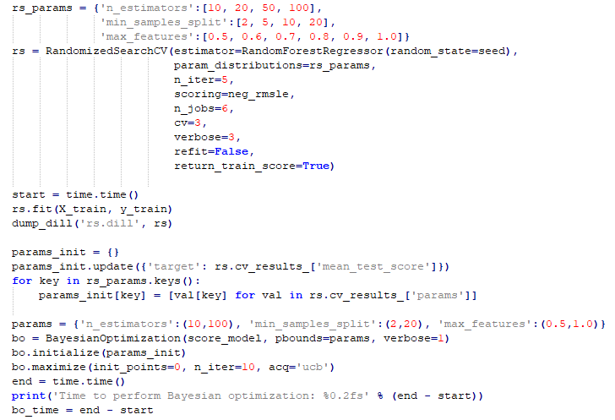
Efficient Initialization

Slide 23
Efficient Sampling
Batched parallel sampling
Cost/benefit analysis
Utility function type
Utility function parameters

Slide 24
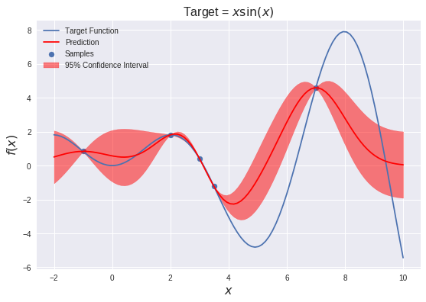
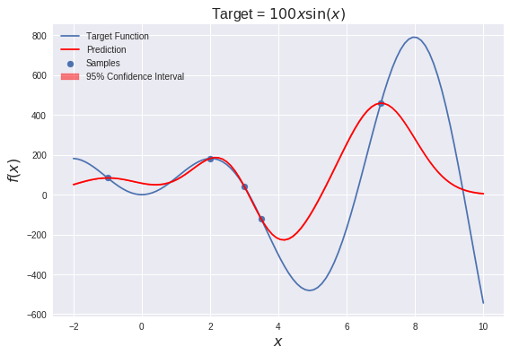
Scaling issues
Large variances in target values greatly affect standard deviation estimates

Slide 25
Scaling Issues
gp_scaling.ipynb

Slide 26
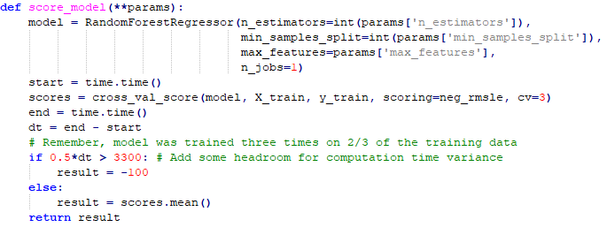
Modified Target Functions
Add additional constraints to the scoring method (target)
Mercari challenge limitation
All training must be completed within a Kaggle kernel

Slide 27


Questions?
Jason King
jkkphys@gmail.com

Slide 28
Resources
Machine Learning: Nando de Freitas @ UBC
Introduction to Gaussian processes
Regression with Gaussian processes
Bayesian optimization and multi-armed bandits
Gaussian Processes for Machine Learning
Carl Edward Rasmussen and Christopher K. I. Williams
A Tutorial on Bayesian Optimization of Expensive Cost Functions, with Application to Active User Modeling and Hierarchical Reinforcement Learning
Eric Brochu, Vlad M. Cora, and Nando de Freitas
Scikit-learn: Gaussian Processes

