Slide 1
A Practical Guide to Bayesian Optimization
Jason King, PhD
Data Scientist, XSOLIS

Slide 2
What led me to Bayesian Optimization?
Like many of you, I compete in Kaggle competitions
For whatever reason, GBMs tend to be the most popular (single) model types
Significantly more hyperparameters to consider compared to GLMs
Most competitive teams use ensembling and/or stacking
Zillow entry was a stacked model: XGBoost, Light GBM, Random Forest, Extra Trees, AdaBoost (tree-based), two Neural Networks, and a K-Nearest-Neighbor.
Linear Regression meta-learner

Slide 3
Hyperparameter comparison
Linear Regression:
fit_intercept, normalize
Ridge:
alpha, fit_intercept, normalize, solver, max_iter
Decision Tree:
criterion, splitter, max_depth, min_samples_split, min_samples_leaf, min_weight_fraction_leaf, max_features, max_leaf_nodes, min_impurity_split, min_impurity_descrease, presort
Random Forest:
above, n_estimators, bootstrap

Slide 4
Hyperparameter comparison
XGBoost:
booster, eta, gamma, max_depth, min_child_weight, max_delta_step, subsample, colsample_bytree, colsample_bylevel, lambda, alpha, tree_method, sketch_eps, scale_pos_weight, updater, refresh_leaf, process_type, grow_policy, max_leaves, max_bin, objective, base_score
Neural Networks:
∞ (get a grad student!)

Slide 5
Zillow Prize
High-cost training
Started seeing a lot of chatter about a smarter automated tuning method
Learning the hyperparameter space
A number of Python implementations
Metric Optimization Engine (MOE)
Bayesian Optimization
Hyperopt
Relatively straightforward to implement in my code
Still required a bounded range to search over
Took less iterations, and new models performed better

Slide 6
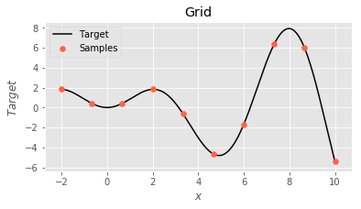
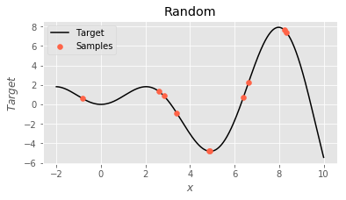
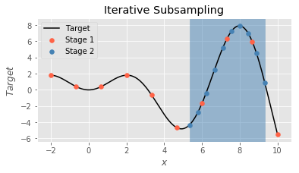
Hyperparameter tuning strategies
Grid
Random
Iterative subsampling

Slide 7
Objectives
Learn how to implement Bayesian Optimization in your code
Understand the underlying mechanism
Discuss the limitations of the technique
Explore some extended use cases

Slide 8
Installation
pip install bayesian-optimization

Slide 9
Example 1
simple_regression.ipynb

Slide 10
Example 2
simple_classification.ipynb

Slide 11
Example 3
process_mercari.ipynb
bayes_opt_mercari_sub.py
bayes_opt_mercari_full.py
bayes_opt_mercari_analysis.ipynb

Slide 12
Gaussian Process
A gaussian process uses lazy learning and a measure of similarity between points (kernel function) to predict the value for unseen points
Given a black box function/process, we can obtain a few samples and generate a predicted function with uncertainty
This enables derivative-free optimization
More importantly, if sampling the target function is expensive, we can reduce overall cost

Slide 13
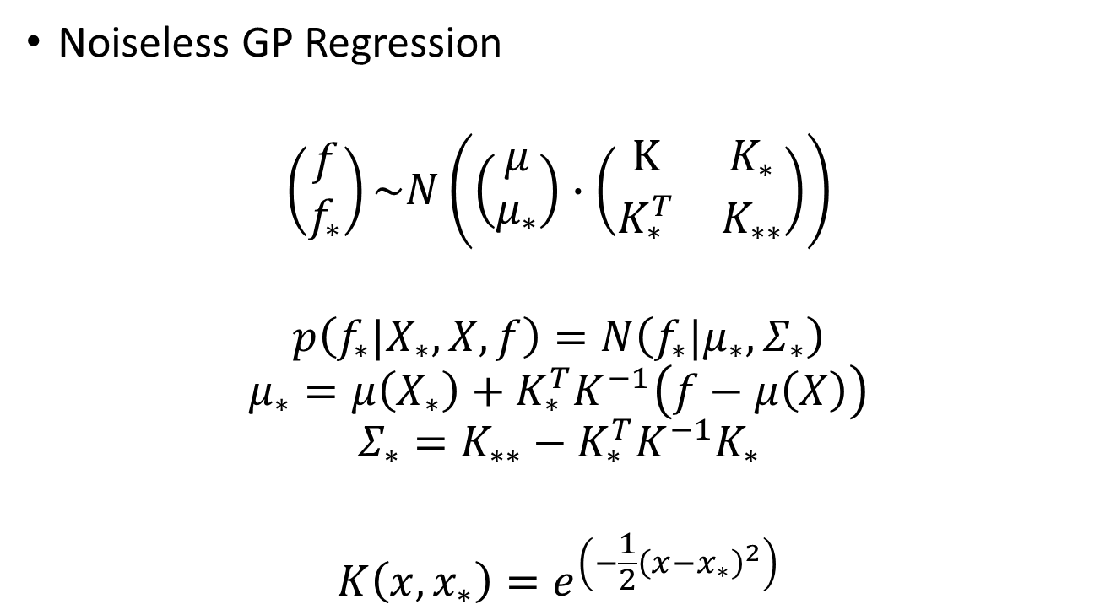
Gaussian Process
Noiseless GP Regression
$$\left(\begin{matrix}f \\ f_{∗}\end{matrix}\right)\sim N\left(\left(\begin{matrix}μ \\ μ_{∗}\end{matrix}\right)∙\left(\begin{matrix}\text{K} & K_{∗} \\ K_{∗}^{T} & K_{∗∗}\end{matrix}\right)\right)$$
$$p\left(f_{∗}|X_{∗},X,f\right)=N\left(f_{∗}|μ_{∗},Σ_{∗}\right)$$
$$μ_{∗}=μ\left(X_{∗}\right)+K_{∗}^{T}K^{−1}\left(f−μ\left(X\right)\right)$$
$$Σ_{∗}=K_{∗∗}−K_{∗}^{T}K^{−1}K_{∗}$$
$$K\left(x,x_{∗}\right)=e^{\left(−\frac{1}{2}{\left(x−x_{∗}\right)}^{2}\right)}$$

Slide 14
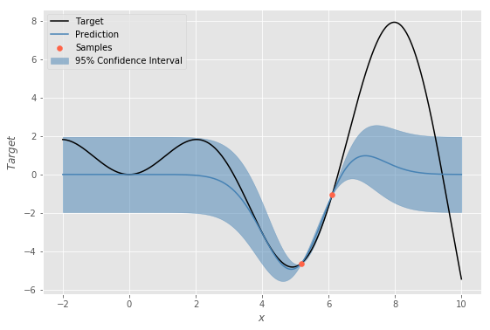

Gaussian Process Regression

Slide 15
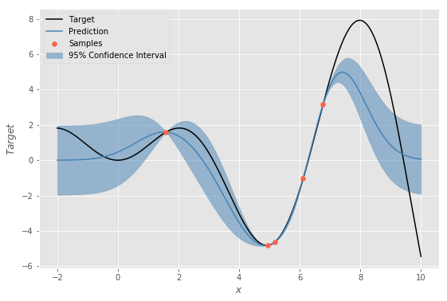

Gaussian Process Regression

Slide 16

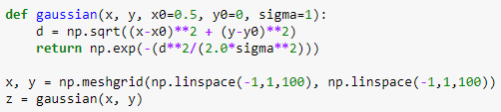
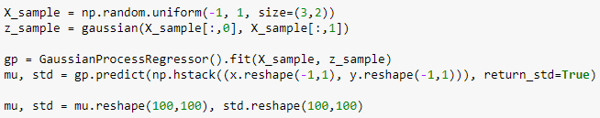
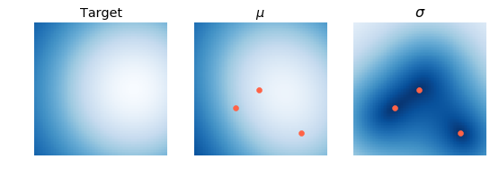
Gaussian Process Regression

Slide 17
Gaussian Process Regression

Slide 18
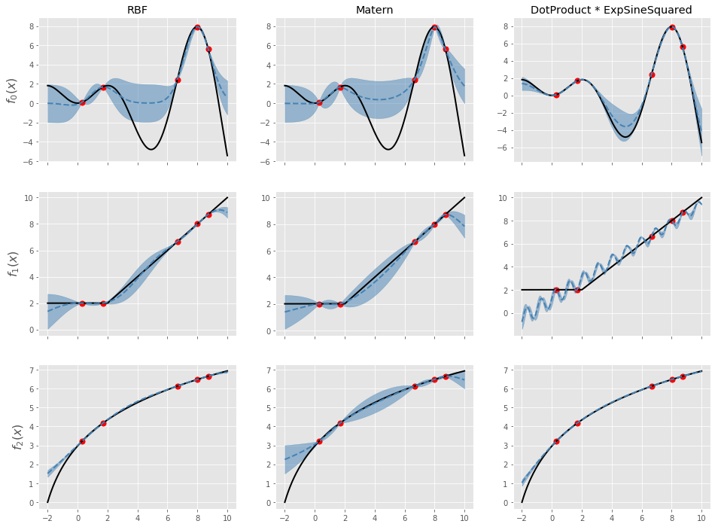
Gaussian Process - Kernels

Slide 19
Bayesian Optimization
bayes_opt_example.ipynb

Slide 20


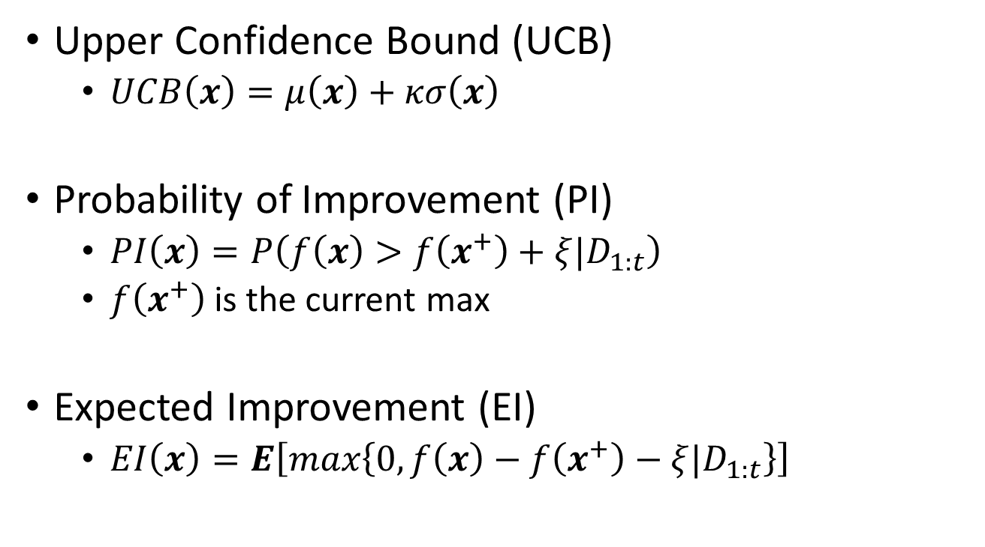
Utility Functions
Upper Confidence Bound (UCB)
$UCB\left(x\right)=μ\left(x\right)+κσ\left(x\right)$
Probability of Improvement (PI)
$PI\left(x\right)=P\left(f\left(x\right)>f\left(x^{+}\right)+ξ|D_{1:t}\right)$
$f\left(x^{+}\right)$is the current max
Expected Improvement (EI)
$EI\left(x\right)=E\left[max\left\{0,f\left(x\right)−f\left(x^{+}\right)−ξ{|D}_{1:t}\right\}\right]$

Slide 21
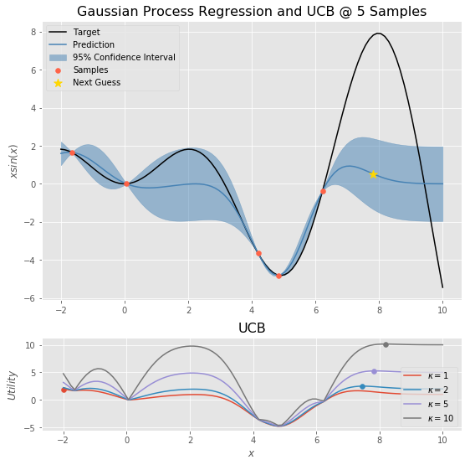
Utility Functions

Slide 22
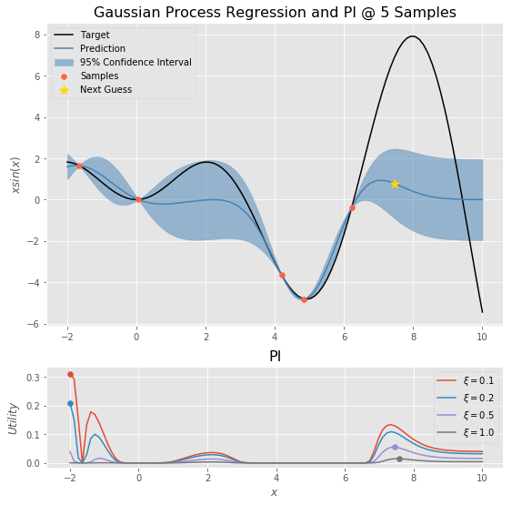
Utility Functions

Slide 23
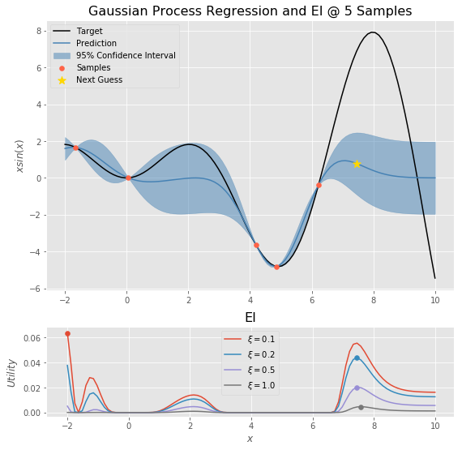
Utility Functions

Slide 24
Limitations
Overhead
Retrain Gaussian process regressor every iteration
(Hyper)-Hyperparameters
Kernel choice
Scaling
Noise level
Sequential (traditionally)
Smarter initialization
Efficient sampling
Bounds
Not unique to Bayesian Optimization

Slide 25
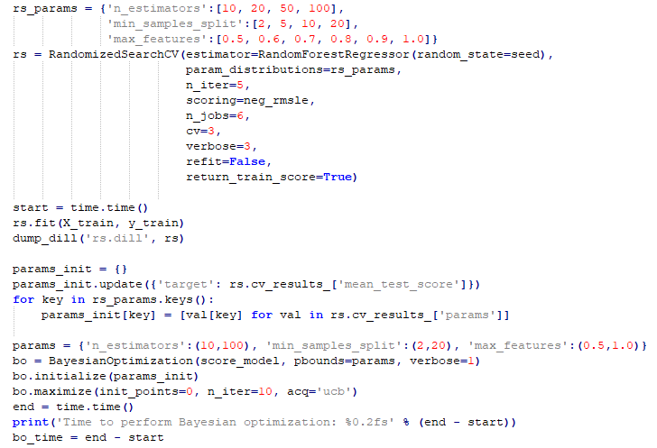
Efficient Initialization

Slide 26
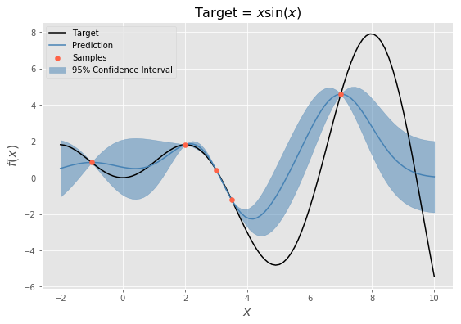
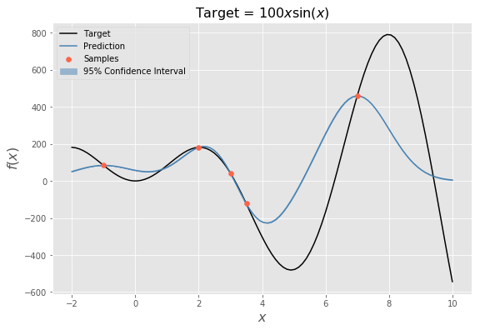
Scaling issues
Large variances in target values greatly affect standard deviation estimates

Slide 27
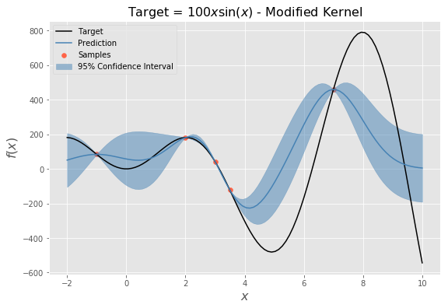
Scaling issues

Slide 28
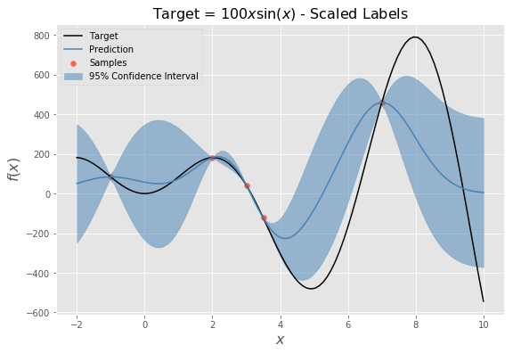
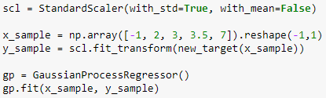

Scaling issues

Slide 29
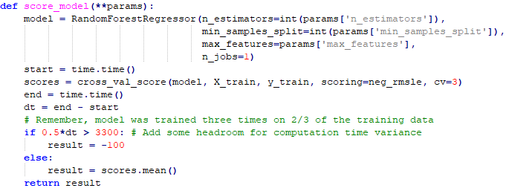
Modified Target Functions
Add additional constraints to the scoring method (target)
Mercari challenge limitation
All training must be completed within a Kaggle kernel

Slide 30


Questions?
Jason King
jkkphys@gmail.com

Slide 31
Resources
Machine Learning: Nando de Freitas @ UBC
Introduction to Gaussian processes
Regression with Gaussian processes
Bayesian optimization and multi-armed bandits
Gaussian Processes for Machine Learning
Carl Edward Rasmussen and Christopher K. I. Williams
A Tutorial on Bayesian Optimization of Expensive Cost Functions, with Application to Active User Modeling and Hierarchical Reinforcement Learning
Eric Brochu, Vlad M. Cora, and Nando de Freitas
Scikit-learn: Gaussian Processes

