Slide 1
A Practical Guide to Bayesian Optimization
Jason King, PhD
Data Scientist, XSOLIS

Slide 2
What led me to Bayesian Optimization?
Like many of you, I compete in Kaggle competitions
For whatever reason, GBMs tend to be the most popular model types
Significantly more hyperparameters to consider compared to GLMs

Slide 3
Hyperparameter comparison
Linear Regression:
fit_intercept, normalize
Ridge:
alpha, fit_intercept, normalize, solver, max_iter
Decision Tree:
criterion, splitter, max_depth, min_samples_split, min_samples_leaf, min_weight_fraction_leaf, max_features, max_leaf_nodes, min_impurity_split, min_impurity_descrease, presort
Random Forest:
above, n_estimators, bootstrap

Slide 4
Hyperparameter comparison
XGBoost:
booster, eta, gamma, max_depth, min_child_weight, max_delta_step, subsample, colsample_bytree, colsample_bylevel, lambda, alpha, tree_method, sketch_eps, scale_pos_weight, updater, refresh_leaf, process_type, grow_policy, max_leaves, max_bin, objective, base_score
Neural Networks:
∞ (get a grad student!)

Slide 5
Hyperparameter tuning strategies
Grid (naïve)
Insert image here
Random
Insert image here
Subsampling
Insert image here

Slide 6
Zillow Prize
High-cost training
Started seeing a lot of chatter about a smarter automated tuning method
Learning the hyperparameter space
A number of Python implementations
Metric Optimization Engine (MOE)
Bayesian Optimization
Hyperopt
Relatively straightforward to implement in my code
Still required a bounded range to search over
Took less iterations, and new models performed better

Slide 7
Objectives
Learn how to implement Bayesian Optimization in your code
Understand the underlying mechanism
Discuss the limitations of the technique
Explore some extended use cases

Slide 8
Simple Regression

Slide 9
Simple Classification

Slide 10
Mercari Price Suggestion

Slide 11
Gaussian Process
A gaussian process uses lazy learning and a measure of similarity between points (kernel function) to predict the value for unseen points
Given a black box function/process, we can obtain a few samples and generate a predicted function with uncertainty
This enables derivative-free optimization
More importantly, if sampling the target function is expensive, we can reduce overall cost

Slide 12
Gaussian Process

Slide 13
Gaussian Process

Slide 14
Bayesian Optimization

Slide 15
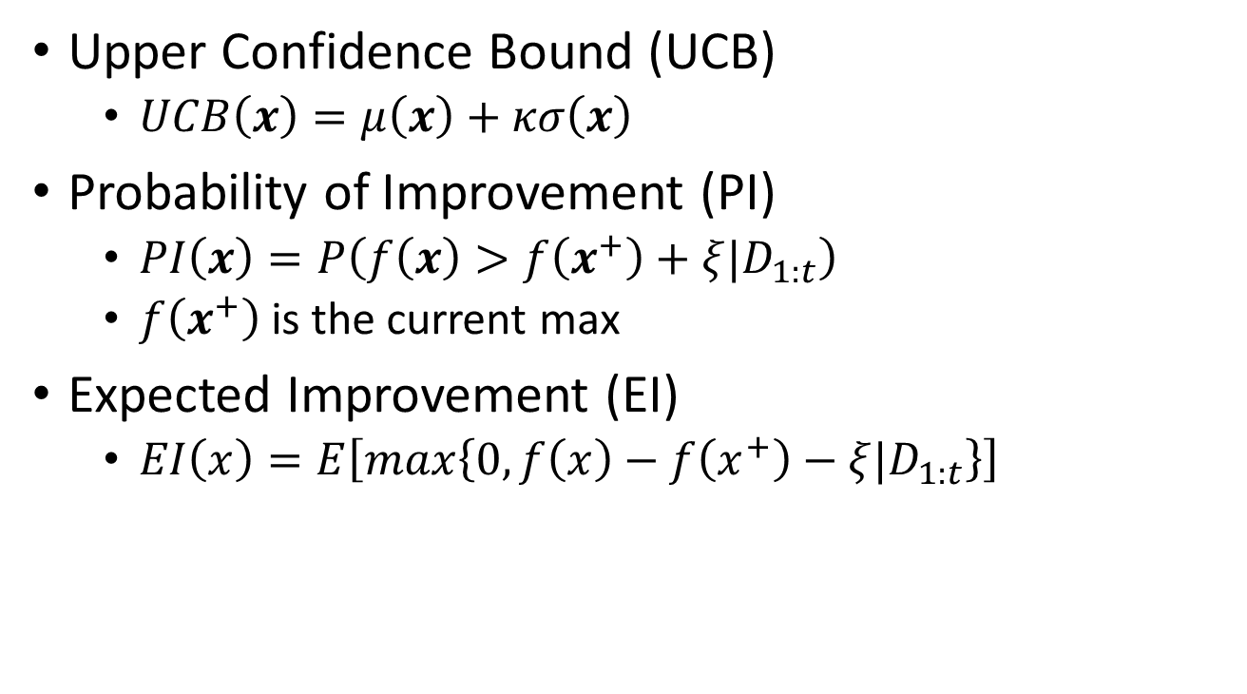
Utility Functions
Upper Confidence Bound (UCB)
$UCB\left(x\right)=μ\left(x\right)+κσ\left(x\right)$
Probability of Improvement (PI)
$PI\left(x\right)=P\left(f\left(x\right)>f\left(x^{+}\right)+ξ|D_{1:t}\right)$
$f\left(x^{+}\right)$is the current max
Expected Improvement (EI)
$EI\left(x\right)=E\left[max\left\{0,f\left(x\right)−f\left(x^{+}\right)−ξ{|D}_{1:t}\right\}\right]$

Slide 16
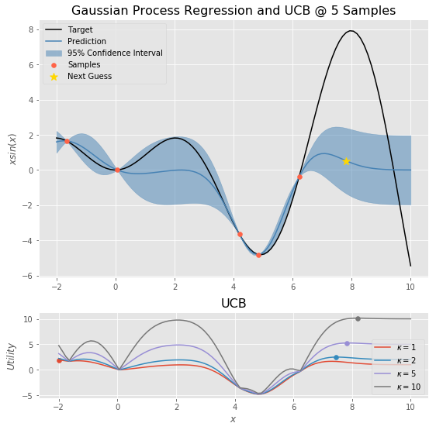
Utility Functions

Slide 17
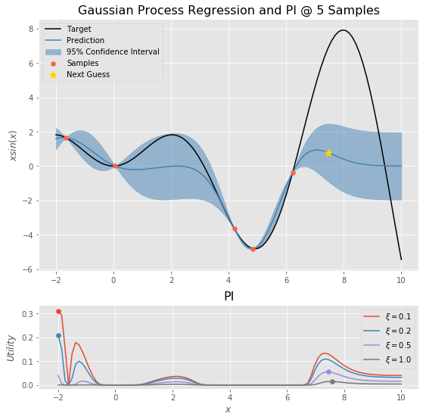
Utility Functions

Slide 18
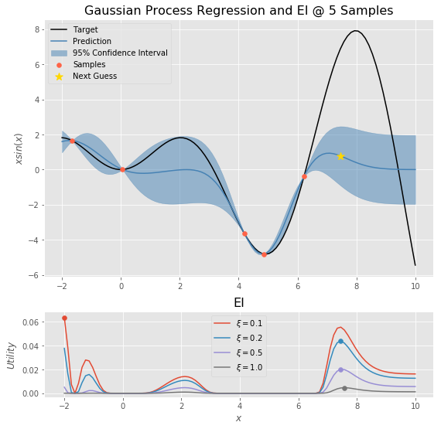
Utility Functions

Slide 19
Limitations
Overhead
Lazy learner
Retrain Gaussian process regressor every iteration
(Hyper)-Hyperparameters
Kernel choice
Scaling
Sequential
Smarter initialization
Parallel batches
Bounds
Not unique to Bayesian Optimization

Slide 20
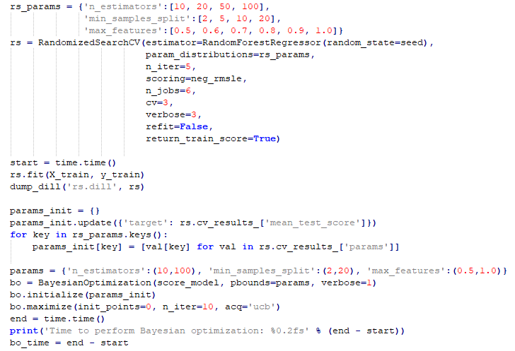
Efficient Initialization

Slide 21
Target Scaling

Slide 22
Modified utility functions
Wrapper function for score to encompass additional constraints

Slide 23
Recap
Knobs

