Slide 1
Fake News Detection
Proposal

Slide 2
Introduction & Motivation
“Our research has shown that the media play a facilitating role – in the easing through of policy action by repetition and reinforcement of media messages, and the absence of proposed alternatives – and also a possible role in shaping behaviour, especially where these are linked to other types of structural support.” ──by Journal of Social and Political Psychology
source: https://jspp.psychopen.eu/article/view/96/37

Slide 3

Background
Fake news has been around for a long time, and has gained notoriety during the recent presidential elections in America, whereby Mark Zuckerberg, CEO of Facebook, made the following claim, "I regret saying fake news on Facebook did not impact the 2016 US presidential election". Clearly, Fake News is becoming more of a problem for Society.
Fake news is inherently detrimental to Society, and we feel that we should do our part in the efforts to combat fake news.

Slide 4
Scenario
With the advent of Social Media and new media outlets with an ever-increasing consumer base for information shared or published on these networks, it has now become more important than ever to be able to quickly identify and prevent the spread of fake news.
However the detection of fake news is still in it’s infancy, and has yet to be resolved.

Slide 5
Problem
In this project, we plan to explore the use of different Artificial Intelligence methods to evaluate the truthfulness of a given article/statement.
In particular, we are interested in determining the usefulness of Convolutional Neural Network (CNN) and Recurrent Neural Networks (RNN) in identifying fake news based on the fake news data set we have obtained from Kaggle and other sources.

Slide 6
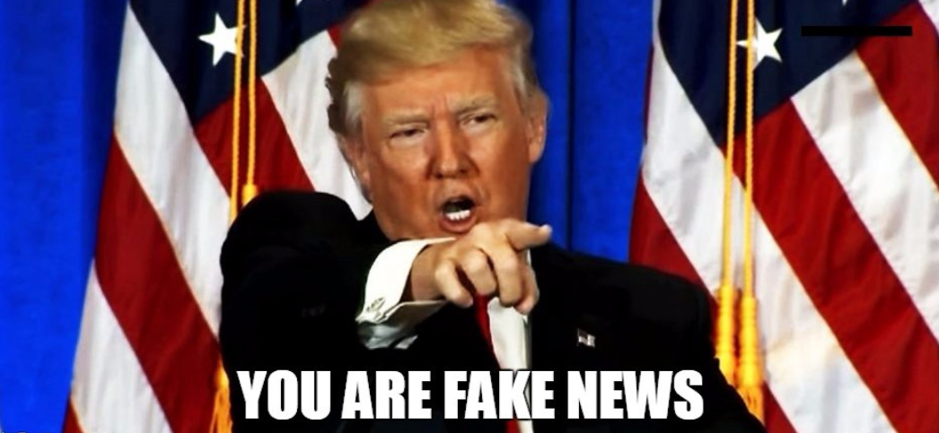
Proposed Idea
We plan to use the following attributes in our CNN/RNN model to provide various classifications to the inputs given to the model :
title
content
source web site
language
author
From the input given to our CNN/RNN model, we plan to provide a confidence score indicating how authentic the model believes the input to be, and classify the input given to our model into the following classifications :
fake
satire
bias
conspiracy
rumor
state
source country
reply counts
shared counts
likes counts
junk science
hate group
clickbait
cautious
good news

Slide 7
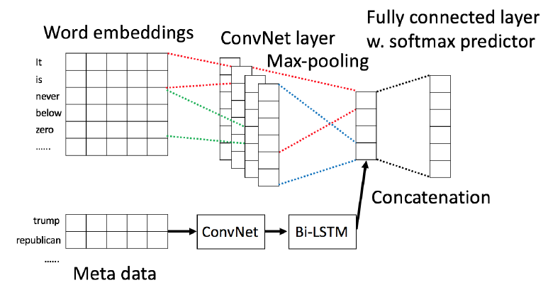
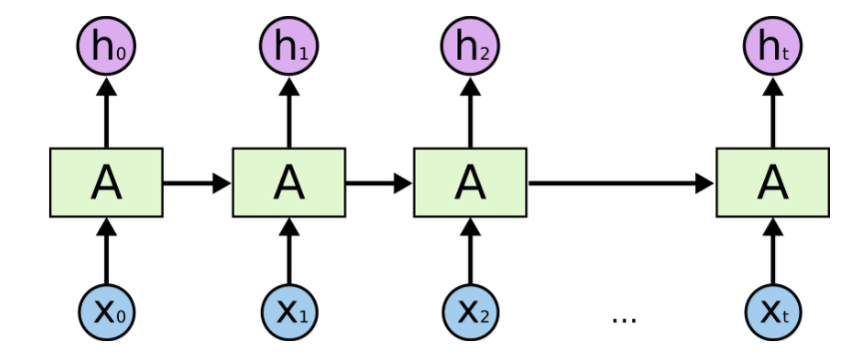
Proposed Idea (Cont.)
We will focus on United States Presidential Election news. Using a set of test data that we have labelled manually or extracted from the original training dataset that was not used for training. By doing multiple classification problem, we will test the performance of both the CNN and RNN model and compare the effectiveness of the different models.

Slide 8
Reference
https://www.youtube.com/watch?v=fZ2VS-Okju8
https://towardsdatascience.com/fake-news-classifier-e061b339ad6c
https://www.cs.ucsb.edu/~william/papers/acl2017.pdf
http://www.fakenewschallenge.org/
Notes:
CNN / LSTM / SVM

