Slide 1

NTU S²H Home Project
Platform 2.0 : 運作理論
Chun-Feng Liao (try)
cfliao@ieee.org

Slide 2
訊息導向程式設計模型
所有應用程式都由二個動作組成
  從Topic接收並處理訊息
  向Topic丟出訊息
INPUT TOPIC
Message
OUTPUT TOPIC

Slide 3
Node-Bus-Node Model
Node
Node
Node
Node
Node
Node
Home Message Bus
Notes:
Node 透過Hmb上的Topic交換訊息

Slide 4


Message Delivery
Message Sender
Topic A
Topic B
Node
Message Processor

Slide 5
Node Lifecycle
Dormant
Rest
Activate
Active
Shutdown
Activate
Shutdown
Installed

Slide 6

Node 管理員
Node
管理Node的Lifecycle
Node Manager

Slide 7
Node Container
Node及NodeManager的關連
啟動Node及其相對應的NodeManager
網路連線管理
Node
Container
Node
Node
Manager

Slide 8

Node Runner
啟動Node的工具類別
處理和Spring Framework的介接
new AgentRunner("app-config.xml",
"container").execute();
Node Runner

Slide 10
BaseNode : 最基本的Node實作類別
實作內容
  Node的名稱: Name
  Node的狀態: NodeState

Slide 11
AgentNode: 可以收發訊息的Node
Message Dispatcher
Topic A
Topic B
AgentNode
Message Processor

Slide 12
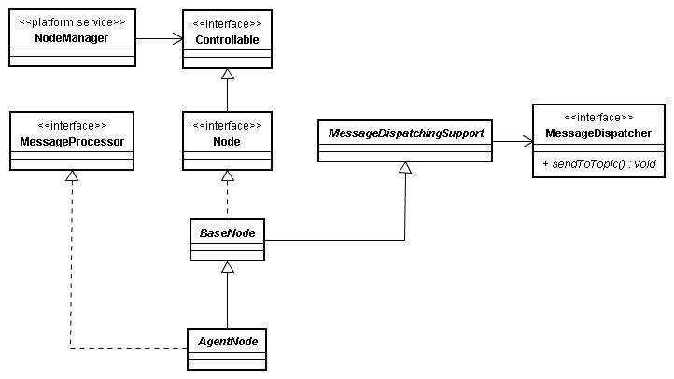
AgentNode

Slide 13
開發Agent的6個步驟
繼承AgentNode
透過建構子設定Agent名稱
實作processMessage()方法
處理生命周期方法
寫作app-config.xml
寫作main()

Slide 14
繼承AgentNode
public class DemoAgentNode extends AgentNode
{
…
}

Slide 15
透過建構子設定Agent名稱
public class DemoAgentNode extends AgentNode
{
public DemoAgentNode()
{
super(DemoAgentNode.class.getPackage().getName());
}
…
}

Slide 16
實作processMessage()方法
public class DemoAgentNode extends AgentNode
{
…
@Override
protected void processMessage(PlatformMessage message) {
String inMessage = message.getContent();
// 依接受的訊息處理邏輯 …
// 將處理結果發送出去
this.getMessageDispatcher().sendToTopic(…);
}
…
}

Slide 17
處理生命周期方法
@Override
protected void onStart()
{
}
@Override
protected void onStop()
{
}
@Override
protected void onShutdown()
{
}

Slide 18
寫作app-config.xml
<bean id="messageDispatcher" class="s2h.platform.messaging.JmsMessageDispatcher">
<property name="jmsTemplate" ref="commonJmsTemplate" />
</bean>
<bean id="demoAgentNode" class="s2h.demo.agentnode.DemoAgentNode">
<property name="messageDispatcher" ref="messageDispatcher" />
<property name="consumingTopic" value="RAW_DATA" />
</bean>
<bean id="nodeManager“ class="s2h.platform.NodeManager">
<property name="jmsFactory" ref="jmsFactory" />
<property name="control" ref="demoAgentNode" />
</bean>
<bean id="container“ class="s2h.platform.AgentNodeContainer">
<property name="jmsFactory" ref="jmsFactory" />
<property name="manager" ref="nodeManager" />
<property name="agentNode" ref="demoAgentNode" />
</bean>

Slide 19
寫作main()
public static void main(String[] args)
{
new AgentRunner("app-config.xml", "container").execute();
}

Slide 20
寫作app-config.xml (revisited)
<bean id="messageDispatcher" class="s2h.platform.messaging.JmsMessageDispatcher">
<property name="jmsTemplate" ref="commonJmsTemplate" />
</bean>
<bean id="demoAgentNode" class="s2h.demo.agentnode.DemoAgentNode">
<property name="messageDispatcher" ref="messageDispatcher" />
<property name="consumingTopic" value="RAW_DATA" />
</bean>
<bean id="nodeManager“ class="s2h.platform.NodeManager">
<property name="jmsFactory" ref="jmsFactory" />
<property name="control" ref="demoAgentNode" />
</bean>
<bean id="container“ class="s2h.platform.AgentNodeContainer">
<property name="jmsFactory" ref="jmsFactory" />
<property name="manager" ref="nodeManager" />
<property name="agentNode" ref="demoAgentNode" />
</bean>

Slide 21
需要修改的地方
<bean id="messageDispatcher" class="s2h.platform.messaging.JmsMessageDispatcher">
<property name="jmsTemplate" ref="commonJmsTemplate" />
</bean>
<bean id=“agentNode" class="s2h.demo.agentnode.DemoAgentNode">
<property name="messageDispatcher" ref="messageDispatcher" />
<property name="consumingTopic" value="RAW_DATA" />
</bean>
<bean id="nodeManager“ class="s2h.platform.NodeManager">
<property name="jmsFactory" ref="jmsFactory" />
<property name="control" ref=“agentNode" />
</bean>
<bean id="container“ class="s2h.platform.AgentNodeContainer">
<property name="jmsFactory" ref="jmsFactory" />
<property name="manager" ref="nodeManager" />
<property name="agentNode" ref=“agentNode" />
</bean>

Slide 22
Advanced Topics
傳送格式: JSON
工具: Hermes JMS及HMB Shell

Slide 23




報告結束
謝謝大家!

