Slide 1




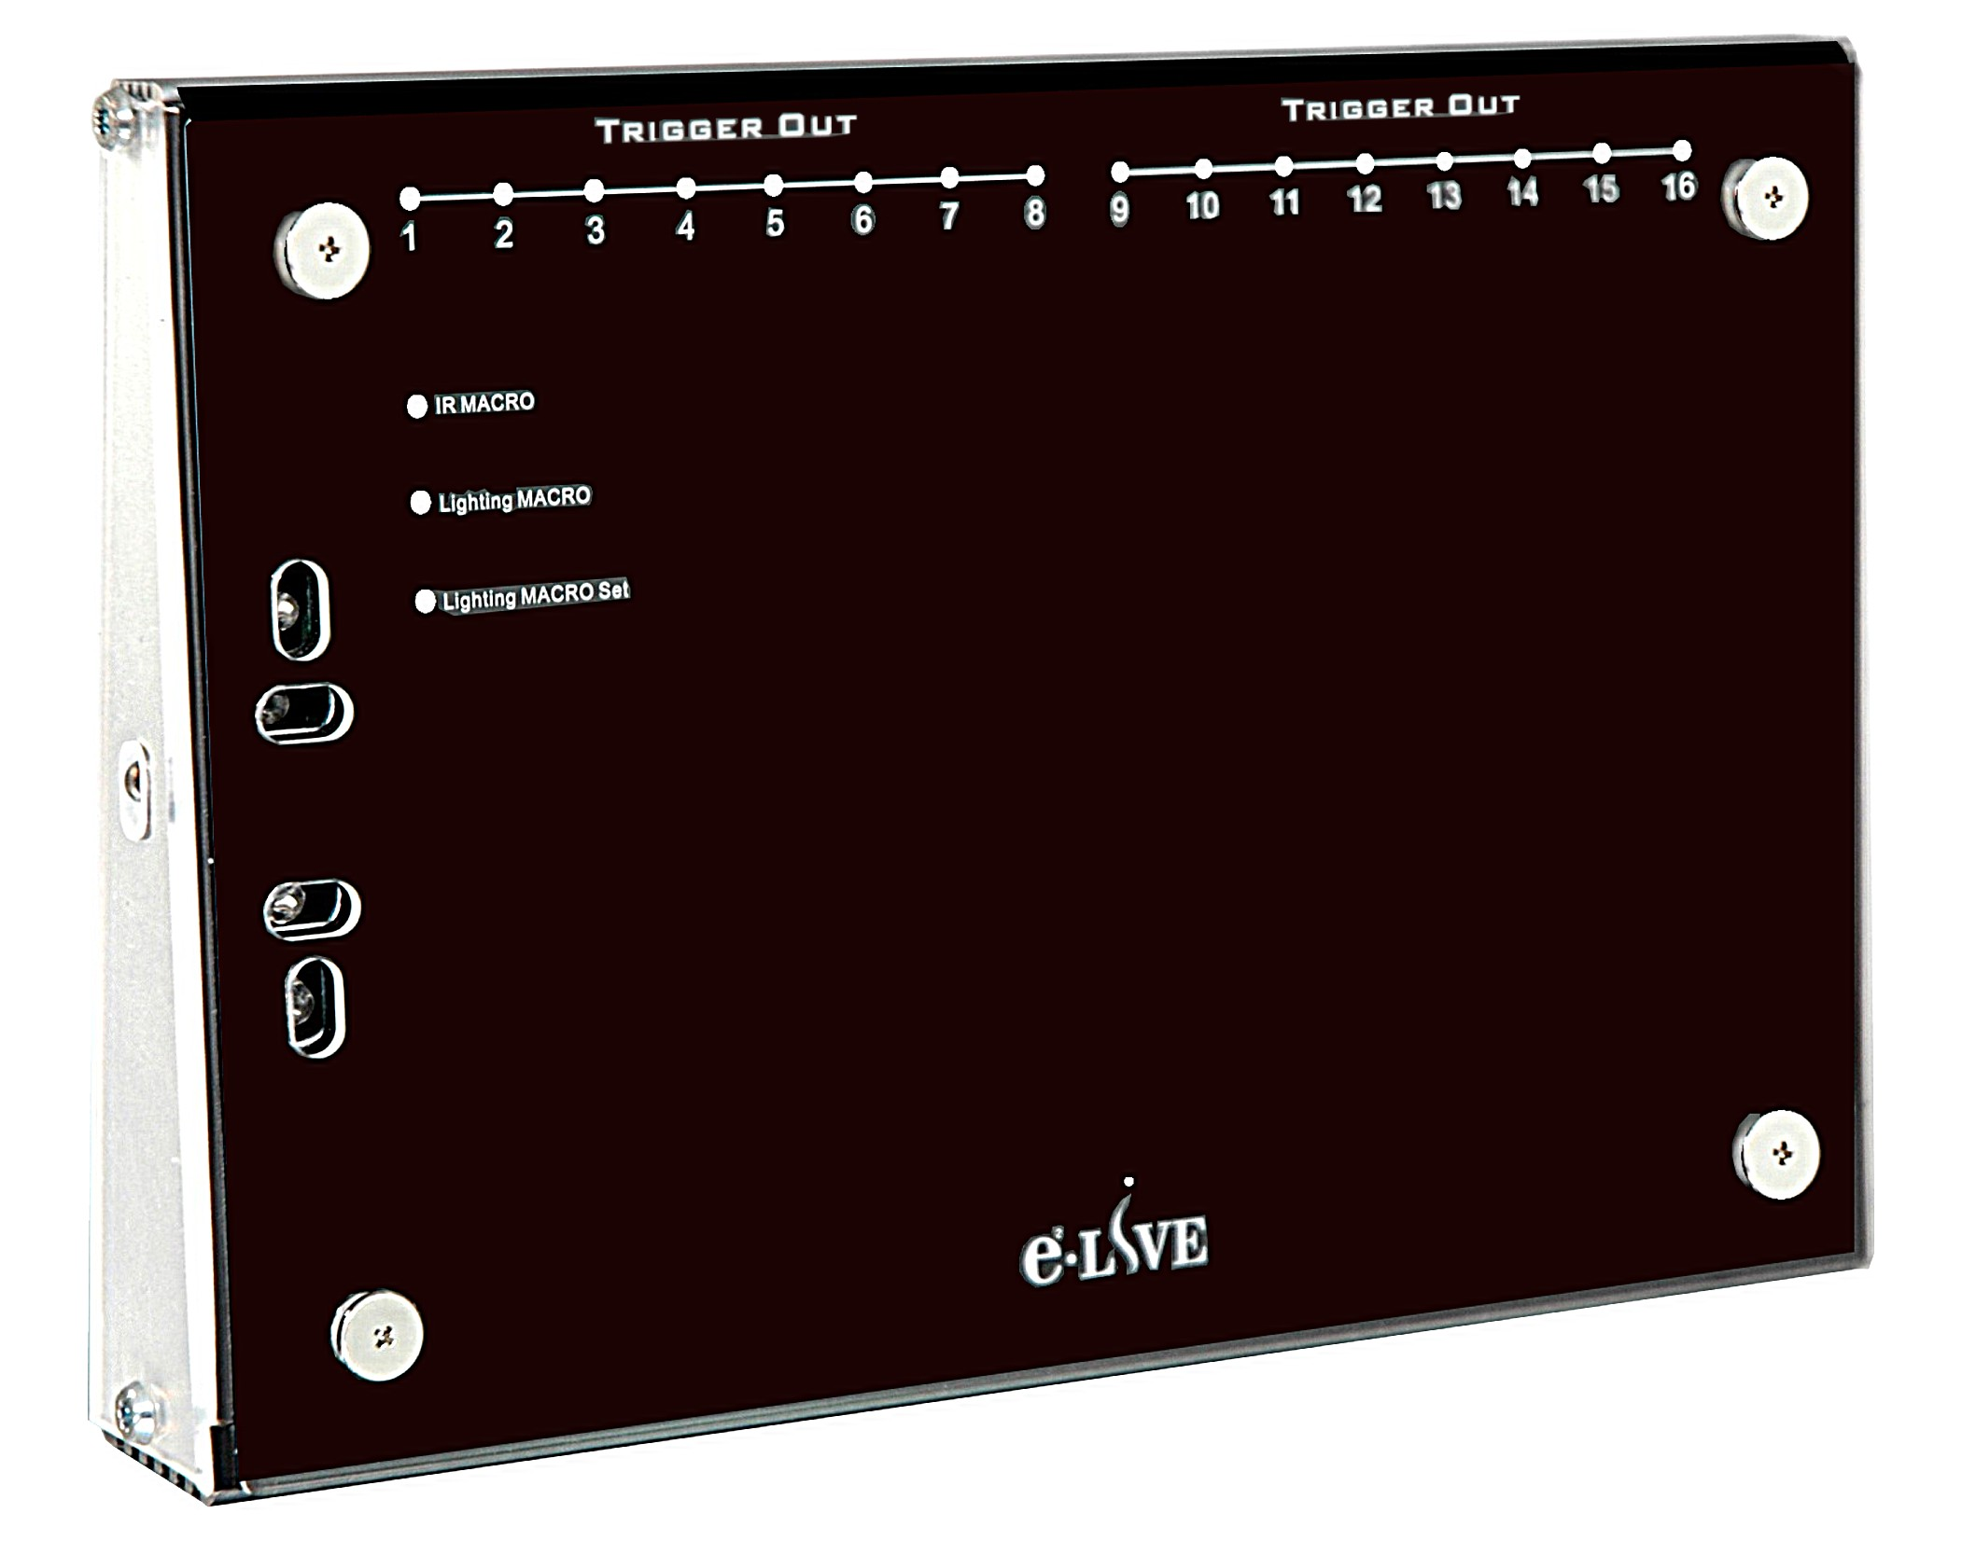
BL313
BL313 Attentive Home
Middleware
Appliances
{“value”:”MY_COMMAND”}
Message Queue
User
Program
Home Appliance
Controller
…
HC-12

Slide 2
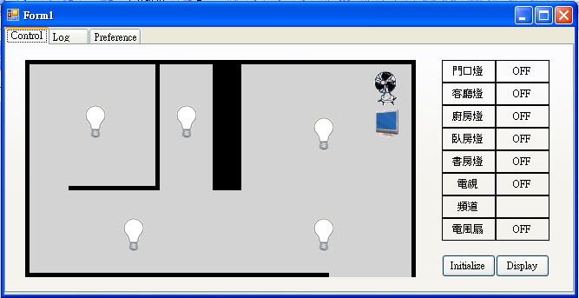
Simulator
Middleware
Simulator
{“value”:”MY_COMMAND”}
Message Queue
User
Program
Home Appliance
Controller
…

Slide 3
BL313 Attentive Home
Middleware
Appliances
{“value”:”MY_COMMAND”}
Message Queue
User
Program
Home Appliance
Controller
…
HC-12
Middleware
Simulator
{“value”:”MY_COMMAND”}
Message Queue
User
Program
Home Appliance
Controller
…

Slide 4
Benefits
Developers can debug anywhere using PC or laptop
Developers can test their code simultaneously
Separation of concerns (HW / SW)

Slide 6
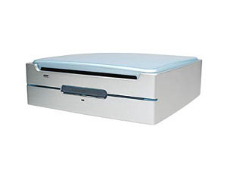

分散式機器時間不一致，校時十分費時
必須一台一台取得資料，並加以整合
資料難以整理、過濾
難以做到Real-time processing
Sensor
Program
Text File
Sensor
Program
User
Program
Text File
Sensor
Program
Text File

Slide 7
Sensor
Program
Sensor
Program
Middleware
Measurement
Persister
Message Queue
Sensor
Program
Home Appliance
Controller
…
Context
Database
Sensor
Program
SQL
User
Program

