Slide 1

Employee Attrition Analysis
Business Question: “Which organizational and employee factors are most significantly correlated with employee attrition, and how can we effectively predict and mitigate future turnover?”
Dataset: ~6,000 employees, 36 features (demographics, compensation, satisfaction, tenure, overtime)
Models Compared: Logistic Regression vs. Random Forest

Slide 2
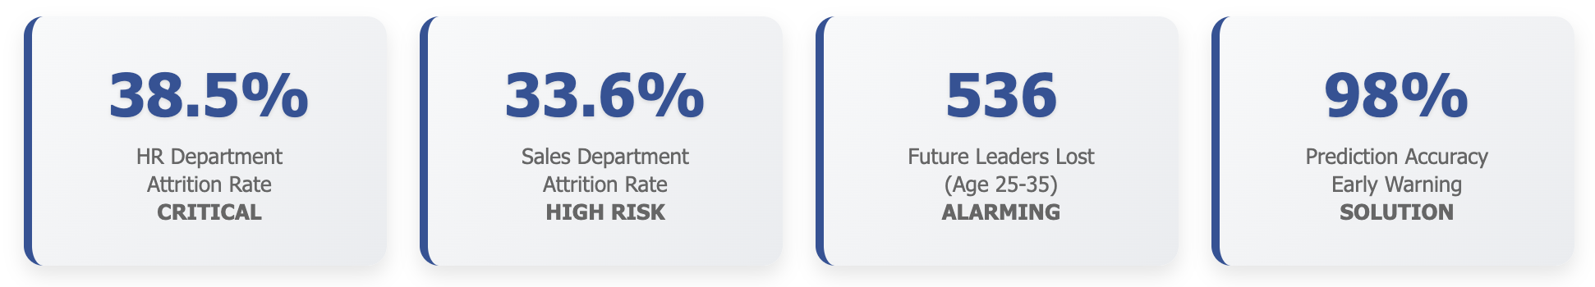
HR Turnover Crisis
29.62% Annual Turnover Rate
1,789 employees lost • $2.4M+ replacement costs • 3 out of 10 employees leaving
Counter-Intuitive Discovery
Employees who left earned $1,337 MORE monthly than those who stayed. Retention isn't about money alone.
Performance Rating Dominates
Single strongest predictor (0.386 correlation). Performance management is our highest-impact intervention point.

Slide 3
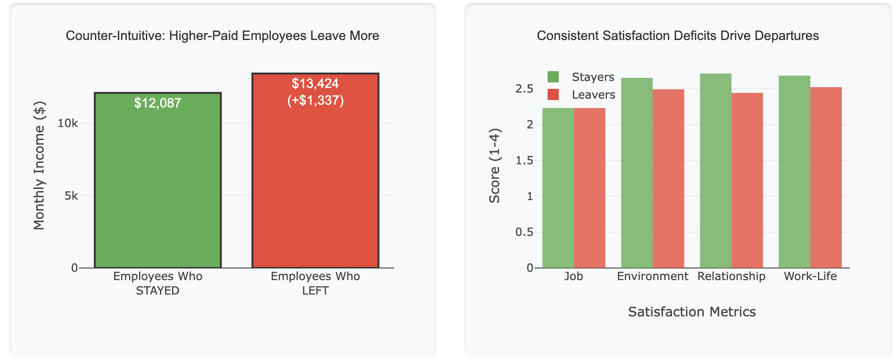
Root Cause Analysis
Root Cause Analysis: Why Our Best People Leave
Geographic Factor: 5.9 miles farther average commute for employees who left. Work-life balance matters more than compensation.
Relationship Quality: Management training is essential.
Career Stagnation: 1.7 years longer since last promotion for departing employees. Career progression is critical.
Critical Roles at Risk: 307 Sales Executives and 293 Lab Technicians lost.

Slide 4
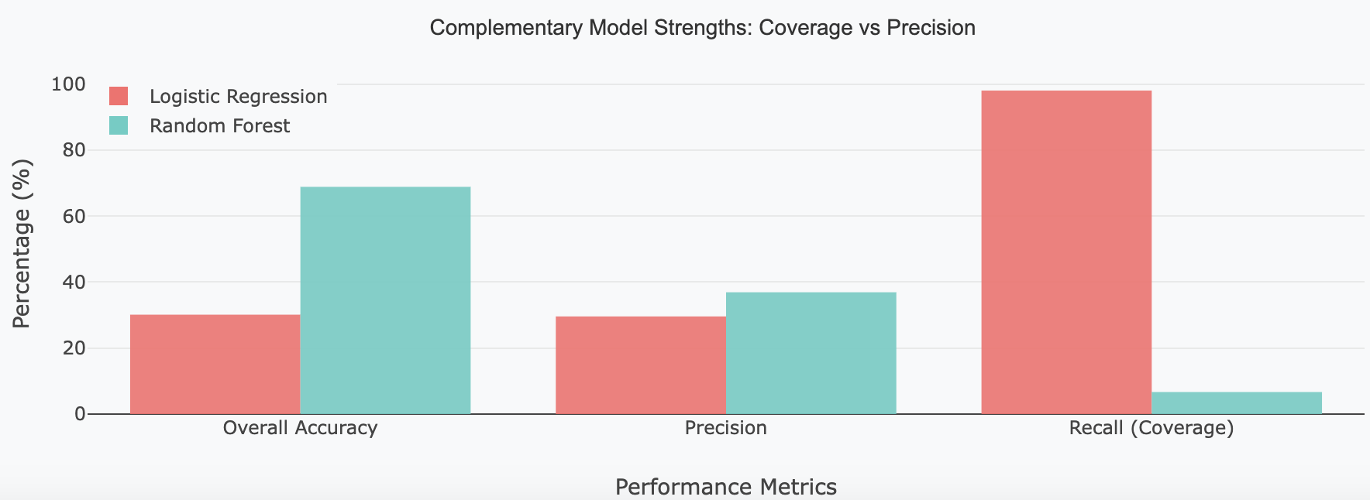
Predictive Analytics: Two-Model Approach
Early Warning System
98.05% Recall Rate
Logistic Regression Model
• Identifies 98 out of 100 potential leavers
• Monthly screening capability
• Proactive intervention trigger
• Use for: Comprehensive at-risk identification
Strategic Planning Tool
68.87% Overall Accuracy
Random Forest Model
• Reliable predictions for resource allocation
• Conservative, high-confidence targeting
• Investment-grade accuracy
• Use for: Retention bonus decisions

Slide 5
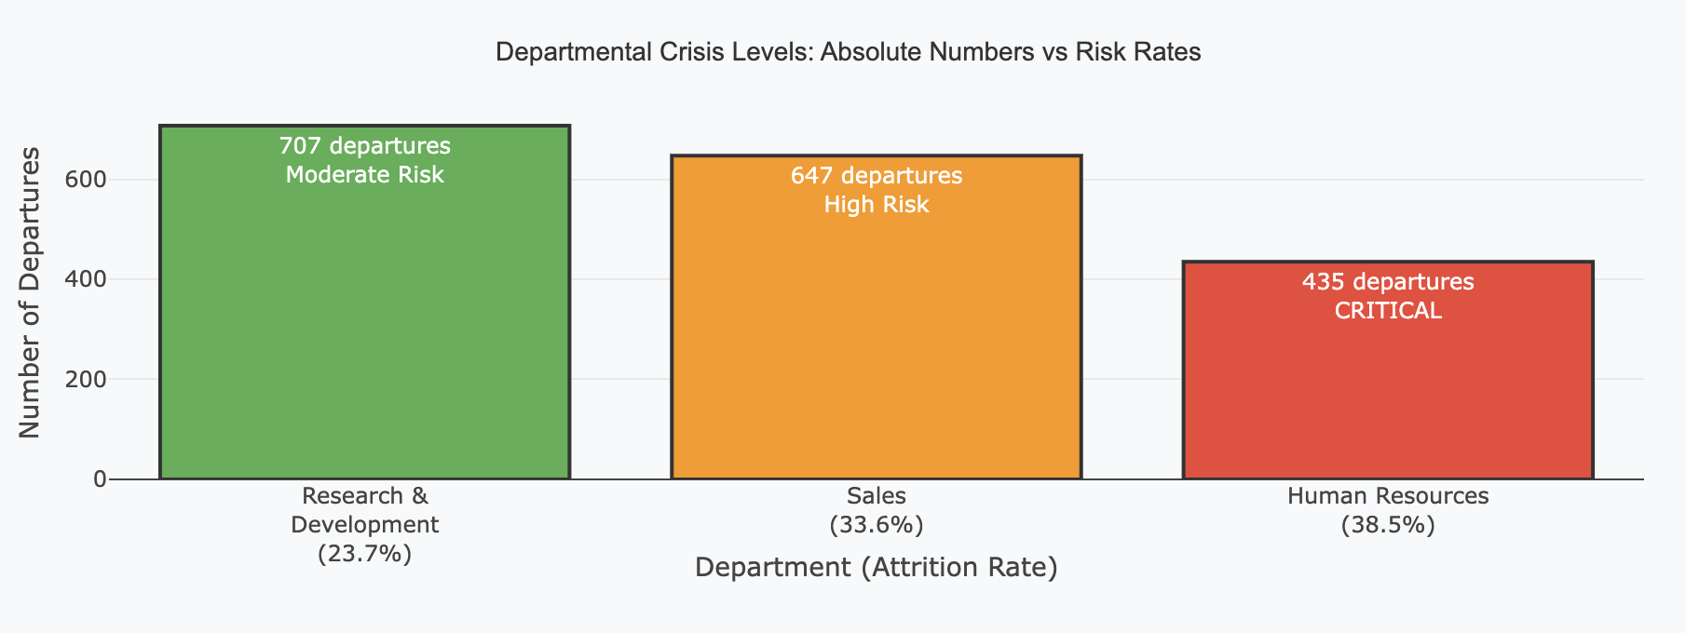
Action Plan
Immediate Actions (0-3 months)
Emergency HR retention program (38.5% crisis)
Performance management overhaul
Geographic flexibility for 20+ mile commuters
Deploy early warning system (98% accuracy)
Strategic Initiatives (3-12 months)
Accelerate promotions: 6.1 → 4.4 year average
Management relationship training
Department-specific retention programs
Predictive analytics dashboard

