Slide 1
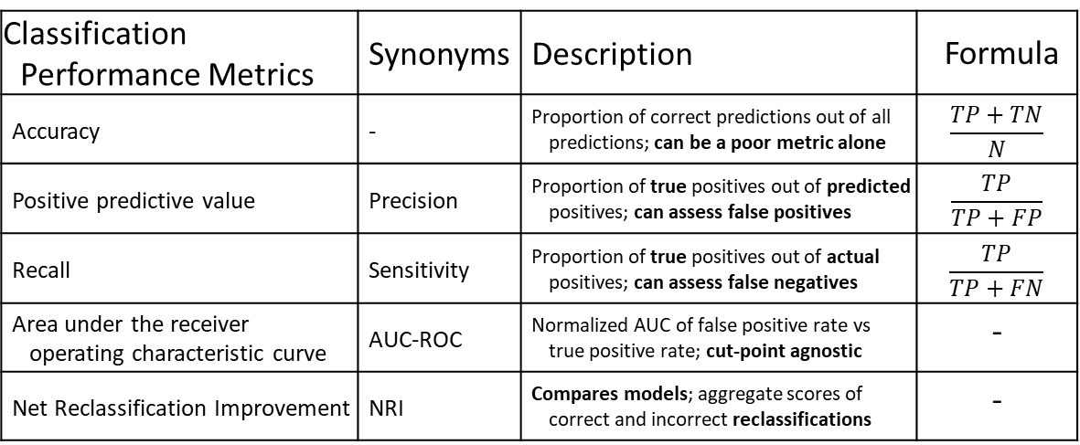
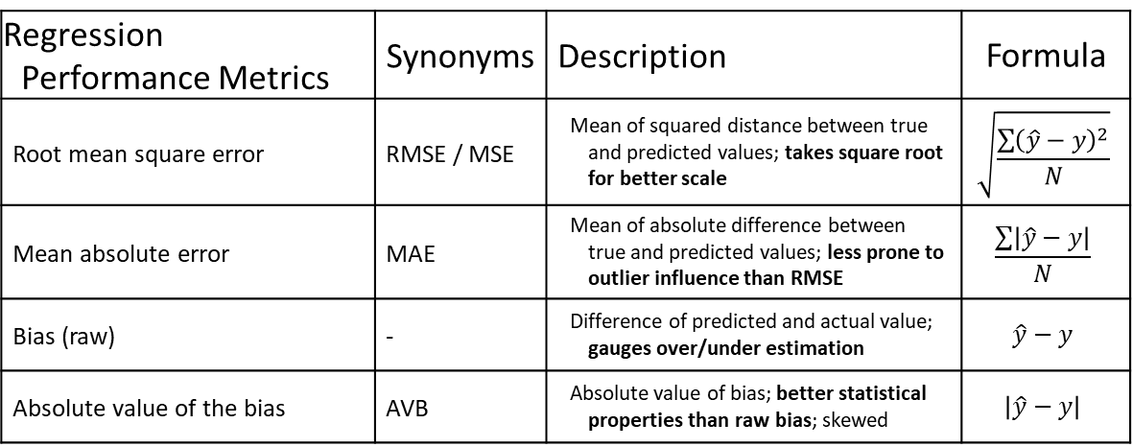
Regression Performance Metrics | Synonyms | Description | Formula
Root mean square error | RMSE / MSE | Mean of squared distance between true and predicted values; takes square root for better scale | $$\sqrt{\frac{\sum{{\left(\hat{y}−y\right)}^{2}}}{N}}$$
Mean absolute error | MAE | Mean of absolute difference between true and predicted values; less prone to outlier influence than RMSE | $$\frac{\sum{\left|\hat{y}−y\right|}}{N}$$
Bias (raw) | - | Difference of predicted and actual value; gauges over/under estimation | $$\hat{y}−y$$
Absolute value of the bias | AVB | Absolute value of bias; better statistical properties than raw bias; skewed | $$\left|\hat{y}−y\right|$$
Classification Performance Metrics | Synonyms | Description | Formula
Accuracy | - | Proportion of correct predictions out of all predictions; can be a poor metric alone | $$\frac{TP+TN}{N}$$
Positive predictive value | Precision | Proportion of true positives out of predicted positives; can assess false positives | $$\frac{TP}{TP+FP}$$
Recall | Sensitivity | Proportion of true positives out of actual positives; can assess false negatives | $$\frac{TP}{TP+FN}$$
Area under the receiver operating characteristic curve | AUC-ROC | Normalized AUC of false positive rate vs true positive rate; cut-point agnostic | -
Net Reclassification Improvement | NRI | Compares models; aggregate scores of correct and incorrect reclassifications | -

