Slide 1
Board Pack
Client: cce2ad28-e9bd-4718-a7e1-03f827e14125
Period: Dec 2025

Slide 2
1. Executive Summary
Key KPIs
• Revenue (Dec 2025): A$12,000
• Burn (Dec 2025): A$49,075
• Cash in bank: A$262,925
• Runway (forward-looking): 4.0 months
• Effective burn (avg): A$43,075 / month
Key risks
• No high / critical risks currently flagged.
Key opportunities
• Focus on executing pipeline and improving collections.
Executive commentary
• Revenue: Money in is up by 12,000 vs last month.
• Burn: Money out is up by 49,075 vs last month.
• Cash: Cash in bank is higher by 262,925 vs last month.
• Runway: Runway is about the same as last month.
• Cash **increased** this month. Runway is **tight**, around 4.0 months. The main driver was **financing activity** – equity raises, loan drawdowns/repayments or dividends. Part of this looks like a **one-off investing move** (not a recurring monthly pattern). There is also a **financing impact** this month (funding or repayments). Priority should be **extending runway** – review hiring pace, contractor spend and large supplier costs.

Slide 3
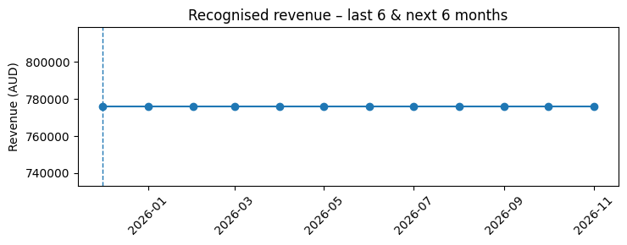
2. Revenue Summary – Sales & Deals
Key numbers
• Latest month recognised revenue: A$776,000
• Next 6 months forecast total: A$4,656,000
• Total pipeline: A$14,012,000
• Weighted pipeline: A$9,306,000
• Pipeline quality (weighted/gross): 66.4%
Revenue commentary
• Recent revenue plus weighted pipeline gives visibility into the next 3–6 months.
• Check if the forecast is driven by a few large deals – monitor conversion risk.
• Consider whether pipeline coverage is at least 3× your target revenue.

Slide 4
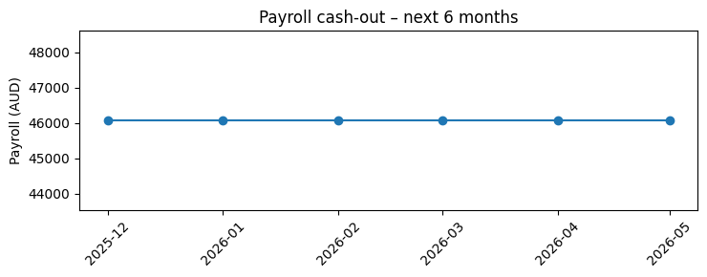
3. Team & Spending
Key numbers
• Average monthly payroll (next 6 months): A$46,075
• Payroll as % of current revenue: 384%
• Active headcount this month: 3.0 FTE
Team & opex commentary
• Check whether payroll growth is in line with revenue growth.
• Identify any high-cost roles that are not clearly linked to revenue or product milestones.
• Review departments that are consistently over budget.

Slide 5
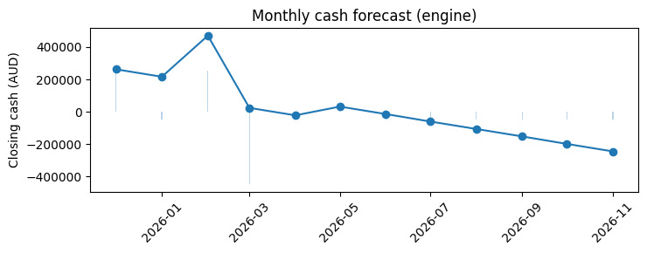
4. Cash Position & Cash Forecast
Key numbers
• Cash today: A$262,925
• Cash cliff (engine): 01 Apr 2026
• AR outstanding: A$17,000
• AP outstanding: A$3,000
• Net working capital (AR – AP): A$14,000
Cash commentary
• Cash cliff expected around Apr 2026 if no changes are made.
• If cash cliff is within 6–9 months, begin funding or cost-reduction planning now.
• Use AR and AP levers (collections, payment terms) before cutting critical growth spend.

Slide 6
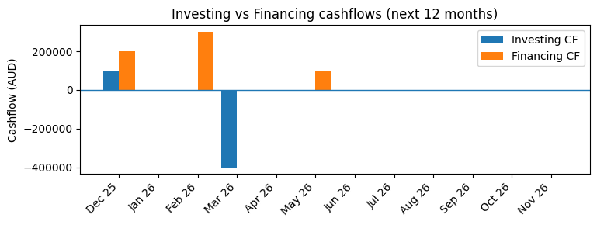
5. Funding Strategy – Investing & Financing
Funding snapshot
• Current closing cash: A$262,925
• Runway (forward): 4.0 months
• Effective burn: A$43,075 / month
• Target runway: 12 months
• Funding required (gap): A$253,975
Board commentary
• Runway is ~4.0 months based on the forward cash forecast.
• Effective burn is ~A$43,075/month (next 3-month average).
• To reach 12 months runway, estimated funding required is A$253,975.
• Recommendation: align spend to runway target and begin raise prep now (metrics pack + pipeline + milestones).

Slide 7
6. Risks, Issues & Notes
Top risks & issues
• No major risks recorded – confirm this with the founder.

