Slide 1

William Stallings Computer Organization and Architecture 9th Edition
Notes:
Lecture slides prepared for “Computer Organization and Architecture”, 9/e, by William Stallings, Chapter 11 “Digital Logic”.

Slide 2
Chapter 11
Digital Logic
Notes:
The operation of the digital computer is based on the storage and processing of binary data. Throughout this book, we have assumed the existence of storage elements that can exist in one of two stable states and of circuits than can operate on binary data under the control of control signals to implement the various computer functions. In this chapter, we suggest how these storage elements and circuits can be implemented in digital logic, specifically with combinational and sequential circuits. The chapter begins with a brief review of Boolean algebra, which is the mathematical foundation of digital logic. Next, the concept of a gate is introduced. Finally, combinational and sequential circuits, which are constructed from gates, are described.

Slide 3
Boolean Algebra
Mathematical discipline used to design and analyze the behavior of the digital circuitry in digital computers and other digital systems
Named after George Boole
English mathematician
Proposed basic principles of the algebra in 1854
Claude Shannon suggested Boolean algebra could be used to solve problems in relay-switching circuit design
Is a convenient tool:
Analysis
It is an economical way of describing the function of digital circuitry
Design
Given a desired function, Boolean algebra can be applied to develop a simplified implementation of that function
Notes:
2
The digital circuitry in digital computers and other digital systems is designed, and its behavior is analyzed, with the use of a mathematical discipline known as Boolean algebra. The name is in honor of an English mathematician George Boole, who proposed the basic principles of this algebra in 1854 in his treatise, An Investigation of the Laws of Thought on Which to Found the Mathematical Theories of Logic and Probabilities. In 1938, Claude Shannon, a research assistant in the Electrical Engineering Department at M.I.T., suggested that Boolean algebra could be used to solve problems in relay-switching circuit design [SHAN38]. Shannon’s techniques were subsequently used in the analysis and design of electronic digital circuits. Boolean algebra turns out to be a convenient tool in two areas:
• Analysis: It is an economical way of describing the function of digital circuitry.
• Design: Given a desired function, Boolean algebra can be applied to develop a simplified implementation of that function.

Slide 4
Boolean Variables and Operations
Makes use of variables and operations
Are logical
A variable may take on the value 1 (TRUE) or 0 (FALSE)
Basic logical operations are AND, OR, and NOT
AND
Yields true (binary value 1) if and only if both of its operands are true
In the absence of parentheses the AND operation takes precedence over the OR operation
When no ambiguity will occur the AND operation is represented by simple concatenation instead of the dot operator
OR
Yields true if either or both of its operands are true
NOT
Inverts the value of its operand
Notes:
3
As with any algebra, Boolean algebra makes use of variables and operations. In this case, the variables and operations are logical variables and operations. Thus, a variable may take on the value 1 (TRUE) or 0 (FALSE). The basic logical operations
are AND, OR, and NOT, which are symbolically represented by dot, plus sign, and overbar:
A AND B = A * B
A OR B = A + B
NOT A = Ā
The operation AND yields true (binary value 1) if and only if both of its operands are true. The operation OR yields true if either or both of its operands are true. The unary operation NOT inverts the value of its operand.
In the absence of parentheses, the AND operation takes precedence over the OR operation. Also, when no ambiguity will occur, the AND operation is represented by simple concatenation instead of the dot operator.

Slide 5
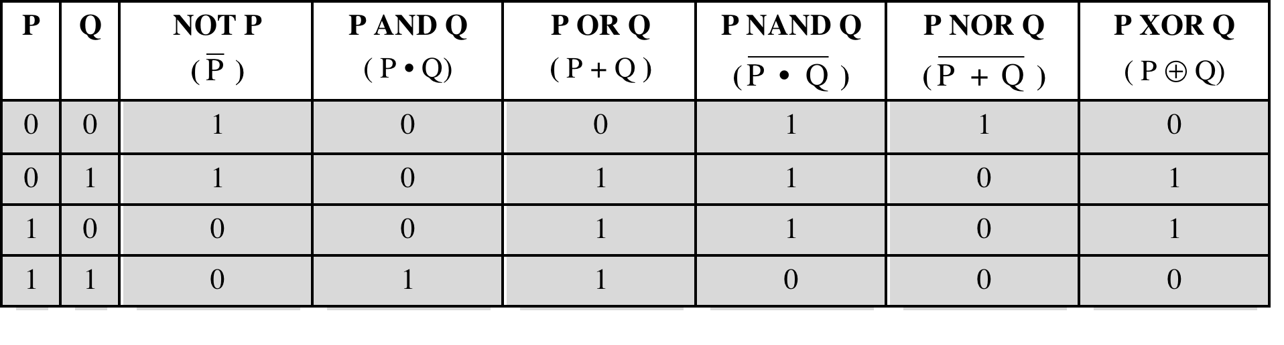
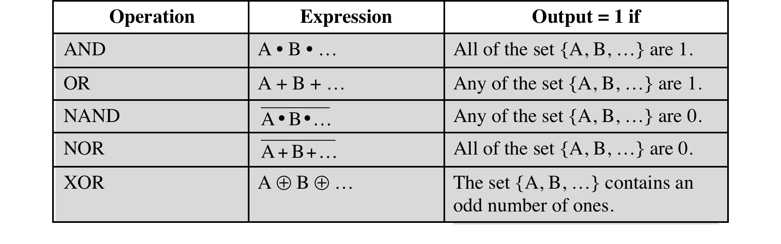
Table 11.1 Boolean Operators
(a) Boolean Operators of Two Input Variables
(b) Boolean Operators Extended to More than Two Inputs (A, B, . . .)
Notes:
4
Table 11.1a defines the basic logical operations in a form known as a truth table, which lists the value of an operation for every possible combination of values of operands. The table also lists three other useful operators: XOR, NAND, and NOR. The exclusive-or (XOR) of two logical operands is 1 if and only if exactly one of the operands has the value 1. The NAND function is the complement (NOT) of
the AND function, and the NOR is the complement of OR.
As we shall see, these three new operations can be useful in implementing certain digital circuits.
The logical operations, with the exception of NOT, can be generalized to more than two variables, as shown in Table 11.1b.

Slide 6
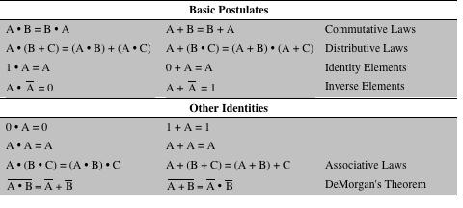
Table 11.2 Basic Identities of Boolean Algebra
Table 11.2 Basic Identities of Boolean Algebra
Notes:
4
Table 11.2 summarizes key identities of Boolean algebra. The equations have been arranged in two columns to show the complementary, or dual, nature of the AND and OR operations. There are two classes of identities: basic rules (or postulates), which are stated without proof, and other identities that can be derived from the basic postulates. The postulates define the way in which Boolean expressions are interpreted.
The two bottommost expressions are referred to as DeMorgan’s theorem.
The reader is invited to verify the expressions in Table 11.2 by substituting actual values (1s and 0s) for the variables A, B, and C.

Slide 7
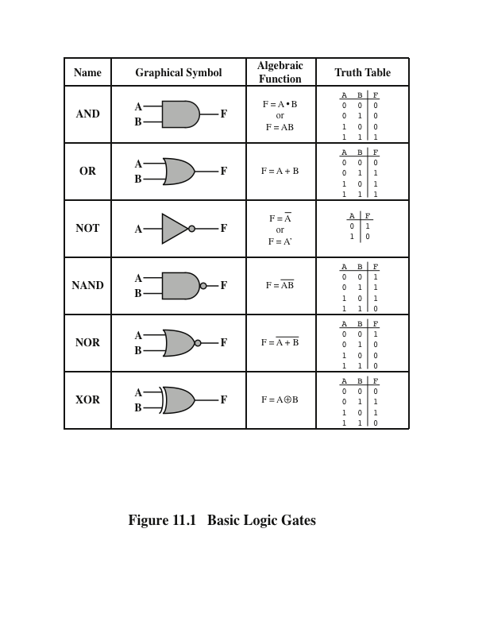
Basic Logic Gates
Notes:
The fundamental building block of all digital logic circuits is the gate. Logical functions are implemented by the interconnection of gates.
A gate is an electronic circuit that produces an output signal that is a simple Boolean operation on its input signals. The basic gates used in digital logic are AND, OR, NOT, NAND, NOR, and XOR. Figure 11.1 depicts these six gates. Each gate is defined in three ways: graphic symbol, algebraic notation, and truth table. The symbology used in this chapter is from the IEEE standard, IEEE Std 91. Note that the inversion (NOT) operation is indicated by a circle.
Each gate shown in Figure 11.1 has one or two inputs and one output. However, as indicated in Table 11.1b, all of the gates except NOT can have more than two inputs. Thus, (X + Y + Z) can be implemented with a single OR gate with three inputs. When one or more of the values at the input are changed, the correct output signal appears almost instantaneously, delayed only by the propagation time of signals through the gate (known as the gate delay). The significance of this delay is discussed in Section 11.3. In some cases, a gate is implemented with two outputs, one output being the negation of the other output.
Here we introduce a common term: we say that to assert a signal is to cause a signal line to make a transition from its logically false (0) state to its logically true (1) state. The true (1) state is either a high or low voltage state, depending on the type of electronic circuitry.
Typically, not all gate types are used in implementation. Design and fabrication are simpler if only one or two types of gates are used. Thus, it is important to identify functionally complete sets of gates. This means that any Boolean function can be implemented using only the gates in the set. The following are functionally complete sets:
AND, OR, NOT
AND, NOT
OR, NOT
NAND
NOR
It should be clear that AND, OR, and NOT gates constitute a functionally complete set, because they represent the three operations of Boolean algebra. For the AND and NOT gates to form a functionally complete set, there must be a way to synthesize the OR operation from the AND and NOT operations. This can be done by applying DeMorgan’s theorem.
Similarly, the OR and NOT operations are functionally complete because they can be used to synthesize the AND operation.

Slide 8
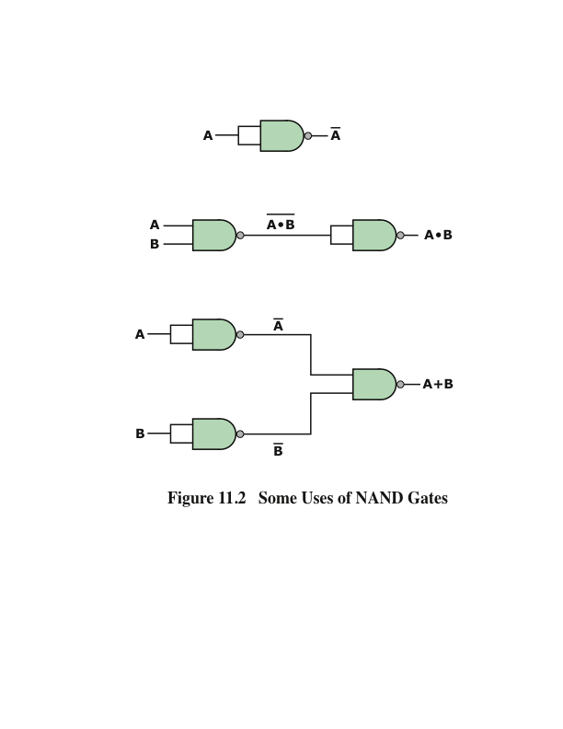
Uses of NAND Gates
Notes:
Figure 11.2 shows how the AND, OR, and NOT functions can be implemented solely with NAND gates.

Slide 9
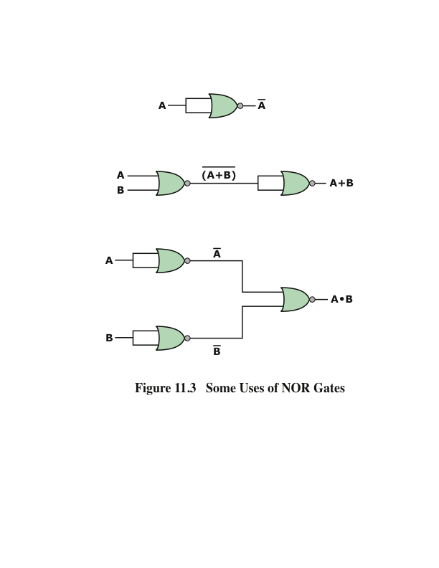
Uses of NOR Gates
Notes:
Figure 11.3 shows the same thing for NOR gates. For this reason, digital circuits can be, and frequently are, implemented solely with NAND gates or solely with NOR gates.
With gates, we have reached the most primitive circuit level of computer hardware. An examination of the transistor combinations used to construct gates departs from that realm and enters the realm of electrical engineering. For our purposes, however, we are content to describe how gates can be used as building blocks to implement the essential logical circuits of a digital computer.

Slide 10
Combinational Circuit
An interconnected set of gates whose output at any time is a function only of the input at that time
The appearance of the input is followed almost immediately by the appearance of the output, with only gate delays
Consists of n binary inputs and m binary outputs
Can be defined in three ways:
Truth table
For each of the 2^{n} possible combinations of input signals, the binary value of each of the m output signals is listed
Graphical symbols
The interconnected layout of gates is depicted
Boolean equations
Each output signal is expressed as a Boolean function of its input signals
Notes:
A combinational circuit is an interconnected set of gates whose output at any time is a function only of the input at that time. As with a single gate, the appearance of the input is followed almost immediately by the appearance of the output, with only gate delays.
In general terms, a combinational circuit consists of n binary inputs and m binary outputs. As with a gate, a combinational circuit can be defined in three ways:
Truth table: For each of the 2n possible combinations of input signals, the binary value of each of the m output signals is listed.
Graphical symbols: The interconnected layout of gates is depicted.
Boolean equations: Each output signal is expressed as a Boolean function of
its input signals.

Slide 11
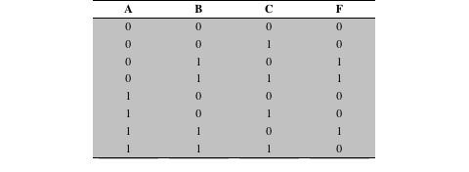
Boolean Function of Three Variables
Table 11.3 A Boolean Function of Three Variables
Notes:
Any Boolean function can be implemented in electronic form as a network of gates. For any given function, there are a number of alternative realizations. Consider the Boolean function represented by the truth table in Table 11.3.
There are three combinations of input values that cause F to be 1, and if any one of these combinations occurs, the result is 1. This form of expression, for self- evident reasons, is known as the sum of products (SOP) form.

Slide 12
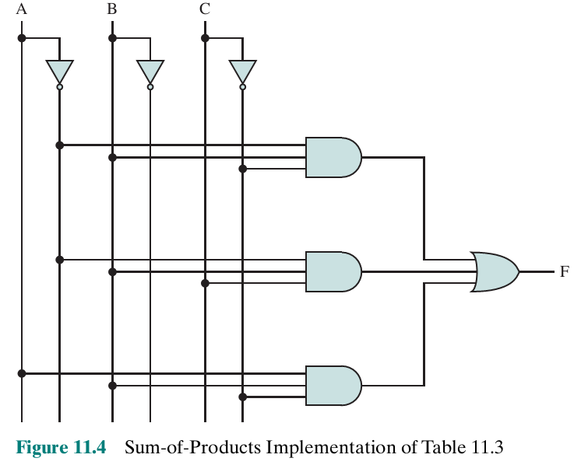
Sum-of-Products Implementation of Table 11.3
Notes:
Figure 11.4 shows a straightforward implementation with AND, OR, and NOT gates.

Slide 13
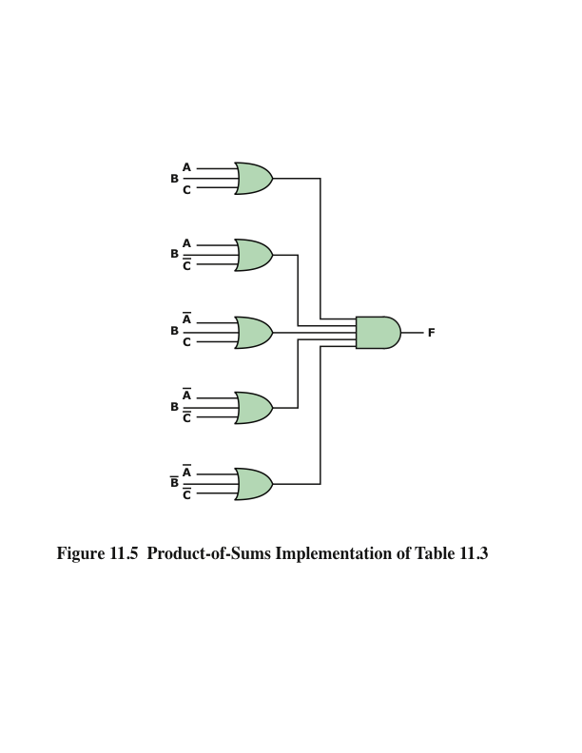
Product-of-Sums Implementation of Table 11.3
Notes:
Product of sums (POS) form, which is illustrated in Figure 11.5. For clarity, NOT gates are not shown. Rather, it is assumed that each input signal and its complement are available. This simplifies the logic diagram and makes the inputs to the gates more readily apparent.
Thus, a Boolean function can be realized in either SOP or POS form. At this point, it would seem that the choice would depend on whether the truth table contains more 1s or 0s for the output function: The SOP has one term for each 1, and the POS has one term for each 0. However, there are other considerations:
It is often possible to derive a simpler Boolean expression from the truth table than either SOP or POS
It may be preferable to implement the function with a single gate type (NAND or NOR)
The significance of the first point is that, with a simpler Boolean expression, fewer gates will be needed to implement the function. Three methods that can be used to achieve simplification are
• Algebraic simplification
• Karnaugh maps • Quine–McCluskey tables

Slide 14
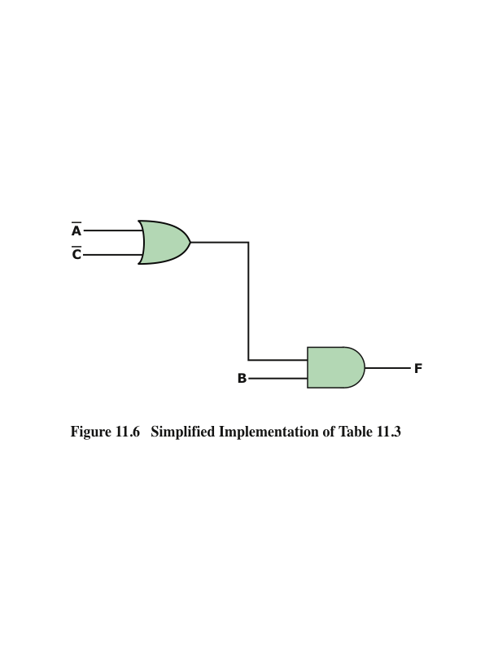
Algebraic Simplification
Involves the application of the identities of Table 11.2 to reduce the Boolean expression to one with fewer elements
Notes:
Algebraic simplification involves the application of the identities of Table 11.2 to reduce the Boolean expression to one with fewer elements.
For example, consider again Equation (11.1).
This expression can be implemented as shown in Figure 11.6. The simplification of Equation (11.1) was done essentially by observation. For more complex expressions, some more systematic approach is needed.

Slide 15
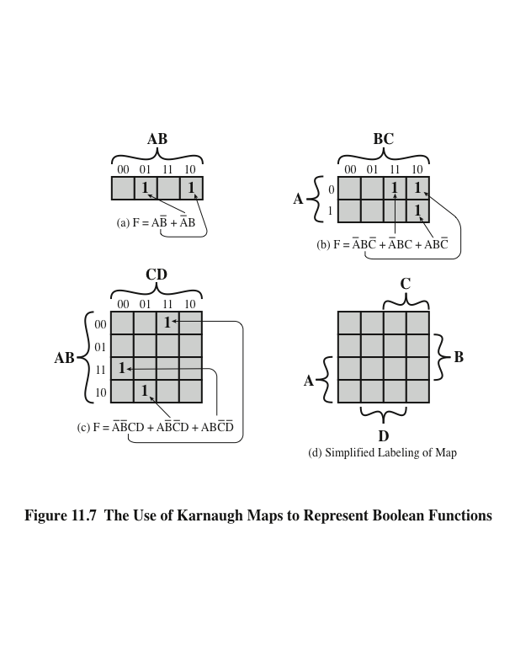
Karnaugh Map
A convenient way of representing a Boolean function of a small number (up to four) of variables
Notes:
For purposes of simplification, the Karnaugh map is a convenient way of representing a Boolean function of a small number (up to four) of variables. The map is an array of 2^{n} squares, representing all possible combinations of values of n binary variables. Figure 11.7a shows the map of four squares for a function of two variables. It is essential for later purposes to list the combinations in the order 00, 01, 11, 10. Because the squares corresponding to the combinations are to be used for recording information, the combinations are customarily written above the squares. In the case of three variables, the representation is an arrangement of eight squares (Figure 11.7b), with the values for one of the variables to the left and for the other two variables above the squares. For four variables, 16 squares are needed, with the arrangement indicated in Figure 11.7c.
The map can be used to represent any Boolean function in the following way. Each square corresponds to a unique product in the sum-of-products form, with a 1 value corresponding to the variable and a 0 value corresponding to the NOT of that variable. For each such product in the function, 1 is placed in the corresponding square. Given the truth table of a Boolean function, it is an easy matter to construct the map: for each combination of values of variables that produce a result of 1 in the truth table, fill in the corresponding square of the map with 1. Figure 11.7b shows the result for the truth table of Table 11.3. To convert from a Boolean expression to a map, it is first necessary to put the expression into what is referred to as canonical form: each term in the expression must contain each variable. So, for example, if we have Equation (11.3), we must first expand it into the full form of Equation (11.1) and then convert this to a map.
The labeling used in Figure 11.7d emphasizes the relationship between variables and the rows and columns of the map. Here the two rows embraced by the symbol A are those in which the variable A has the value 1; the rows not embraced by the symbol A are those in which A is 0; similarly for B, C, and D.

Slide 16
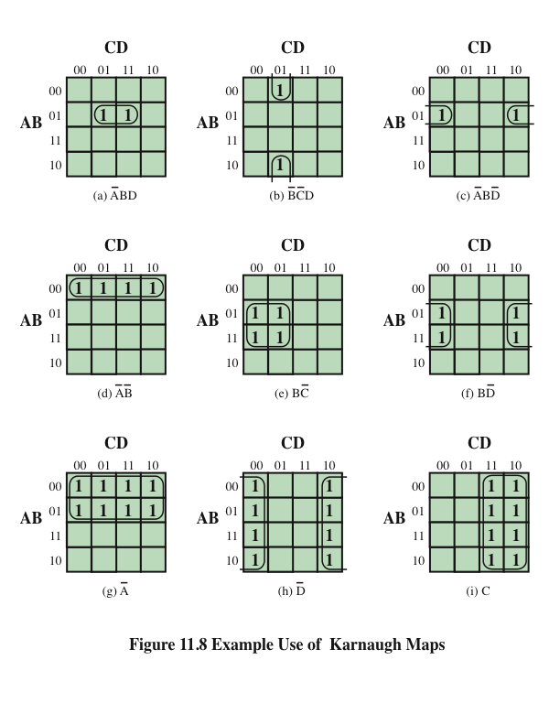
Example
Karnaugh
Maps
Notes:
Once the map of a function is created, we can often write a simple algebraic expression for it by noting the arrangement of the 1s on the map. The principle is as follows. Any two squares that are adjacent differ in only one of the variables. If two adjacent squares both have an entry of one, then the corresponding product terms differ in only one variable. In such a case, the two terms can be merged by eliminating that variable.
This process can be extended in several ways. First, the concept of adjacency can be extended to include wrapping around the edge of the map. Thus, the top square of a column is adjacent to the bottom square, and the leftmost square of a row is adjacent to the rightmost square. These conditions are illustrated in Figures 11.8b and c. Second, we can group not just 2 squares but 2^{n} adjacent squares (i.e., 2, 4, 8, etc.). The next three examples in Figure 11.8 show groupings of 4 squares. Note that in this case, two of the variables can be eliminated. The last three examples show groupings of 8 squares, which allow three variables to be eliminated.
We can summarize the rules for simplification as follows:
1. Among the marked squares (squares with a 1), find those that belong to a unique largest block of 1, 2, 4, or 8 and circle those blocks.
2. Select additional blocks of marked squares that are as large as possible and as few in number as possible, but include every marked square at least once. The results may not be unique in some cases. For example, if a marked square combines with exactly two other squares, and there is no fourth marked square to complete a larger group, then there is a choice to be made as two which of the two groupings to choose. When you are circling groups, you are allowed to use the same 1 value more than once.
3. Continue to draw loops around single marked squares, or pairs of adjacent marked squares, or groups of four, eight, and so on in such a way that every marked square belongs to at least one loop; then use as few of these blocks as possible to include all marked squares.

Slide 17
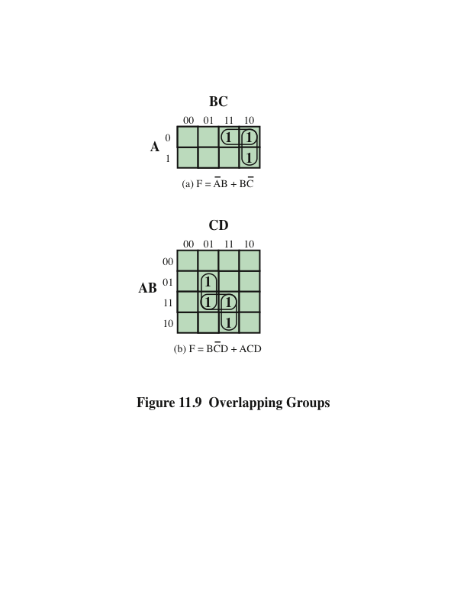
Overlapping
Groups
Notes:
Figure 11.9a, based on Table 11.3, illustrates the simplification process. If any
isolated 1s remain after the groupings, then each of these is circled as a group of 1s.
Finally, before going from the map to a simplified Boolean expression, any group of 1s that is completely overlapped by other groups can be eliminated. This is shown in Figure 11.9b. In this case, the horizontal group is redundant and may be ignored in creating the Boolean expression.
One additional feature of Karnaugh maps needs to be mentioned. In some cases, certain combinations of values of variables never occur, and therefore the corresponding output never occurs. These are referred to as “don’t care” conditions. For each such condition, the letter “d” is entered into the corresponding square of the map. In doing the grouping and simplification, each “d” can be treated as a 1 or 0, whichever leads to the simplest expression.

Slide 18
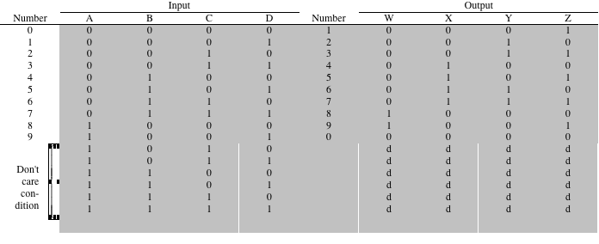
Table 11.4 Truth Table for the One-Digit Packed Decimal Incrementer
Table 11.4 Truth Table for the One-Digit Packed Decimal Incrementer
Notes:
Table 11.4 shows the truth table for producing a 4-bit result that is one more than a 4-bit BCD input. The addition is modulo 10. Thus, 9 + 1 = 0. Also, note that six of the input codes produce “don’t care” results, because those are not valid BCD inputs.

Slide 19
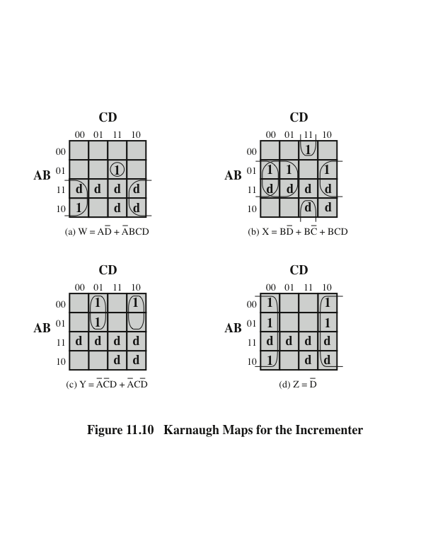
Figure
11.10
Notes:
Figure 11.10 shows the resulting Karnaugh maps for each of the output variables. The d squares are used to achieve the best possible groupings.

Slide 20
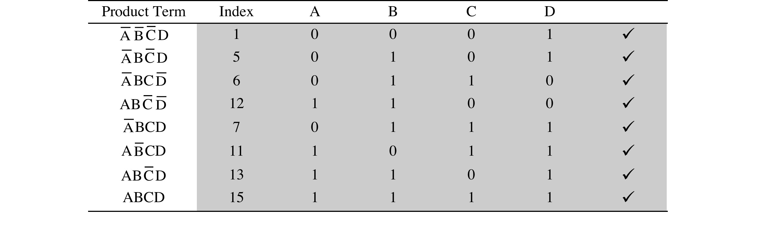
Table 11.5 First Stage of Quine-McCluskey Method
Table 11.5 First Stage of Quine-McCluskey Method
Notes:
For more than four variables, the Karnaugh map method becomes increasingly cumbersome. With five variables, two 16 * 16 maps are needed, with one map considered to be on top of the other in three dimensions to achieve adjacency. Six variables require the use of four 16 * 16 tables in four dimensions! An alternative approach is a tabular technique, referred to as the Quine–McCluskey method. The method is suitable for programming on a computer to give an automatic tool for producing minimized Boolean expressions.
The first step is to construct a table in which each row corresponds to one of the product terms of the expression. The terms are grouped according to the number of complemented variables. That is, we start with the term with no complements, if it exists, then all terms with one complement, and so on. Table 11.5 shows the list for our example expression, with horizontal lines used to indicate the grouping. For clarity, each term is represented by a 1 for each uncomplemented variable and a 0 for each complemented variable. Thus, we group terms according to the number of 1s they contain. The index column is simply the decimal equivalent and is useful in what follows.
The next step is to find all pairs of terms that differ in only one variable, that is, all pairs of terms that are the same except that one variable is 0 in one of the terms and 1 in the other. Because of the way in which we have grouped the terms, we can do this by starting with the first group and comparing each term of the first group with every term of the second group. Then compare each term of the second group with all of the terms of the third group, and so on. Whenever a match is found, place a check next to each term, combine the pair by eliminating the variable that differs in the two terms, and add that to a new list. This process continues until the entire original table has been examined.
The new table is organized into groups, as indicated, in the same fashion as the first table. The second table is then processed in the same manner as the first. That is, terms that differ in only one variable are checked and a new term produced for a third table. In this example, the third table that is produced contains only one term: BD.
In general, the process would proceed through successive tables until a table with no matches was produced. In this case, this has involved three tables.

Slide 21
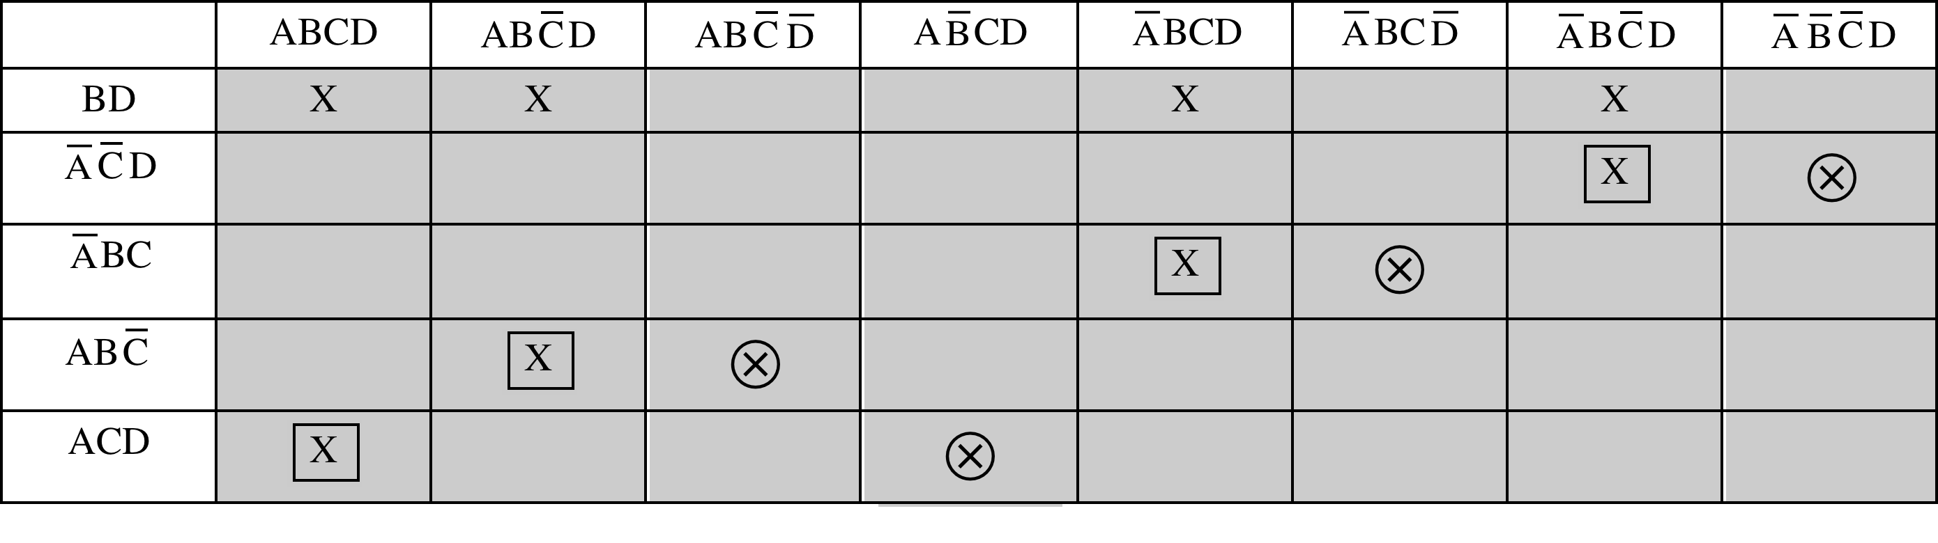
Table 11.6 Last Stage of Quine-McCluskey Method
Table 11.6 Last Stage of Quine-McCluskey Method
Notes:
Once the process just described is completed, we have eliminated many of the possible terms of the expression. Those terms that have not been eliminated are used to construct a matrix, as illustrated in Table 11.6. Each row of the matrix corresponds to one of the terms that have not been eliminated (has no check) in any of the tables used so far. Each column corresponds to one of the terms in the original expression. An X is placed at each intersection of a row and a column such that the row element is “compatible” with the column element. That is, the variables present in the row element have the same value as the variables present in the column element. Next, circle each X that is alone in a column. Then place a square around each X in any row in which there is a circled X. If every column now has either a squared or a circled X, then we are done, and those row elements whose Xs have been marked constitute the minimal expression.
In cases in which some columns have neither a circle nor a square, additional processing is required. Essentially, we keep adding row elements until all columns are covered.

Slide 22
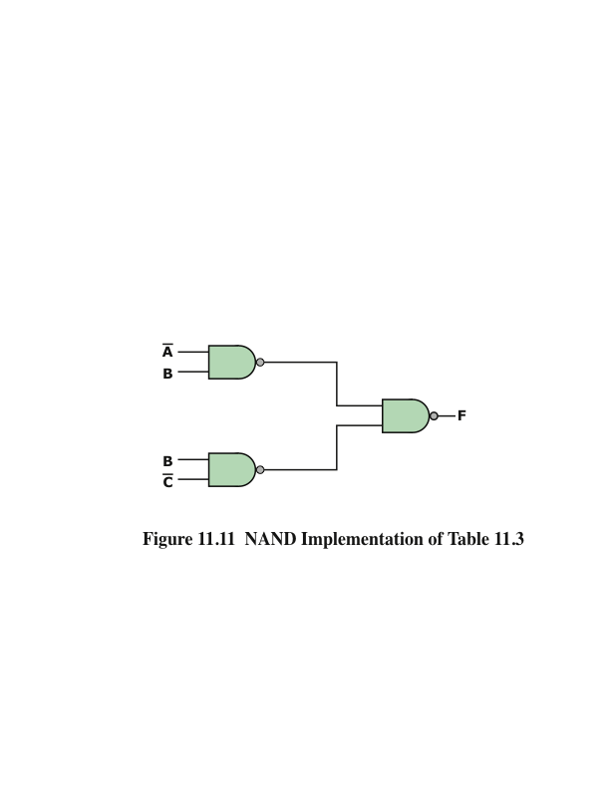
NAND and NOR Implementations
Notes:
Another consideration in the implementation of Boolean functions concerns the types of gates used. It is sometimes desirable to implement a Boolean function solely with NAND gates or solely with NOR gates. Although this may not be the minimum-gate implementation, it has the advantage of regularity, which can simplify the manufacturing process.

Slide 23
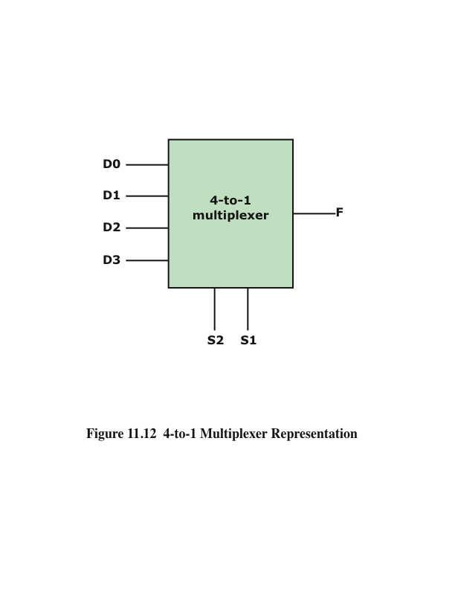
Multiplexers
- connect multiple inputs to a single output
Notes:
The multiplexer connects multiple inputs to a single output. At any time, one of the inputs is selected to be passed to the output. A general block diagram representation is shown in Figure 11.12. This represents a 4-to-1 multiplexer. There are four input lines, labeled D0, D1, D2, and D3. One of these lines is selected to provide the
output signal F. To select one of the four possible inputs, a 2-bit selection code is needed, and this is implemented as two select lines labeled S1 and S2.

Slide 24

4-to-1 Multiplexer Truth Table
Table 11.7 4-to-1 Multiplexer Truth Table
Notes:
An example 4-to-1 multiplexer is defined by the truth table in Table 11.7. This is a simplified form of a truth table. Instead of showing all possible combinations of input variables, it shows the output as data from line D0, D1, D2, or D3. Figure 11.13 shows an implementation using AND, OR, and NOT gates. S1 and S2 are connected to the AND gates in such a way that, for any combination of S1 and S2, three of the AND gates will output 0. The fourth AND gate will output the value of the selected line, which is either 0 or 1. Thus, three of the inputs to the OR gate are always 0, and the output of the OR gate will equal the value of the selected input gate. Using this regular organization, it is easy to construct multiplexers of size 8-to-1, 16-to-1, and so on.

Slide 25
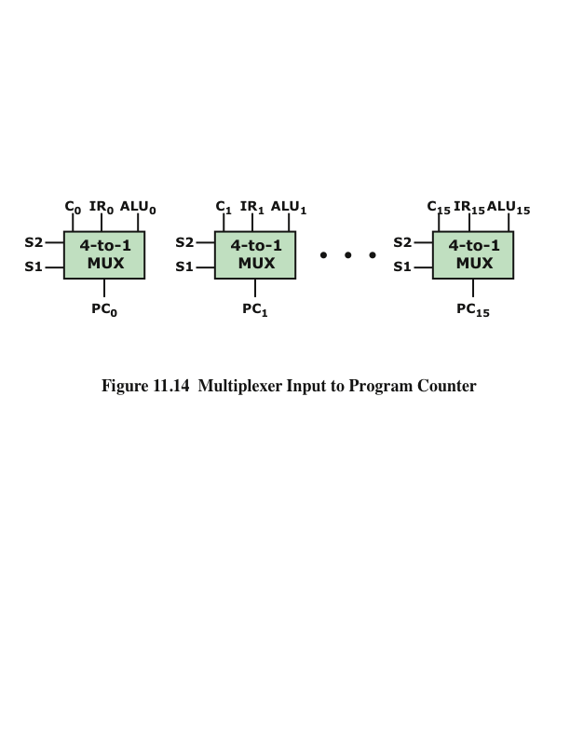
Multiplexer Input to Program Counter
Notes:
Multiplexers are used in digital circuits to control signal and data routing. An example is the loading of the program counter (PC). The value to be loaded into the program counter may come from one of several different sources:
* A binary counter, if the PC is to be incremented for the next instruction
*The instruction register, if a branch instruction using a direct address has just been executed
*The output of the ALU, if the branch instruction specifies the address using a displacement mode
These various inputs could be connected to the input lines of a multiplexer, with the PC connected to the output line. The select lines determine which value is loaded into the PC. Because the PC contains multiple bits, multiple multiplexers are used, one per bit. Figure 11.14 illustrates this for 16-bit addresses.

Slide 26
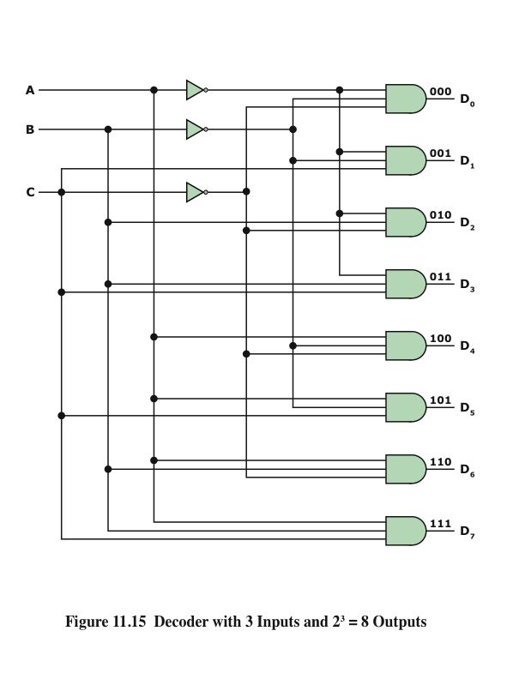
Decoders
- combinational circuits with a number of output lines, only one of which is asserted at any time
Notes:
A decoder is a combinational circuit with a number of output lines, only one of which is asserted at any time. Which output line is asserted depends on the pattern of input lines. In general, a decoder has n inputs and 2n outputs. Figure 11.15 shows a decoder with three inputs and eight outputs.

Slide 27
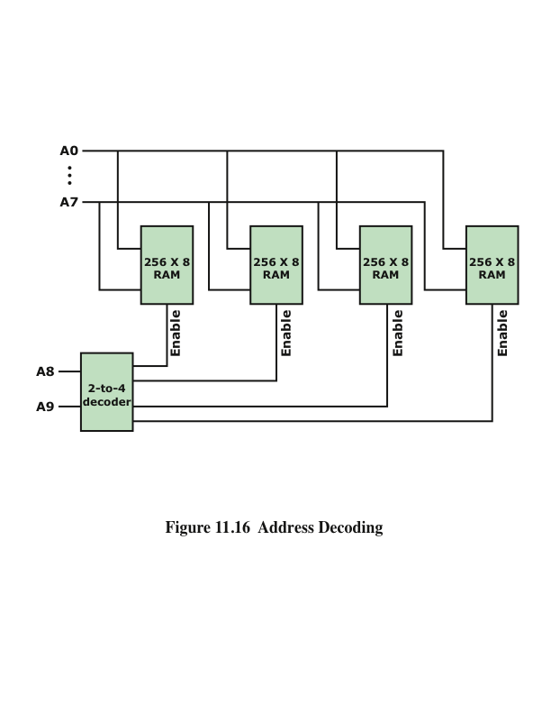
Address Decoding
Notes:
Decoders find many uses in digital computers. One example is address decoding. Suppose we wish to construct a 1K-byte memory using four 256 * 8-bit RAM chips. We want a single unified address space, which can be broken down as follows:
Address Chip
0000-00FF 0
0100-01FF 1
0200-02FF 2
0300-03FF 3
Each chip requires 8 address lines, and these are supplied by the lower-order 8 bits of the address. The higher-order 2 bits of the 10-bit address are used to select one of the four RAM chips. For this purpose, a 2-to-4 decoder is used whose output enables one of the four chips, as shown in Figure 11.16.

Slide 28
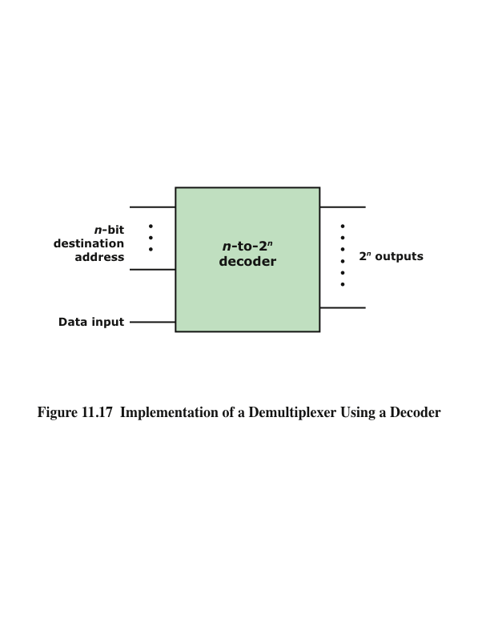
Implementation of a Demultiplexer Using a Decoder
Notes:
With an additional input line, a decoder can be used as a demultiplexer. The demultiplexer performs the inverse function of a multiplexer; it connects a single input to one of several outputs. This is shown in Figure 11.17. As before, n inputs are decoded to produce a single one of 2n outputs. All of the 2n output lines are ANDed
with a data input line. Thus, the n inputs act as an address to select a particular out- put line, and the value on the data input line (0 or 1) is routed to that output line.
The configuration in Figure 11.17 can be viewed in another way. Change the label on the new line from Data Input to Enable. This allows for the control of the timing of the decoder. The decoded output appears only when the encoded input is present and the enable line has a value of 1.

Slide 29
Read-Only Memory (ROM)
Memory that is implemented with combinational circuits
Combinational circuits are often referred to as “memoryless” circuits because their output depends only on their current input and no history of prior inputs is retained
Memory unit that performs only the read operation
Binary information stored in a ROM is permanent and is created during the fabrication process
A given input to the ROM (address lines) always produces the same output (data lines)
Because the outputs are a function only of the present inputs, ROM is a combinational circuit
Notes:
Combinational circuits are often referred to as “memoryless” circuits, because their output depends only on their current input and no history of prior inputs is retained. However, there is one sort of memory that is implemented with combinational circuits, namely read-only memory (ROM).
Recall that a ROM is a memory unit that performs only the read operation. This implies that the binary information stored in a ROM is permanent and was created during the fabrication process. Thus, a given input to the ROM (address lines) always produces the same output (data lines). Because the outputs are a function only of the present inputs, the ROM is in fact a combinational circuit.

Slide 30
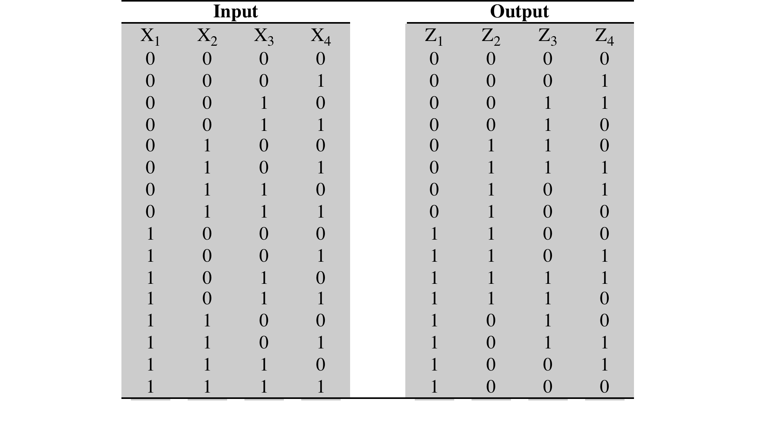
Truth Table for a ROM
Table
11.8
Notes:
A ROM can be implemented with a decoder and a set of OR gates. As an example, consider Table 11.8. This can be viewed as a truth table with four inputs and four outputs. For each of the 16 possible input values, the corresponding set of values of the outputs is shown. It can also be viewed as defining the contents of a 64-bit ROM consisting of 16 words of 4 bits each. The four inputs specify an address, and the four outputs specify the contents of the location specified by the address. Figure 11.18 shows how this memory could be implemented using a 4-to-16 decoder and four OR gates. As with the PLA, a regular organization is used, and the interconnections are made to reflect the desired result.

Slide 31
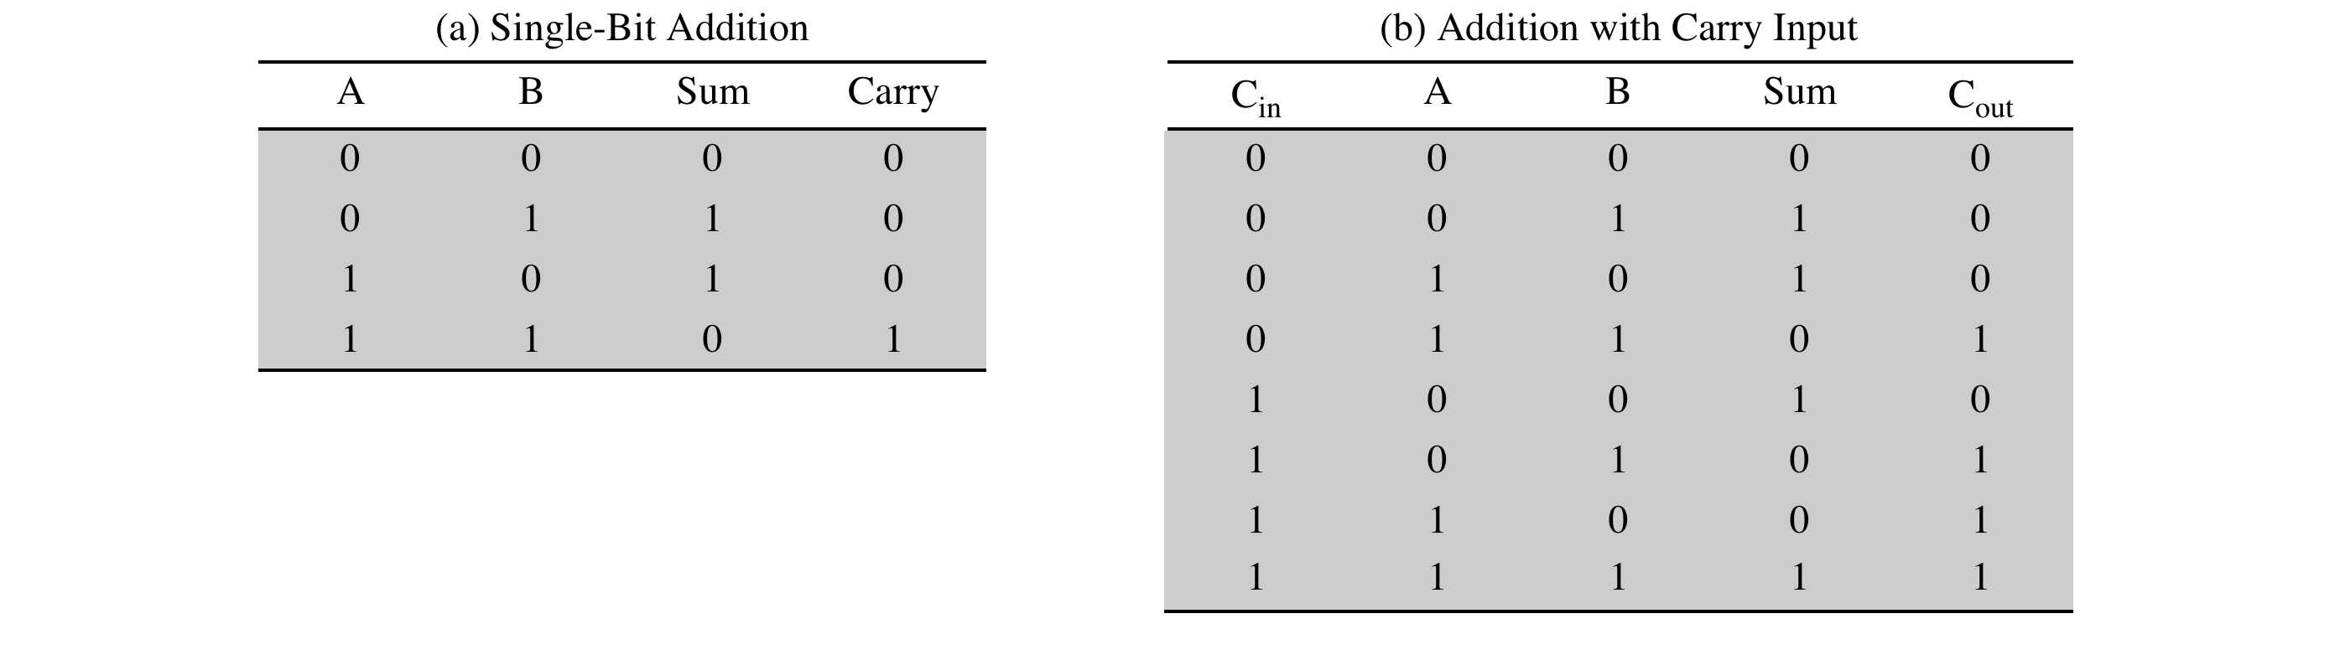
Binary Addition Truth Tables
Table 11.9 Binary Addition Truth Tables
Notes:
Binary addition differs from Boolean algebra in that the result includes a carry term.
However, addition can still be dealt with in Boolean terms. In Table 11.9a, we show the logic for adding two input bits to produce a 1-bit sum and a carry bit. This truth table could easily be implemented in digital logic. However, we are not interested in performing addition on just a single pair of bits. Rather, we wish to add two n-bit numbers. This can be done by putting together a set of adders so that the carry from one adder is provided as input to the next.
For a multiple-bit adder to work, each of the single-bit adders must have three inputs, including the carry from the next-lower-order adder. The revised truth table appears in Table 11.9b.

Slide 32
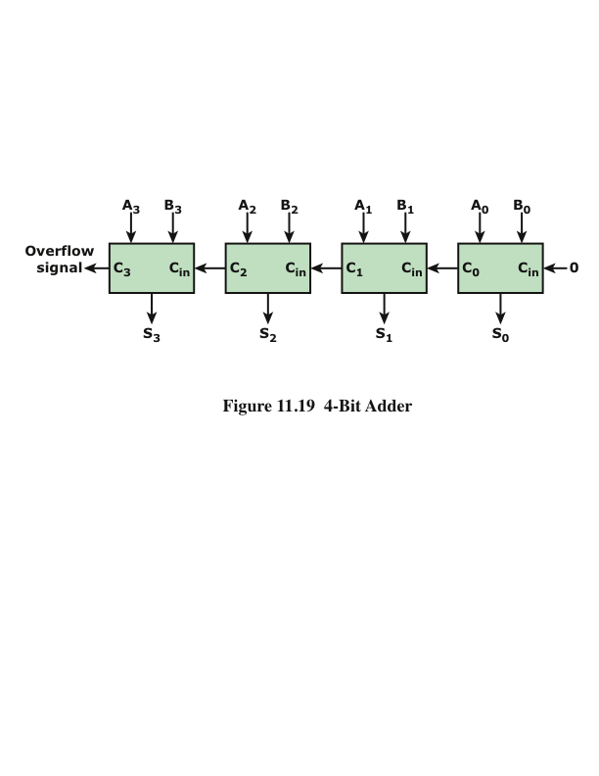
4-Bit Adder
Notes:
A 4-bit adder is depicted in Figure 11.19.

Slide 33
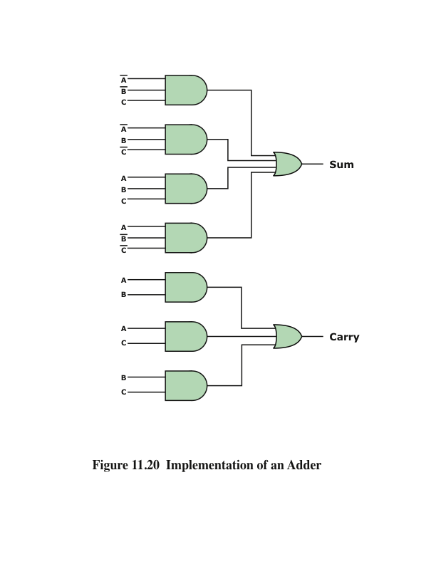
Implementation of an Adder
Notes:
Figure 11.20 is an implementation using AND, OR, and NOT gates.

Slide 34
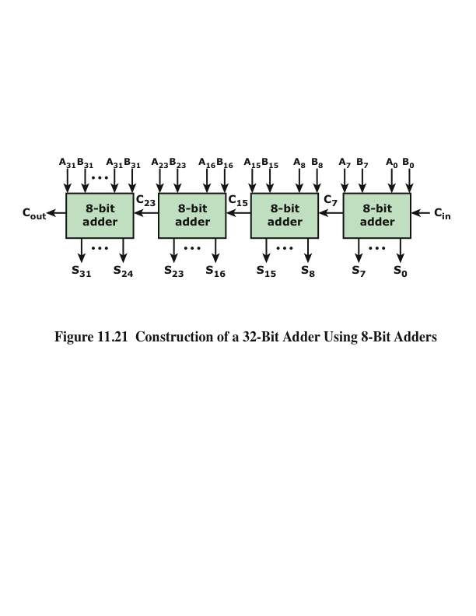
Construction of a 32-Bit Adder Using 8-Bit Adders
Notes:
Thus we have the necessary logic to implement a multiple-bit adder such as shown in Figure 11.21. Note that because the output from each adder depends on the carry from the previous adder, there is an increasing delay from the least significant to the most significant bit. Each single-bit adder experiences a certain amount of gate delay, and this gate delay accumulates. For larger adders, the accumulated delay can become unacceptably high.
If the carry values could be determined without having to ripple through all the previous stages, then each single-bit adder could function independently, and delay would not accumulate. This can be achieved with an approach known as carry lookahead.
Figure 11.21 shows how a 32-bit adder can be constructed out of four 8-bit adders. In this case, the carry must ripple through the four 8-bit adders, but this will be substantially quicker than a ripple through thirty-two 1-bit adders.

Slide 35
Sequential Circuit
Current output depends not only on the current input, but also on the past history of inputs
Makes use of combinational circuits
Sequential
Circuit
Notes:
Combinational circuits implement the essential functions of a digital computer. However, except for the special case of ROM, they provide no memory or state information, elements also essential to the operation of a digital computer. For the latter purposes, a more complex form of digital logic circuit is used: the sequential circuit. The current output of a sequential circuit depends not only on the current input, but also on the past history of inputs. Another and generally more useful way to view it is that the current output of a sequential circuit depends on the current input and the current state of that circuit.
In this section, we examine some simple but useful examples of sequential circuits. As will be seen, the sequential circuit makes use of combinational circuits.

Slide 36
Flip-Flops
Simplest form of sequential circuit
There are a variety of flip-flops, all of which share two properties:
The flip-flop is a bistable device. It exists in one of two states and, in the absence of input, remains in that state. Thus, the flip-flop can function as a 1-bit memory.
The flip-flop has two outputs, which are always the complements of each other.
Notes:
The simplest form of sequential circuit is the flip-flop. There are a variety of flip- flops, all of which share two properties:
The flip-flop is a bistable device. It exists in one of two states and, in the absence of input, remains in that state. Thus, the flip-flop can function as a 1-bit memory.
The flip-flop has two outputs, which are always the complements of each other.

Slide 37
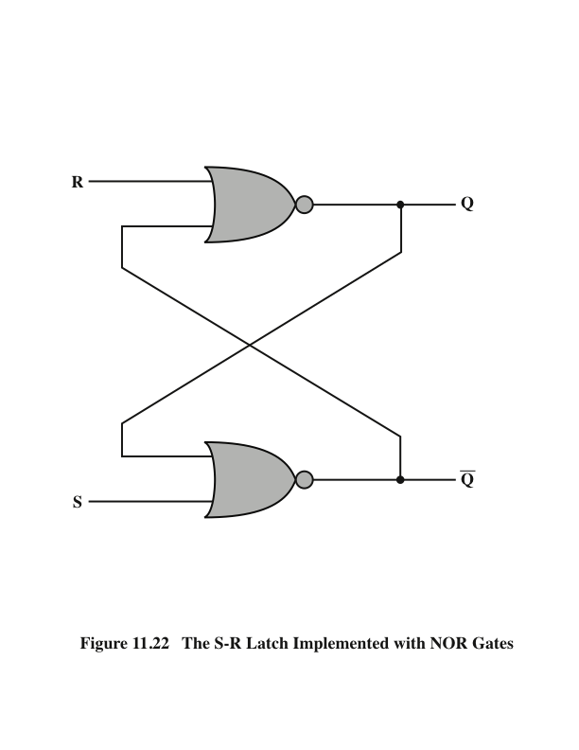
The S-R Latch
Notes:
Figure 11.22 shows a common configuration known as the S–R flip-flop or S–R latch.
The circuit has two inputs, S (Set) and R (Reset), and two outputs, and consists of two NOR gates connected in a feedback arrangement.

Slide 38
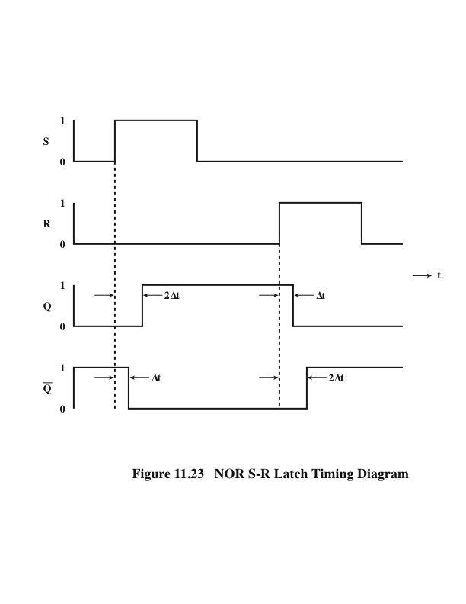
NOR S-R Latch Timing Diagram
Notes:
Figure 11.23 NOR S-R Latch Timing Diagram.

Slide 39
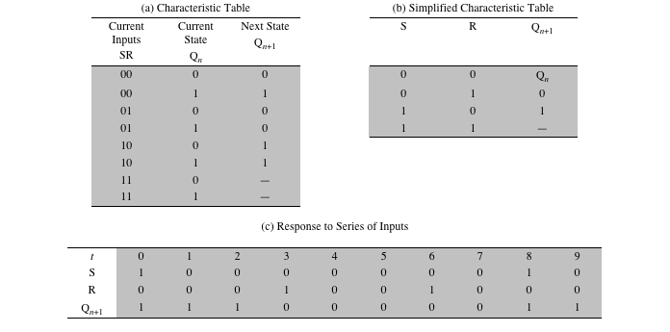
Table 11.10 The S-R Latch
Notes:
The S–R latch can be defined with a table similar to a truth table, called a characteristic table, which shows the next state or states of a sequential circuit as a function of current states and inputs. In the case of the S–R latch, the state can be defined by the value of Q. Table 11.10a shows the resulting characteristic table. Observe that the inputs S = 1,R = 1 are not allowed, because these would pro- duce an inconsistent output. The table can be expressed more compactly, as in Table 11.10b. An illustration of the behavior of the S–R latch is shown in Table 11.10c.

Slide 40
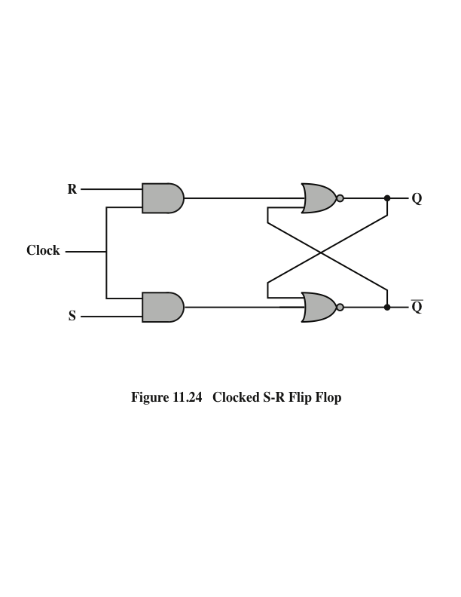
Clocked S-R Flip-Flop
Notes:
The output of the S–R latch changes, after a brief time delay, in response to a change in the input. This is referred to as asynchronous operation. More typically, events in the digital computer are synchronized to a clock pulse, so that changes occur only when a clock pulse occurs. Figure 11.24 shows this arrangement. This device is referred to as a clocked S–R flip-flop. Note that the R and S inputs are passed to the NOR gates only during the clock pulse.

Slide 41
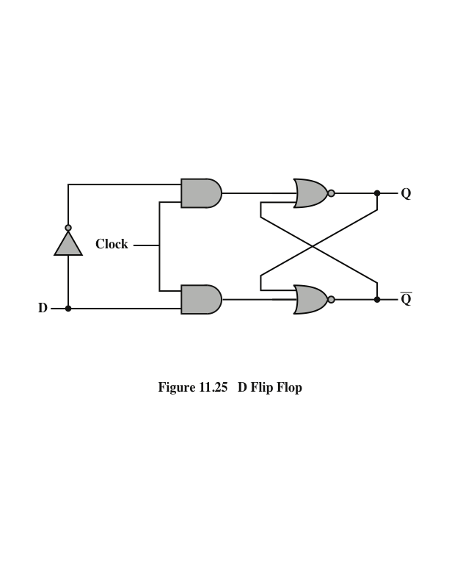
D Flip-Flop
Notes:
One problem with S–R flip-flop is that the condition R = 1,S = 1 must be avoided. One way to do this is to allow just a single input. The D flip-flop accomplishes this. Figure 11.25 shows a gate implementation of the D flip-flop. By using an inverter, the non-clock inputs to the two AND gates are guaranteed to be the opposite of each other.
The D flip-flop is sometimes referred to as the data flip-flop because it is, in effect, storage for one bit of data. The output of the D flip-flop is always equal to the most recent value applied to the input. Hence, it remembers and produces the last input. It is also referred to as the delay flip-flop, because it delays a 0 or 1 applied to its input for a single clock pulse.

Slide 42
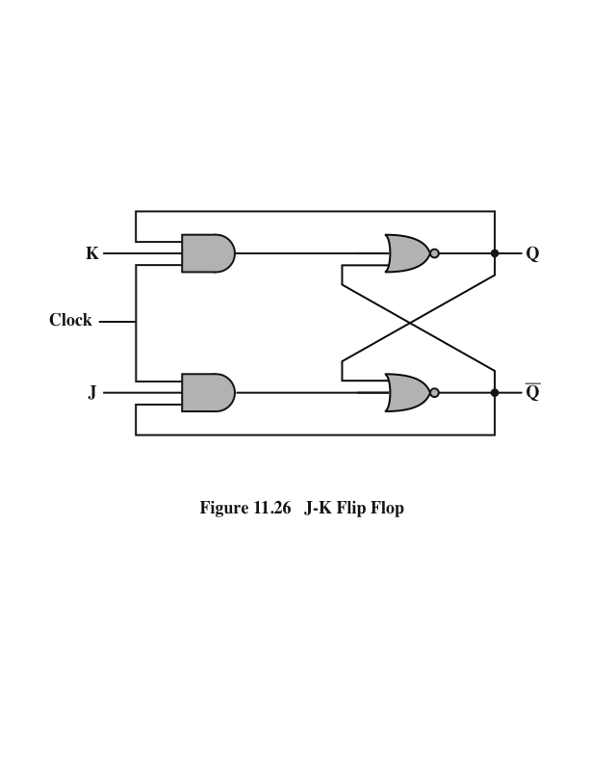
J-K Flip Flop
Notes:
Another useful flip-flop is the J–K flip-flop. Like the S–R flip-flop, it has two inputs. However, in this case all possible combinations of input values are valid. Figure 11.26 shows a gate implementation of the J–K flip-flop.

Slide 43
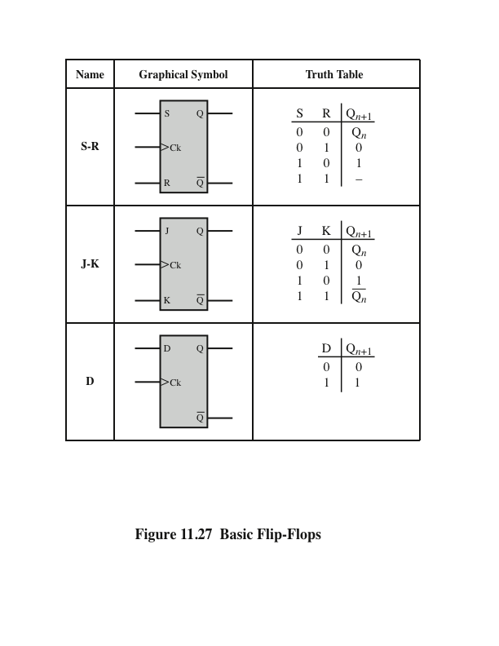
Basic Flip-Flops
Notes:
Figure 11.27 shows its characteristic table (along with those for the S–R and D flip-flops). Note that the first three combinations are the same as for the S–R flip-flop. With no input asserted, the output is stable. If only the J input is asserted, the result is a set function, causing the output to be 1; if only the K input is asserted, the result is a reset function, causing the output to be 0. When both J and K are 1, the function performed is referred to as the toggle function: the output is reversed. Thus, if Q is 1 and 1 is applied to J and K, then Q becomes 0. The reader should verify that the implementation of Figure 11.26 produces this characteristic function.

Slide 44
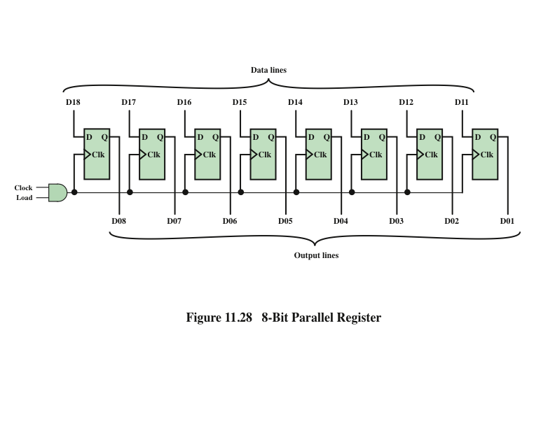
Parallel Register
Notes:
A parallel register consists of a set of 1-bit memories that can be read or written simultaneously. It is used to store data. The registers that we have discussed throughout this book are parallel registers.
The 8-bit register of Figure 11.28 illustrates the operation of a parallel register using D flip-flops. A control signal, labeled load, controls writing into the register from signal lines, D11 through D18. These lines might be the output of multiplexers, so that data from a variety of sources can be loaded into the register.

Slide 45
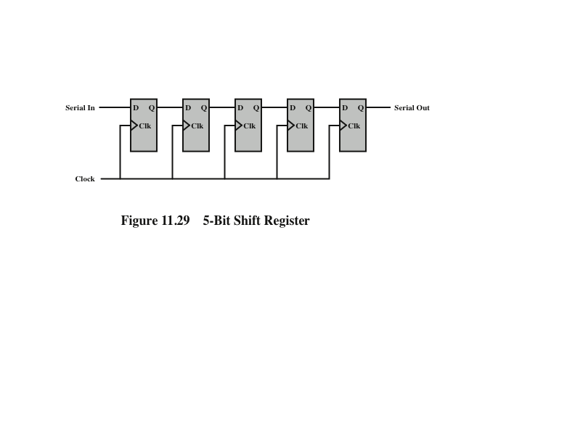
5-Bit Shift Register
Notes:
A shift register accepts and/or transfers information serially. Consider, for example, Figure 11.29, which shows a 5-bit shift register constructed from clocked D flip-flops. Data are input only to the leftmost flip-flop. With each clock pulse, data are shifted to the right one position, and the rightmost bit is transferred out.
Shift registers can be used to interface to serial I/O devices. In addition, they can be used within the ALU to perform logical shift and rotate functions. In this
latter capacity, they need to be equipped with parallel read/write circuitry as well as serial.

Slide 46
Counter
A register whose value is easily incremented by 1 modulo the capacity of the register
After the maximum value is achieved the next increment sets the counter value to 0
An example of a counter in the CPU is the program counter
Can be designated as:
Asynchronous
Relatively slow because the output of one flip-flop triggers a change in the status of the next flip-flop
Synchronous
All of the flip-flops change state at the same time
Because it is faster it is the kind used in CPUs
Notes:
Another useful category of sequential circuit is the counter. A counter is a register whose value is easily incremented by 1 modulo the capacity of the register; that is, after the maximum value is achieved the next increment sets the counter value to 0. Thus, a register made up of n flip-flops can count up to 2n - 1. An example of a counter in the CPU is the program counter.
Counters can be designated as asynchronous or synchronous, depending on the way in which they operate. Asynchronous counters are relatively slow because the output of one flip-flop triggers a change in the status of the next flip-flop. In a synchronous counter, all of the flip-flops change state at the same time. Because the latter type is much faster, it is the kind used in CPUs. However, it is useful to begin the discussion with a description of an asynchronous counter.

Slide 47
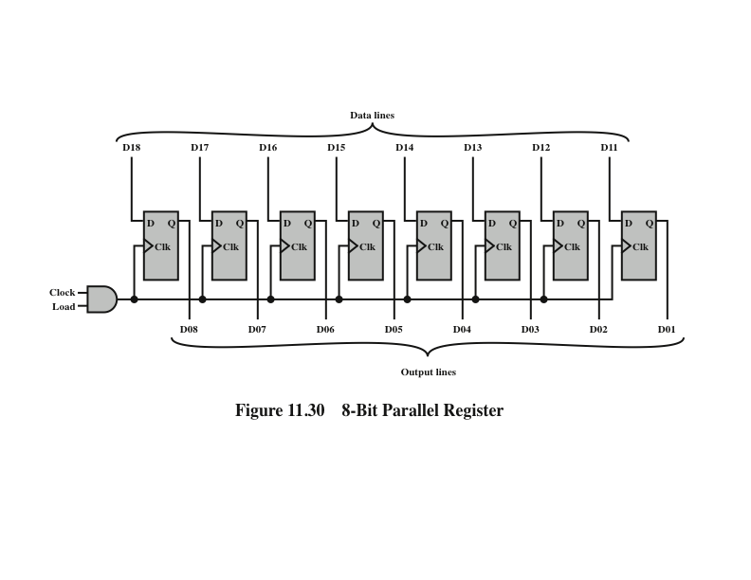
Ripple Counter
Notes:
An asynchronous counter is also referred to as a ripple counter, because the change that occurs to increment the counter starts at one end and “ripples” through to the other end. Figure 11.30 shows an implementation of a 4-bit counter using J–K flip-flops, together with a timing diagram that illustrates its behavior. The timing diagram is idealized in that it does not show the propagation delay that occurs as the signals move down the series of flip-flops. The output of the leftmost flip-flop (Q₀) is the least significant bit. The design could clearly be extended to an arbitrary number of bits by cascading more flip-flops.
In the illustrated implementation, the counter is incremented with each clock pulse. The J and K inputs to each flip-flop are held at a constant 1. This means that, when there is a clock pulse, the output at Q will be inverted (1 to 0; 0 to 1). Note that the change in state is shown as occurring with the falling edge of the clock pulse; this is known as an edge-triggered flip-flop. Using flip-flops that respond to the transition in a clock pulse rather than the pulse itself provides better timing control in complex circuits. If one looks at patterns of output for this counter, it can be seen that it cycles through 0000, 0001, ..., 1110, 1111, 0000, and so on.

Slide 48
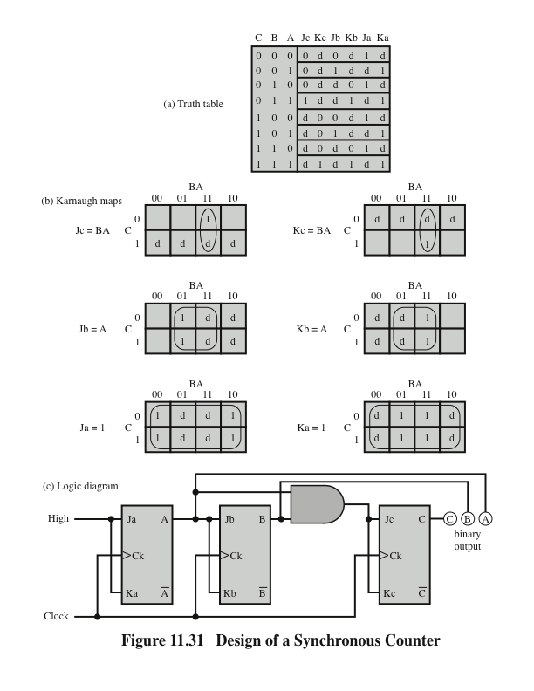
Design of a Synchronous Counter
Notes:
The ripple counter has the disadvantage of the delay involved in changing value, which is proportional to the length of the counter. To overcome this disadvantage, CPUs make use of synchronous counters, in which all of the flip-flops of the counter change at the same time. In this subsection, we present a design for a 3-bit synchronous counter. In doing so, we illustrate some basic concepts in the design of a synchronous circuit.
For a 3-bit counter, three flip-flops will be needed. Let us use J–K flip-flops. Label the uncomplemented output of the three flip-flops A, B, and C, respectively, with C representing the least significant bit. The first step is to construct a truth table that relates the J–K inputs and outputs, to allow us to design the overall circuit. Such a truth table is shown in Figure 11.31a. The first three columns show the possible combinations of outputs A, B, and C. They are listed in the order that they will appear as the counter is incremented. Each row lists the current value of A, B, C and the inputs to the three flip-flops that will be required to reach the next value of A, B, C.
Let us return to Figure 11.31a. Consider the first row. We want the value of A to remain 0, the value of B to remain 0, and the value of C to go from 0 to 1 with the next application of a clock pulse. The excitation table shows that to maintain an output of 0, we must have inputs of J = 0 and don’t care for K. To effect a transition from0to1,theinputsmustbeJ = 1andK = d. These values are shown in the first row of the table. By similar reasoning, the remainder of the table can be filled in.
Having constructed the truth table of Figure 11.31a, we see that the table shows the required values of all of the J and K inputs as functions of the current values of A, B, and C. With the aid of Karnaugh maps, we can develop Boolean expressions for these six functions. This is shown in part b of the figure. For example, the Karnaugh map for the variable Ja (the J input to the flip-flop that produces the A output) yields the expression Ja = BC. When all six expressions are derived, it is a straightforward matter to design the actual circuit, as shown in part c of the figure.

Slide 49
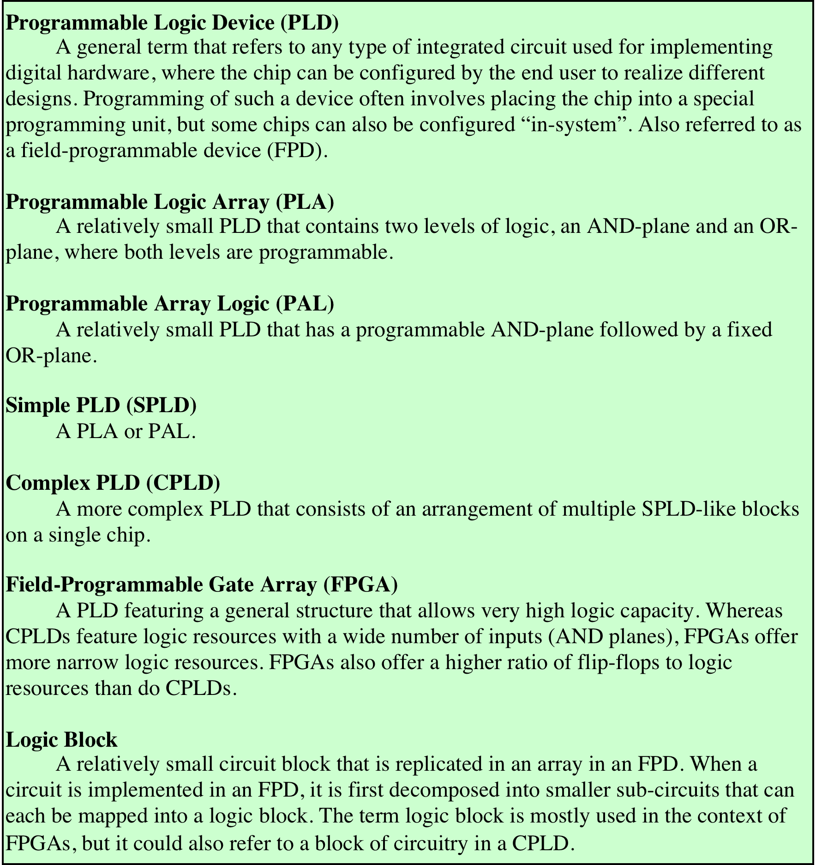
Programmable Logic Devices (PLD) Terminology
Table 11.11
Notes:
As the level of integration provided by integrated circuits increases, other considerations apply. Early integrated circuits, using small-scale integration (SSI), provided from one to ten gates on a chip. Each gate is treated independently, in the building-block approach described so far. To construct a logic function, a number of these chips are laid out on a printed circuit board and the appropriate pin interconnections are made.
Increasing levels of integration made it possible to put more gates on a chip and to make gate interconnections on the chip as well. This yields the advantages of decreased cost, decreased size, and increased speed (because on-chip delays are of shorter duration than off-chip delays). A design problem arises, however. For each particular logic function or set of functions, the layout of gates and interconnections on the chip must be designed. The cost and time involved in such custom chip design is high. Thus, it becomes attractive to develop a general-purpose chip that can be readily adapted to specific purposes. This is the intent of the programmable logic device (PLD).
There are a number of different types of PLDs in commercial use. Table 11.11 lists some of the key terms and defines some of the most important types. In this section, we first look at one of the simplest such devices, the programmable logic array (PLA) and then introduce perhaps the most important and widely used type of PLD, the field-programmable gate array (FPGA).

Slide 50
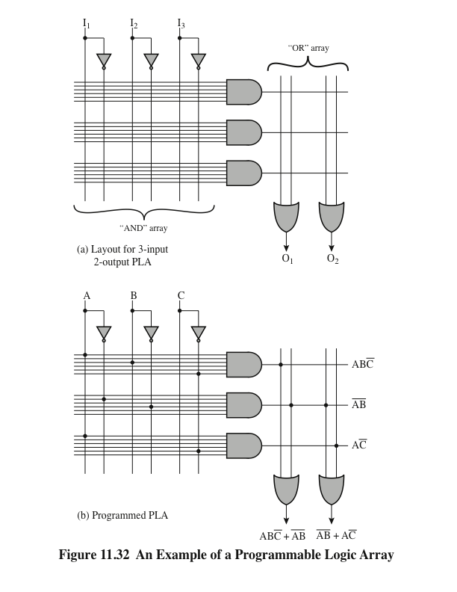
Programmable Logic Array (PLA)
Notes:
The PLA is based on the fact that any Boolean function (truth table) can be expressed in a sum-of-products (SOP) form, as we have seen. The PLA consists of a regular arrangement of NOT, AND, and OR gates on a chip. Each chip input is passed through a NOT gate so that each input and its complement are available to each AND gate. The output of each AND gate is available to each OR gate, and the output of each OR gate is a chip output. By making the appropriate connections, arbitrary SOP expressions can be implemented.
Figure 11.32a shows a PLA with three inputs, eight gates, and two outputs. On the left is a programmable AND array. The AND array is programmed by establishing a connection between any PLA input or its negation and any AND gate input by connecting the corresponding lines at their point of intersection. On the
right is a programmable OR array, which involves connecting AND gate outputs to OR gate inputs. Most larger PLAs contain several hundred gates, 15 to 25 inputs, and 5 to 15 outputs. The connections from the inputs to the AND gates, and from the AND gates to the OR gates, are not specified until programming time.
PLAs are manufactured in two different ways to allow easy programming (making of connections). In the first, every possible connection is made through a fuse at every intersection point. The undesired connections can then be later removed by blowing the fuses. This type of PLA is referred to as a field-programmable logic array. Alternatively, the proper connections can be made during chip fabrication by using an appropriate mask supplied for a particular interconnection pattern. In either case, the PLA provides a flexible, inexpensive way of implementing digital logic functions.
Figure 11.32b shows a programmed PLA that realizes two Boolean expressions.

Slide 51
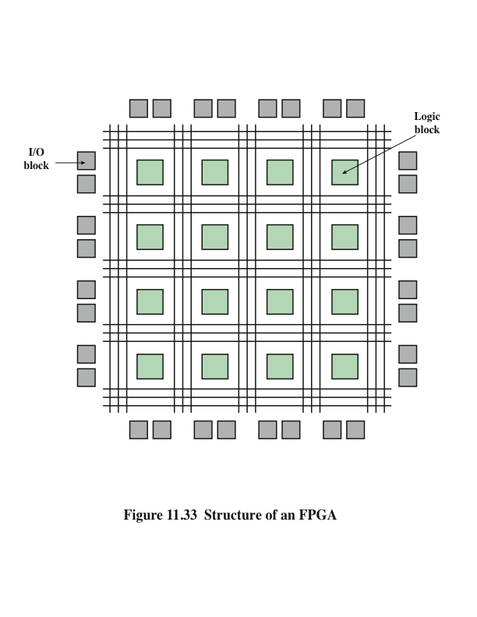
Structure of a Field-Programmable Gate Array (FPGA)
Notes:
The PLA is an example of a simple PLD (SPLD). The difficulty with increasing capacity of a strict SPLD architecture is that the structure of the programmable logic-planes grows too quickly in size as the number of inputs is increased. The only feasible way to provide large capacity devices based on SPLD architectures is then to integrate multiple SPLDs onto a single chip and provide interconnect to programmably connect the SPLD blocks together. Many commercial PLD products
exist on the market today with this basic structure, and are collectively referred to as Complex PLDs (CPLDs). The most important type of CPLD is the FPGA.
An FPGA consists of an array of uncommitted circuit elements, called logic blocks, and interconnect resources. An illustration of a typical FPGA architecture is shown in Figure 11.33. The key components of an FPGA are;
• Logic block: The configurable logic blocks are where the computation of the user’s circuit takes place.
• I/O block: The I/O blocks connect I/O pins to the circuitry on the chip.
• Interconnect: These are signal paths available for establishing connections
among I/O blocks and logic blocks.

Slide 52
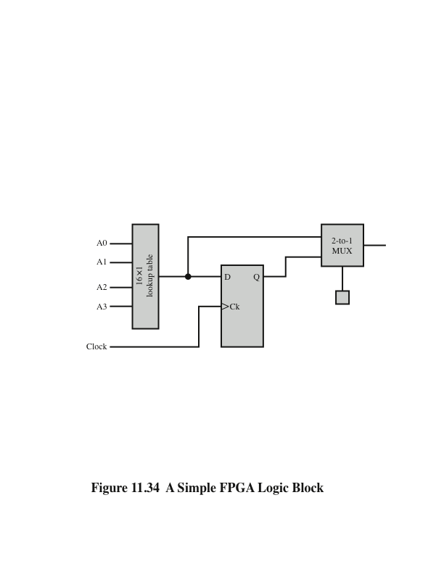
Simple FPGA Logic Block
Notes:
Figure 11.34 shows an example of a simple logic block consisting of a D flip-flop, a 2-to-1 multiplexer, and a 16-bit lookup table. The lookup table is a memory consisting of 16 1-bit elements, so that 4 input lines are required to select one of the 16 bits. Larger logic blocks have larger lookup tables and multiple interconnected lookup tables. The combinational logic realized by the lookup table can be output directly or stored in the D flip-flop and output synchronously. A separate one-bit memory controls the multiplexer to determine whether the output comes directly from the lookup table or from the flip-flop.
By interconnecting numerous logic blocks, very complex logic functions can be easily implemented.

Slide 53
Summary
Digital
Logic
Chapter 11
Boolean Algebra
Gates
Combinational Circuits
Implementation of Boolean Functions
Multiplexers
Decoders
Read-Only-Memory
Adders
Sequential Circuits
Flip-Flops
Registers
Counters
Programmable Logic Devices
Programmable Logic Array
Field-Programmable Gate Array
Notes:
Chapter 11 summary.

Slide 54
Key terms
Chapter 11
adder
AND gate
Boolean algebra
clocked S–R flip-flop
combinational circuit
complex PLD (CPLD)
counter
decoder
D flip-flop
field-programmable gate array (FPGA)
flip-flop
gates
graphical symbol
J–K flip-flop
Karnaugh map
multiplexer
NAND gate
NOR
OR gate
parallel register
product of sums (POS)
programmable array logic (PAL)
programmable logic array (PLA)
programmable logic device (PLD)
read-only memory (ROM)
register
sequential circuit
shift register
simple PLD (SPLD)
sum of products (SOP)
synchronous counter
S–R Latch
truth table
XOR gate
Notes:
Chapter 5 summary.

Slide 55
Homework
Chapter 11
11.1 → 11.7
Notes:
Chapter 6 summary.

Slide 56
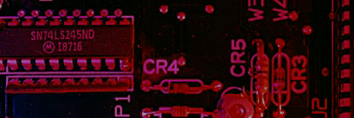
Phụ lục
Latches
The active-HIGH S-R latch is in a stable (latched) condition when both inputs are LOW.
0
R
1
Assume the latch is initially RESET (Q = 0) and the inputs are at their inactive level (0). To SET the latch (Q = 1), a momentary HIGH signal is applied to the S input while the R remains LOW.
0
Q
Latch initially RESET
0
1
Q
0
S
0
R
0
To RESET the latch (Q = 0), a momentary HIGH signal is applied to the R input while the S remains LOW.
1
Q
Latch initially SET
1
0
Q
0
S

Slide 57
Phụ lục
Basic Shift Register Operations
A shift register is an arrangement of flip-flops with important applications in storage and movement of data. Some basic data movements are illustrated here.
Data in
Data in
Data out
Data out
Data in
Data out
Serial in/shift right/serial out
Serial in/shift left/serial out
Parallel in/serial out
Data in
Data in
Data out
Data out
Serial in/parallel out
Parallel in/parallel out
Rotate right
Rotate left

Slide 58
Phụ lục
Serial-in/Serial out Shift Register
Shift registers are available in IC form or can be constructed from discrete flip-flops as is shown here with a five-bit serial-in serial-out register.
Each clock pulse will move an input bit to the next flip-flop. For example, a 1 is shown as it moves across.
1
1
1
1
1
1
CLK
CLK
CLK
CLK
CLK

Slide 59
Phụ lục
A Basic Application
An application of shift registers is conversion of serial data to parallel form.
For example, assume the binary number 1011 is loaded sequentially, one bit at each clock pulse.
After 4 clock pulses, the data is available at the parallel output.
CLK
CLK
CLK
CLK

