Slide 1

William Stallings Computer Organization and Architecture 9th Edition
Notes:
Lecture slides prepared for “Computer Organization and Architecture”, 9/e, by William Stallings, Chapter 18 “Multicore Computers”.

Slide 2
Chapter 18
Multicore Computers
Notes:
A multicore computer, also known as a chip multiprocessor, combines two or more processors (called cores) on a single piece of silicon (called a die). Typically, each core consists of all of the components of an independent processor, such as registers, ALU, pipeline hardware, and control unit, plus L1 instruction and data caches. In addition to the multiple cores, contemporary multicore chips also include L2 cache and, increasingly, L3 cache.
This chapter provides an overview of multicore systems. We begin with a look at the hardware performance factors that led to the development of multicore computers and the software challenges of exploiting the power of a multicore system. Next, we look at multicore organization. Finally, we examine three examples of multicore products, covering personal computer and workstation systems (Intel), embedded systems (ARM), and mainframes (IBM).

Slide 3
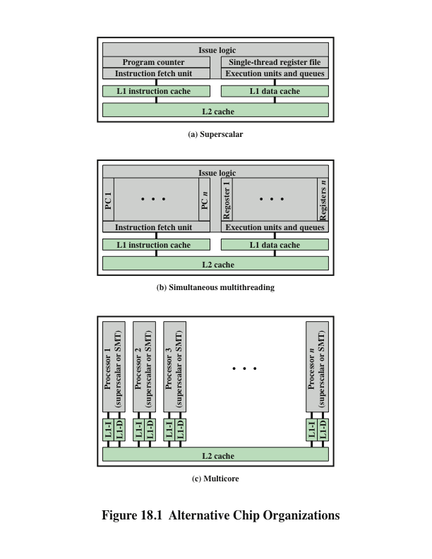
Alternative Chip Organization
Notes:
The organizational changes in processor design have primarily been focused on increasing instruction-level parallelism, so that more work could be done in each clock cycle. These changes include, in chronological order (Figure 18.1):
* Pipelining: Individual instructions are executed through a pipeline of stages so that while one instruction is executing in one stage of the pipeline, another instruction is executing in another stage of the pipeline.
* Superscalar: Multiple pipelines are constructed by replicating execution resources. This enables parallel execution of instructions in parallel pipelines, so long as hazards are avoided.
* Simultaneous multithreading (SMT): Register banks are replicated so that multiple threads can share the use of pipeline resources.
For each of these innovations, designers have over the years attempted to increase the performance of the system by adding complexity. In the case of pipelining, simple three-stage pipelines were replaced by pipelines with five stages, and then many more stages, with some implementations having over a dozen stages. There is a practical limit to how far this trend can be taken, because with more stages, there is the need for more logic, more interconnections, and more control signals. With superscalar organization, increased performance can be achieved by increasing the number of parallel pipelines. Again, there are diminishing returns as the number of pipelines increases. More logic is required to manage hazards and to stage instruction resources. Eventually, a single thread of execution reaches the point where hazards and resource dependencies prevent the full use of the multiple pipelines available. This same point of diminishing returns is reached with SMT, as the complexity of managing multiple threads over a set of pipelines limits the number of threads and number of pipelines that can be effectively utilized.

Slide 4
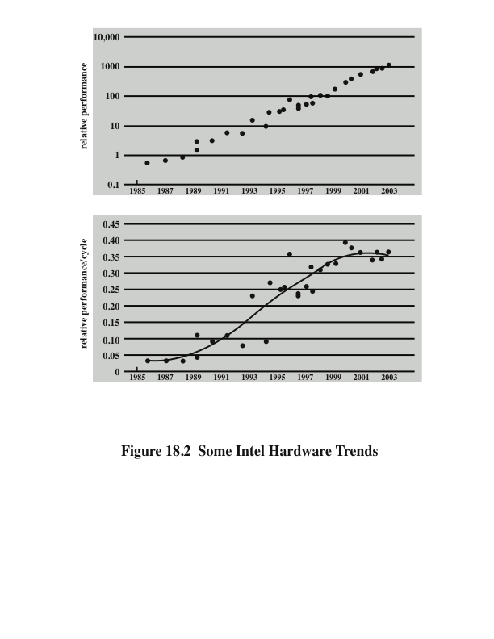
Intel Hardware Trends
Notes:
Figure 18.2, from [OLUK05], is instructive in this context. The upper graph shows the exponential increase in Intel processor performance over the years. The lower graph is calculated by combining Intel’s published SPEC CPU figures and processor clock frequencies to give a measure of the extent to which performance improvement is due to increased exploitation of instruction-level parallelism. There is a flat region in the late 1980s before parallelism was exploited extensively. This is followed by a steep rise as designers were able to increasingly exploit pipelining, superscalar techniques, and SMT. But, beginning about 2000, a new flat region of the curve appears, as the limits of effective exploitation of instruction-level parallelism are reached.
There is a related set of problems dealing with the design and fabrication of the computer chip. The increase in complexity to deal with all of the logical issues related to very long pipelines, multiple superscalar pipelines, and multiple SMT register banks means that increasing amounts of the chip area are occupied with coordinating and signal transfer logic. This increases the difficulty of designing, fabricating, and debugging the chips. The increasingly difficult engineering challenge related to processor logic is one of the reasons that an increasing fraction of the processor chip is devoted to the simpler memory logic. Power issues, discussed next, provide another reason.

Slide 5
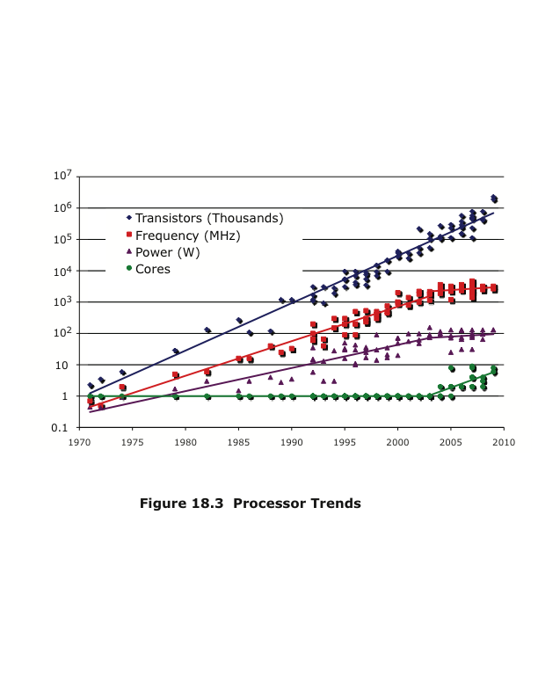
Processor Trends
Notes:
To maintain the trend of higher performance as the number of transistors per chip rise, designers have resorted to more elaborate processor designs (pipelining, super- scalar, SMT) and to high clock frequencies. Unfortunately, power requirements have grown exponentially as chip density and clock frequency have risen. This is shown in the Figure 18.3, which repeats Figure 2.11.

Slide 6
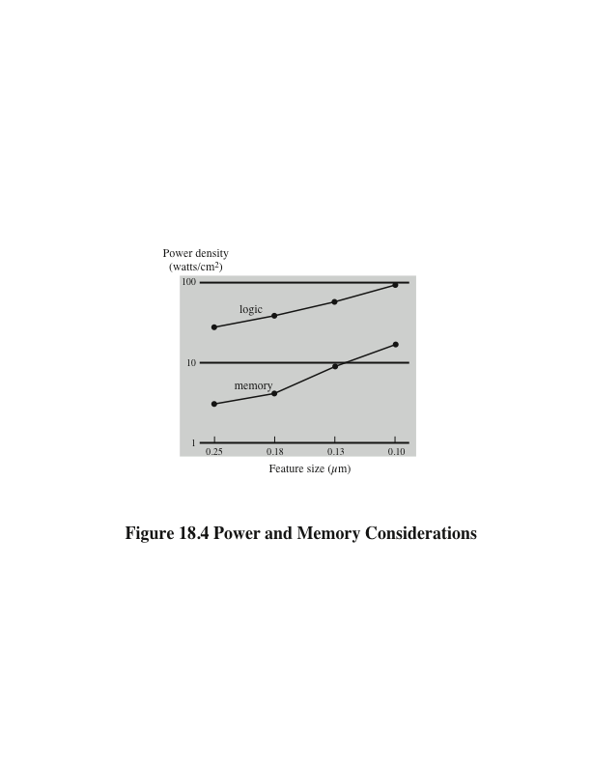
Power
Memory
Notes:
One way to control power density is to use more of the chip area for cache memory. Memory transistors are smaller and have a power density an order of magnitude lower than that of logic (see Figure 18.4). Further, as chip transistor density has increased, the percentage of chip area devoted to memory has grown, and is now well over half the chip area.

Slide 7
Power Consumption
By 2015 we can expect to see microprocessor chips with about 100 billion transistors on a 300 mm² die
Assuming that about 50-60% of the chip area is devoted to memory, the chip will support cache memory of about 100 MB and leave over 1 billion transistors available for logic
How to use all those logic transistors is a key design issue
Pollack’s Rule
States that performance increase is roughly proportional to square root of increase in complexity
Notes:
By 2015, we can expect to see microprocessor chips with about 100 billion transistors on a 300 mm² die. Assuming about 50–60% of the chip area is devoted to memory, the chip will support cache memory of about 100 MB and leave over 1 billion transistors available for logic.
How to use all those logic transistors is a key design issue. As discussed earlier in this section, there are limits to the effective use of such techniques as superscalar
and SMT. In general terms, the experience of recent decades has been encapsulated in a rule of thumb known as Pollack’s rule [POLL99], which states that performance increase is roughly proportional to square root of increase in complexity. In other words, if you double the logic in a processor core, then it delivers only 40% more performance. In principle, the use of multiple cores has the potential to provide near-linear performance improvement with the increase in the number of cores.
Power considerations provide another motive for moving toward a multicore organization. Because the chip has such a huge amount of cache memory, it becomes unlikely that any one thread of execution can effectively use all that memory. Even with SMT, you are multithreading in a relatively limited fashion and cannot therefore fully exploit a gigantic cache, whereas a number of relatively independent threads or processes has a greater opportunity to take full advantage of the cache memory.

Slide 8
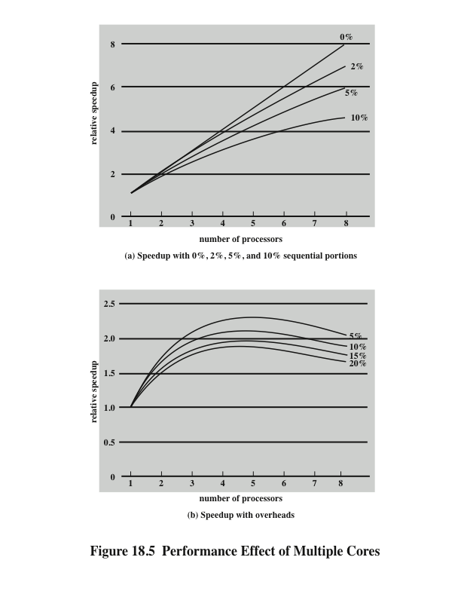
Performance Effect of Multiple Cores
Notes:
The potential performance benefits of a multicore organization depend on the ability to effectively exploit the parallel resources available to the application. Let us focus first on a single application running on a multicore system.
The law assumes a program in which a fraction (1 – f ) of the execution time involves code that is inherently serial and a fraction f that involves code that is infinitely parallelizable with no scheduling overhead.
This law appears to make the prospect of a multicore organization attractive. But as Figure 18.5a shows, even a small amount of serial code has a noticeable impact. If only 10% of the code is inherently serial (f = 0.9), running the program on a multi- core system with 8 processors yields a performance gain of only a factor of 4.7. In addition, software typically incurs overhead as a result of communication and distribution of work among multiple processors and as a result of cache coherence overhead. This results in a curve where performance peaks and then begins to degrade because of the increased burden of the overhead of using multiple processors (e.g., coordination and OS management). Figure 18.5b, from [MCDO05], is a representative example.

Slide 9
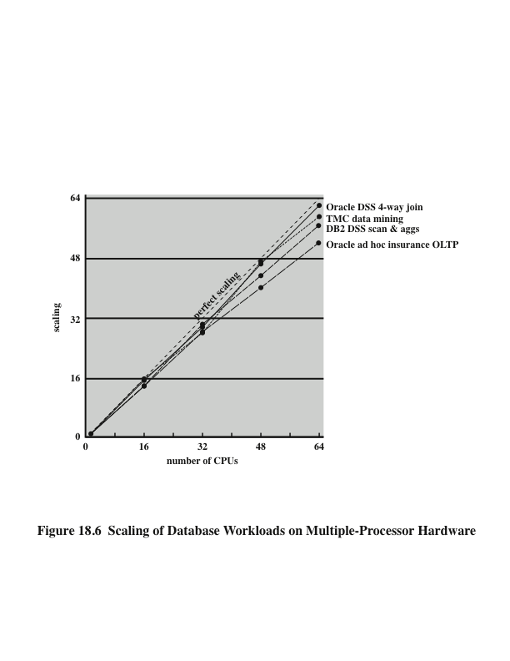
Scaling of Database Workloads on Multiple-Processor Hardware
Notes:
However, software engineers have been addressing this problem and there are numerous applications in which it is possible to effectively exploit a multicore sys- tem. [MCDO05] analyzes the effectiveness of multicore systems on a set of database applications, in which great attention was paid to reducing the serial fraction within hardware architectures, operating systems, middleware, and the database application software. Figure 18.6 shows the result. As this example shows, database management systems and database applications are one area in which multicore systems can be used effectively. Many kinds of servers can also effectively use the parallel multicore organization, because servers typically handle numerous relatively independent transactions in parallel.

Slide 10
Effective Applications for Multicore Processors
Multi-threaded native applications
Characterized by having a small number of highly threaded processes
Lotus Domino, Siebel CRM (Customer Relationship Manager)
Multi-process applications
Characterized by the presence of many single-threaded processes
Oracle, SAP, PeopleSoft
Java applications
Java Virtual Machine is a multi-threaded process that provides scheduling and memory management for Java applications
Sun’s Java Application Server, BEA’s Weblogic, IBM Websphere, Tomcat
Multi-instance applications
One application running multiple times
If multiple application instances require some degree of isolation, virtualization technology can be used to provide each of them with its own separate and secure environment
Notes:
In addition to general-purpose server software, a number of classes of applications benefit directly from the ability to scale throughput with the number of cores. [MCDO06] lists the following examples:
Multithreaded native applications: Multithreaded applications are characterized by having a small number of highly threaded processes. Examples of threaded applications include Lotus Domino or Siebel CRM (Customer Relationship Manager).
Multiprocess applications: Multiprocess applications are characterized by the presence of many single-threaded processes. Examples of multi-process applications include the Oracle database, SAP, and PeopleSoft.
Java applications: Java applications embrace threading in a fundamental way. Not only does the Java language greatly facilitate multithreaded applications, but the Java Virtual Machine is a multithreaded process that provides scheduling and memory management for Java applications. Java applications that can benefit directly from multicore resources include application servers such as Sun’s Java Application Server, BEA’s Weblogic, IBM’s Websphere, and the open-source Tomcat application server. All applications that use a Java 2 Platform, Enterprise Edition (J2EE platform) application server can immediately benefit from multicore technology.
• Multi-instance applications: Even if an individual application does not scale to take advantage of a large number of threads, it is still possible to gain from multicore architecture by running multiple instances of the application in parallel. If multiple application instances require some degree of isolation, virtualization technology (for the hardware of the operating system) can be used to provide each of them with its own separate and secure environment.

Slide 11
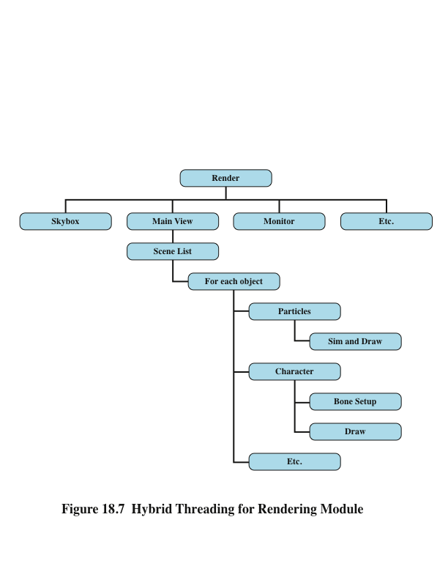
Hybrid Threading for Rendering Module
Notes:
Valve is an entertainment and technology company that has developed a number of popular games, as well as the Source engine, one of the most widely played game engines available. Source is an animation engine used by Valve for its games and licensed for other game developers.
In recent years, Valve has reprogrammed the Source engine software to use multithreading to exploit the power of multicore processor chips from Intel and AMD [REIM06]. The revised Source engine code provides more powerful support for Valve games such as Half Life 2.
Valve found that through coarse threading, it could achieve up to twice the performance across two processors compared to executing on a single processor. But this performance gain could only be achieved with contrived cases. For real- world gameplay, the improvement was on the order of a factor of 1.2. Valve also found that effective use of fine-grain threading was difficult. The time per work unit can be variable, and managing the timeline of outcomes and consequences involved complex programming.
Valve found that a hybrid threading approach was the most promising and would scale the best as multicore systems with eight or sixteen processors became
available. Valve identified systems that operate very effectively when assigned to a single processor permanently. An example is sound mixing, which has little user interaction, is not constrained by the frame configuration of windows, and works on its own set of data. Other modules, such as scene rendering, can be organized into a number of threads so that the module can execute on a single processor but achieve greater performance as it is spread out over more and more processors.
Figure 18.7 illustrates the thread structure for the rendering module. In this hierarchical structure, higher-level threads spawn lower-level threads as needed. The rendering module relies on a critical part of the Source engine, the world list, which is a database representation of the visual elements in the game’s world. The first task is to determine what are the areas of the world that need to be rendered. The next task is to determine what objects are in the scene as viewed from multiple angles. Then comes the processor-intensive work. The rendering module has to work out the rendering of each object from multiple points of view, such as the player’s view, the view of TV monitors, and the point of view of reflections in water.
Some of the key elements of the threading strategy for the rendering module are listed in [LEON07] and include the following:
• Construct scene-rendering lists for multiple scenes in parallel (e.g., the world and its reflection in water).
• Overlap graphics simulation.
* Compute character bone transformations for all characters in all scenes in
parallel.
* Allow multiple threads to draw in parallel.
The designers found that simply locking key databases, such as the world list, for a thread was too inefficient. Over 95% of the time, a thread is trying to read from a data set, and only 5% of the time at most is spent in writing to a data set. Thus, a concurrency mechanism known as the single-writer-multiple-readers model works effectively.

Slide 12
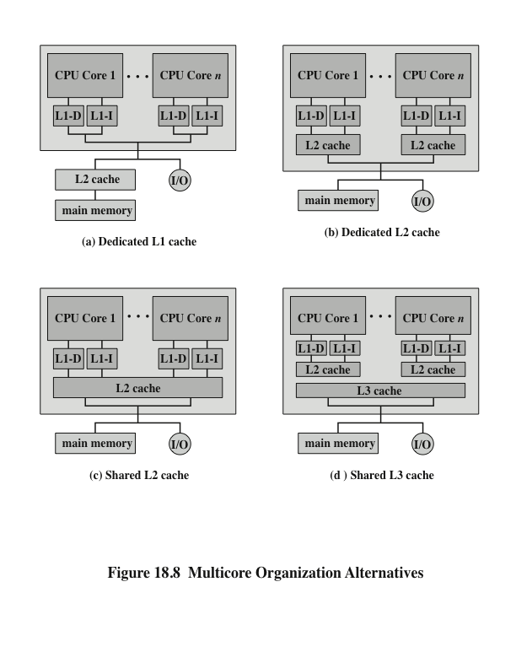
Multicore Organization Alternatives
Notes:
Figure 18.8 shows four general organizations for multicore systems. Figure 18.8a is an organization found in some of the earlier multicore computer chips and is still seen in embedded chips. In this organization, the only on-chip cache is L1 cache, with each core having its own dedicated L1 cache. Almost invariably, the L1 cache is divided into instruction and data caches. An example of this organization is the ARM11 MPCore.
The organization of Figure 18.8b is also one in which there is no on-chip cache sharing. In this, there is enough area available on the chip to allow for L2 cache. An example of this organization is the AMD Opteron. Figure 18.8c shows a similar allocation of chip space to memory, but with the use of a shared L2 cache. The Intel Core Duo has this organization. Finally, as the amount of cache memory available on the chip continues to grow, performance considerations dictate splitting off a separate, shared L3 cache, with dedicated L1 and L2 caches for each core processor. The Intel Core i7 is an example of this organization.
Another organizational design decision in a multicore system is whether the individual cores will be superscalar or will implement simultaneous multithreading (SMT). For example, the Intel Core Duo uses superscalar cores, whereas the Intel Core i7 uses SMT cores. SMT has the effect of scaling up the number of hardware- level threads that the multicore system supports. Thus, a multicore system with four cores and SMT that supports four simultaneous threads in each core appears the same to the application level as a multicore system with 16 cores. As software is developed to more fully exploit parallel resources, an SMT approach appears to be more attractive than a superscalar approach.

Slide 13
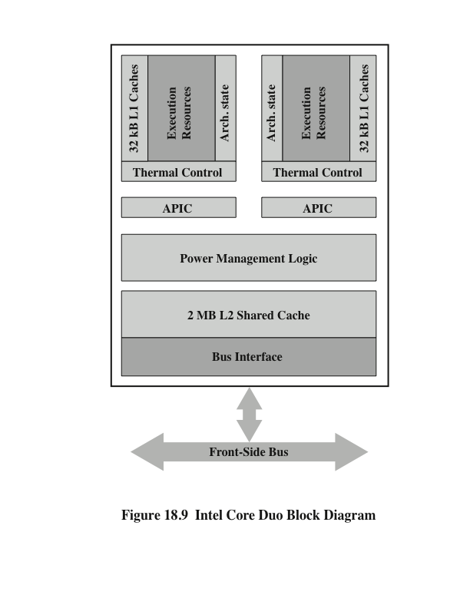
Intel Core Duo Block Diagram
Notes:
The Intel Core Duo, introduced in 2006, implements two x86 superscalar processors with a shared L2 cache (Figure 18.8c).
The general structure of the Intel Core Duo is shown in Figure 18.9. Let us consider the key elements starting from the top of the figure. As is common in multicore systems, each core has its own dedicated L1 cache. In this case, each core has a 32-kB instruction cache and a 32-kB data cache.
Each core has an independent thermal control unit. With the high transistor density of today’s chips, thermal management is a fundamental capability, especially for laptop and mobile systems. The Core Duo thermal control unit is designed to manage chip heat dissipation to maximize processor performance within thermal constraints. Thermal management also improves ergonomics with a cooler system and lower fan acoustic noise. In essence, the thermal management unit monitors digital sensors for high-accuracy die temperature measurements. Each core can be defined as an independent thermal zone. The maximum temperature for each thermal zone is reported separately via dedicated registers that can be polled by software. If the temperature in a core exceeds a threshold, the thermal control unit reduces the clock rate for that core to reduce heat generation.

Slide 14
Intel x86 Multicore Organization Core Duo
Advanced Programmable Interrupt Controller (APIC)
Provides inter-processor interrupts which allow any process to interrupt any other processor or set of processors
Accepts I/O interrupts and routes these to the appropriate core
Includes a timer which can be set by the OS to generate an interrupt to the local core
Power management logic
Responsible for reducing power consumption when possible, thus increasing battery life for mobile platforms
Monitors thermal conditions and CPU activity and adjusts voltage levels and power consumption appropriately
Includes an advanced power-gating capability that allows for an ultra fine grained logic control that turns on individual processor logic subsystems only if and when they are needed
Continued . . .
Notes:
The next key element of the Core Duo organization is the Advanced Programmable Interrupt Controller (APIC). The APIC performs a number of functions, including the following:
1. The APIC can provide interprocessor interrupts, which allow any process to interrupt any other processor or set of processors. In the case of the Core Duo, a thread in one core can generate an interrupt, which is accepted by the local APIC, routed to the APIC of the other core, and communicated as an interrupt to the other core.
2. The APIC accepts I/O interrupts and routes these to the appropriate core.
3. Each APIC includes a timer, which can be set by the OS to generate an interrupt to the local core.
The power management logic is responsible for reducing power consumption
when possible, thus increasing battery life for mobile platforms, such as laptops. In essence, the power management logic monitors thermal conditions and CPU activity and adjusts voltage levels and power consumption appropriately. It includes an advanced power-gating capability that allows for an ultra fine-grained logic control that turns on individual processor logic subsystems only if and when they are needed.

Slide 15
Intel x86 Multicore Organization Core Duo
2MB shared L2 cache
Cache logic allows for a dynamic allocation of cache space based on current core needs
MESI support for L1 caches
Extended to support multiple Core Duo in SMP
L2 cache controller allows the system to distinguish between a situation in which data are shared by the two local cores, and a situation in which the data are shared by one or more caches on the die as well as by an agent on the external bus
Bus interface
Connects to the external bus, known as the Front Side Bus, which connects to main memory, I/O controllers, and other processor chips
Notes:
The Core Duo chip includes a shared 2-MB L2 cache. The cache logic allows for a dynamic allocation of cache space based on current core needs, so that one core can be assigned up to 100% of the L2 cache. The L2 cache includes logic to support the MESI cache coherence protocol for the attached L1 caches. The key point to consider is when a cache write is done at the L1 level. A cache line gets the M state when a processor writes to it; if the line is not in E or M-state prior to writing it, the cache sends a Read-For-Ownership (RFO) request that ensures that the line exists in the L1 cache and is in the I state in the other L1 cache. The Intel Core Duo extends this protocol to take into account the case when there are multiple Core Duo chips organized as a symmetric multiprocessor (SMP) system. The L2 cache controller allow the system to distinguish between a situation in which data are shared by the two local cores, but not with the rest of the world, and a situation in which the data are shared by one or more caches on the die as well as by an agent on the external bus (can be another processor). When a core issues an RFO, if the line is shared only by the other cache within the local die, we can resolve the RFO internally very fast, without going to the external bus at all. Only if the line is shared with another agent on the external bus do we need to issue the RFO externally.
The bus interface connects to the external bus, known as the Front Side Bus, which connects to main memory, I/O controllers, and other processor chips.

Slide 16
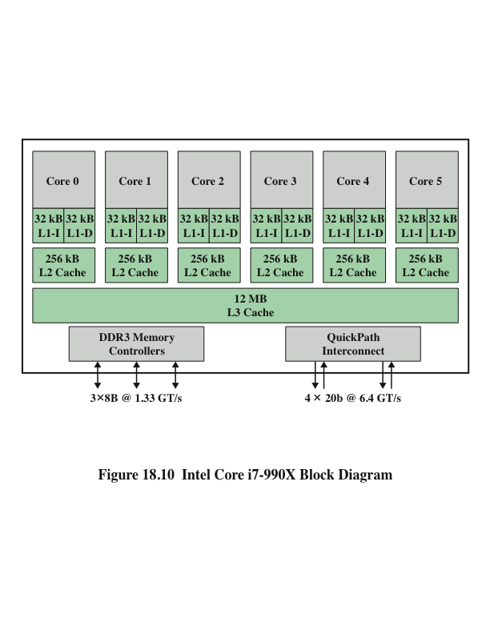
Intel Core i7-990X Block Diagram
Notes:
The Intel Core i7-990X, introduced in November of 2008, implements four x86 SMT processors, each with a dedicated L2 cache, and with a shared L3 cache (Figure 18.8d).
The general structure of the Intel Core i7-990X is shown in Figure 18.10. Each core has its own dedicated L2 cache and the four cores share a 12-MB L3 cache. One mechanism Intel uses to make its caches more effective is prefetching, in which the hardware examines memory access patterns and attempts to fill the caches speculatively with data that’s likely to be requested soon. It is interesting to compare the performance of this three-level on chip cache organization with a comparable two- level organization from Intel.

Slide 17

Table 18.1 Cache Latency
Notes:
Table 18.1 shows the cache access latency, in terms of clock cycles for two Intel multicore systems running at the same clock frequency. The Core 2 Quad has a shared L2 cache, similar to the Core Duo. The Core i7 improves on L2 cache performance with the use of the dedicated L2 caches, and provides a relatively high-speed access to the L3 cache.
The Core i7-990X chip supports two forms of external communications to other chips. The DDR3 memory controller brings the memory controller for the DDR main memory onto the chip. The interface supports three channels that are 8 bytes wide for a total bus width of 192 bits, for an aggregate data rate of up to 32 GB/s. With the memory controller on the chip, the Front Side Bus is eliminated.

Slide 18
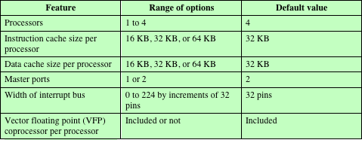
Table 18.2 ARM11 MPCore Configurable Options
Notes:
The ARM11 MPCore is a multicore product based on the ARM11 processor family. The ARM11 MPCore can be configured with up to four processors, each with its own L1 instruction and data caches, per chip. Table 18.2 lists the configurable options for the system, including the default values.

Slide 19
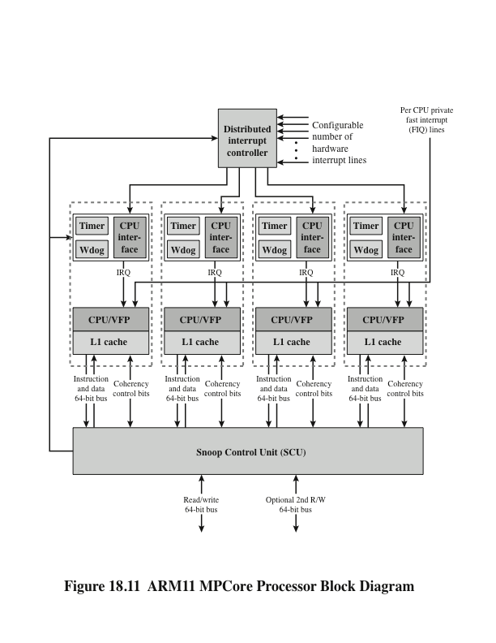
ARM11 MPCore Processor Block Diagram
Notes:
Figure 18.11 presents a block diagram of the ARM11 MPCore. The key elements of the system are as follows:
Distributed interrupt controller (DIC): Handles interrupt detection and interrupt prioritization. The DIC distributes interrupts to individual processors.
Timer: Each CPU has its own private timer that can generate interrupts.
Watchdog: Issues warning alerts in the event of software failures. If the watchdog is enabled, it is set to a predetermined value and counts down to 0. It is periodically reset. If the watchdog value reaches zero, an alert is issued.
CPU interface: Handles interrupt acknowledgment, interrupt masking, and interrupt completion acknowledgement.
CPU: A single ARM11 processor. Individual CPUs are referred to as MP11 CPUs.
Vector floating-point (VFP) unit: A coprocessor that implements floating- point operations in hardware.
L1 cache: Each CPU has its own dedicated L1 data cache and L1 instruction cache.
Snoop control unit (SCU): Responsible for maintaining coherency among L1 data caches.

Slide 20
Interrupt Handling
Distributed Interrupt Controller (DIC) collates interrupts from a large number of sources
It provides:
Masking of interrupts
Prioritization of the interrupts
Distribution of the interrupts to the target MP11 CPUs
Tracking status of interrupts
Generation of interrupts by software
Is a single function unit that is placed in the system alongside MP11 CPUs
Memory mapped
Accessed by CPUs via private interface through SCU
Provides a means of routing an interrupt request to a single CPU or multiple CPUs, as required
Provide a means of interprocessor communication so that a thread on one CPU can cause activity by a thread on another CPU
Notes:
The Distributed Interrupt Controller (DIC) collates interrupts from a large number of sources. It provides
Masking of interrupts
Prioritization of the interrupts
Distribution of the interrupts to the target MP11 CPUs
Tracking the status of interrupts
Generation of interrupts by software
The DIC is a single functional unit that is placed in the system alongside MP11 CPUs. This enables the number of interrupts supported in the system to
be independent of the MP11 CPU design. The DIC is memory mapped; that is, control registers for the DIC are defined relative to a main memory base address. The DIC is accessed by the MP11 CPUs using a private interface through the SCU.
The DIC is designed to satisfy two functional requirements:
Provide a means of routing an interrupt request to a single CPU or multiple CPUs, as required.
Provide a means of interprocessor communication so that a thread on one CPU can cause activity by a thread on another CPU.

Slide 21
DIC Routing
The DIC can route an interrupt to one or more CPUs in the following three ways:
An interrupt can be directed to a specific processor only
An interrupt can be directed to a defined group of processors
An interrupt can be directed to all processors
OS can generate interrupt to:
All but self
Self
Other specific CPU
Typically combined with shared memory for inter-process communication
16 interrupt IDs available for inter-processor communication
Notes:
The DIC can route an interrupt to one or more CPUs in the following three ways:
An interrupt can be directed to a specific processor only.
An interrupt can be directed to a defined group of processors. The MPCore views the first processor to accept the interrupt, typically the least loaded, as being best positioned to handle the interrupt.
An interrupt can be directed to all processors.
From the point of view of software running on a particular CPU, the OS can generate an interrupt to all but self, to self, or to specific other CPUs. For communication between threads running on different CPUs, the interrupt mechanism is typically combined with shared memory for message passing. Thus, when a thread is interrupted by an interprocessor communication interrupt, it reads from the appropriate block of shared memory to retrieve a message from the thread that triggered the interrupt. A total of 16 interrupt IDs per CPU are available for interprocessor communication.

Slide 22
Interrupt States
From the point of view of an MP11 CPU, an interrupt can be:
Inactive
Is one that is nonasserted, or which in a multi- processing environment has been completely processed by that CPU but can still be either Pending or Active in some of the CPUs to which it is targeted, and so might not have been cleared at the interrupt source
Pending
Is one that has been asserted, and for which processing has not started on that CPU
Active
Is one that has been started on that CPU, but processing is not complete
An Active interrupt can be pre-empted when a new interrupt of higher priority interrupts MP11 CPU interrupt processing
Notes:
From the point of view of an MP11 CPU, an interrupt can be
Inactive: An Inactive interrupt is one that is non-asserted, or which in a multi- processing environment has been completely processed by that CPU but can still be either Pending or Active in some of the CPUs to which it is targeted, and so might not have been cleared at the interrupt source.
Pending: A Pending interrupt is one that has been asserted, and for which processing has not started on that CPU.
Active: An Active interrupt is one that has been started on that CPU, but processing is not complete. An Active interrupt can be pre-empted when a new interrupt of higher priority interrupts MP11 CPU interrupt processing.

Slide 23
Interrupt Sources
Inter-process Interrupts (IPI)
Private to CPU
ID0-ID15
Software triggered
Priority depends on target CPU not source
Private timer and/or watchdog interrupt
ID29 and ID30
Legacy FIQ line
Legacy FIQ pin, per CPU, bypasses interrupt distributor
Directly drives interrupts to CPU
Hardware
Triggered by programmable events on associated interrupt lines
Up to 224 lines
Start at ID32
Notes:
Interrupts come from the following sources:
Interprocessor interrupts (IPIs): Each CPU has private interrupts, ID0-ID15, that can only be triggered by software. The priority of an IPI depends on the receiving CPU, not the sending CPU.
Private timer and/or watchdog interrupts: These use interrupt IDs 29 and 30.
Legacy FIQ line: In legacy IRQ mode, the legacy FIQ pin, on a per CPU basis, bypasses the Interrupt Distributor logic and directly drives interrupt requests into the CPU.
Hardware interrupts: Hardware interrupts are triggered by programmable events on associated interrupt input lines. CPUs can support up to 224 interrupt input lines. Hardware interrupts start at ID32.

Slide 24
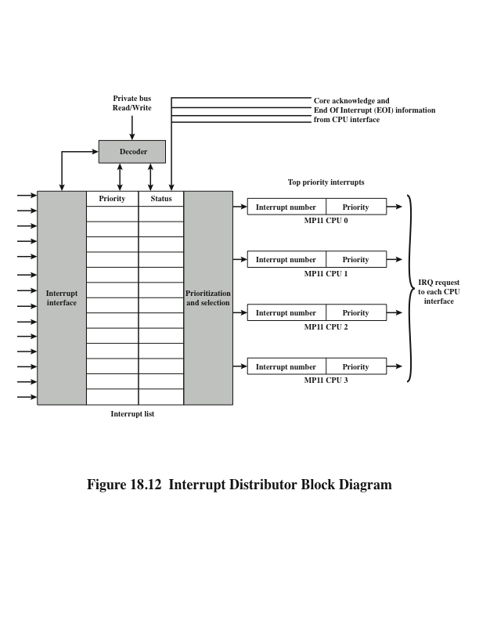
ARM11 MPCore Interrupt Distributor
Notes:
Figure 18.12 is a block diagram of the DIC. The DIC is configurable to sup- port between 0 and 255 hardware interrupt inputs. The DIC maintains a list of interrupts, showing their priority and status. The Interrupt Distributor transmits to each CPU Interface the highest Pending interrupt for that interface. It receives back the
information that the interrupt has been acknowledged, and can then change the status of the corresponding interrupt. The CPU Interface also transmits End of Interrupt Information (EOI), which enables the Interrupt Distributor to update the status of this interrupt from Active to Inactive.

Slide 25
Cache Coherency
Snoop Control Unit (SCU) resolves most shared data bottleneck issues
L1 cache coherency scheme is based on the MESI protocol
Direct Data Intervention (DDI)
Enables copying clean data between L1 caches without accessing external memory
Reduces read after write from L1 to L2
Can resolve local L1 miss from remote L1 rather than L2
Duplicated tag RAMs
Cache tags implemented as separate block of RAM
Same length as number of lines in cache
Duplicates used by SCU to check data availability before sending coherency commands
Only send to CPUs that must update coherent data cache
Migratory lines
Allows moving dirty data between CPUs without writing to L2 and reading back from external memory
Notes:
The MPCore’s Snoop Control Unit (SCU) is designed to resolve most of the traditional bottlenecks related to access to shared data and the scalability limitation introduced by coherence traffic.
The L1 cache coherency scheme is based on the MESI protocol described in Chapter 17. The SCU monitors operations with shared data to optimize MESI state migration. The SCU introduces three types of optimization: direct data intervention, duplicated tag RAMs, and migratory lines.
Direct data intervention (DDI) enables copying clean data from one CPU L1 data cache to another CPU L1 data cache without accessing external memory. This reduces read after read activity from the Level 1 cache to the Level 2 cache. Thus, a local L1 cache miss is resolved in a remote L1 cache rather than from access to the shared L2 cache.
Recall that main memory location of each line within a cache is identified by a tag for that line. The tags can be implemented as a separate block of RAM of the same length as the number of lines in the cache. In the SCU, duplicated tag RAMs are duplicated versions of L1 tag RAMs used by the SCU to check for data availability before sending coherency commands to the relevant CPUs. Coherency commands are sent only to CPUs that must update their coherent data cache. This reduces the power consumption and performance impact from snooping into and manipulating each processor’s cache on each memory update. Having tag data available locally lets the SCU limit cache manipulations to processors that have cache lines in common.
The migratory lines feature enables moving dirty data from one CPU to another without writing to L2 and reading the data back in from external memory.

Slide 26
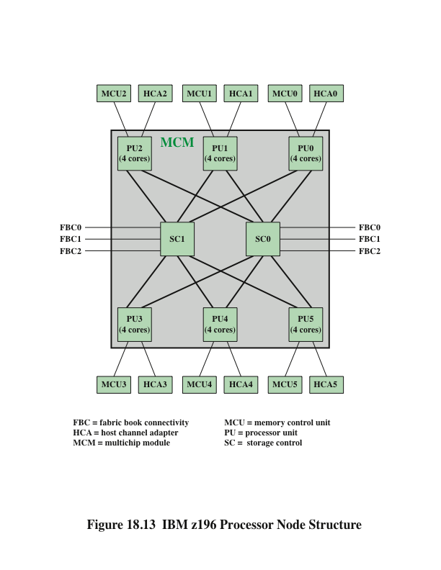
IBM z196 Processor Node Structure
Notes:
The principal building block of the mainframe is the multichip module (MCM), a glass ceramic module that houses 8 chips. The key components of the configuration are shown in Figure 18.13:
• Processor unit (PU): There are six 5.2-GHz processor PU chips, each containing four processor cores plus three levels of cache. The PUs have external
connections to main memory via memory control units and to I/O via host
channel adapters. Thus, each MCM includes 24 core processors.
• Storage control (SC): The two SC chips contain an additional level of cache plus interconnection logic for connecting to three other MCMs.
The microprocessor core features a wide superscalar, out-of-order pipe- line that can decode three z/Architecture CISC instructions per clock cycle and execute up to five operations per cycle. The instruction execution path is predicted by branch direction and target prediction logic. Each core has six execution units: two integer units, one floating-point unit, two load/store units, and one decimal unit.

Slide 27
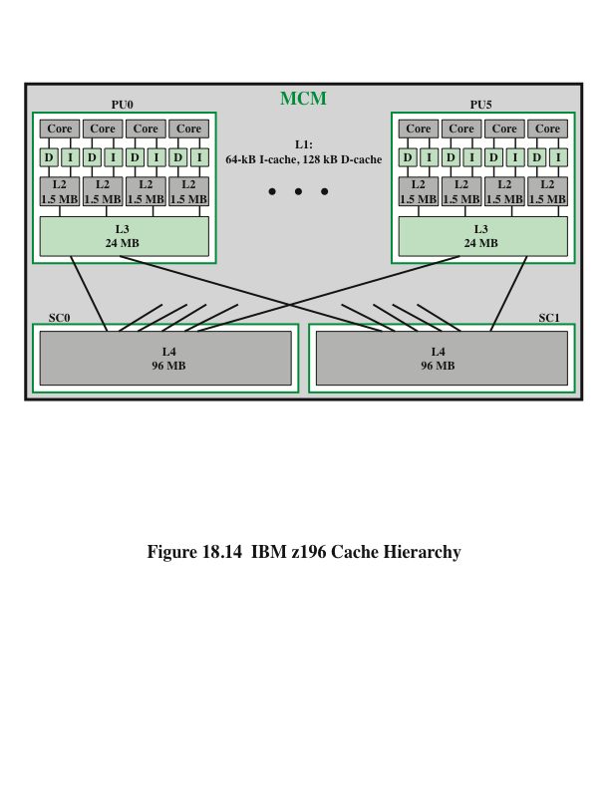
IBM z196 Cache Hierarchy
Notes:
The z196 incorporates a four-level cache structure, which IBM states is the industry’s first four-level cache. We look at each level in turn (Figure 18.14).
Each core has a dedicated 192-kB level 1 cache, divided into a 128-kB data cache and a 64-kB instruction cache. The L1 cache is designed as a store-through cache to L2, that is, altered data are also stored to the next level of memory. These caches are 8-way set associative.
Each core also has a dedicated 1.5-MB level 2 cache, which is also a store- through to L3. The L2 cache is 12-way set associative.
Each 4-core processor unit chip includes a 24-MB level 3 cache shared by all four processors. Because L1 and L2 caches are store-through, the L3 cache must process every store generated by the four cores on its chip. This feature maintains data availability during a core failure. The L3 cache is 12-way set associative. The z196 implements embedded DRAM (eDRAM) as L3 cache memory on the chip.
While this eDRAM memory is slower than static RAM (SRAM) normally used to implement cache memory, you can put a lot of it onto a given area. For many workloads, having more memory closer to the chip is more important than having fast memory.
Finally, all 6 PUs on an MCM share a 192-MB level 4 cache, which is split into one 96-MB cache on each SC. The principal motivation for incorporating a level 4 cache is that the very high clock speed of the core processors results in a significant mismatch with main memory speed. The fourth cache layer is needed to keep the cores running efficiently. The large shared L3 and L4 caches are suited to transaction-processing workloads exhibiting a high degree of data sharing and task swapping. The L4 cache is 24-way set associative. The SC chip, which houses the L4 cache, also acts as an L4 cache cross-point switch for L4-to-L4 traffic to up to three remote books by three bidirectional data buses. L4 is the coherence manager, meaning that all memory fetches must be in the L4 cache before that data can be used by the processor.
All four caches use a line size of 256 bytes.

Slide 28
Key terms
Chapter 18
Amdahl’s law
chip multiprocessor
multicore
simultaneous multithreading (SMT)
superscalar
Notes:
Chapter 5 summary.

Slide 29
Summary
Multicore
Computers
Chapter 18
Multicore organization
Intel x86 multicore organization
Intel Core Duo
Intel Core i7-990X
ARM11 MPCore
Interrupt handling
Cache coherency
IBM zEnterprise mainframe
Hardware performance issues
Increase in parallelism and complexity
Power consumption
Software performance issues
Software on multicore
Valve game software example
Notes:
Chapter 18 summary.

