Slide 1
Analyzing the Neighborhoods in Porto to Start a new Restaurant
IBM Applied Data Science Capstone Project
19/07/2021
Carlos Fortes

Slide 2
Problem
While opening a restaurant can be a very lucrative business, a lack of demand causes many restaurants to close within the first year of opening
Factors for Restaurant’s Success: Location, Competition, Quality of Food
Business Problem: If the client wanted to open an mexican Restaurant in Porto, what areas are the best options to open the restaurant?

Slide 3
Data
Data Sources:
Foursquare API
Neighborhood coordinates

Slide 4
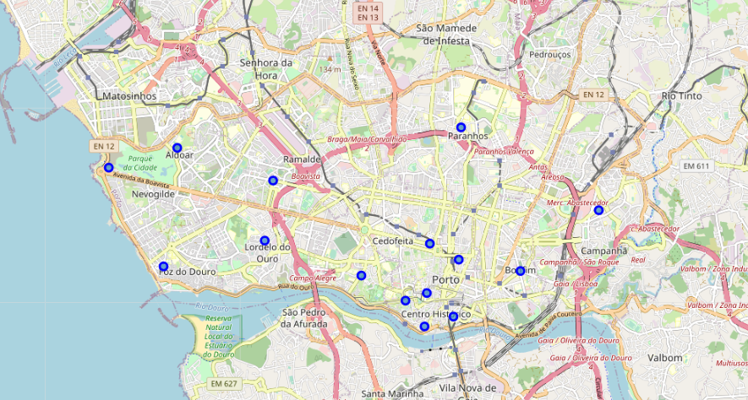
Problem

Slide 5
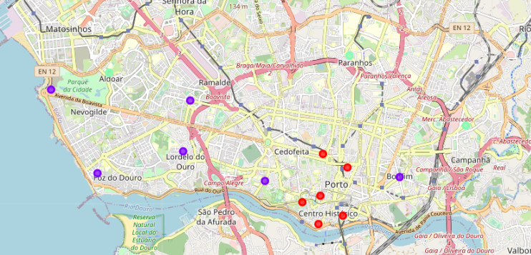
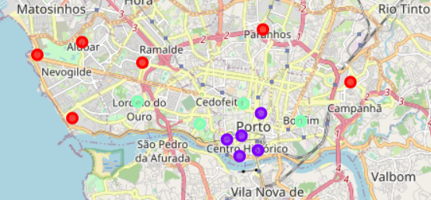
Foursqaure API
Cluster 0 = Red Cluster 1 = Purple Cluster 2 = Blue Cluster 3 = Turquoise Cluster 4 = Orange

Slide 6
Cluster | Characteristics
Cluster 0 ‘RED’ | Outer city Type
Cluster 1 ‘Purple’ | Downtown Type
Cluster 2 ‘Blue Teal’ | Inner city Type

Slide 7
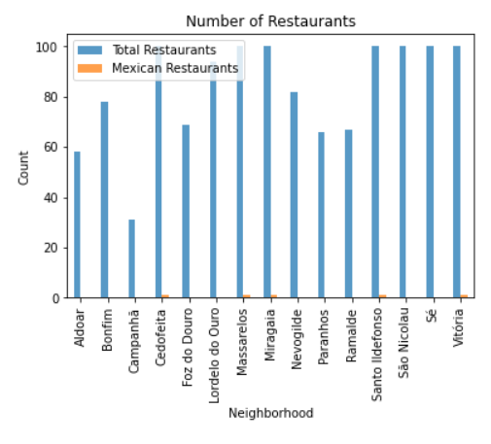
From the plot, the following areas can be eliminated due to the large number of restaurants:
Cedofeita
Massarelos
Miragaia

Slide 8
Conclusion
The optimal location to open a Mexican restaurant in Porto, Portugal would be the Bonfim area.

Slide 9
Thank you!

