Slide 1

Final Project
Docker Deployment System Built On
Amazon Web Services
Chris Fortier
cscie90 Cloud Computing
Harvard University Extension School
Prof. Zoran B. Djordjević

Slide 2
Objective
To implement a rolling deployment of Docker containers without disrupting current traffic.

Slide 3
Technologies
Amazon Web Services
  Cloudformation
  VPC
  EC2
  Route53
  Auto-Scaling Groups
Docker
Consul

Slide 4
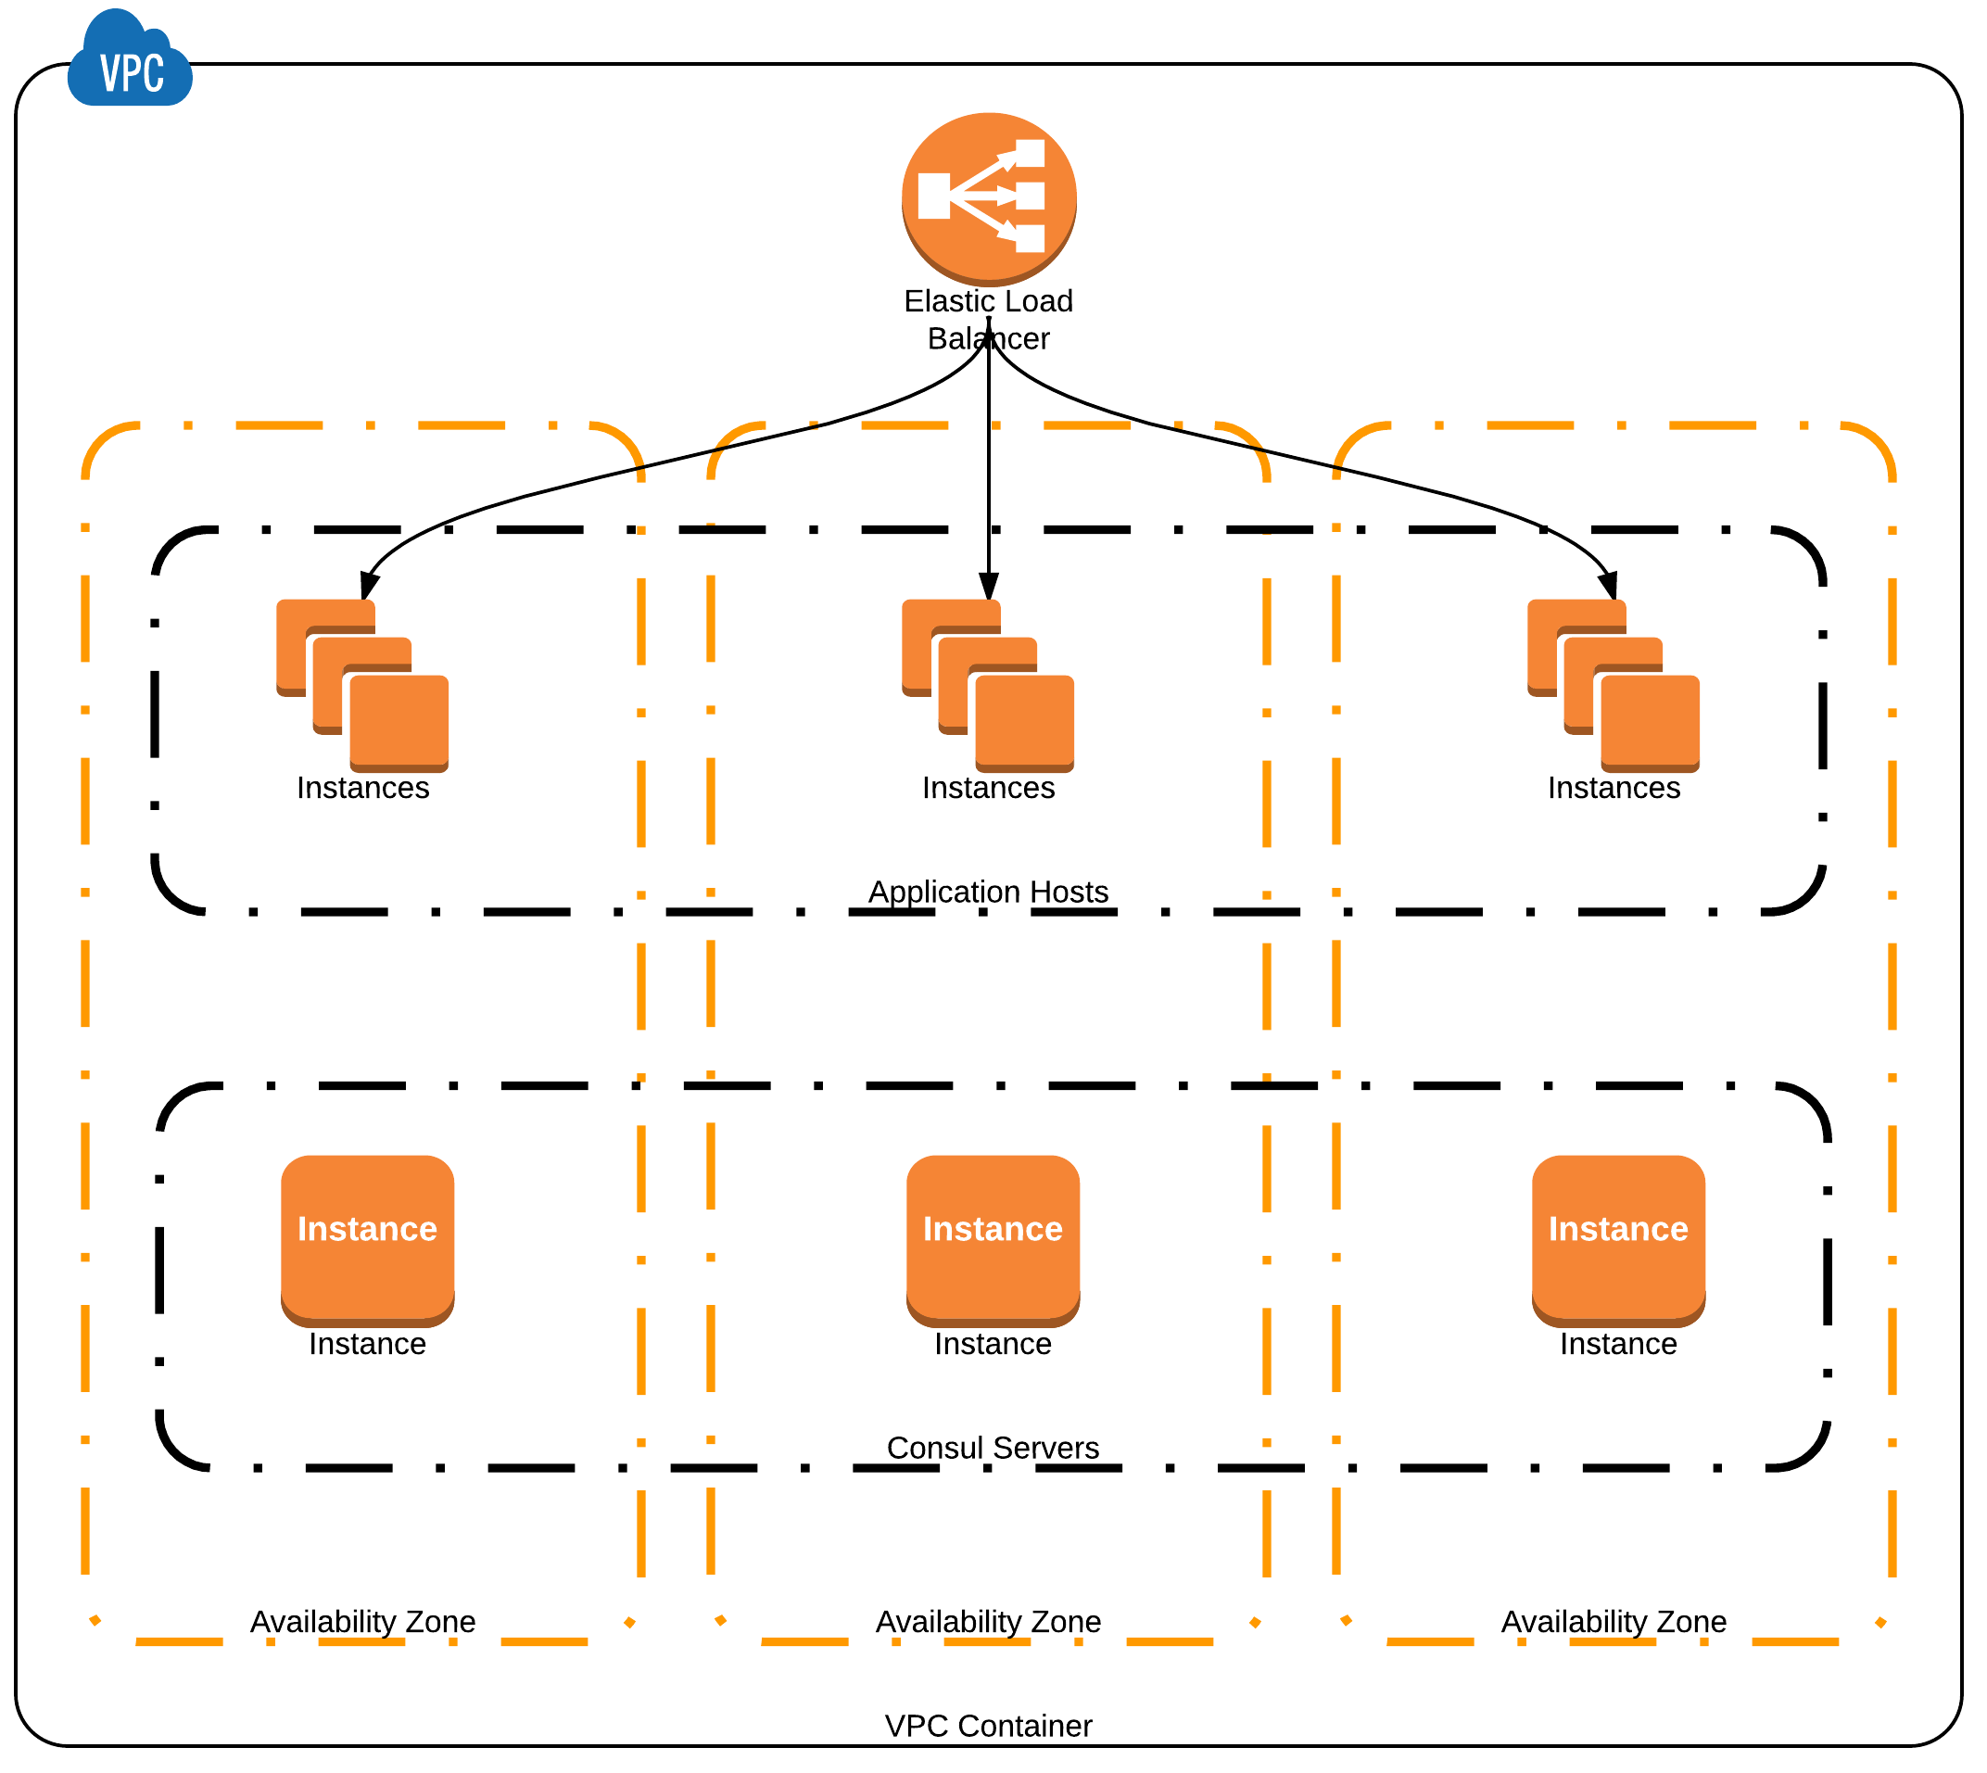

Slide 5
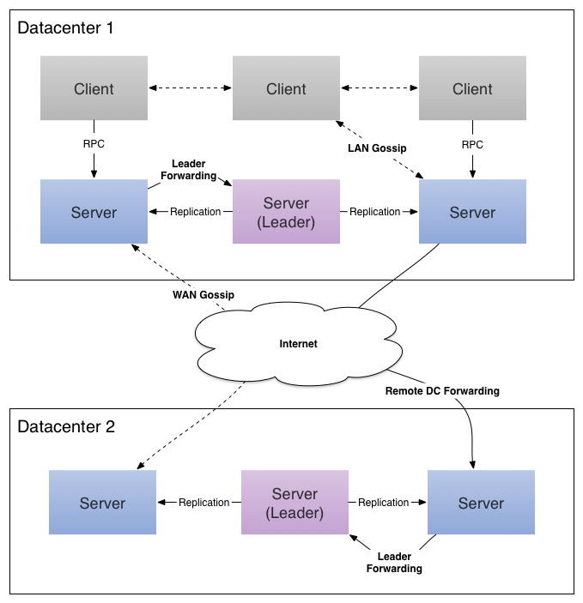

Slide 6
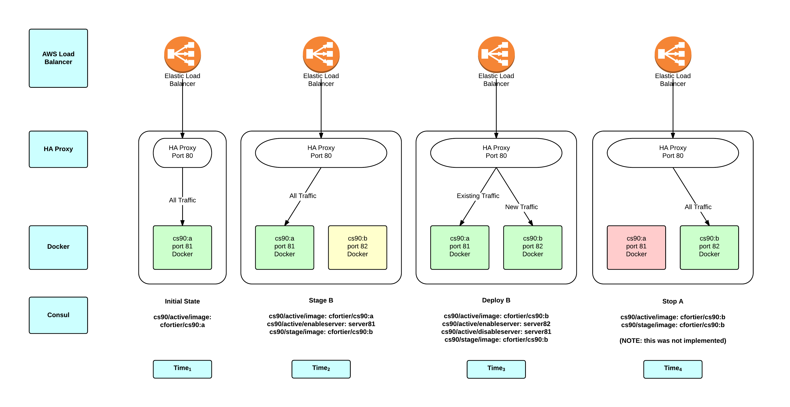

Slide 7
Initial Deployment
Query Consul for active image
Pull and Run active image/container
Health Check Container
Update HA Proxy

Slide 8
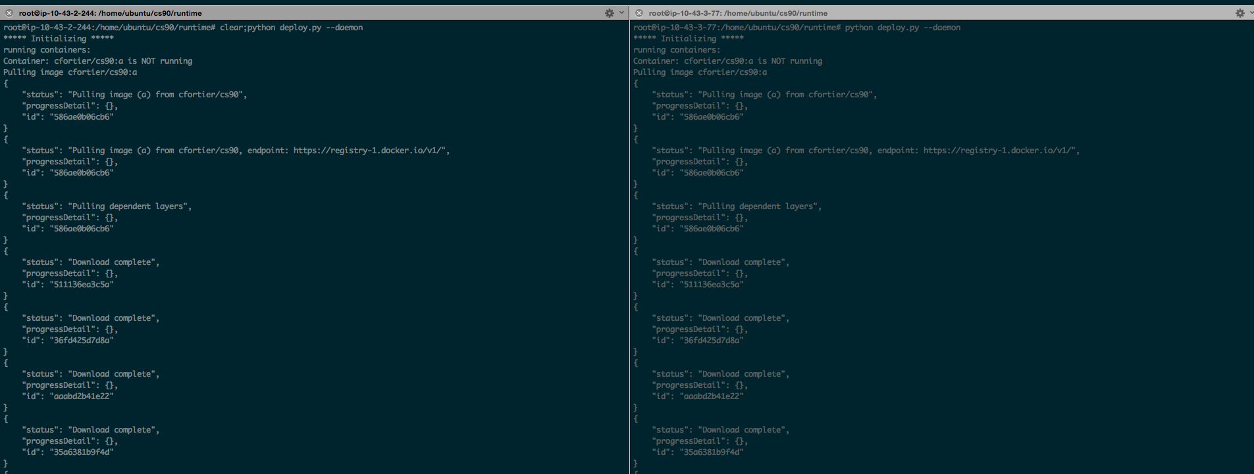
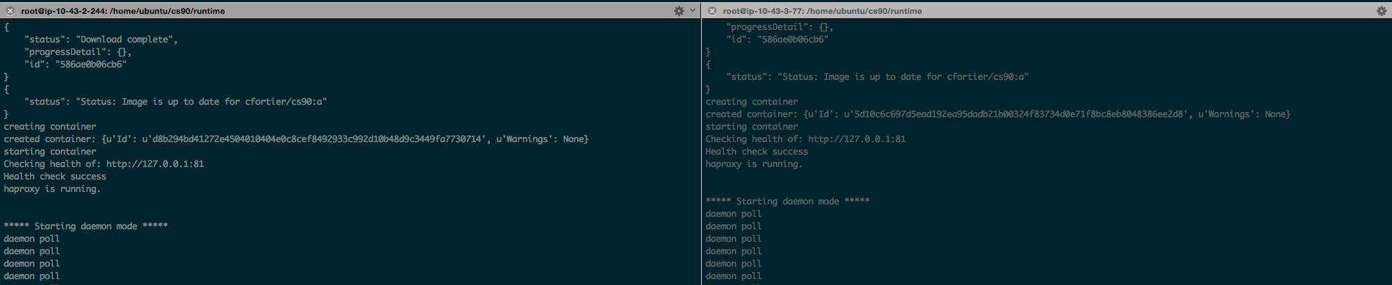

Slide 9
Update Deployment
Poll Consul for changes to stage
Pull and Run stage image/container
Health Check Container
Wait for active value to be changed
Update HA Proxy
  Enable new container
  Set old to maintenance mode

Slide 10
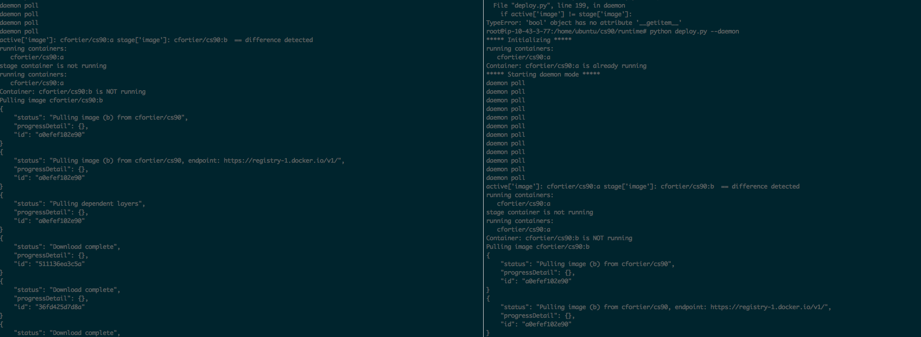
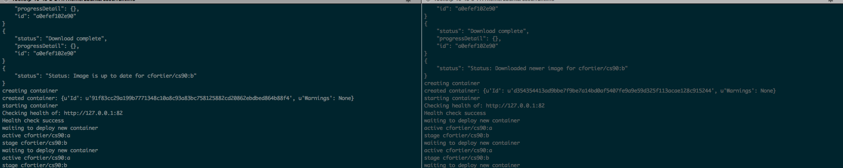

Slide 11
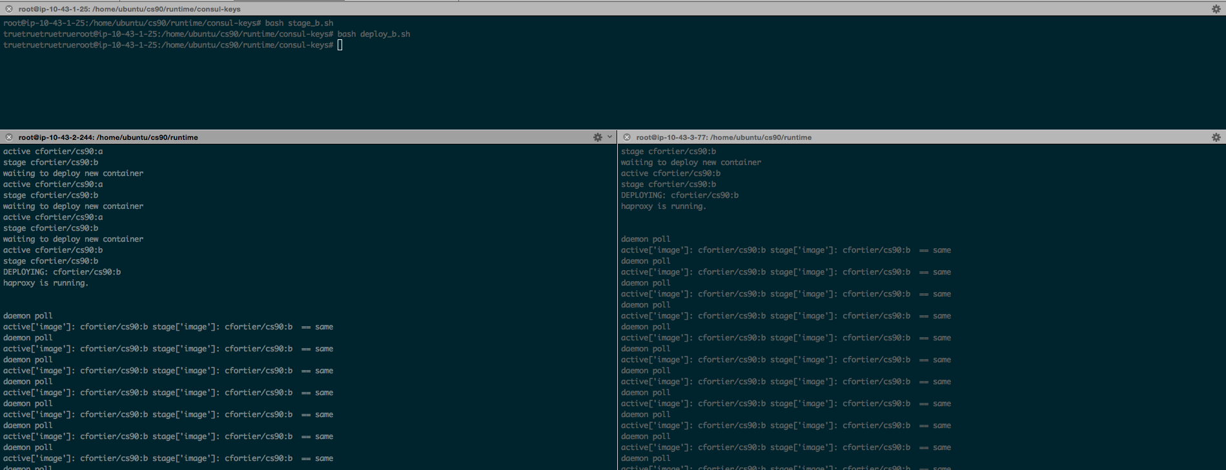

Slide 12
Conclusion

