Slide 1
PS 239T Final Project: Discussions on Constitutional Development in the Hong Kong LegCo
Chuyue Frances Huang
Date: December 7th. 2016
Notes:
-Hong Kong, a special place in my heart, banned books in the library and anti-communist magazines
-this project is a starting point for me to analyze the discussion on elections in the legislature

Slide 2
Background & Research Question:
Background:
Hong Kong is about to host an election for the Chief Executive in March 2017, but as of now, the candidates are subject to the screening.
The key place where all the debates on Constitutional development is the Legislative Council (“LegCo”), whose members are elected every four years.
Starting this October, LegCo is in its sixth session.
Question:
Has Hong Kong improved its effectiveness of governance in the past 19 years?
How has the number of discussions on key constitutional and electoral matters change in the past 19 years?
If so, who are the most active legislators behind the discussions?

Slide 3
Methodology
Data
Skills
World Governance Index
Open LegCo Database
Database on Particular Policy Issues
Member Biography
Webpages with information on members and their party affiliations
R:
data cleaning and visualization
XML and webscraping
Regular expressions (Regex)
Text analysis
Python:
API
Notes:
date, event summary,

Slide 4
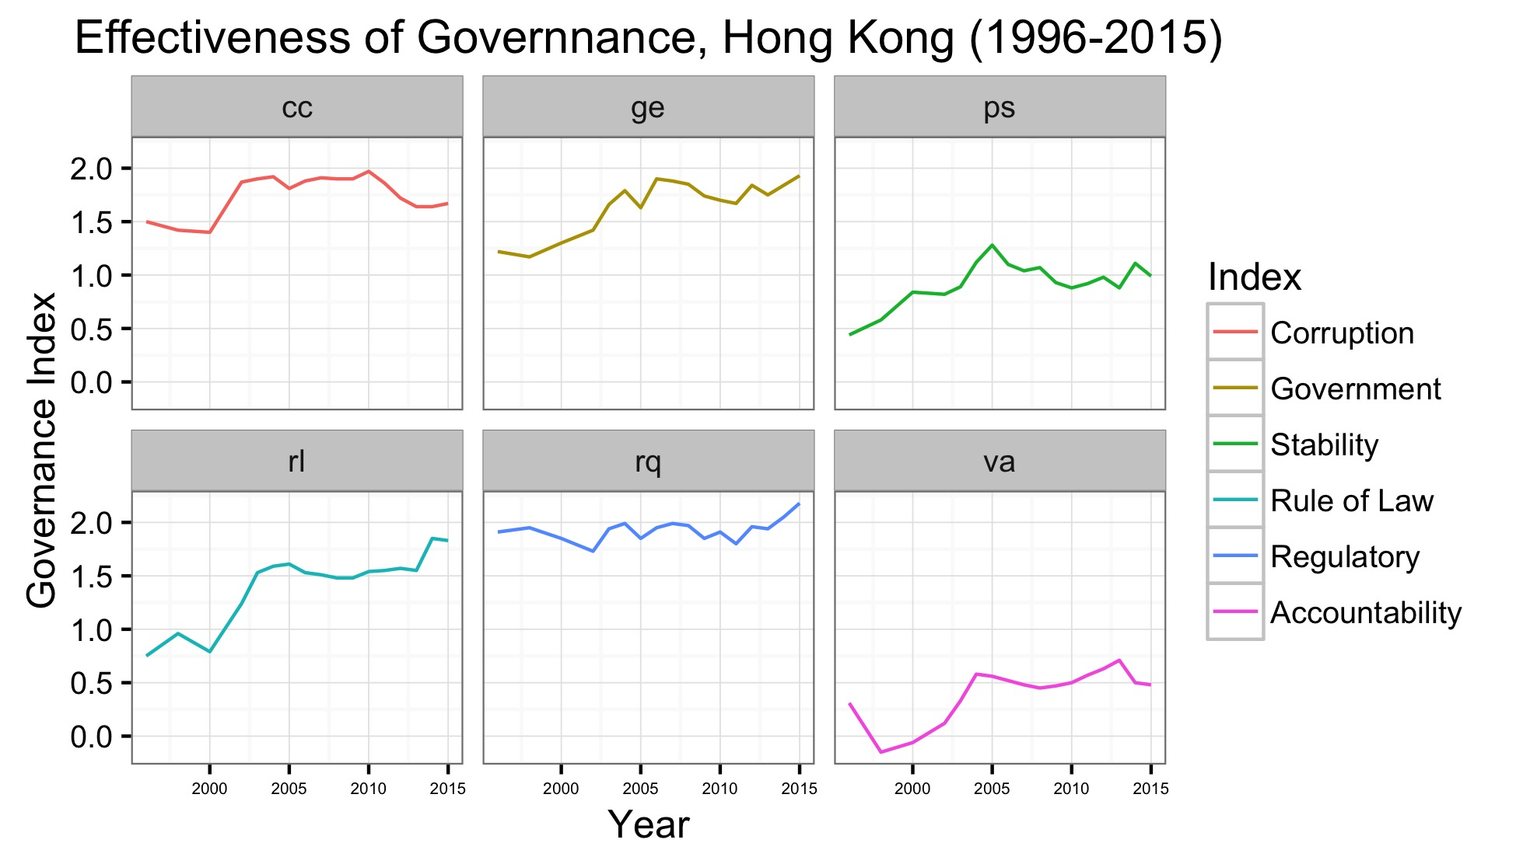
Hong Kong’s Democratic Development and Effectiveness of Governance(1996-2015)
Notes:
data from the World Governance Index
on all six indices, Hong Kong seems to have improved its effectiveness of governance since 1997
not to say that Hong Kong is a full-fledged democracy, but it scores relatively high even compared to other established democracy in East Asia

Slide 5
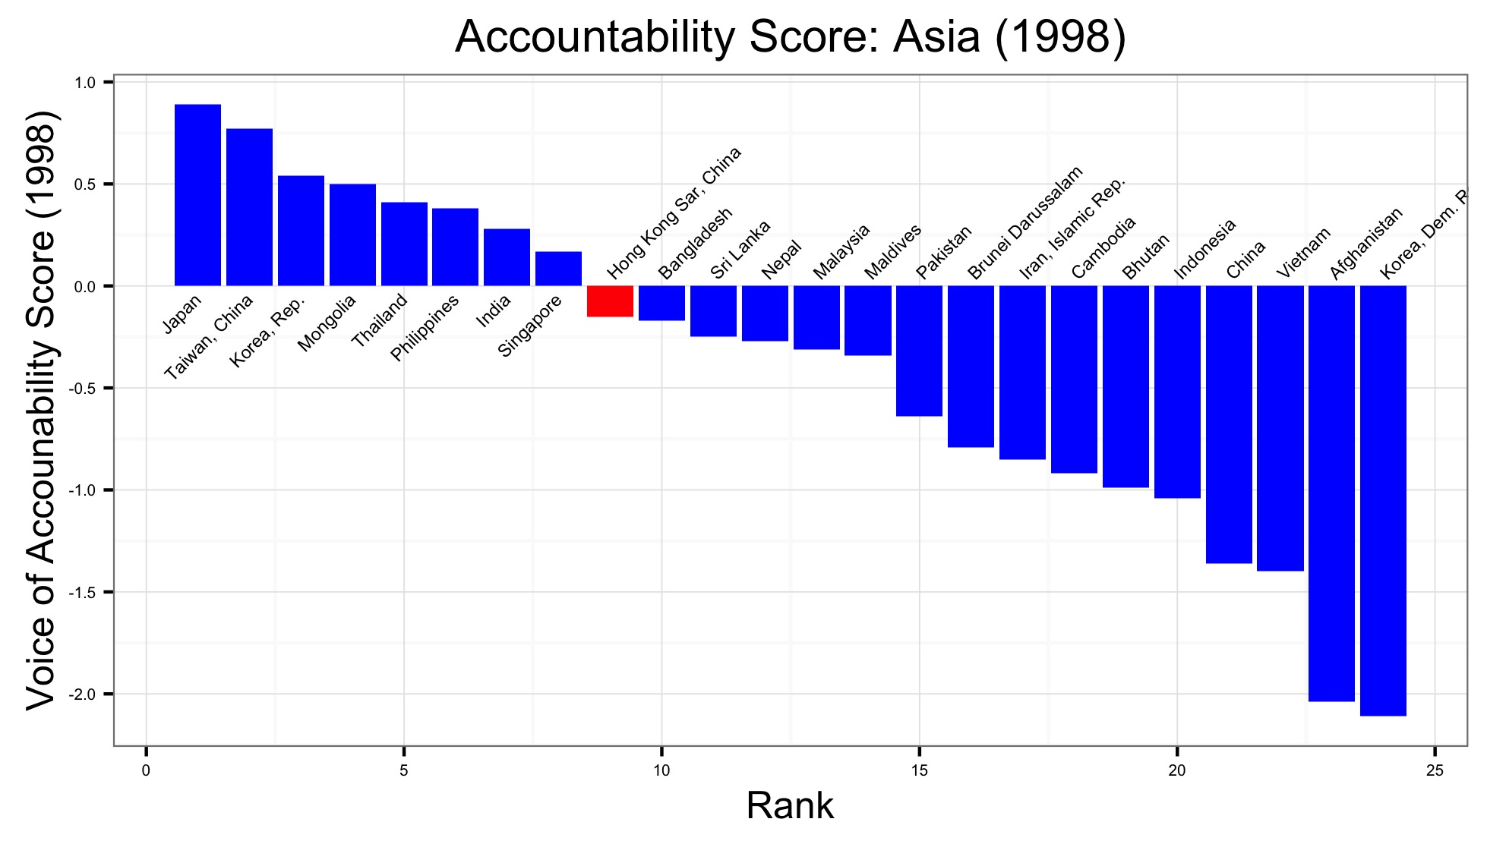
HK’s Governance Index in Comparison to Other East Asian Countries (1998)

Slide 6
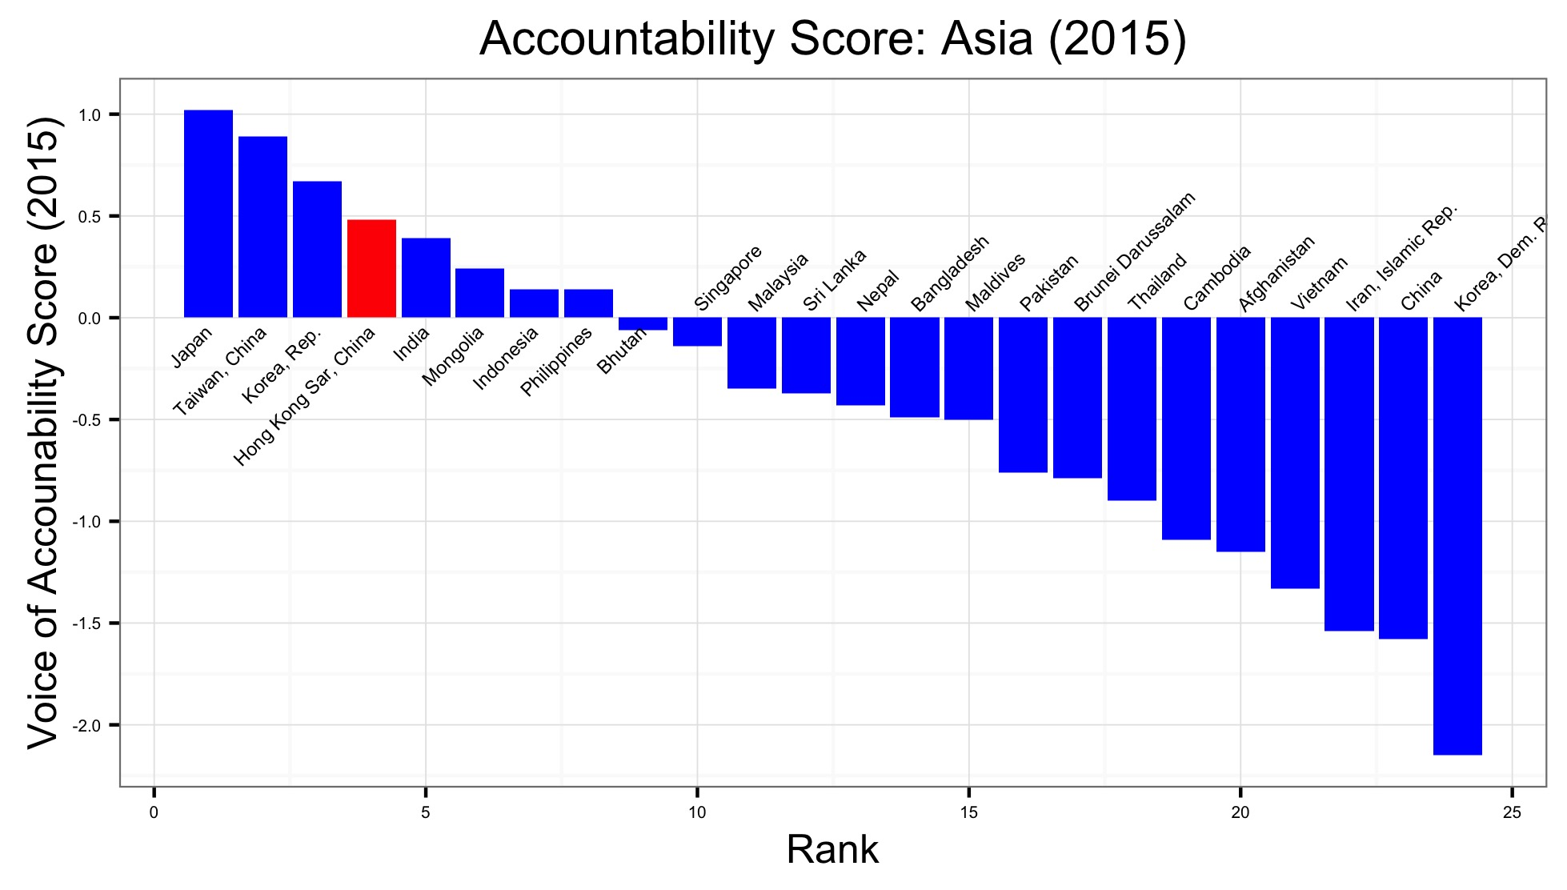
HK’s Governance Index in Comparison to Other East Asian Countries (2015)

Slide 7
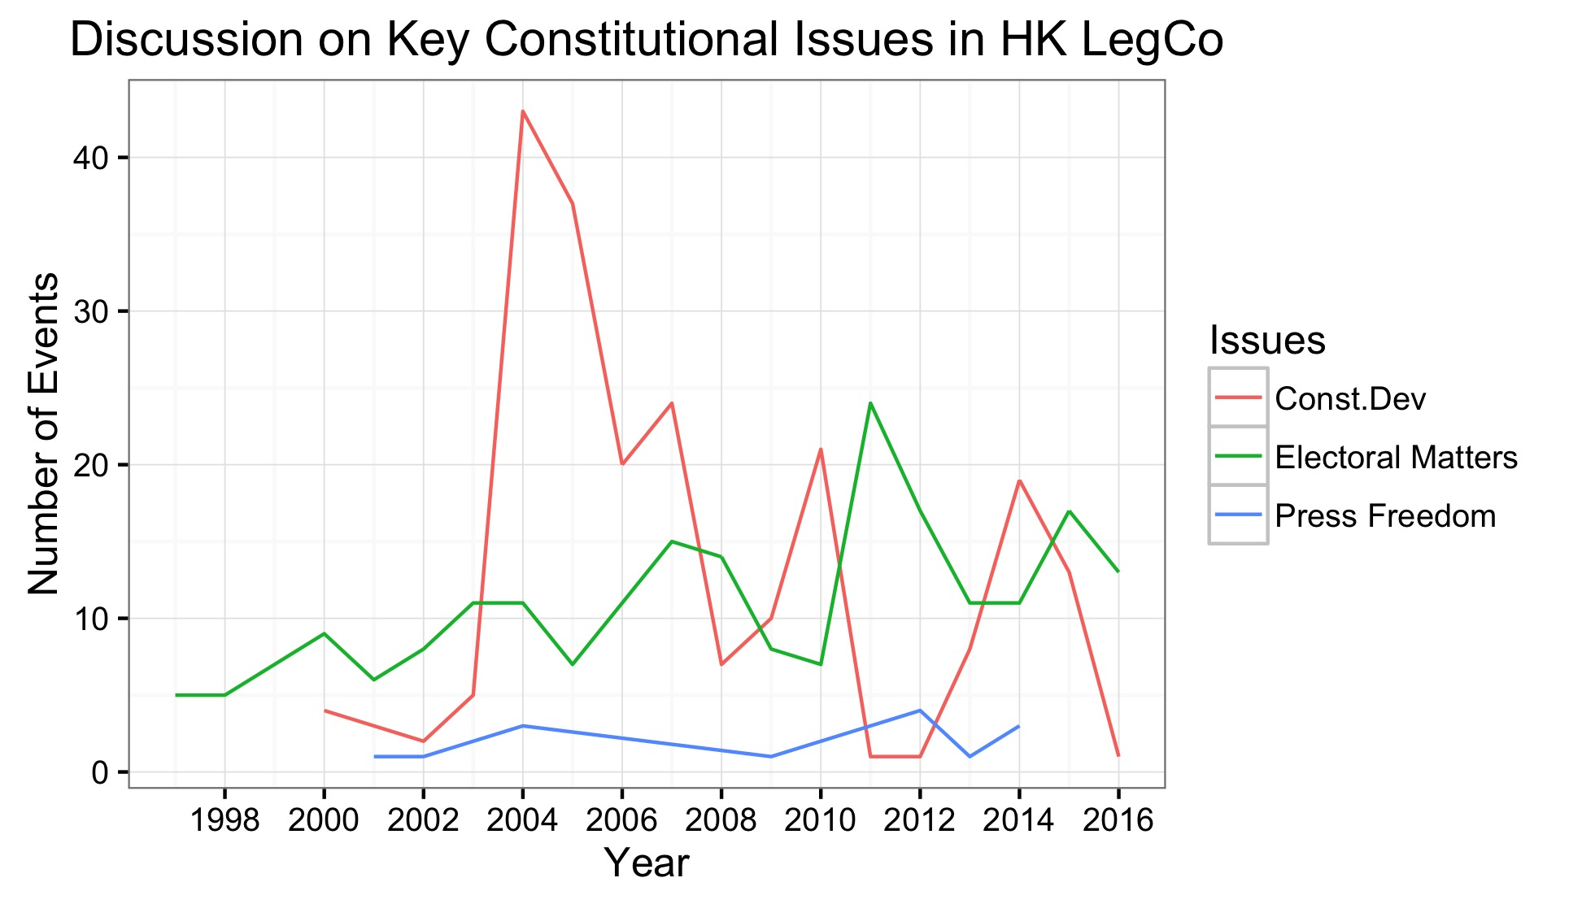
Discussion on Constitutional Issues
With the exception of 2004, the discussion on these sensitive issues dipped on election years (2008, 2012, 2016)
After 2014, the number of discussion sharply decreased.
In particular, what are they talking about? And who are the legislators pushing for these discussions?

Slide 8
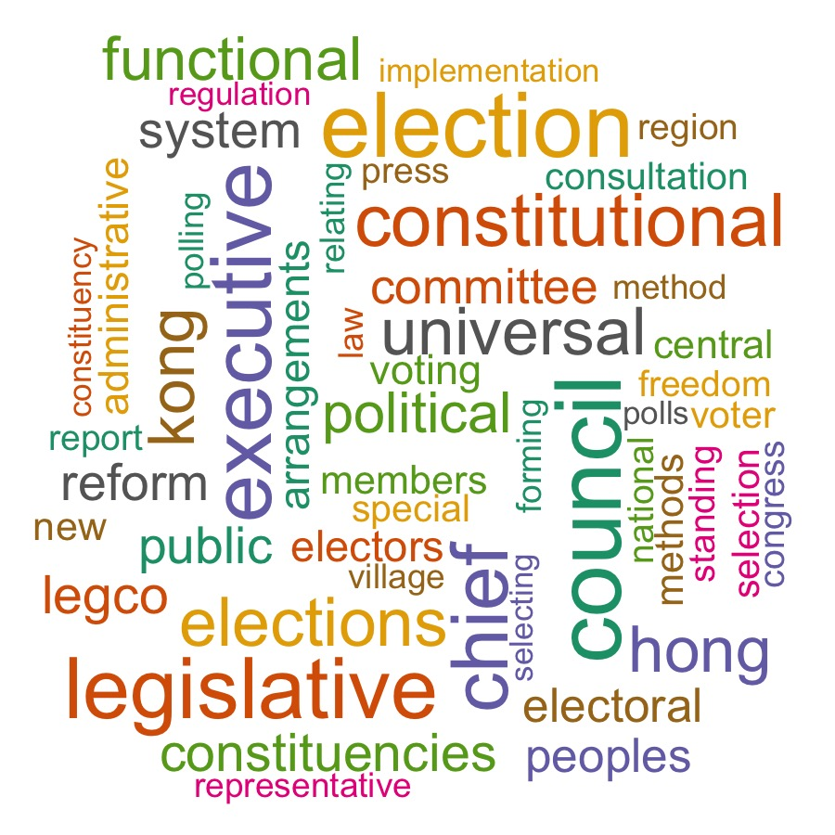
Motion Topics: Word Cloud
Use regex to clean the event summary, and obtain the motion topic by extracting the words within the quotation marks.
Observations:
words like “constitutional” tops the list
the word universal and voting are very frequent, which can mean that the discussion on universal voting is frequent
“electoral methods”—how to host election

Slide 9
Getting the Legislators’ Names
Examples:
Dr Hon Alan LEONG (title/first(eng)/last) → Alan Leong
Hon Ronny TONG Ka-wah (title/first(eng)/last/first(chi) → Ronny Tong
Hon LEE Cheuk-yan (title/last/first(chi) → Cheuk-yan Lee
Solution:
regex to get the last name (all caps) -- "[[:upper:]]{2,6}"
which() : get the position of the words, and get the difference in position between the last name and the title to figure out the pattern of the names
substr(): extract words out of a character string based on the positions

Slide 10
Members and Parties→ Most Active Members
use XML path to get the table with member information online (members and their parties)
also use XML to scrape a table with the parties and the affiliations
Pan-democracy
Pro-Beijing
Localists
Non-affiliated Others
Then merge the party and affiliation dataset back to the main dataframe
arrange
the most active members on the three key issues
"Emily Lau" (PD)
"Tai-fai Lam" (PD)
"Frederick Fung" (PD)
"Albert Ho" (PD)
"Albert Chan" (PD)
"Alan Leong" (PD)
"James To" (PD)
"Philip Wong" (PD)
"Yiu-chung Leung” (PD)
Unsurprisingly, they are ALL from the pan-democracy camp.

Slide 11
Taking this forward:
Exploring other Open LegCo databases, like one with all the voting records
Meeting minutes
Text analysis of the members’ speeches

Slide 12
Fun Fact about the HK LegCo:
There are two kinds of constituencies in HK: geographic and functional.
Functional constituency:
examples of functional constituencies:
Economic Synergy → renamed Business and Professionals Alliance for Hong Kong

