Slide 1
Predicting Student Grades
Final Project
General Assembly
Data Science
Carolyn Randall
July 2017

Slide 2
The Data
Datasets downloaded from Kaggle.com
Data collected using school reports and questionnaires
Data attributes include student grades, demographic, social and school related features
Both datasets contained the same features

Slide 3


Two datasets containing the performance in two distinct subjects:
Mathematics
Portuguese language

Slide 4
Project goal was to try and answer the following:
What factors influence the average Math grade score?
What factors influence the average Portuguese grade score?

Slide 5
What factors are the SAME in predicting the performance of student’s test scores for Math & Portuguese?
What factors are DIFFERENT in predicting the performance of student’s test scores for Math and Portuguese?
How could someone IMPROVE their test score in Math & Portuguese?

Slide 6
Steps
Read & explore the data
Visualize the data
Run a regression model on both data sets
Review the results
Compare the two result sets
Summarize
What is next?

Slide 7
Exploring the Data

Slide 8
Profile of the math dataset
Number of variables : 33
Number of observations: 395
Total missing: 0%
Variable type numeric: 15
Variable type categorical: 17
Rejected = 1
G3 highly correlated with G2 (.90487)

Slide 9
Profile of Portuguese dataset
Number of variables : 33
Number of observations: 649
Total missing: 0%
Variable type numeric: 15
Variable type categorical: 17
Rejected = 1
G3 highly correlated with G2 (.91855)

Slide 10
Some observations while exploring the data
No missing data in either dataset
Both datasets contain the same features
Features are a mix of numeric & categorical variables 15-numeric, 17 categorical
Portuguese dataset contained 649 records
Math dataset contained 395 records

Slide 11
Notes on grades features
20-point grading scale used, where 0 is the lowest grade & 20 is a perfect score.
students were evaluated in three periods (G1, G2, G3) the last evaluation (G3)
I will be using the average as my target (average of G1, G2, G3)
Students were evaluated at two schools

Slide 12
% of grades > mid-point
Number of grades > 10 midway
216 of 395 math grades greater than 10
54.68%
450 out of 649 Portuguese grades greater than 10
69.34%

Slide 13
Visualize the data

Slide 14
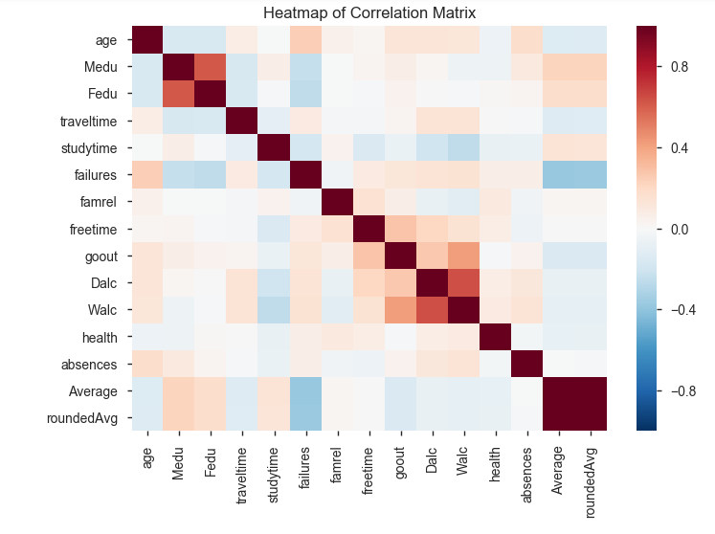
Heat map correlation – Math

Slide 15
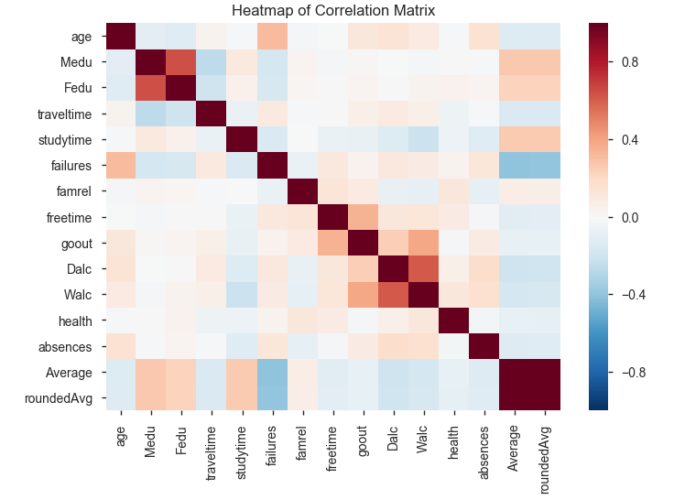
Heat map correlation – Portuguese

Slide 16
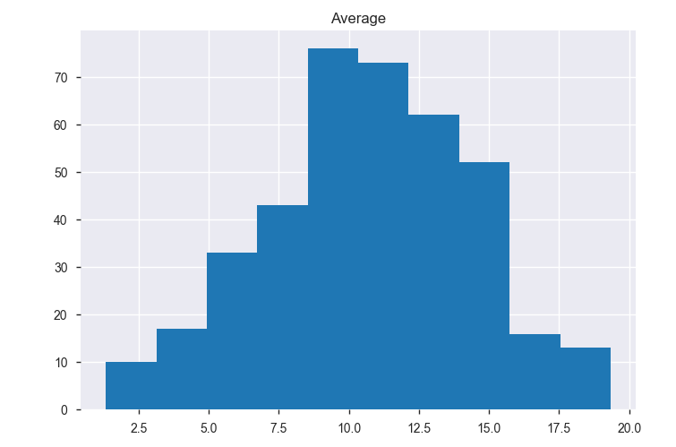
Math averages - Distribution

Slide 17
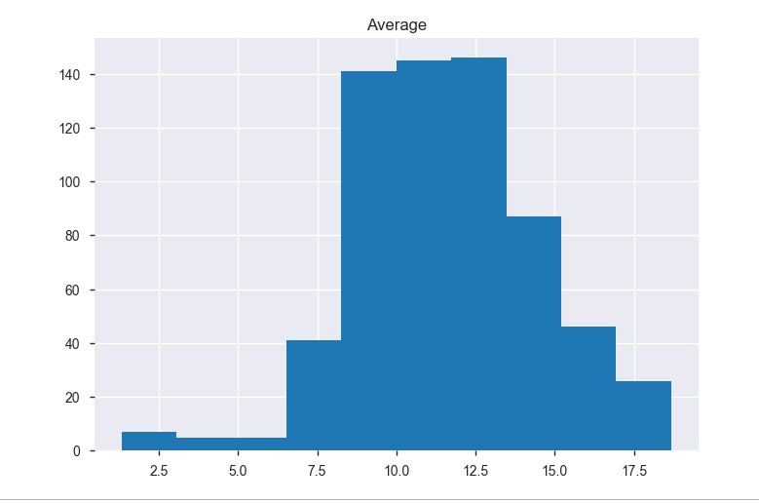
Portuguese – averages distribution

Slide 18
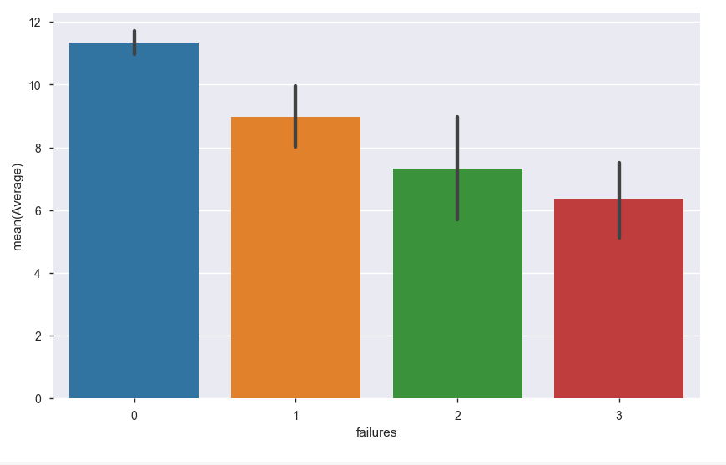
Math failures / Average

Slide 19
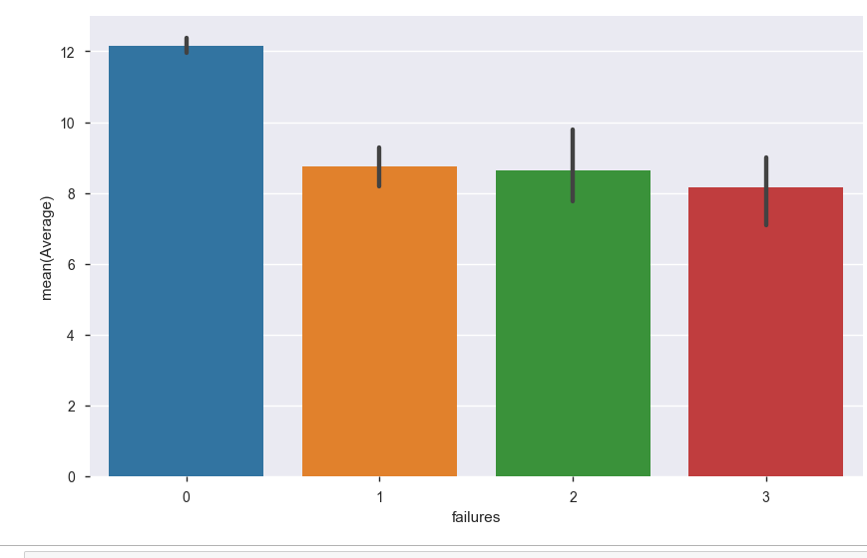
Portuguese failures/average

Slide 20
Convert using dummies
Used Pandas.get_dummies
Converted all the categorical data to numeric using dummies for both the Math and Portuguese datasets so I can run all the data thru my model

Slide 21
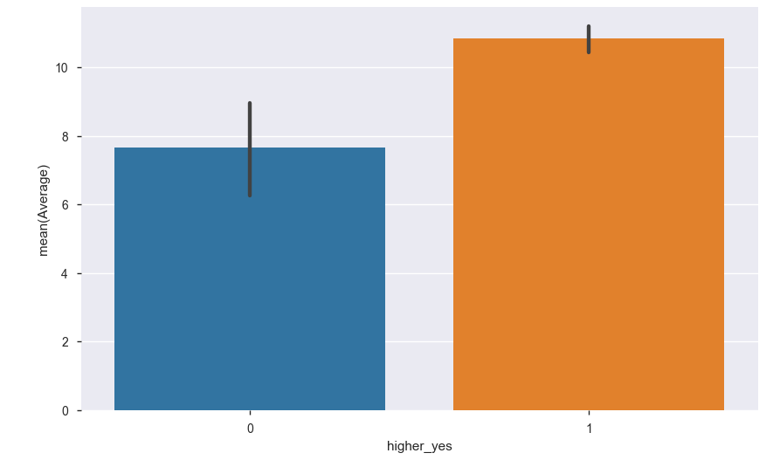
Math – higher yes/average

Slide 22
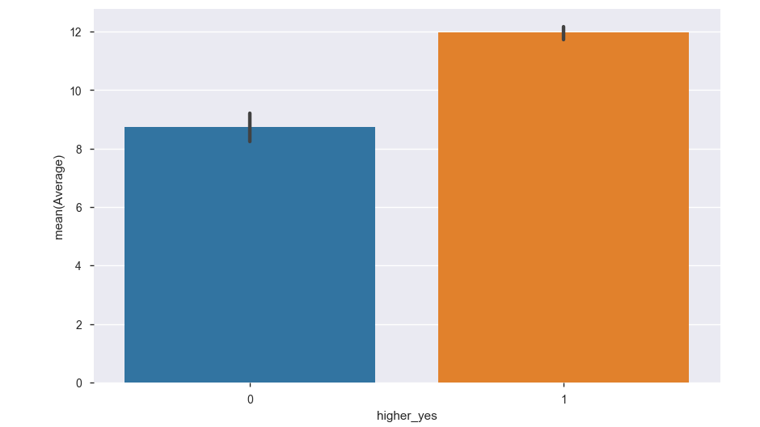
Portuguese higher yes/average

Slide 23
The Model

Slide 24
Lasso – Least Absolute Shrinkage & Selection Operator
A regression method that involves penalizing the absolute size of the regression coefficients
Convenient when you want some automatic feature selection
OR
When dealing with highly correlated predictors

Slide 25
Regularization Why do we do it?
Tuning the model complexity so your models are better at predicting.
If not done, models may be too complex and overft
OR
too simple and underfit

Slide 26
Lasso Regularization
Lasso regularization is useful if we think many of the features are irrelevant, since a feature with a zero coefficient is essentially removed from the model
This makes Lasso regularization a good technique for feature selection

Slide 27
Math: 0.0 coefficients not included in the model features excluded
Internet = y or n
Nursery = y or n
Activities = y or n
Paid = y or n
Famsup = y
Schoolsup = y
Absences
School = MS or GP
Address = U or R
Famsize LE 3
Pstatus = A or T
Mjob=home or teacher
Sex = male
Higher = yes
Romantic = yes
Fedu
Famrel
Freetime
Dalc
Walc
Health
Fjob=home, health, other

Slide 28
Math Features selected
Higher = no
Failures
Schoolsup = no
Mjob= health,services
Fjob = teacher
Romantic = no
Famsize GT 3
Sex = Female
Famsup = no
traveltime
Reason = course
Studytime
Medu
Mjob = other
Age
Goout
Reason = reputation
Guardian = father

Slide 29
Math results
NOT wishing to take higher education had negative impact on grades
The less failures, the higher the grade
Not requiring extra education support contributed to higher grades
Mother’s job in health or services had positive impact on grades

Slide 30
Math results cont.
Father’s job as a teacher has a positive influence on grades
Not being involved romantically had a positive influence on grades
Family size > 3 had negative impact
Being female had a negative impact on grades

Slide 31
Math results more..
Family education support = no contributed to higher grades ?? Not sure this one makes sense
Reason chose the school = course had negative impact on grades
Increase in travel time causes decrease in grades

Slide 32
Math results
The more one studies the better the grade
Mother’s education level had positive impact
Mother’s job = other shows negative impact
Age has negative impact

Slide 33
Math more
Frequency of going out impacted the grade
If the student choose the school for reputation, this had a positive impact
If the guardian was the father, this had a positive impact, guardian mother or other was excluded

Slide 34
Portuguese: 0.0 coefficients – features excluded
Higher = y
School = MS
Schoolsup = y
Internet = y
Age
Traveltime
Famrel
Freetime
goout
Health
Absences
Sex = f & m
Address = R or U
Famsize
Pstatus (both A &T)
Mjob – all
Mjob – all
Reason = course, home, other

Slide 35
Portuguese: 0.0 coefficients – features excluded
Guardian all 3
Famsup
Paid
Activities
Nursery
Romantic

Slide 36
Portuguese Features selected
Higher = no
Failures
School = GP
Reason = reputation
Schoolsup = no
Studytime
Walc
Dalc
Medu
Fedu
Internet = no

Slide 37
Comparison Math vs. Portuguese

Slide 38
More features were excluded from the Portuguese model
Number of features selected for the Math Lasso was 18
Number of features selected for the Portuguese Lasso was 11

Slide 39
Features used in Math but excluded from Portuguese
Age
Romantic = yes
Mjob = health, services or other
Famsize > 3
Guardian = Father
Sex = female
Famsup = No
Traveltime
Reasons to choose school for the course
Goout

Slide 40
Features selected for Portuguese but excluded from Math
Internet = no
School = GP
Walc
Dalc
Fedu

Slide 41
Things in common for Math and Portuguese grades
Students that did not wish to pursue higher education had a negative impact on grades
Increased value in the past class failures had a negative impact on grades
Attending a school for it’s reputation had a positive impact

Slide 42
Common for both cont.
Students that did not require extra education support had a positive influence
The more the student studies, the better the grade
Mother’s level of education, as level of education increase, the grade increases

Slide 43
Some differences
Student drinking habits has an impact on the Portuguese grades but were not included in the Math selection. The greater the level of drinking the lower the grade.

Slide 44
One of the schools was a factor in the Portuguese grades, so maybe that school has a better language teacher(s)?
Mother’s level of education impacted Portuguese grades but not Math. Not sure how to interpret that. Maybe higher level of education indicates study of languages

Slide 45
Not having internet access was noted to impact Portuguese grades. I would have thought that would impact either, but the model excluded that from the Maths.
Being in a romantic relationship had negative impact on grades for Math

Slide 46
It was interesting that the Father’s job of being a teacher had a positive impact on grades which makes sense, but the Mother’s job as teacher was not included in either

Slide 47
What can be done to improve grades
Both Math & Portuguese:
Encourage students to spend time studying
Encourage students to pursue higher education
Math:
Going out impacted not sure you can get a teenager to go out less?
Portuguese
Education on drinking

Slide 48
What next
More models, due to time only Lasso regression was the only model included in this presentation.
I was really interested to see what the trees would show
Might see if I can do more analysis to see if the drinking that impacted the Portuguese grades was more prevalant at one school

Slide 49
Post Class & what I have learned
Run thru all the class material and labs
Data Science requires TIME, so spending time running models on different types of data is how I believe you learn in this field

Slide 50
Questions?

