Slide 1
Predicting Student Grades
Final Project
General Assembly
Data Science
Carolyn Randall
July 2017

Slide 2
The Data
Datasets downloaded from Kaggle.com
Data collected using school reports and questionnaires
Data attributes include student grades, demographic, social and school related features
Two datasets containing the performance in two distinct subjects:
Mathematics
Portuguese language
Both datasets contained the same features

Slide 3
Project goal to try and answer the following:
What factors influence the average math grade score?
What factors influence the average Portuguese grade score?

Slide 4
What factors are the same in predicting the performance of students test scores for Math and Portuguese?
What factors are different in predicting the performance of student’s test scores for Math and Portuguese?
How could someone improve their test score in Maths (or Portuguese)?

Slide 5
process
Read & explore the data
Visulaizat sfjsalfjslkdfjlaksdjflkas
See if we can predict

Slide 6
Exploring the Data

Slide 7
Profile of the math dataset
Number of variables : 33
Number of observations: 395
Total missing: 0%
Variable type numeric: 15
Variable type categorical: 17
Rejected = 1
G3 highly correlated with G2 (.90487)

Slide 8
Profile of Portuguese dataset
Number of variables : 33
Number of observations: 649
Total missing: 0%
Variable type numeric: 15
Variable type categorical: 17
Rejected = 1
G3 highly correlated with G2 (.91855)

Slide 9
Some observations while exploring the data
No missing data in either dataset
Both datasets contain the same features
Features are a mix of numeric & categorical variables 15-numeric, 17 categorical
Portuguese dataset contained 649 records
Math dataset contained 395 records

Slide 10
Notes on grades
a 20-point grading scale is used, where 0 is the lowest grade and 20 is the perfect score.
students were evaluated in three periods and the last evaluation (G3)
I will be using Average as my target (average of G1, G2, G3)
Students evaluated at two schools
Number of grades > 10 midway
216 of 395 math grades greater than 10
54.68%
450 out of 649 Portuguese grades greater than 10
69.34%

Slide 11
Visualize the data
Add more pictures here once review results

Slide 12
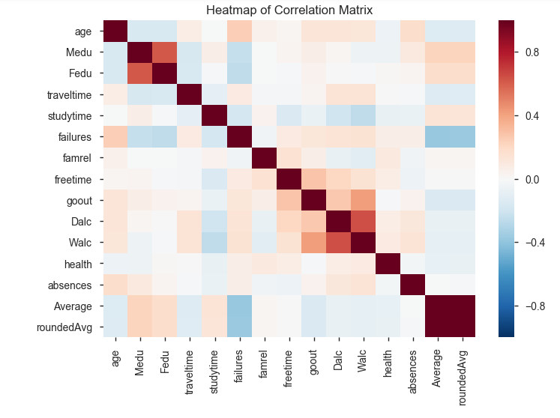
Heat map correlation – Math

Slide 13
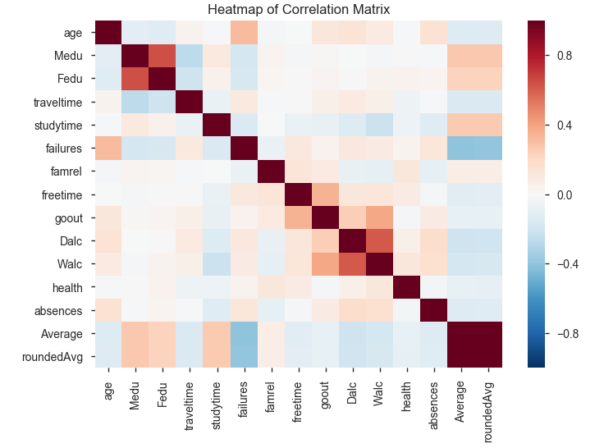
Heat map correlation – Portuguese

Slide 14
Statistical summary of data

Slide 15
Next steps
Converted all the categorical data to numeric using dummies for both the Math and Portuguese datasets so I can run the numeric data thru my model

Slide 16
Modelling
Lasso regression model used
xxxxx

Slide 17
Lasso regression
Uses penalty
Uses an absolute value of beta in our penalty term
Along with shrinking coefficients, lasso performs feature selection
Some of the coefficients become exactly zero, which is equivalent to the particular feature being excluded from the model.

Slide 18
When the tuning parameter is zero, we get least squares, as it increases the shrinkage penalty has more of an impact and the coefficients will equal zero
Some of the coefficients become exactly zero, which is equivalent to the particular feature being excluded from the model.

Slide 19
Lasso regularization is useful when we think we have

Slide 20
Lasso optimal Alpha value is: 0.01
Gave RMSE of 3.23008131319

