Slide 1

Integrate and Educate: how your peers are educating their residents in integrated care, and how you can too
Andres Barkil-Oteo
Kristen Dunaway
Anna Ratzliff
Claudia Reardon

Slide 2
Outline
Background
Survey results
Example best practices
Summary recommendations
Discussion

Slide 3
No disclosures except those individually mentioned during talk

Slide 4
What are the types of integrated care?
Traditional psychiatric consultation in primary care and/or other medical/surgical outpatient settings (“co-located care”)
Population-based approaches such as collaborative care
Telepsychiatry consultation to medical colleagues
Provision of both primary medical care and psychiatric care by psychiatry residents
Notes:
Co-located care: primary care consults psychiatry in the same manner that they would refer patients to mental health in a separate buliding, but they are located in the same building
Collaborative care: In this model, psychiatrists work together with primary care providers to manage the behavioral health of a defined population of patients. This may include use of objective rating scales, adjustment of care based on rating scale results and evidence-based treatment algorithms, and case management involvement. Of note, some programs may use the terms “integrated care” and “collaborative care” interchangeably, but technically speaking, collaborative care is a subset of integrated care.

Slide 5
Context for residency training
Many barriers to traditional psychiatric care exist:
Lack of availability of specialists
Long wait times for appointments
Poor follow-up
Stigma
Health care reform: includes incentives for management of the health of populations of patients, eg, via patient-centered medical homes
Freedman 2009. Psychiatric Services.
Konrad 2009. Psychiatric Services.
Unutzer 2006. Psychiatric Services.
Huang 2013. UW-Madison Dept of Psychiatry Grand Rounds.

Slide 6
And the new motivator: milestones!

Slide 7
Relevant advanced milestones: PC3
4.1: Devises individualized treatment plan for complex presentations
4.2: Integrates multiple modalities and providers in comprehensive approach
5.1: Supervises treatment planning of other learners and multidisciplinary providers
Notes:
We’re talking about “advanced” (ie, level 3-5) milestones here b/c that is when, according to our survey results, most programs are offering integrated care rotations, if they do so at all. For some of these milestones, the lower level ones could also be capturable via this type of rotation, but I’ll only highlight the advanced milestones for this purpose.

Slide 8
Relevant advanced milestones: MK2
4.3: Shows knowledge sufficient to identify and treat a wide range of psychiatric conditions in patients with medical disorders
4.4: Demonstrates sufficient knowledge to systematically screen for, evaluate, and diagnose common medical conditions in psychiatric patients and to ensure appropriate further evaluation and treatment of these conditions in collaboration with other medical providers

Slide 9
Relevant advanced milestones: SBP4
3.3: Discusses methods for integrating mental health and medical care in treatment planning
4.1: Provides integrated care for psychiatric patients through collaboration with other physicians
Notes:
4.1 here doesn’t mince words: residents should be providing integrated care by the time they are graduation-ready

Slide 10
Relevant milestones: ICS1
4.2: Leads a multidisciplinary care team

Slide 11
Relevant milestones: ICS2
4.1: Demonstrates effective verbal communication with patients, families, colleagues, and other health care providers that is appropriate, efficient, concise, and pertinent
4.2: Demonstrates written communication with patients, families, colleagues, and other health care providers that is appropriate, efficient, concise, and pertinent
Notes:
Our primary care colleagues want and need their psychiatric consultants to be efficient and concise. That doesn’t come naturally to psychiatrists.

Slide 12
The current state of integrated care training for psychiatry residents
2014 AADPRT survey of general and CAP psychiatry residency programs
Notes:
Response rate within typical range for this type of survey, though admittedly low. Demographics of respondents (eg, academic vs community programs) do align with national distribution of programs per FREIDA, which does suggest less of a responder bias that you might otherwise suspect.

Slide 13
Does your program offer a rotation(s) in integrated care for your residents?
General: 78% yes
CAP: 72% yes

Slide 14
Types of integrated care offered
#1 (most common): Traditional psychiatric consultation within primary care clinics
#2: Population-based approaches such as collaborative care
#3: Psychiatric consultation within other medical/surgical outpatient settings
#4: Telepsychiatry
#5 (least common): Provision of both primary medical care and psychiatric care by psychiatry residents
**The majority of all of these are offered to upper-class residents
Notes:
Probably difficult/expensive to figure out supervision for #5

Slide 15
Percentage of programs offering various venues for integrated care rotations

Slide 16
Are your integrated care rotations required?
General: 35% required
CAP: 60% required
Notes:
Offerings in underclass years tend to be required, while in latter years elective

Slide 17
Which faculty provide supervision?
Psychiatrist: 95%
Psychologists or social workers: 18%
Dually-trained physicians: 18%
Primary care physicians: 16%
Notes:
This and most subsequent slides lump general and CAP together because findings were similar for both groups. Here you see that you obviously don’t need the scarce resource of dually-trained physicians to supervise these rotations.

Slide 18
How do psychiatrist supervisors spend their time?
On site full time during clinic and sees EVERY patient: 47%*
On site full time during clinic WITHOUT seeing every patient: 42%*
On site for PART of the duration of clinic WITHOUT seeing every patient: 28%
Reviews cases with residents AFTER clinic at OTHER location: 25%
*59% of supervisors who are on site full time during the clinic also do other clinical activities besides supervision (their own direct patient care, supervision of care coordinators, consultation without seeing patients)
Notes:
AADPRT members reportedly were very interested in understanding the logistics, including finances and how supervision is arranged/paid, and hence the motivation for asking this question.

Slide 19
How are psychiatrist supervisors paid?
Psychiatry department: 52%
Via billing revenues generated in integrated care clinic: 43%
By the primary care or other med/surg department: 22%
Grant money: 17%

Slide 20
Integrated care didactics
43% of all programs provide didactics
How provided:
By psychiatry/mental health faculty in usual didactic format: 98%
By non-psychiatry colleagues: 33%
Multidisciplinary group supervision: 16%
By psychiatry residents or other residents: 14%
Jointly attended by psychiatry residents and primary care or other residents: 9%

Slide 21
Other themes
Programs without such rotations are wondering how to ‘start small’
Programs anticipate starting with senior residents in elective format until sustainability of experience can be established
Programs have concerns about establishing funding perceived as stable enough to attract quality physicians
Small number note that they do not embrace integrated care as the right direction for psychiatry

Slide 22
Resources
AADPRT Virtual Training Office Integrated Care Resources (log in required): http://www.aadprt.org/pages.aspx?PageName=AADPRT_Integrated_Care_Resources
Notes:
I will do this transition

Slide 23
Teaching Collaborative Care: University of Washington
Anna Ratzliff, MD, PhD
Assistant Professor
Associate Director of Education, Division of Integrated Care & Public Health
Department of Psychiatry & Behavioral Sciences
University of Washington

Slide 24
UW Psychiatry Resident Integrated Care Training
Integrated Care Rotation & Didactics
Integrated Care Pathway
Collaborative Care Rotation
Notes:
Integrated Care Rotation and Didactics
Integrated Care Rotation
6 month in co-located clinic
R2 Lecture:
Spectrum of Integrated Care
R4:
Primary Care Psychiatry
Brief Behavioral Interventions
Integrated Care Track
Open to all residents interested in learning more about integrated care
Newsletter for all residents
Quarterly journal club Meetings
Mentoring for careers in integrated care
Highlight opportunities for research in integrated care
MHIP Rotation

Slide 25
Sample Didactics

Slide 26





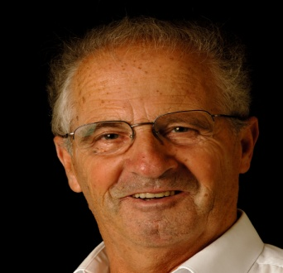




Notes:
2/10 see a psychiatrist or psychologist
4/10 receive treatment in primary care
~ 30 Million with an antidepressant Rx but only 20 % improve

Slide 27
No Treatment
Primary Care Provider
Mental Health Provider
Wang P, et al., Twelve-Month Use of Mental Health Services
in the United States, Arch Gen Psychiatry, 62, June 2005
Notes:
2/10 see a psychiatrist or psychologist
4/10 receive treatment in primary care
~ 30 Million with an antidepressant Rx but only 20 % improve

Slide 28
Why not just refer?
½ do not follow through
2 visit mean
Grembowski, Martin et al. 2002
Simon, Ding et al. 2012
Notes:
When patients are referred to mental health specialists by a primary care provider, almost half do not follow through (Grembowski, Martin et al. 2002 )
Even when they do go, the mean number of appointments is 2 visits

Slide 29
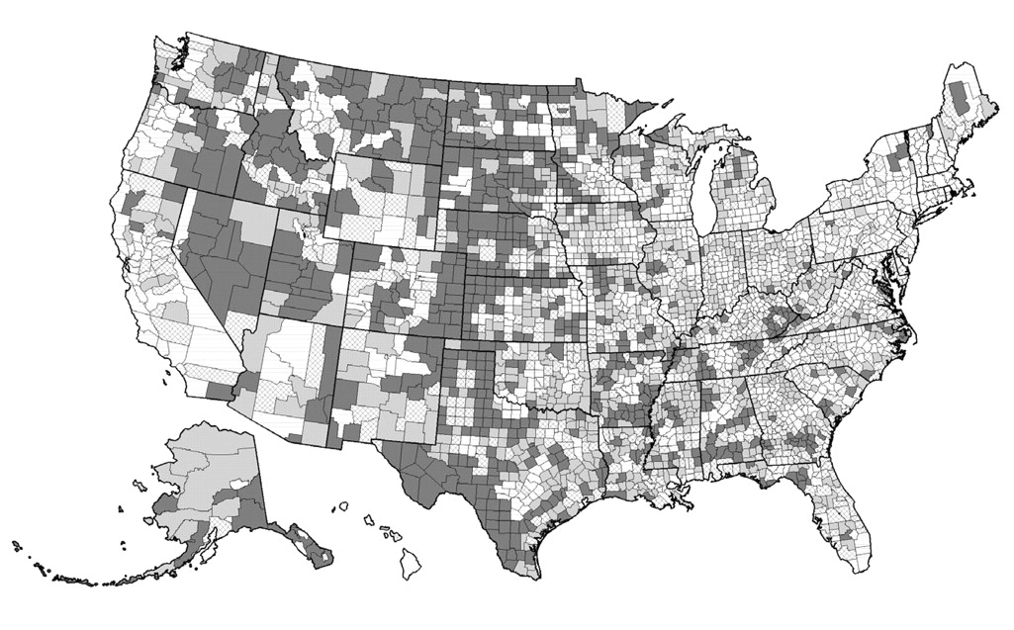
Why not just refer?
Thomas KC et al, 2009
Notes:
County-Level Estimates of Mental Health Professional Shortage in the United States
Kathleen C. Thomas, M.P.H., Ph.D.; Alan R. Ellis, M.S.W.; Thomas R. Konrad, Ph.D.; Charles E. Holzer, Ph.D.; Joseph P. Morrissey, Ph.D.
Psychiatric Services 2009; doi: 10.1176/appi.ps.60.10.1323
1 in 5 - unmet need for non-prescribers
96% unmet need for prescribers
Nearly one in five counties (18%) in the nation had unmet need for nonprescribers. Nearly every county (96%) had unmet need for prescribers and therefore some level of unmet need overall. Rural counties and those with low per capita income had higher levels of unmet need.
Results
Over three-quarters (77%) of U.S. counties had a severe shortage of mental health prescribers or nonprescribers, with over half their need unmet. Eight percent of U.S. counties had a severe shortage of nonprescribers, with over half of their need unmet. Almost one in five counties (18%) in the nation had at least some unmet need for nonprescribers. Seventy-seven percent of U.S. counties had a severe shortage of prescribers, with over half of their need unmet. Nearly every county (96%) had at least some unmet need for prescribers. Table 1 provides statistics on the percentage of need unmet at the county level. Ordinary least-squares regression of the percentage of county overall need unmet as a function of county characteristics indicated that rurality and per capita income were the best predictors of unmet need (R²=.34). A 1-point increase in rurality on the 9-point Rural-Urban Continuum Code corresponded to an increase in unmet need of 3.3 percentage points. A $1,000 increase in per capita income corresponded to a decrease in unmet need of 1.3 percentage points.

Slide 30

Lexicon of Integrated Care Terms
Patient- Centered Care
Integrated Care
Coordinated Care
Shared Care
Collaborative Care
Co-located Care
Integrated Primary Care or Primary Care Behavioral Health
Behavioral Health Care
Patient-Centered Medical Home
Mental Health Care
Substance Abuse Care
Primary Care
Adapted from: Peek, CJ - A family tree of related terms used in behavioral health and primary care integration. http://integrationacademy.ahrq.gov/lexicon

Slide 31
Collaborative Care: The Research Evidence
Now over 80 Randomized Controlled Trials (RCTs)
Meta analysis of collaborative care (CC) for depression in primary care (US and Europe)
→ Consistently more effective than usual care
Since 2006, several additional RCTs in new populations and for other common mental disorders
Including anxiety disorders, PTSD
Archer, J. et al., 2012

Slide 32
Team Approach
PCP
Core
Program
New Roles
Patient
BH Care
Manager
Consulting
Psychiatrist
Other Behavioral Health Clinicians
Optional Additional
Clinic Resources
Outside
Resources
Substance Treatment, Vocational Rehabilitation, CMHC,
Other Community Resources

Slide 33
Principles of Effective Integrated Behavioral Health Care
Patient Centered Team Care / Collaborative Care
Co-location is not Collaboration. Team members learn to work differently.
Measurement-Based Treatment to Target
Population-Based Care
All patients tracked in a registry: no one ‘falls through the cracks’.
Evidence-Based Care
Accountable Care
Treatments are actively changed until the clinical goals are achieved.
Treatments used are ‘evidence-based’.
Providers are accountable and reimbursed for quality of care and clinical outcomes, not just the volume of care provided.
Notes:
We have learned that there are a couple of key principles that such systematic models of care have to follow to be effective.
Similar approaches could also be helpful for other common disorders: pain, epilepsy, parkinson’s where we have treatments but they are often not used very effectively.

Slide 34
Collaborative Care Rotation

Slide 35
Structure:
1-2 hours working with a care manager (located in a primary care clinic) in weekly phone consultation
1 hour of combined didactics and supervision about the cases and the consultation process
Residents are responsible for writing case reviews which are reviewed by consulting psychiatrist before being released to clinic
At least one clinic visit to primary care sites to provide in-person consultation and primary care provider education
Can be combined with a half-day research elective

Slide 36
Teaching Methods: Consultation
Psychiatric Consultation
Evaluation
Individualized Study
Weekly Supervised Consultation
Increasing Responsibility
Develop Integrated Care Plans
On site visit
Six Core Modules
Notes:
Objectives: Objectives are outlined for each module in the knowledge, skills and attitude domains. These objectives would typically have been met after the didactic slide set and reading had been completed.
Readings: One or two key papers from the collaborative care literature have been selected and summarized for each module. The readings can be assigned ahead of time or after the didactic material is covered.
Slide Sets: Each set of slides is annotated for the consulting psychiatrist to review with the resident. These cover both academic and practical aspects of collaborative care.
Discussion and Reflection Questions: Each module lists several reflection and discussion questions to prompt the resident to explore the didactic material on a more personal level. Discussions of these questions draw upon the residents’ own individual thoughts and experiences. We encourage residents to journal or make process notes to enhance these discussions.
Additional References and Resources: This section contains additional papers of interest, as well as websites and other resources for residents to explore.

Slide 37
Teaching Methods: Six Core Modules
Psychiatric Consultation
Evaluation
Objectives
Readings
Slide Sets
Discussion and Reflection Questions
Additional References and Resources
Individualized Study
Weekly Supervised Consultation
Increasing Responsibility
Develop Integrated Care Plans
On site visit
Six Core Modules
Notes:
Objectives: Objectives are outlined for each module in the knowledge, skills and attitude domains. These objectives would typically have been met after the didactic slide set and reading had been completed.
Readings: One or two key papers from the collaborative care literature have been selected and summarized for each module. The readings can be assigned ahead of time or after the didactic material is covered.
Slide Sets: Each set of slides is annotated for the consulting psychiatrist to review with the resident. These cover both academic and practical aspects of collaborative care.
Discussion and Reflection Questions: Each module lists several reflection and discussion questions to prompt the resident to explore the didactic material on a more personal level. Discussions of these questions draw upon the residents’ own individual thoughts and experiences. We encourage residents to journal or make process notes to enhance these discussions.
Additional References and Resources: This section contains additional papers of interest, as well as websites and other resources for residents to explore.

Slide 38
MATERIALS
OVERVIEW OF ENTIRE SERIES: Collaborative Care Consultation Psychiatry: A Clinical Rotation Curriculum for Psychiatry Residents
Module 1: Psychiatry Resident Training: Introduction to Collaborative Care
Module 2: Psychiatry Resident Training: Introduction to MHIP
Module 3: Psychiatry Resident Training: Collaborative Care Teams
Module 4: Psychiatry Resident Training: Case Finding, Differential Diagnosis and Case Formulation
Module 5: Psychiatry Resident Training: Making Recommendations and Treating to Target
Module 6: Psychiatry Resident Training: Team Building, Workflows, and Quality Improvement

Slide 39
Roles of the Primary Care Consulting Psychiatrist
Shape behavioral healthcare for a defined population of patients in primary care
Caseload Consultant
Direct Consultant
Clinical Educator
Clinical Leader
Consult indirectly through care team on a defined caseload of patients in primary care
Consult directly by seeing selected patients in person or via telemedicine
Train BHCs and PCPs
Both directly and indirectly

Slide 40
Teaching Methods: Individualized Study
Psychiatric Consultation
Objectives
Readings
Slide Sets
Discussion and Reflection Questions
Additional References and Resources
Individualized Study
Clinical Topics
Special Populations
Systems Issues and Quality Improvement
Psychopharmacology
Evaluation
Weekly Supervised Consultation
Six Core Modules
Increasing Responsibility
Develop Integrated Care Plans
On site visit
Notes:
Objectives: Objectives are outlined for each module in the knowledge, skills and attitude domains. These objectives would typically have been met after the didactic slide set and reading had been completed.
Readings: One or two key papers from the collaborative care literature have been selected and summarized for each module. The readings can be assigned ahead of time or after the didactic material is covered.
Slide Sets: Each set of slides is annotated for the consulting psychiatrist to review with the resident. These cover both academic and practical aspects of collaborative care.
Discussion and Reflection Questions: Each module lists several reflection and discussion questions to prompt the resident to explore the didactic material on a more personal level. Discussions of these questions draw upon the residents’ own individual thoughts and experiences. We encourage residents to journal or make process notes to enhance these discussions.
Additional References and Resources: This section contains additional papers of interest, as well as websites and other resources for residents to explore.

Slide 41
Teaching Methods: Evaluation
Six Core Modules
Objectives
Readings
Slide Sets
Discussion and Reflection Questions
Additional References and Resources
Individualized Study
Clinical Topics
Psychiatric Consultation
Weekly Supervised Consultation
Develop Integrated Care Plans
Evaluation
Pre-test
360-Degree Evaluation
Post-test
Standard Evaluation of Resident
Standard Evaluation of Rotation and Attending
Special Populations
Systems Issues and Quality Improvement
Psychopharmacology
Increasing Responsibility
On site visit
Notes:
Objectives: Objectives are outlined for each module in the knowledge, skills and attitude domains. These objectives would typically have been met after the didactic slide set and reading had been completed.
Readings: One or two key papers from the collaborative care literature have been selected and summarized for each module. The readings can be assigned ahead of time or after the didactic material is covered.
Slide Sets: Each set of slides is annotated for the consulting psychiatrist to review with the resident. These cover both academic and practical aspects of collaborative care.
Discussion and Reflection Questions: Each module lists several reflection and discussion questions to prompt the resident to explore the didactic material on a more personal level. Discussions of these questions draw upon the residents’ own individual thoughts and experiences. We encourage residents to journal or make process notes to enhance these discussions.
Additional References and Resources: This section contains additional papers of interest, as well as websites and other resources for residents to explore.

Slide 42
Future Directions
Update UW Didactics
Working in a team; Supporting a care manager
Discussion about integrating education and maintaining expertise
Overview of systems issues and types of leadership
Brief behavioral interventions
Clinical conditions in primary care
New elective in Advanced Collaborative Care Implementation?
Shaping an implementation
Leadership in integrated
Quality improvement project
Other?
Integrating education with medicine residents
Online learning experiences

Slide 43
www.aims.uw.edu
Acknowledgments
Rebecca Sladek
Dr Jürgen Unützer
AIMS Center Staff
Disclosures
Consulting Psychiatrist Contract, Community Health Plan of Washington
Supported from contracts and grants to the AIMS Center at the University of Washington

Slide 44
Example best practice: Yale (Barkil-Oteo and Huang)
“Teaching Collaborative Care in Non-Collaborative Settings”
Didactic curriculum available on AADPRT website
Especially useful for programs without integrated care clinics available

Slide 45
Teaching Residents Collaborative Care in Non-collaborative Settings
AADPRT 2015
Andres Barkil-Oteo, MD, MSc
Assistant Professor of Psychiatry
Yale School of Medicine

Slide 46
Disclosures
None

Slide 47
Rational of the curriculum
Collaborative care is not just about the way care is organized; it requires a dramatic change in the way psychiatrists think about their role
Current clinical psychiatric training is largely focused on the direct provision of patient care
Many residency programs has no access to collaborative care clinic settings

Slide 48
Description of the curriculum
Two one hour lecture on the basics of Collaborative care (Different roles for psychiatrists, Population focused, measurement based care)
Online videos simulating a consultation session between a psychiatrist and behavior health manager
In class practice of consultation role with clinical cases in PCP settings
In class practice of delivering clinical scales

Slide 49
Description of the curriculum
AADPRT model curriculum (to be posted on the new website)
Under review at MedEdPORTAL
Paper describing implementation and assessment under review

Slide 50
Preparing for the Milestones
Curriculum delivered to 46 psychiatry residents in 5 New England area psychiatry programs.
PGY1=5
PGY2=10
PGY3=22
PGY4=9
N total=46

Slide 51
Milestones: SBP4
Describes the difference between consultant and primary treatment provider
Describes differences in providing consultation for the system or team versus the individual patient
Provides consultation to other medical services
Clarifies the consultation question
Assists primary treatment care team in identifying unrecognized clinical care issues
Discusses methods for integrating mental health and medical care in treatment planning
Provides integrated care for psychiatric patients through collaboration with other physicians

Slide 52
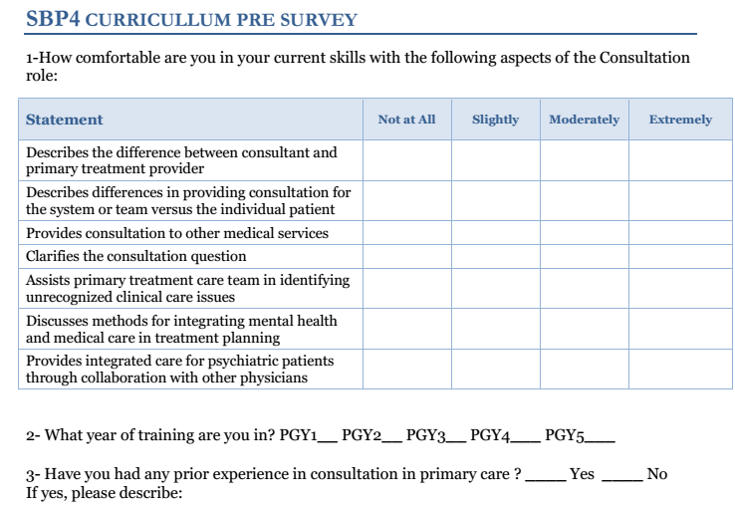
Not at all=1, slightly=2, moderately=3, extremely=4.

Slide 53
N=46. p< 0.0001

Slide 54
Feedback
“Great presentation: did not realize this model existed”
“Cases are great and illustrative”
“This topic was something we get no training on. It’s good to get information about the future of psychiatry.”
“This was great information about an area of patient care and care systems that we are not exposed to here.”
“Great that cases were included. Could be great to have examples within {residency program} of collaborative vs co-located care.”

Slide 55
Challenges?
Examples change depending on year of residency training (e.g. PGY-2 vs PGY-4)
“When you were working on the CL service, have you ever…?”
Balance between public health/population focus and traditional consultations
“I need to see this patient or I am not providing good care”
Skepticism of measurement based care
Does CIDI really work for bipolar disorder?
Where to practice skills after the workshop?
At the end of the day, few opportunities to practice collaborative care skills

Slide 56
Challenges?
Evaluation: subjective improvement on milestones is not an optimal assessment
QIKAT-like assessment for collaborative care (Knowledge + skills) assessment

Slide 57
Summary Recommendations
Use AADPRT VTO materials
VAs and FQHCs often have settings amenable to residency training in this model
Programs wishing to offer telemedicine opps for residents may consider the VA for this, since there is a VA Telemental Health Training Program widely available to VAs across the U.S.
Upper level residents may be better prepared than earlier residents for this experience
Multidisciplinary group supervision or joint case conferences between psychiatry and primary care or other medical residents may represent excellent opps for further modeling of the multidisciplinary teamwork that is integrated care
A minimally resource-intensive way to provide didactics may be for primary care residents and psych residents to lead seminars for each other and for other clinic staff within integrated care clinics

Slide 58
Audience discussion
What challenges or successes have you found in funding integrated care resources?
What have been your experiences with psychiatrists vs other disciplines providing supervision of these experiences?
Any experiences with interdisciplinary group supervision led by residents?
What challenges or successes have you found with providing didactics on integrated care?
Any other comments or questions you have are welcome!
Notes:
CR will facilitate but all panelists should chime in!!

Slide 59
Thank you!
Questions? clreardon@wisc.edu
AADPRT Integrated Care Task Force:
Kim Best
Deborah Cowley
Kristen Dunaway
Marshall Forstein
Emily Frosch
Christina Girgis
Jaesu Han
Erick Hung
Jeralyn Jones
Tanya Keeble
Robert McCarron
Claudia Reardon
Rick Summers
Ex Oficio Members: Adrienne Bentman, Chris Varley

