Slide 1
Agreement between expert- and model-based
assessments of the climate vulnerability
of marine species
Validation results
Shipeng Dong
13 September 2026
1
Notes:
Today I will focus on validation: how CVA scores correspond to distribution and productivity responses in the current matched datasets.

Slide 2
Validation questions
CVA classification | Empirical response
Potential for distribution change | Latitude shift, centroid shift, depth shift and thermal habitat availability change
Sensitivity | Absolute θ
Vulnerability | Absolute MSY change
Expected direction of impact | Signed θ and signed MSY change
The comparisons assess correspondence within the available matched datasets.
2
Notes:
The validation asks whether classifications designed by experts correspond to empirical response.
Potential for distribution change derives from four sensitivity attributes: temperature sensitivity, adult mobility, early life dispersal, and habitat specificity.
We compare that classification with observed and projected spatial responses.
Absolute theta evaluates the magnitude of warming sensitivity, absolute MSY change evaluates the magnitude of the productivity response.
Signed analyses retain beneficial and adverse directions.

Slide 3
Matched data across five U.S. regions
Region | Historical shift | Projected shift | Productivity | Direction
Bering Sea | 31 | 12 | 13 | 11
Gulf of Mexico | 12 | 31 | 3 | 3
US Northeast | 63 | 20 | 15 | 15
US Southeast | 37 | 33 | 9 | 9
US West Coast | 51 | 14 | 22 | 22
Total | 194 | 110 | 62 | 60
Historical: DISMAP Projected: Morley RCP 8.5 mid-century
Productivity: stock assessments Direction: two missing scores excluded
3
Notes:
The analyses cover five current CVA regions.
Historical latitude and depth responses share 194 records.
The projected centroid and habitat analyses use 110 matched Morley records.
Productivity analyses use 62 assessed stocks,
and the direction analysis retains 60 because two Bering Sea stocks lack a CVA direction score.

Slide 4
Common analysis framework
Primary model
response ~ predictor_z + region
Predictors: z scores within each complete-case dataset
Shifts: log1p(km or m). Productivity: raw absolute or signed units.
BH correction within endpoint and predictor family
FDR: q < 0.05 Nominal: P < 0.05 and q ≥ 0.05
4
Notes:
All main continuous association results use linear models with region fixed effects.
We standardize each predictor within its complete case dataset.
Latitude and centroid shifts, and habitat models use log transformation.
We apply BH correction separately within endpoint and predictor family.

Slide 5
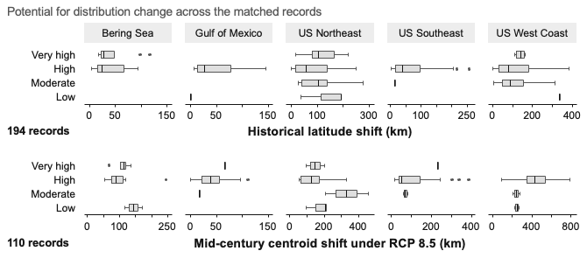
Historical and mid-century redistribution
5
Notes:
The potential for distribution change across the matched records.
Historical latitude was converted from degrees to kilometers for making comparison easier..
The distributions overlap across CVA categories and the categories cover only a limited range in some regions.
Within region Spearman tests detect no association.

Slide 6
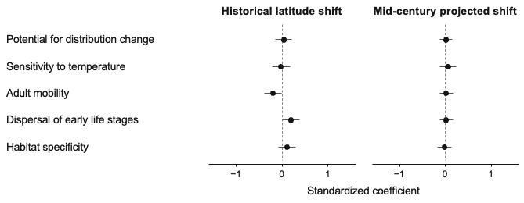
Potential for distribution change and its attributes
Potential score: P = 0.705 for historical shift and P = 0.879 for projected shift.
6
Notes:
This comparison isolate the potential score and the four attributes used to derive it.
The aggregate potential score shows little correspondence with either endpoint.
Early life dispersal has a nominal positive historical association and adult mobility a nominal negative one.
ALL the twelve sensitivity attributes q value above 0.05.

Slide 7
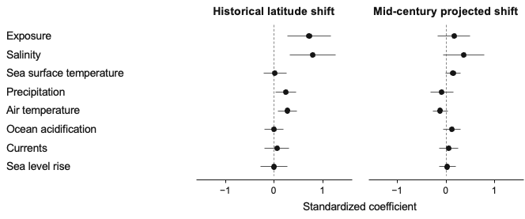
Exposure associations differ between endpoints
Historical exposure, salinity and air temperature meet q < 0.05.
No projected coefficient meets P < 0.05.
7
Notes:
Aggregate exposure has the clearest historical association:
Historical exposure, salinity and air temperature meet q below 0.05.
In contrast, none of mid-century models reach P below 0.05.

Slide 8
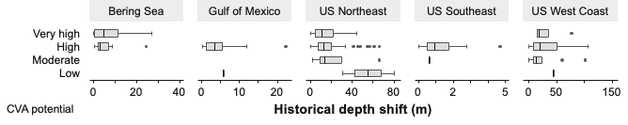
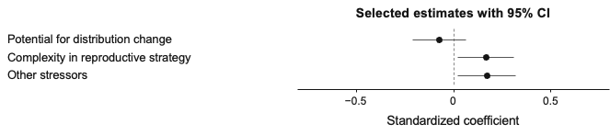
Historical depth shift: limited correspondence
All 23 depth associations have q ≥ 0.150.
8
Notes:
The historical depth analysis.
Potential for distribution change was not associated with historical depth shift.
Reproductive strategy complexity and other stressors have nominal positive associations.
No depth association survives FDR correction.

Slide 9
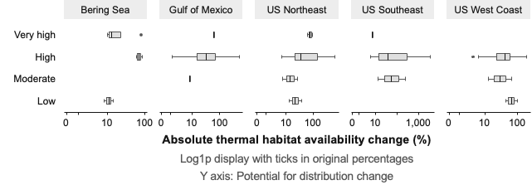
Thermal habitat availability adds another metric
RCP 8.5: 2041 to 2060 relative to 2007 to 2020
110 records: 65 increases and 45 decreases. High potential contains 88 records.
9
Notes:
This supplementary validation asks whether potential for distribution change corresponds to thermal habitat availability.
We use the original data and log transfermation.
High potential contains 88 of the 110 records, which restricts information across score levels.

Slide 10
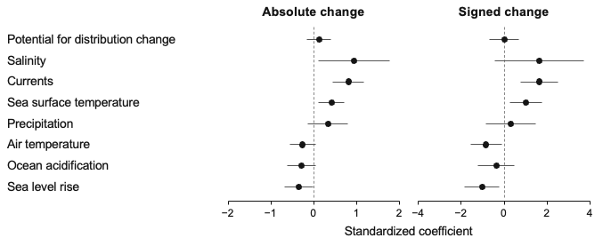
Habitat change relates to selected exposure factors
Absolute change: currents and SST meet q < 0.05.
Potential score shows no association with either response.
10
Notes:
Potential for distribution change is unrelated to absolute and signed change.
SST and currents are positiveto both.
No sensitivity subscores survives FDR correction.

Slide 11
Productivity magnitude and direction
Response | Interpretation
Absolute θ | Magnitude of SST influence on productivity
Signed θ | Direction and magnitude of SST influence
Absolute MSY change | Magnitude of the percentage MSY change
Signed MSY change | Increase or decrease in MSY (%)
Current data: historical MSY comparison
1930 to 1939 versus 2001 to 2010
Future MSY projections for 2026 to 2055 remain pending.
11
Notes:
Absolute and signed responses answer distinct questions.
Absolute theta represents the magnitude of estimated SST influence.
Signed theta retains whether the estimated influence is positive or negative.
The same distinction applies to MSY percentage change.

Slide 12
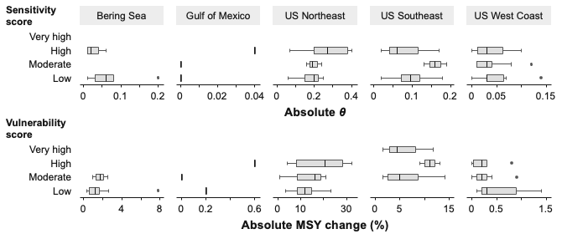
Absolute productivity responses across CVA scores
12
Notes:
The upper panel compares sensitivity with absolute theta, the lower compares vulnerability with absolute MSY change.
Sensitivity has no very high records.
No Spearman correlation reaches P below 0.05 for these two comparisons.

Slide 13
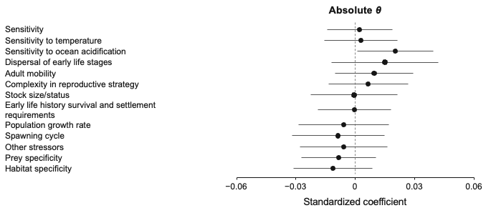
Absolute θ shows little correspondence with sensitivity
Aggregate sensitivity: P = 0.790. No attribute meets q < 0.05.
13
Notes:
The aggregate sensitivity coefficient is close to zero: β = 0.002.
Sensitivity to ocean acidification has a nominal positive association.
All other sensitivity attribute results also fail the FDR threshold.
Sensitivity to temperature has a coefficient of 0.003 for absolute theta.

Slide 14
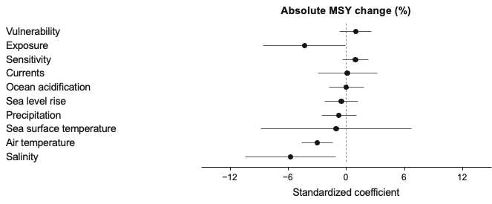
Absolute MSY change and CVA exposure
Air temperature: β = −3.004, q = 0.0043.
Aggregate exposure and salinity remain nominal associations.
14
Notes:
Vulnerability has no detected aggregate correspondence with absolute MSY change.
Air temperature exposure has a negative association.
Aggregate exposure and Salinity are nominal negative with MSY Change, but neither passes q below 0.05.
No sensitivity attribute passes correction.
The negative coefficient describes smaller absolute MSY changes at higher exposure scores.

Slide 15
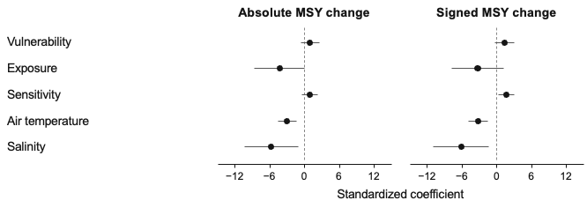
Signed responses retain the MSY exposure associations
Signed θ: aggregate sensitivity P = 0.194, all attribute q > 0.05
Signed MSY: air temperature q = 0.0025 and salinity q = 0.046.
Aggregate sensitivity is nominal: P = 0.023, q = 0.070.
15
Notes:
Signed response show no significant association with theta.
For signed MSY change, sensitivity is positive.
Vulnerability and aggregate exposure remain nonsignificant.

Slide 16
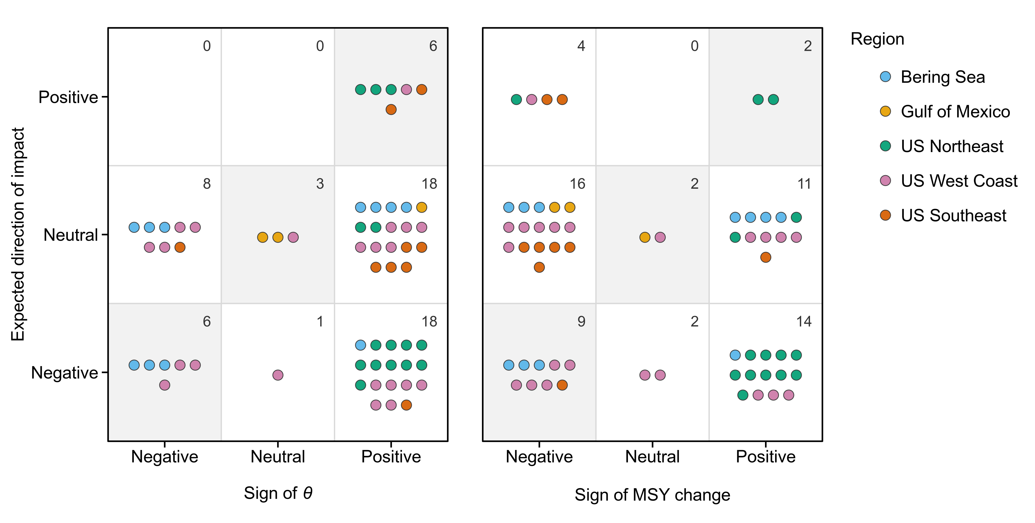
Expected impact and response signs vary by region
16
Notes:
This is the expected impact and response signs.
The matrices compare expert direction against the observed sign of theta or MSY change.
For theta, 25% stocks agree.
For MSY change, 22%. CVA directions are more negative than theta signs, over 60%.

Slide 17
Direction tests address different questions
Test | θ | MSY change
Sign categories Fisher test | P = 0.547 | P = 0.556
Continuous response Spearman correlation | ρ = −0.032 P = 0.811 | ρ = −0.318 P = 0.013, q = 0.026
Continuous response Region fixed effects | β = −0.0075 P = 0.625 | β = −2.507 P = 0.032, q = 0.063
The adjusted MSY inverse association remains nominal after BH correction.
17
Notes:
The categorical and continuous analyses answer different questions.
Fisher tests find no association between the three expert direction classes and response sign classes.
Spearman correlation is near zero for theta, signed MSY has rho -0.318.
After region adjustment, the MSY coefficient is -2.507, and support a nominal inverse association.

Slide 18
Main validation findings
Aggregate classifications
Limited correspondence with redistribution, absolute θ
and absolute MSY change in the matched datasets.
Exposure factors
Several associations survive FDR correction, with different
patterns across historical shifts, habitat change and MSY.
Direction of impact
Low descriptive agreement. The adjusted inverse MSY
association remains nominal after multiple testing.
18
Notes:
The main message is limited correspondence between CVA score and their proposed empirical response.
Some individual exposure factors contain stronger statistical signals, although the pattern varies by endpoint.
Directional agreement is descriptively low, and the region-adjusted inverse MSY association remains nominal after correction.
These results support careful interpretation of the tested classifications and metrics.

Slide 19
Questions for discussion
Future MSY results
Confirm delivery and integration of the 2026 to 2055 projections.
Decide how to position the current historical comparison.
Main text and supplementary evidence
Confirm placement of thermal habitat validation and signed responses.
19
Notes:
First, if the future MSY projections enter the analysis, should the historical comparison remain as validation after that update?
Second, where should the thermal habitat and signed response analyses sit in the manuscript?

Slide 20
Regional correlations: redistribution
Region | Historical n / levels | Latitude ρ | P | Projected n / levels | Centroid ρ | P
Bering Sea | 31 / 2 | 0.167 | 0.370 | 12 / 3 | −0.221 | 0.489
Gulf of Mexico | 12 / 2 | 0.480 | 0.114 | 31 / 3 | 0.341 | 0.061
US Northeast | 63 / 4 | −0.025 | 0.847 | 20 / 4 | −0.345 | 0.136
US Southeast | 37 / 2 | 0.187 | 0.267 | 33 / 3 | 0.114 | 0.528
US West Coast | 51 / 4 | −0.023 | 0.873 | 14 / 3 | 0.541 | 0.046
Predictor: Potential for distribution change
Within-region Spearman tests shown with unadjusted P values.
Appendix
20

Slide 21
Regional correlations: absolute productivity
Region | n | Sensitivity levels | |θ| ρ | P | Vulnerability levels | |MSY| ρ | P
Bering Sea | 13 | 2 | −0.430 | 0.142 | 2 | 0.171 | 0.576
Gulf of Mexico | 3 | 3 | 0.866 | 0.333 | 3 | 0.500 | 0.667
US Northeast | 15 | 3 | 0.342 | 0.212 | 3 | 0.276 | 0.319
US Southeast | 9 | 3 | −0.076 | 0.846 | 3 | −0.080 | 0.838
US West Coast | 22 | 3 | −0.124 | 0.582 | 3 | −0.320 | 0.147
Sensitivity versus absolute θ and vulnerability versus absolute MSY change.
No within-region test meets P < 0.05. Gulf of Mexico n = 3.
Appendix
21

Slide 22
Key fixed-effects estimates
Response and predictor | β | 95% CI | P | q
Latitude: exposure | 0.721 | [0.278, 1.163] | 0.002 | 0.006
Latitude: salinity | 0.789 | [0.316, 1.262] | 0.001 | 0.008
Latitude: air temperature | 0.269 | [0.069, 0.468] | 0.009 | 0.030
Latitude: precipitation | 0.244 | [0.033, 0.456] | 0.024 | 0.056
Abs. habitat: currents | 0.804 | [0.436, 1.172] | 0.000047 | 0.00033
Abs. habitat: SST | 0.412 | [0.108, 0.715] | 0.008 | 0.029
Abs. MSY: air temperature | −3.004 | [−4.645, −1.363] | 0.00062 | 0.004
Signed MSY: salinity | −6.198 | [−11.038, −1.357] | 0.013 | 0.046
One predictor SD. Response units differ across endpoints.
Appendix
22

