Slide 1
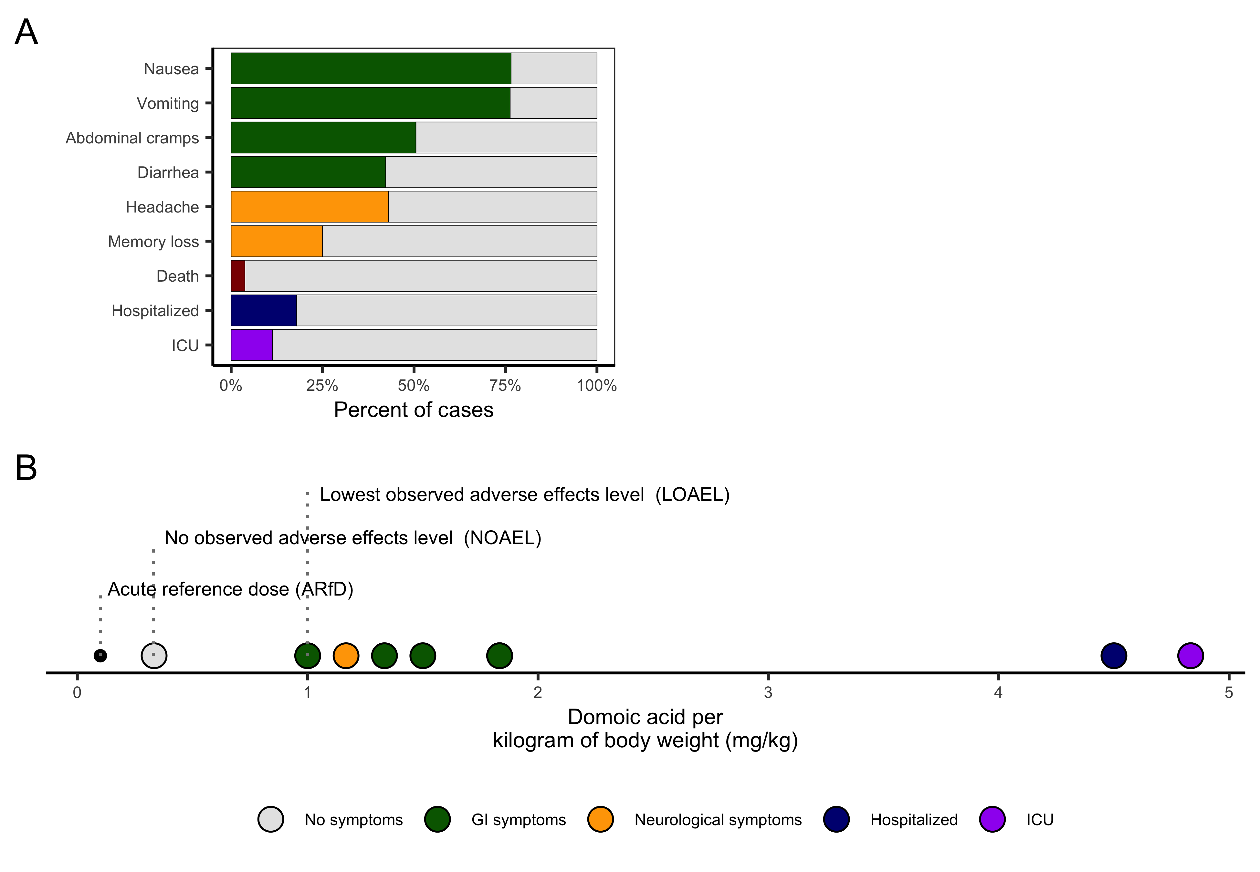


C
The maximum residue limit (MRL) is the concentration of toxin in food that would exceed the ARfD in an average human.
0.3 kg
60 kg
MRL = ARfD * human weight / crab weight
MRL = 0.1 mg/kg * 60 kg / 0.3 kg = 20 mg/kg
Safety factor of 10

