Slide 1
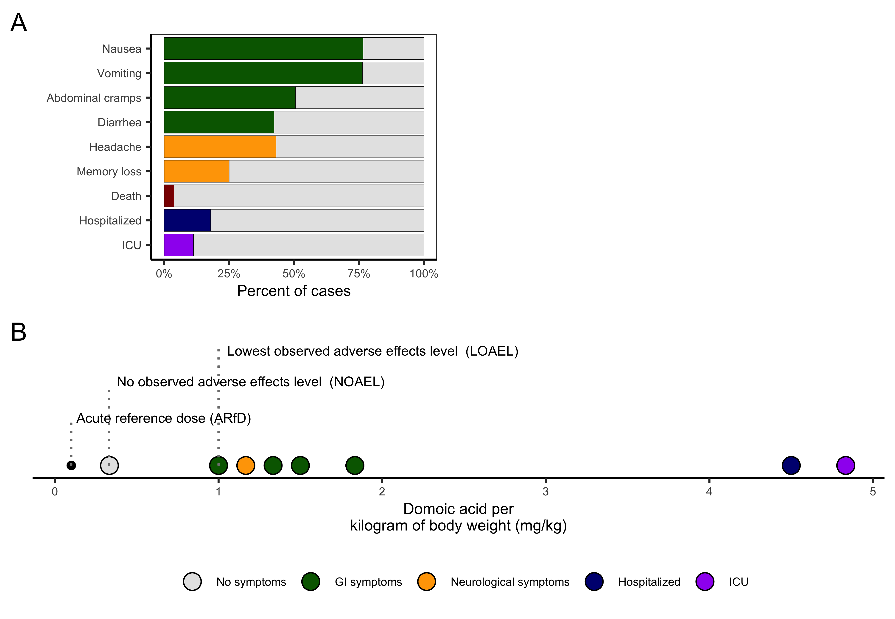


C
The maximum residue limit (MRL) is the concentration of toxin in food that would exceed the ARfD in a human of average body weight.
0.3 kg
60 kg
MRL = ARfD * human weight / serving weight
MRL = 0.1 mg/kg * 60 kg / 0.3 kg = 20 mg/kg = 20 ppm
In 1993, the FDA set a 30 ppm action threshold for the viscera based on two assumptions: (1) a serving of crab is 0.3 kg meat and 0.15 kg viscera and (2) domoic acid levels are 5x higher in the viscera than the meat. Thus, given an acute dose of 6 mg for a 60 kg person, 1 mg would come from the meat and 5 mg would come from the viscera:
5 mg / 0.15 kg viscera = 33 mg/kg ≈ 30 mg/kg 1 mg / 0.30 kg meat =
Safety factor of 10

