Slide 1
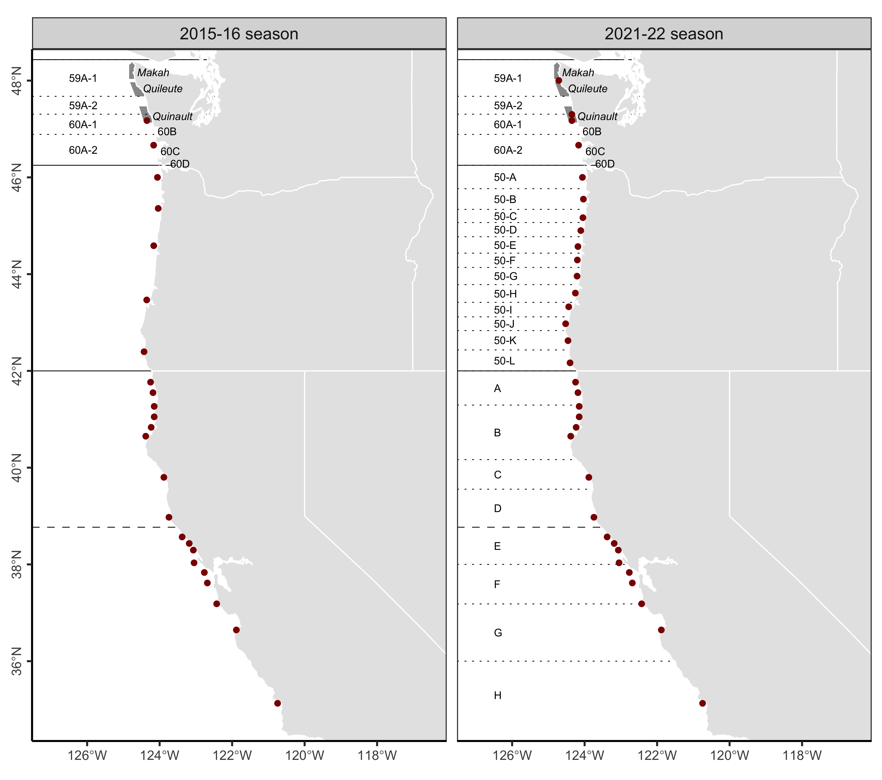
Washington
Monitoring
2 monitoring sites
Management
4 coastal, 3 inland zones
Area closures
Washington
Monitoring
4 monitoring sites (+2)
Management
4 coastal, 3 inland zones
Area closures, evisceration orders (+)
Oregon
Monitoring
5 monitoring sites
Management
No delineated management zones
Area closures
Oregon
Monitoring
12 monitoring sites (+7)
Management
12 coastal zones (+12)
Area closures, evisceration orders (+)
California
Monitoring
17 monitoring sites
Management
No delineated management zones
Area closures
California
Monitoring
17 monitoring sites
Management
8 coastal zones (+8)
Area closures, evisceration orders (+)

