Slide 1

Focus Group Meetings .
Meeting summary
Tracey Mangin
January 28, 2025

Slide 2
Outline
Background
Summary - all meetings
Regional differences
Next steps
Follow up with participants
Incorporating information into research
Notes:
The idea was that these meetings would help us identify climate impacts and mitigation strategies that we missed in our research and to ensure that our study was comprehensive in terms of the types of mitigation strategies examined.

Slide 3
Background
Purpose: Talk with fishermen about observed/anticipated climate change impacts on fisheries outcomes and potential mitigations strategies to foster resilient West Coast Fisheries
Notes:
The idea was that these meetings would help us identify climate impacts and mitigation strategies that we missed in our research and to ensure that our study was comprehensive in terms of the types of mitigation strategies examined.

Slide 4
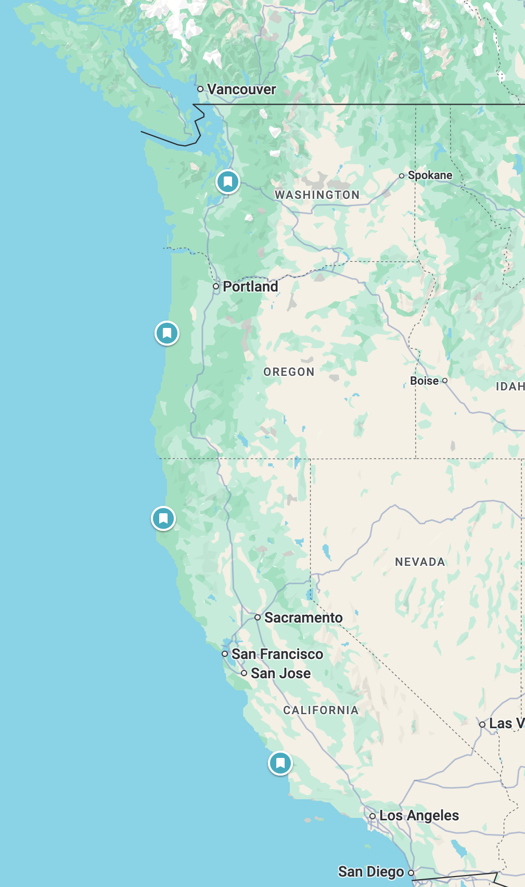
Background
Purpose: Talk with fishermen about observed/anticipated climate change impacts on fisheries outcomes and potential mitigations strategies to foster resilient West Coast Fisheries
Locations:
Eureka, CA
Newport, OR
Morro Bay, CA
??, WA
Notes:
Massive effort to recruit people to join the meetings
Decided to go to Morro Bay and Eureka because they are near the OSW leases, and picked Newport based on suggestions
Did not have time to do our trip to the WA area before Ellen’s last day, didn’t pick a location yet for WA

Slide 5
Background
Reality: Talk with fishermen about observed/anticipated climate change OSW impacts on fisheries outcomes and at times potential mitigations strategies to foster resilient West Coast Fisheries
Locations:
Eureka, CA (7 participants)
Newport, OR (3 participants)
Morro Bay, CA (7 participants)
??, WA
X
Notes:
We completed 3 / 4 intended Focus Group Meetings
Massive effort to recruit people to join the meetings
Newport meeting coincided with a good fishing day, fewer participants
Generally seemed like many of the participants have spent a lot of time having similar conversations

Slide 6
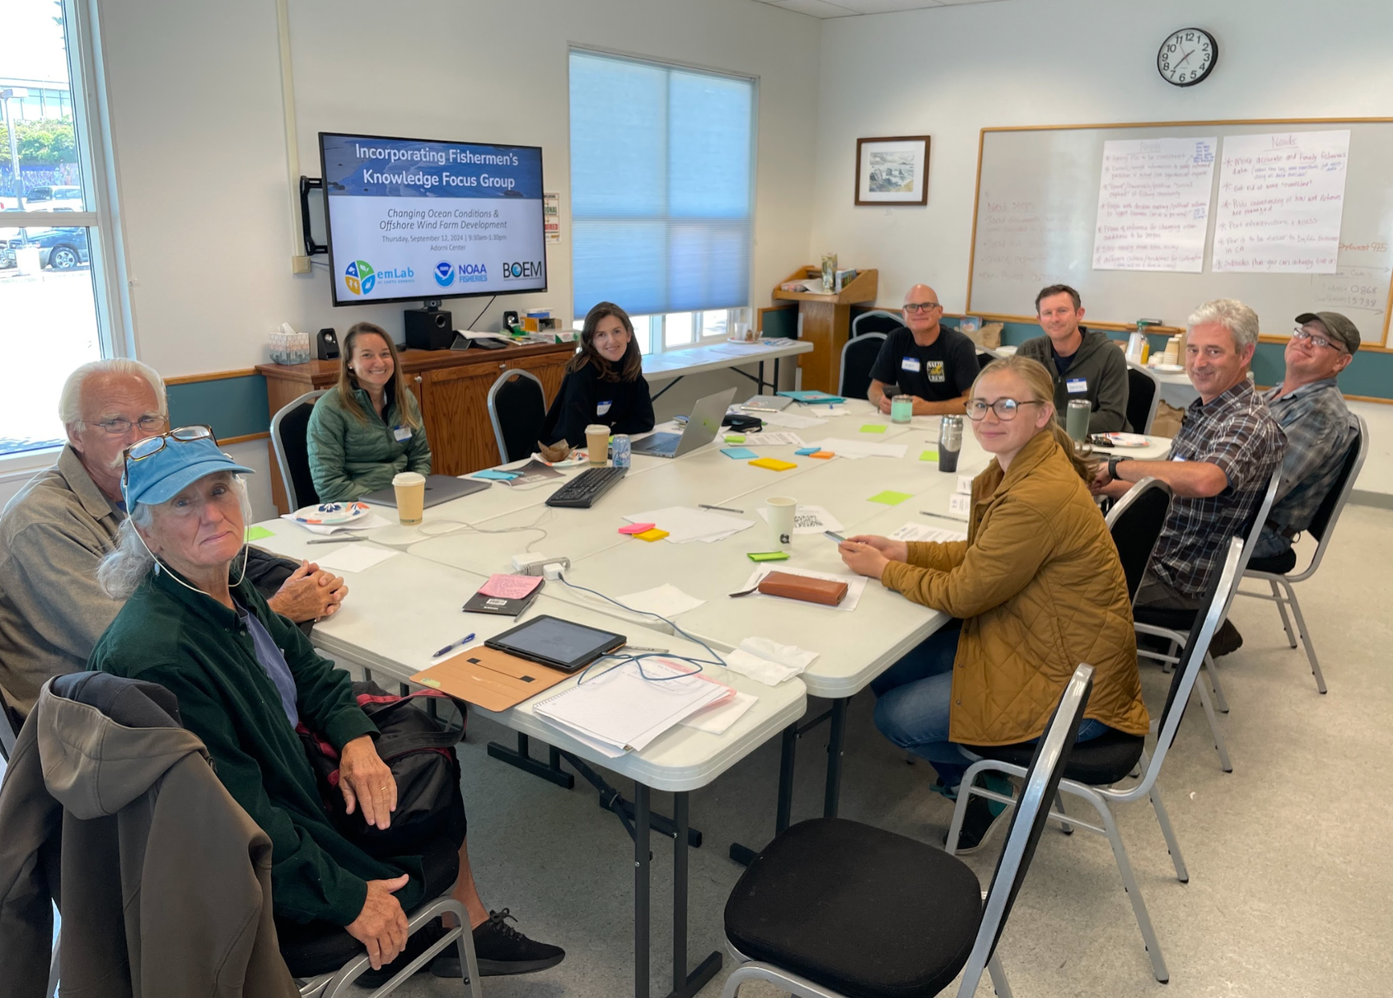
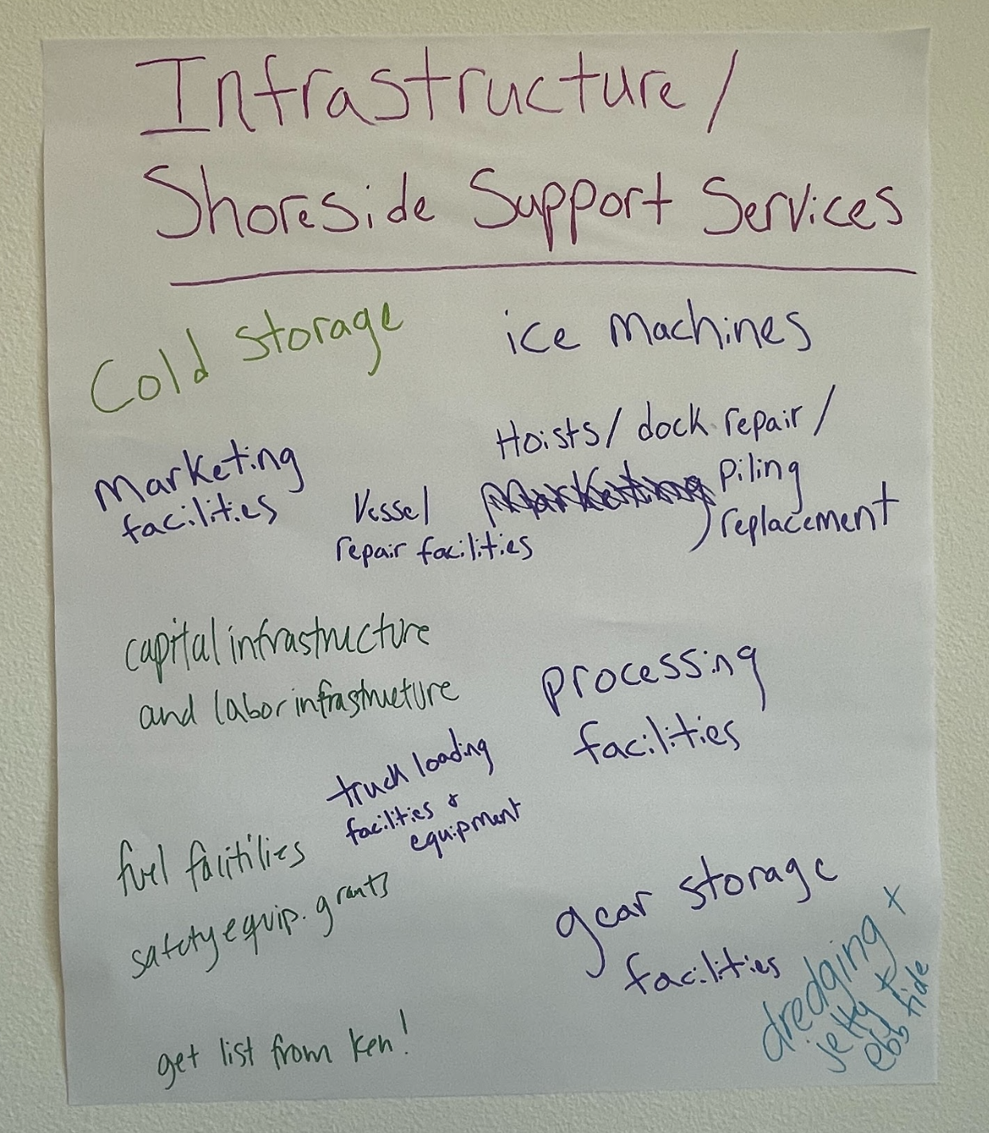
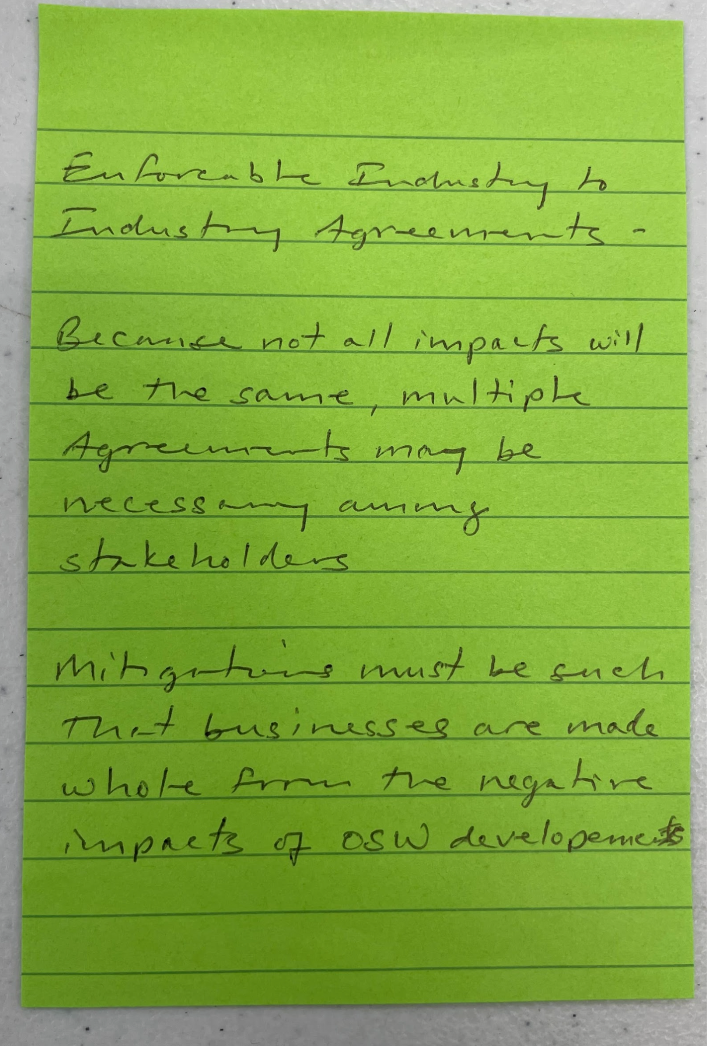
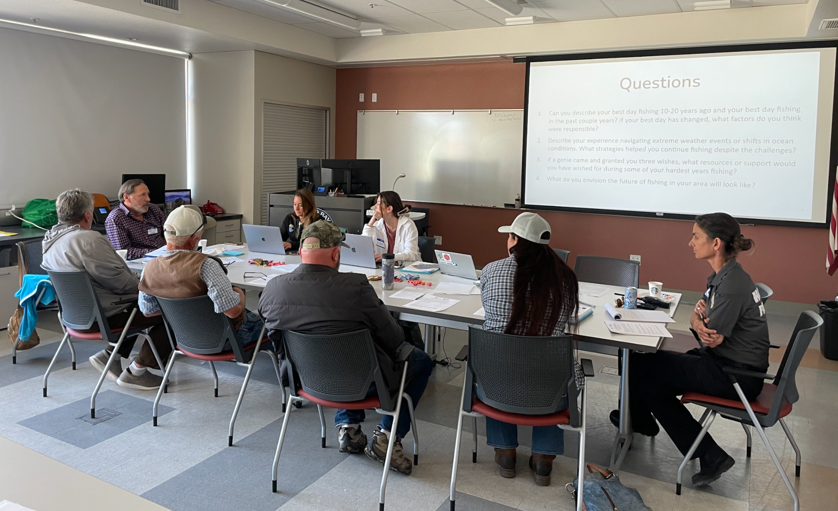
Background
Sorry, these are the last images you’ll see here!
Notes:
We used several different approaches to spark conversation about potential mitigations strategies to address challenges from climate change
Post-its, flip charts, etc.
And sometimes we did… but mostly participants wanted to talk about OSW development
Participants both voiced concerns and wanted to ask questions

Slide 7
Summary. General themes
Industry importance. Fishing provides a sense of purpose and is culturally significant - it’s a way of life, not just a job, and contributes to food security
WC fisheries are some of the most sustainable in the world. Highly regulated, incredibly sustainable - they are environmental stewards
Everything is always dynamic and cyclical. Fishermen are used to adapting to environmental changes and will follow the fish (if there is somewhere to go); “good” and “bad” fishing areas change over time

Slide 8
Summary. General themes related to OSW
Fishermen want avoidance. First and foremost
Precautionary rollout. Participants want pilot projects/small scale implementation to research before expansion
OSW will be huge blow to an already fragile industry.
OSW has many unknown environmental implications and could be a net negative for the ocean. Believes that they will make fisheries less resilient to climate change and have net negative ecosystem impacts on ocean
Technological and economic viability should be proven.
Notes:
“Use the existing CA lease areas as case studies”

Slide 9
Summary. OSW process
Rushed, hasty, lacking appropriate analysis.
Assessment and analysis should come before leasing.
Trial/pilot projects should occur before massive rollout.
Lack of transparency, honesty, knowledge, and competence.
Inadequate communication with BOEM.
Desire for more meaningful collaboration and discussion with BOEM and OSW companies earlier in process.
Valuation estimates will not capture full estimate of area of resources. (“good”/ “bad” areas change, hard to value upwelling ecosystem, etc.)
Notes:
Rushed, hasty, lacking appropriate analysis.
Assessment and analysis should come before leasing.
Trial/pilot projects should occur before massive rollout.
Lack of transparency, honesty, knowledge, and competence.
Inadequate communication with BOEM.
Desire for more meaningful collaboration and discussion with BOEM and OSW companies earlier in process
This includes siting
Valuation estimates will not capture full estimate of area of resources (“good”/ “bad” areas change, hard to value upwelling ecosystem, etc.)
E.g., it might not look like the lease area in morro bay is valuable now (not that much fishing there) but changes in markets or fish behavior could change that.

Slide 10
Summary. Challenges
“Regulated to extinction.” Already squeezed by area closures; single-species management not working for some species
Unfavorable market conditions. Lack of market and price drops for harvested species, increasing costs, fewer buyers, hard to compete with cheaper, less sustainable imported seafood.
Lack of infrastructure. Lack of cold storage and processors (+ repair support)... but note it doesn’t matter if they can’t fish
Lack of support/public awareness. Public is unaware about sustainability/quality of product; industry not supported by government.*
Everything is expensive. Coastal CA, doing business in CA, gears, and permit are all expensive.
Notes:
“Regulated to extinction.” Already squeezed by area closures; single-species management not working for some species
Unfavorable market conditions.
Lack of market for species like anchovy, sardine, sablefish, and price drops for harvested species like dungeness crab
Increasing costs (in part due to inflation) while catches remain the same
Fewer processors and buyers, and buyers can have tremendous leverage
Hard to compete less sustainable imported seafood, which is cheaper to produce because they are subject to much weaker environmental and social standards
Lack of infrastructure.
Lack of cold storage and processors - it’s too expensive
Lack of support/public awareness.
NOTE. OR participants feel supported by state government. CA does not. Both feel that they can’t compete with foreign product and that federal action could help level the playing field. Also they are not as supported as the agriculture sector, fore example.
Everything is expensive

Slide 11
Summary. Challenges related to OSW
OSW will disrupt fishing activity, largely through fishery exclusion. Concentrates fishermen/fisheries, increases transit time, increasing cost and reducing product quality
OSW could compromise scientific assessment through disrupted surveys.
“Another hit,” “death by a thousand cuts, and this is a huge wound.” OSW will make it harder to operate in an industry that is already difficult to operate in
Industrialization from OSW threatens culture, community, identity.
Notes:
OSW will disrupt fishing activity.
Increased vessel traffic and potential changes in how agencies control fleet movements
Safety concerns with increased traffic and congestion
Risk to essential habitat/spawning grounds (latter is a concern for Coos Bay)
Unknown risks to fisheries resources (e.g., upwelling, cumulative effects, and cables).
Another hit
The margins really do seem razor thin

Slide 12
Summary. Mitigation related to OSW
Clear communication regarding scale and scope of OSW. Fishermen can’t anticipate impacts without this info
Monitoring, enforcement, and transparency related to impacts from OSW.
More data collection and scientific analysis. NOAA surveys, study cumulative impacts, BACI studies. Idea: have fishermen drag instruments and collect data to supplement income
Community fund modeled after the Cable Committee Agreement.
Exit strategies. Leasees should be responsible for decommissioning and a strategy devised for when companies leave without decommissioning
Scale mitigation funding with scale of OSW.
Utilize/mandate OSW designs that lessen impacts on fisheries. (although this could affect the economic feasibility of OSW)
Allow fishermen to benefit from local boat mechanics brought in for OSW.
Hire professional to represent them (e.g., lawyers, lobbyist).
Notes:
Clear communication regarding scale and scope of OSW. Fishermen can’t anticipate impacts without this info
Monitoring, enforcement, and transparency related to impacts from OSW.
This could help level the playing field and result in important information for assessing risk and impact to fisheries.

Slide 13
Summary. Mitigation more generally
More scientific data collections and analyses. Need for nearshore wetfish; analyses should consider why catch decreases (market conditions? infrastructure issues?)
Ease/adjust regulations. Permitting that allows fishermen to follow fish (consider borders), regulate hours of net on bottom instead of individual species, don’t lower catch limit just because there is a decrease in landings, adjust protected species numbers to reflect growth in populations, use warning for Dungeness crab, allow for small scale catch without seine permit for squid/wetfish
Improve infrastructure/technology. Cold storage is very important and ice plants are “dilapidated” on the WC; provide funding to adopt technologies like nanofreeze
Improve market conditions. Educate the public and consumers on sustainability of resource compared to imported seafood, level the playing field between domestic and foreign fisheries with federal policies that prioritize the US…
Notes:
Nanofreeze - maintains product quality for longer “merluza doesn’t get much respect from where i come from”
Improve market conditions - foreshadowing for later

Slide 14
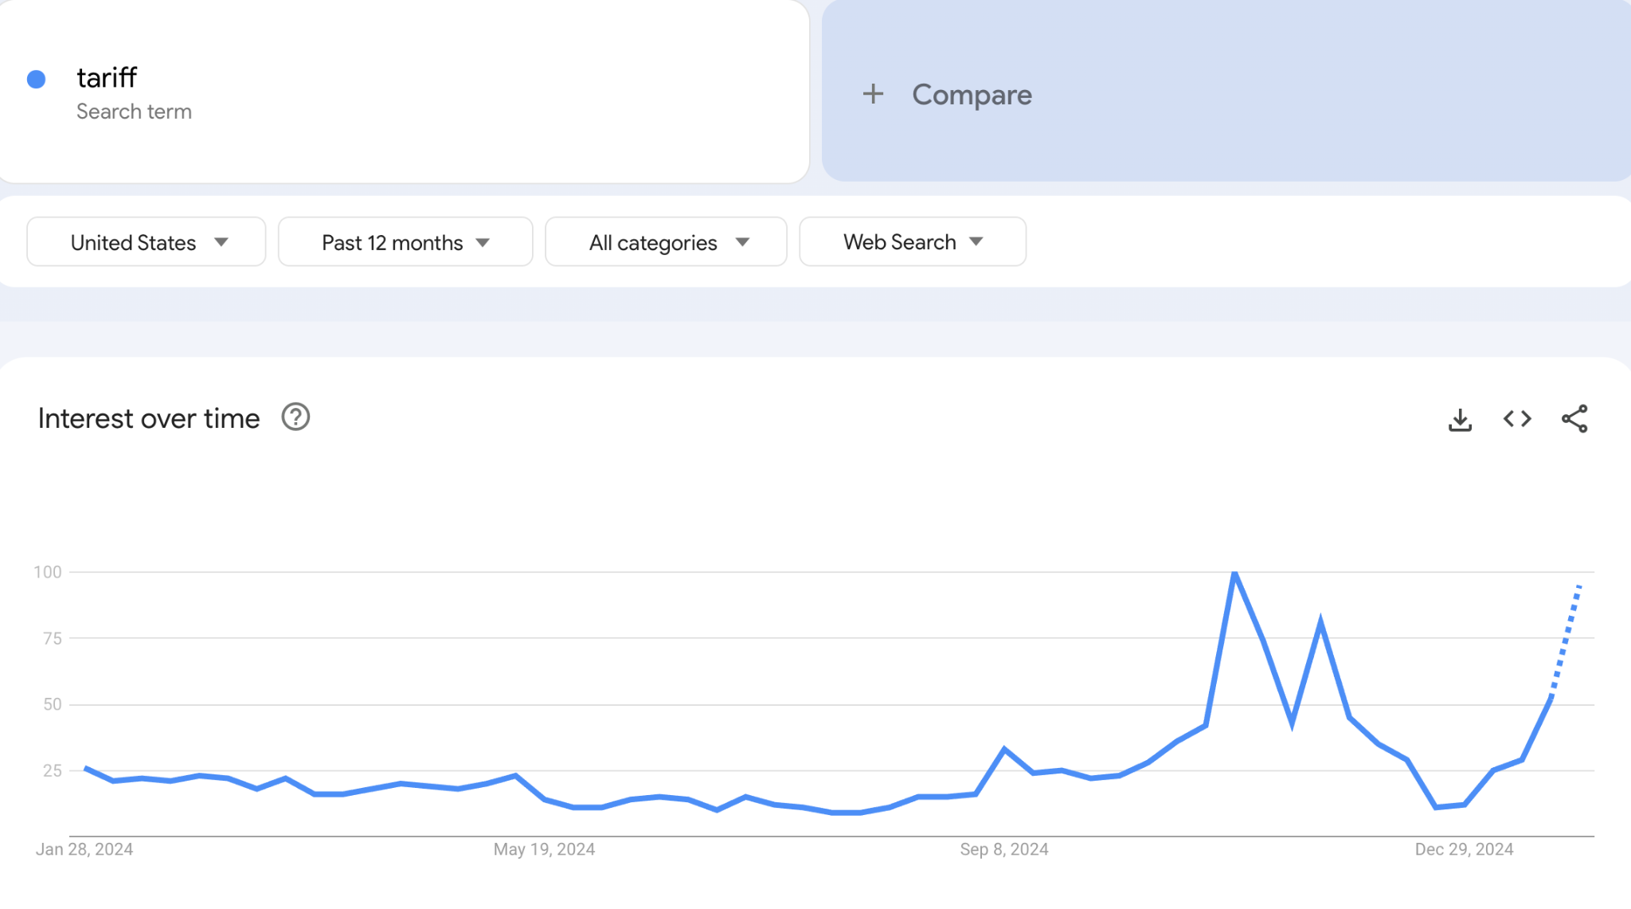
Summary. Bonus image
More scientific data collections and analyses. Need for nearshore wetfish; analyses should consider why catch decreases (market conditions? infrastructure issues?)
Ease/adjust regulations. Permitting that allows fishermen to follow fish (consider borders), regulate hours of net on bottom instead of individual species, don’t lower catch limit just because there is a decrease in landings, adjust protected species numbers to reflect growth in populations, use warning for Dungeness crab, allow for small scale catch without seine permit for squid/wetfish
Improve infrastructure/technology. Cold storage is very important and ice plants are “dilapidated” on the WC; provide funding to adopt technologies like nanofreeze
Improve market conditions. Educate the public and consumers on sustainability of resource compared to imported seafood, level the playing field between domestic and foreign fisheries with federal policies that prioritize the US…
Notes:
Tariffs were mentioned in the focus groups. But it sounds like they could be a double edge sword, because, trade… and that there are now concerns that they won’t have access to those foreign markets that they NEED access to.

Slide 15
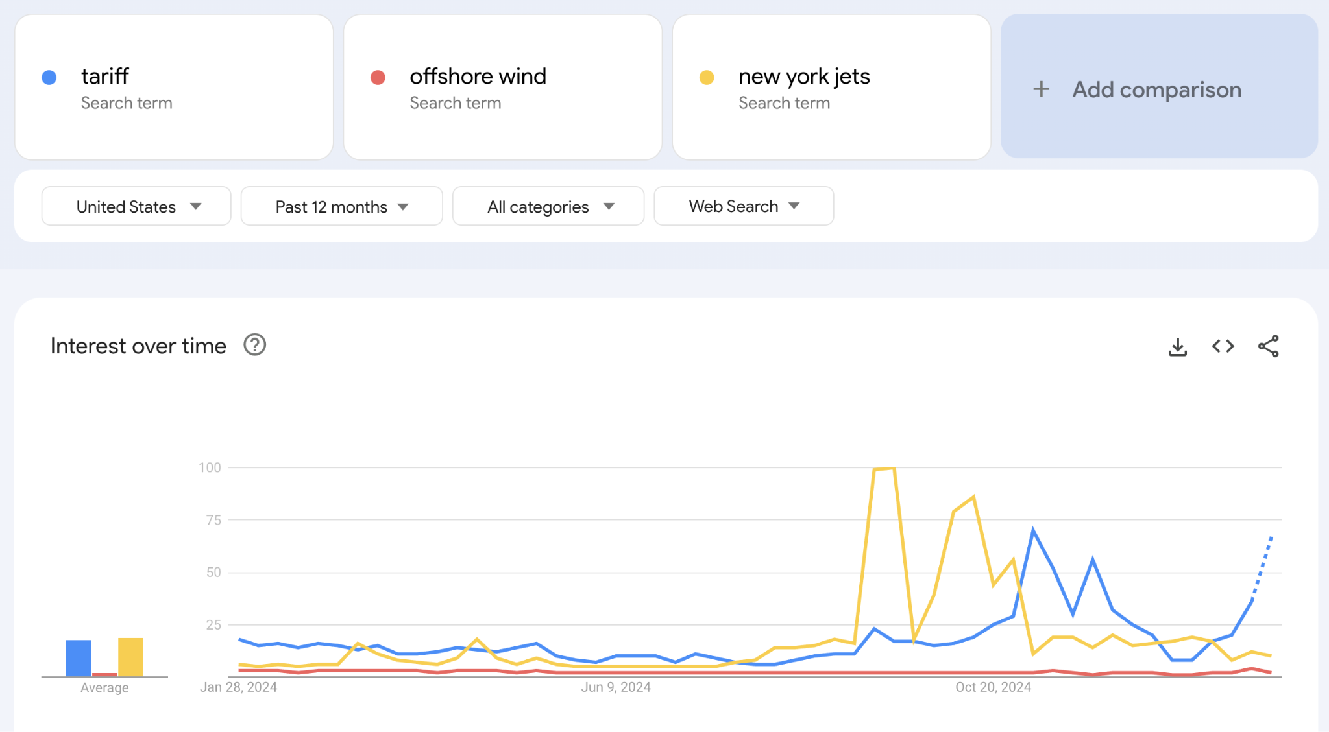
Summary. You’ve made it so far without images…
More scientific data collections and analyses. Need for nearshore wetfish; analyses should consider why catch decreases (market conditions? infrastructure issues?)
Ease/adjust regulations. Permitting that allows fishermen to follow fish (consider borders), regulate hours of net on bottom instead of individual species, don’t lower catch limit just because there is a decrease in landings, adjust protected species numbers to reflect growth in populations, use warning for Dungeness crab, allow for small scale catch without seine permit for squid/wetfish
Improve infrastructure/technology. Cold storage is very important and ice plants are “dilapidated” on the WC; provide funding to adopt technologies like nanofreeze
Improve market conditions. Educate the public and consumers on sustainability of resource compared to imported seafood, level the playing field between domestic and foreign fisheries with federal policies that prioritize the US…
Notes:
You’ve made it so far without images!

Slide 16
Summary. Mitigation more generally
More scientific data collections and analyses. Need for nearshore wetfish; analyses should consider why catch decreases (market conditions? infrastructure issues?)
Ease/adjust regulations. Permitting that allows fishermen to follow fish (consider borders), regulate hours of net on bottom instead of individual species, don’t lower catch limit just because there is a decrease in landings, adjust protected species numbers to reflect growth in populations, use warning for Dungeness crab, allow for small scale catch without seine permit for squid/wetfish
Improve infrastructure/technology. Cold storage is very important and ice plants are “dilapidated” on the WC; provide funding to adopt technologies like nanofreeze
Improve market conditions. Educate the public and consumers on sustainability of resource compared to imported seafood, level the playing field between domestic and foreign fisheries
Policies that prioritize the US, enforcing MMA abroad, tariffs(?)
Increase opportunities for younger generation. Apprenticeship with Sea Grant, scholarships.
Mixed interest in insurance. Some interest in a fisheries-specific insurance plan like that of agriculture, but also participants weren’t sure if people could pay for it.
Not interested in adding new habitat. They want to maintain the ecosystem that they have.

Slide 17
Regional differences
CA compared to OR:
CA more open to subsidies than OR
Feeling that OR has more support from state government than CA
Aging of the fleet and challenges for the younger generation more of a concern in CA compared to OR
Morro Bay compared to Eureka
Morro Bay has been involved in drafting mitigation plans for years, further along
The two areas have distinct characteristics and challenges
Notes:
OR didn’t like the idea of subsidies, certainly not forever

Slide 18
Next steps
With participants:
Share summary document for review and feedback
Prepare final summary for BOEM, as requested by participants
Our research:
Incorporate participant knowledge and feedback into mitigation assessment

Slide 19
Thank you for your attention!
To thank you for you attention, you get lunch tomorrow!
Menu: South Coast Deli
Input your lunch order into the lunch spreadsheet

