Slide 1
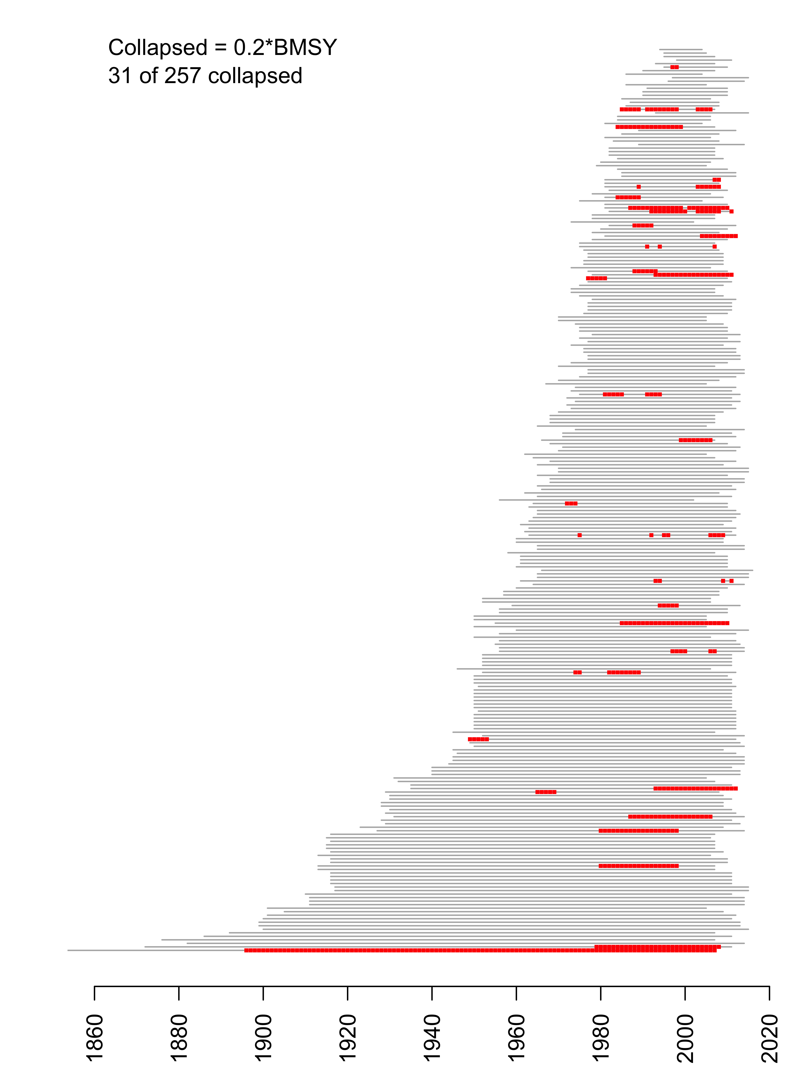
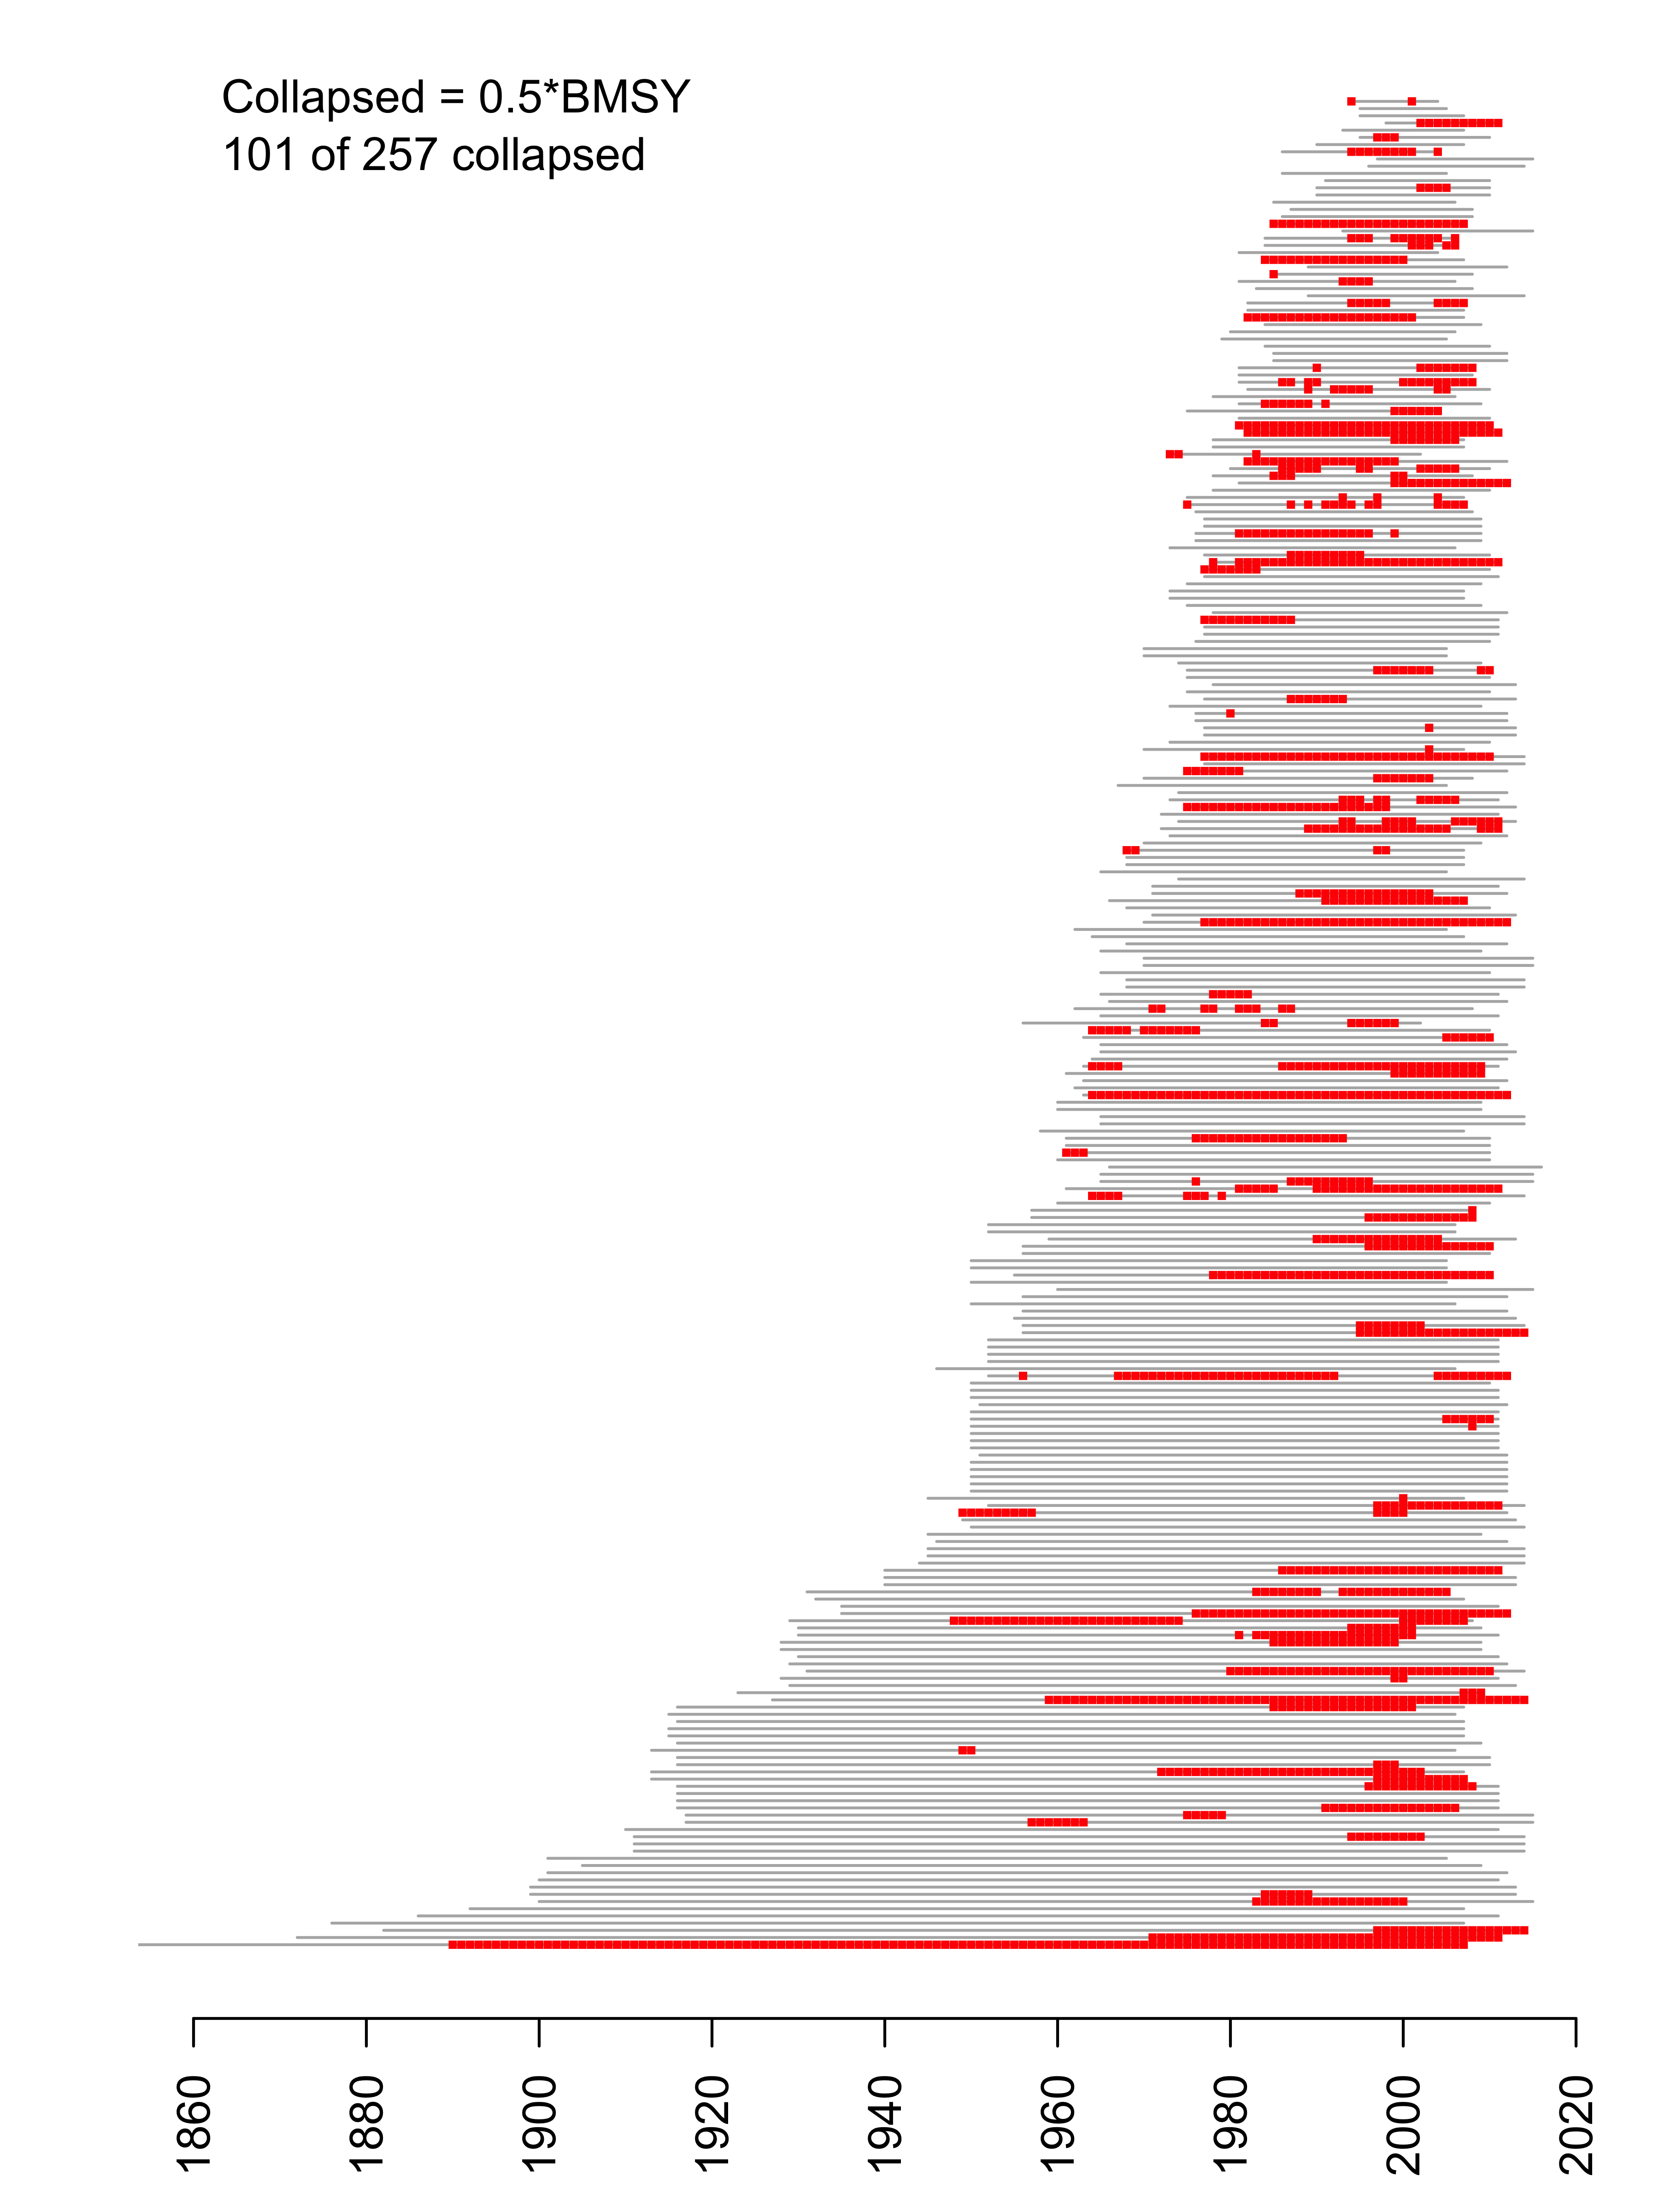
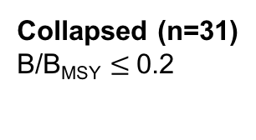
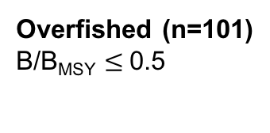
Collapsed (n=31)
B/B_{MSY} $≤$0.2
Overfished (n=101)
B/B_{MSY} $≤$0.5

