Slide 1
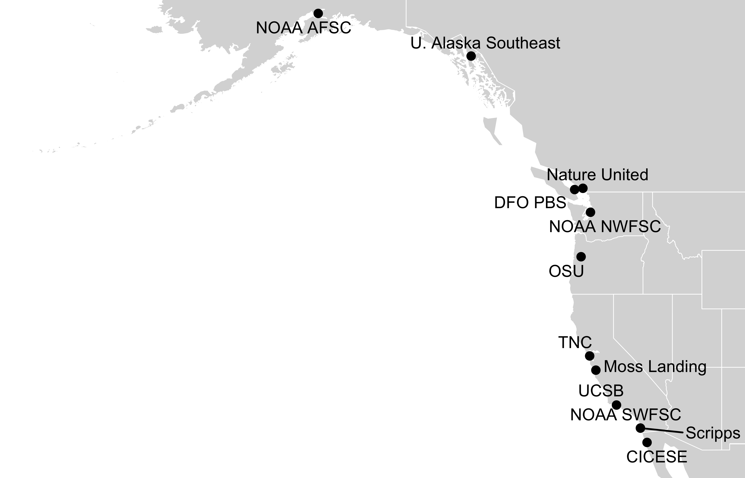
Impact of the 2014-16 marine heatwave
on North American West Coast fisheries:
surprises and lessons from key case studies
Christopher Free | University of California, Santa Barbara
Lyall Bellquist, Andrew Thompson, Kate Richerson, Will Satterthwaite, Barbara Muhling, Will White, Mike Navarro, Jenn Burt, Kristin Marshall, Sean Anderson, Lauren Rogers
TNC NAR CoP Webinar | February 28, 2022

Slide 2
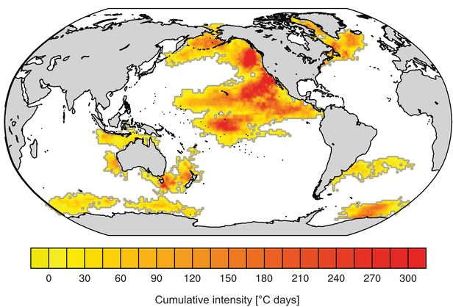
“The Blob” | 2014-2016
Largest and longest on record
Widespread fishery closures, fishery collapses, range expansions, mortality events
Tasman Sea| 2015-2016
Disease outbreaks in farmed shellfish, mortality of wild shellfish, poleward range expansions
Western Australia| 2010-2011
Fish kills, abalone die off, poleward range extensions
Laufkötter et al. (2020) Science

Slide 3





Cascading ecosystem changes resulting from the heatwave
Mammals/seabirds:
Mammals: Unusual mortality events due to juvenile starvation, increased entanglements
Seabirds: Mass mortality events due to starvation through trophic cascades
Finfish/shellfish:
Poleward range expansions, both winners and losers in production
Zooplankton:
Abundance remained high but composition changed dramatically
Inshore: reduced stratification -> reduced nutrient availability -> reduced production
Offshore: reduced stratification -> increased light exposure -> increased production
Harmful algae blooms: a perfect storm of conditions -> a HAB of unprecedented intensity
Phytoplankton:
Physical:
Warm water -> intensified stratification -> reduced nutrient fluxes

Slide 4
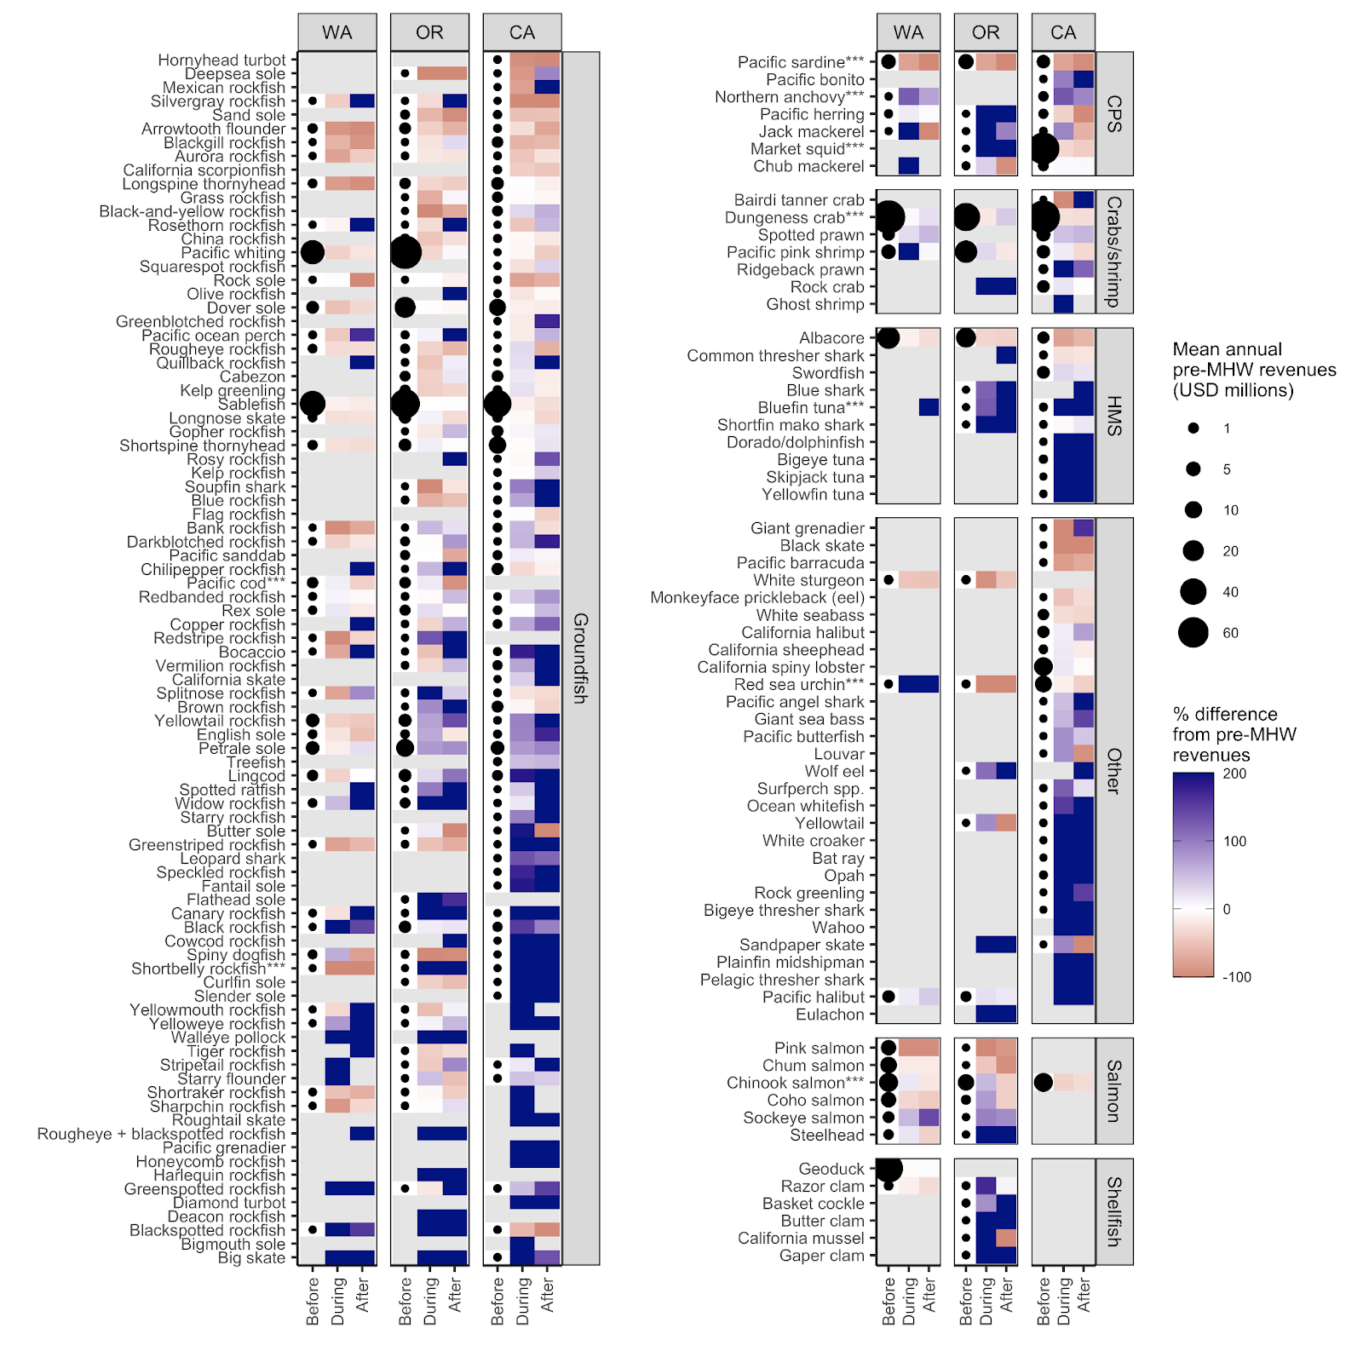
Winners and losers:
Change in fisheries revenues during the marine heatwave
Based on
PACFIN fisheries landings data

Slide 5
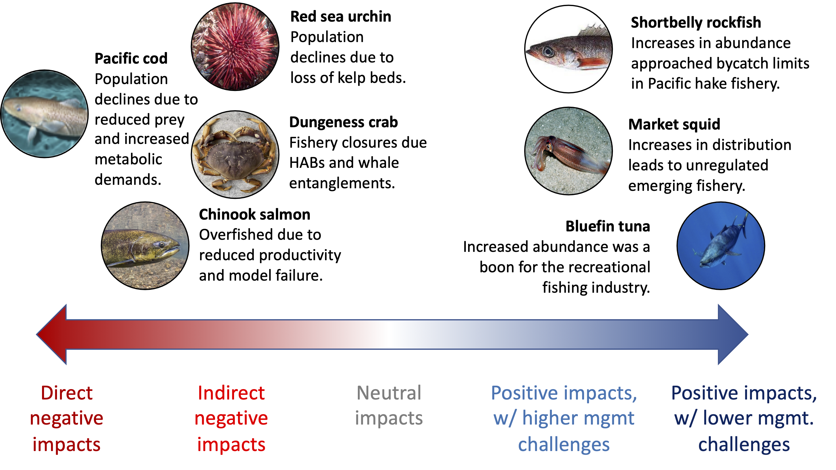
Case studies

Slide 6
Preliminary management takeaways
Stock assessment
Increase integration of ecosystem considerations such as environmentally-driven recruitment, time-varying mortality, or spatial structure (Pacific hake)
Increase international coordination to ensure that shifting availability is not conflated with increased productivity (Bluefin tuna)
Fisheries management
Increase precaution to buffer against scientific uncertainty (Chinook salmon)
Increase flexibility to and preparation for surprises such as explosions in choke species (Short-belly rockfish)
Increase monitoring to enable efficient management of climate risks (Dungeness crab)
Socio-economic resilience
Promote flexible infrastructure so climate winners can compensate for climate losers (Market squid)
Strengthen participatory governance to develop tractable solutions (Dungeness crab)

