Slide 1
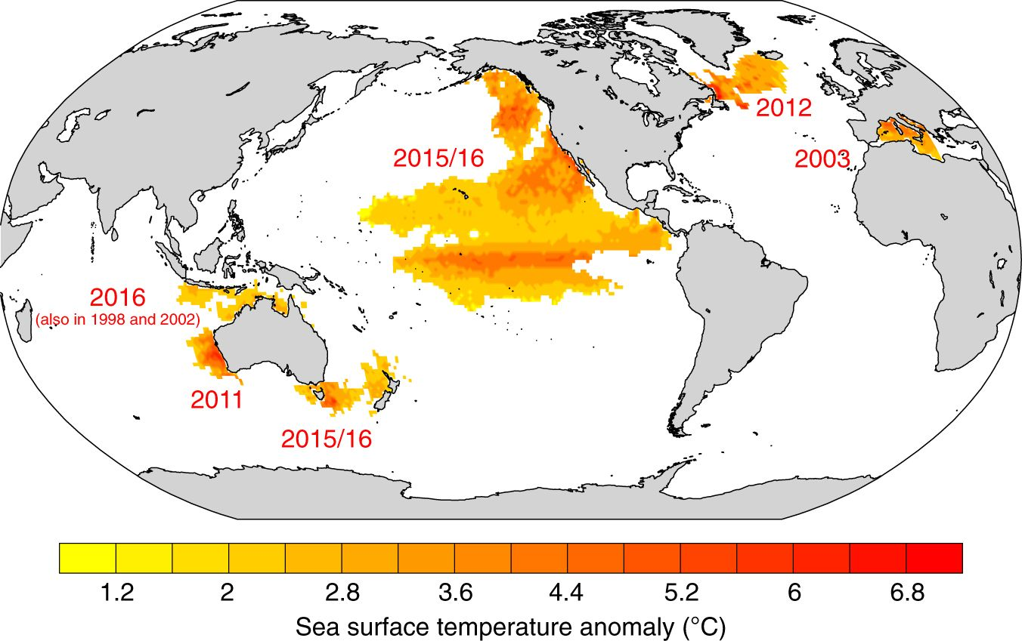
Marine heat waves: global perspective
Unprecedented:
Scale
Duration
Complexity
Intensity
Impact

Slide 2
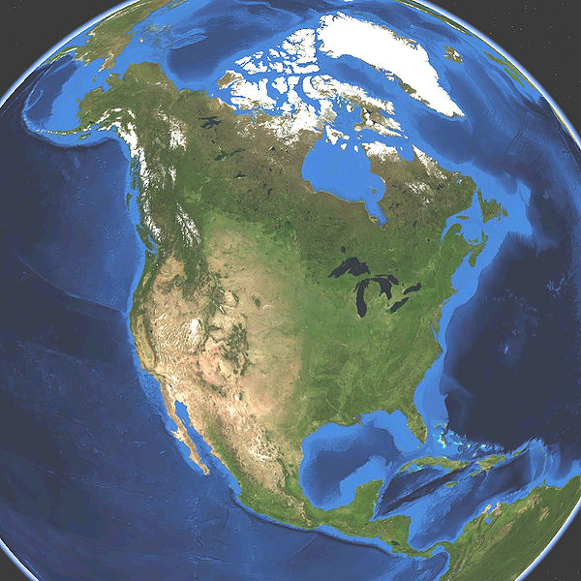
West coast climate impacts during the last 5 years: Mexico to Alaska
Changes in distribution (temperature)
-Species (plankton to baleen whales)
-Fisheries (Sardine, multiple salmon, market squid, Alaska groundfish, etc.)
Changes in production (temperature, disease, starvation, recruitment failure, etc.)
-Species (kelp, red abalone, gray whales, HABs, mortality events from sea stars to sea lions)
-Fisheries (Sardine, Dungeness, Pacific cod, spiny lobster, Pacific whiting, razor clam, etc.)
Fisheries impacts
-Changes (Dungeness, Pacific whiting, multiple salmon, Pacific cod, etc.)
-Closures (Dungeness, sardine, spiny lobster, red abalone, multiple shellfish, etc.)
Societal impacts
-Cascading effects of fisheries closures (hospitality industry, assistance, cultural identity)
-Pacific hurricane intensification off Mexico
-2015: 2nd most active hurricane season in NE Pacific (11 storms)
-Hurricane Patricia: strongest ever recorded on earth ($463M in damages)
Economic impacts
-Federal fisheries disaster declarations (shift from overfishing-related to climate-related)
-Single-HAB-event loss estimates of $122M for Dungeness and razor clam fisheries alone

Slide 3
Two objectives
1) Produce a collaborative and comprehensive science product
Climate impacts to west coast ocean ecosystems and fisheries, from Mexico to Alaska
Open discussion for managing fisheries under future extreme-event scenarios
Has potential for broader policy scaling because marine heatwaves occur globally
2) Use this platform of science to shine a spotlight on ocean importance, impacts, and solutions in the context of climate change
To catalyze new funding sources, public awareness, and policy momentum

