Slide 1
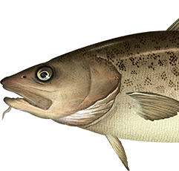
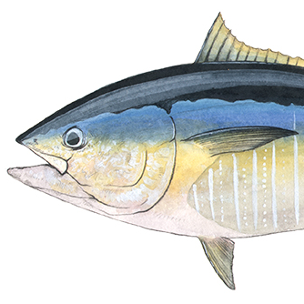
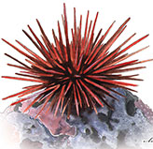
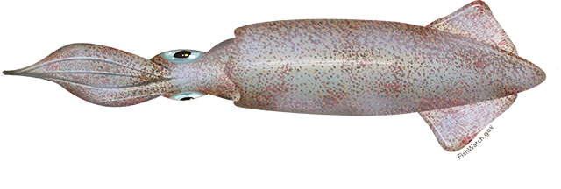
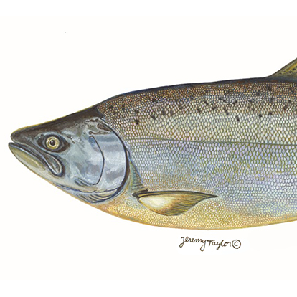
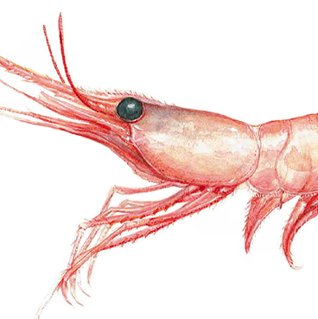
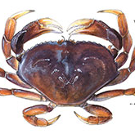
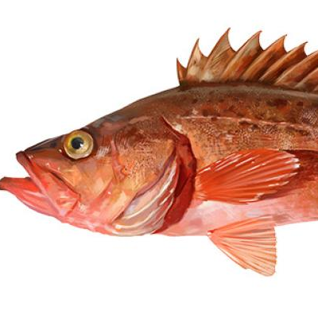
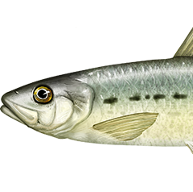
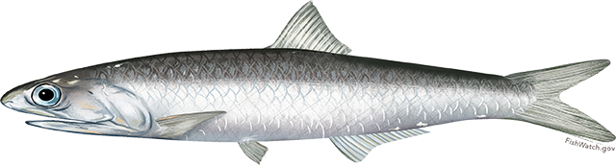
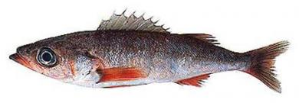
Pacific cod
Population declines due to reduced prey availability and increased metabolic demands.
Pacific bluefin tuna
Increased abundance was a boon for the recreational fishing industry but caused early closures in commercial fishery.
Range shifts
Kelp, urchin, abalone
Population declines and fishery closures due to loss of kelp beds.
California market squid
Increases in distribution created an unregulated emerging fishery.
Chinook salmon
Overfished due to reduced productivity and model failure.
Shrimp species
Revenues spiked mid-heatwave due to record high prices and strong recruitment before the heatwave.
Dungeness crab
Fishery closures due to harmful algal blooms and whale entanglements.
Bocaccio rockfish
Enormously high recruitment rebuilt this previously endangered fish stock.
Recruitment spikes
Sardine and anchovy
Low sardine productivity and high anchovy productivity reversed expectations for warm years.
Shortbelly rockfish
Increases in abundance approached bycatch limits in Pacific hake fishery.
Direct negative impacts
Indirect negative impacts
Positive impacts, with higher management challenges
Positive impacts, with lower management challenges
Social-ecological impact of the heatwave

