Slide 1
Fx Forward Curve Introduction
FinPricing

Slide 2
Yield Curve
FX forward curve is also called FX implied forward curve or FX derived curve. It is derived from USD zero rate curve and FX forward spreads and used to value FX trades.
Market standard is to use FX quoted forward spreads and USD zero rate curve to generate FX implied forward curve. In other words, FX curve construction generates an interest rate curve of the quoting currency from the interest rate curve of the base currency. The construction methodology is based on the arbitrage-free relationship between forward FX rates and the discount rates of the two currencies.

Slide 3
Yield Curve
Summary
FX Forward Curve Introduction
FX Forward Curve Construction
Market Inputs and Curve Outputs

Slide 4
Yield Curve
FX Forward Curve Introduction
The term structure of FX forward curve, also known as FX implied forward curve, is defined as the relationship between the currency zero rate and maturity.
The settlement dates for the given underlying tenors.
Application of the market conventions for O/N and T/N points. O/N is overnight rate and T/N is tomorrow next.

Slide 5
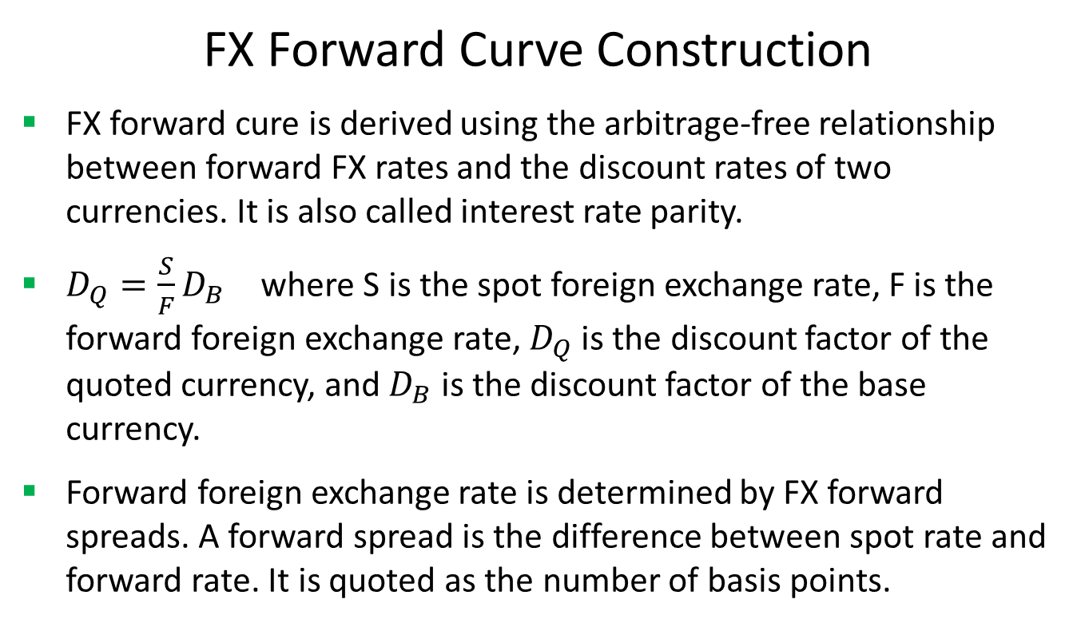
Yield Curve
FX Forward Curve Construction
FX forward cure is derived using the arbitrage-free relationship between forward FX rates and the discount rates of two currencies. It is also called interest rate parity.
$D_{Q}=\frac{S}{F}D_{B}$ where S is the spot foreign exchange rate, F is the forward foreign exchange rate, $D_{Q}$ is the discount factor of the quoted currency, and $D_{B}$ is the discount factor of the base currency.
Forward foreign exchange rate is determined by FX forward spreads. A forward spread is the difference between spot rate and forward rate. It is quoted as the number of basis points.

Slide 6
FX Forward Curve
Inputs and Outputs
Spot FX rate
USD zero rate curve or discount curve.
FX forward spread:
Quote Name | Forward Spread
USD/CNH O/N | 9.0
USD/CNH T/N | 5.75
USD/CNH 1W | 41.0
USD/CNH 1M | 154.0

Slide 7
FX Forward Curve
Inputs and Outputs
Outputs
Tenor | Zero Rate
6/27/2014 | 0.00989
7/7/2014 | 0.01013
8/27/2014 | 0.01085
9/27/2014 | 0.01126

Slide 8
Thank You
You can find more details at
https://finpricing.com/lib/IrCurveIntroduction.html

