Slide 1

'Avoiding Programming' for Safety Critical Systems
Andy Edmunds
ae2@ecs.soton.ac.uk

Slide 2
In the last Session ...
- We showed how errors can be introduced by the programming activity.
- We showed some examples of attempts to improve programming languages.
- We suggested that Event-B could help.

Slide 3
What can 'we' do?
- With Event-B tools (+ Tasking Event-B)
- we can generate code automatically.
- formal modelling helps to
highlight/remove systematic errors.
- Using automatic code generation we
- do less coding.
- encourage re-use (using code templates).

Slide 4
How to do this ...
- As you know, Event-B is modelling, not programming.
- Developers focus on the design, not code.
- To produce source code, we add 'extra' information to Event-B.
… and still we need a trusted compiler.
… and, ideally, 'certify' the translator.
- We could still verify the code with JML, SPARKAda etc

Slide 5
Targets for Translation ...
Targets: Ada, OpenMP C, FMI C, Java ….
- The approach is suitable for
- single threaded implementations.
- multi-threaded implementations (using decomposition).
- not currently OO, but could be done.
Current Focus is on embedded systems.
- 'Implementable' controller code
- Environment simulation.

Slide 6
Event-B at the implementation level
- Tasking Event-B
- Event-B models:
- Controller Tasks (AutoTask Machine).
- Shared Protected Objects (Shared Machine).
- Environment Tasks (Environ Machine).
- Use Decomposition to partition the system.
- Shared Event Style.
- Shared Events model communication, between - Controller tasks and Environment tasks.
- Controller tasks and Protected Objects.
- Environment tasks and Protected Objects.

Slide 7
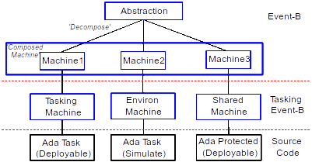
Where Tasking Event-B Fits in.

Slide 8
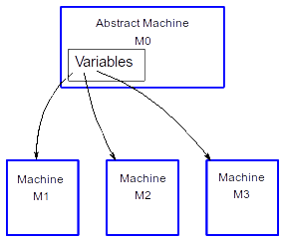
Shared Event Decomposition
Tool-driven decomposition

Slide 9
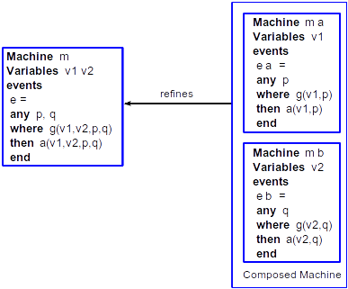
Event 'Synchronization'

Slide 10
Preparing for Decomposition
A Problematic Decomposition
Machine
M0
Cannot
Decompose !!
Vars A: x, B: x
Evt =
A := B
Refines
Composed Machine
Machine
M1
Machine
M2
Vars A: x
Evt =
A := ?
Vars B: x
Evt =
? := B

Slide 11
Preparing for Decomposition
Introduce Parameters
Machine M1
Refines M0
Vars A: x, B: x
Evt = ANY p
WHEN p = B
THEN A := p
Was A := B

Slide 12
A Model of Communication
Machine M1
Vars A: x, B: x
Evt = ANY p
WHEN p = B
THEN A := p
Decompose
Refines
Composed Machine
Machine M2
Machine M3
Vars A: x
Evt = ANY p
WHEN p = B & p: x
THEN A := p
Vars B: x
Evt = ANY p
WHEN p = B & p: x
THEN SKIP

Slide 13
A Model of Communication
Incoming parameter
Outgoing parameter
Composed Machine
Machine M2
Machine M3
Vars A: x
Evt = ANY p?
WHEN p = B & p: x
THEN A := p
Vars B: x
Evt = ANY p!
WHEN p = B & p: x
THEN SKIP

Slide 14
An Implementation of the Communication
Incoming parameter
Outgoing parameter
Machine M2
Machine M3
Vars A: x
Evt = ANY p?
WHEN p = B & p: x
THEN A := p
Vars B: x
Evt = ANY p!
WHEN p = B & p: x
THEN SKIP
subroutine
call
Evt(p: x){
A := p
}
Evt(B);

Slide 15
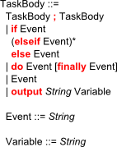
Tasking Event-B
Adds 'Tasking' Implementation Information to Event-B
Task Body Syntax:
- Allows use of Branches, Sequence and Loops.
- Has an 'Output' to console.

Slide 16
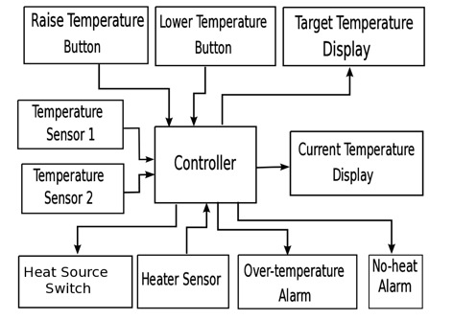
Heater Controller Example
Controller vs Environment
This example is from the Tasking Event-B wiki tutorial.

Slide 17
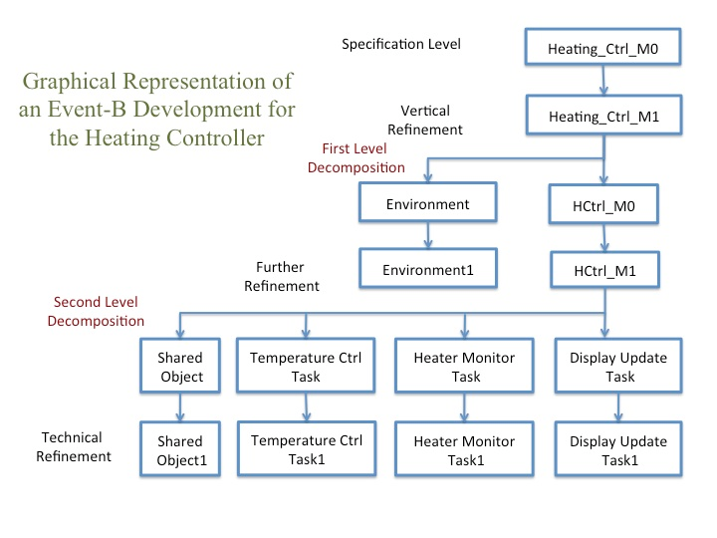
Heater Controller Example
Another View

Slide 18
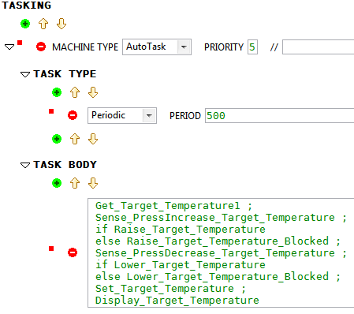
A Tasking Machine
Implementation level Specification
AutoTasks Machines and Environ Machines
Events:
Used in a
Sequence,
Branch,
Loop,
Output

Slide 19
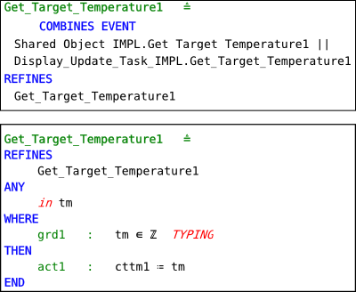
'in'/ 'out' annotations
synchronization
Parameter
direction

Slide 20
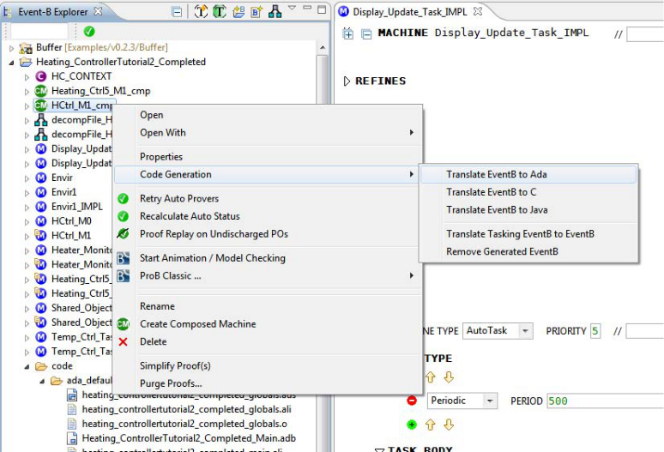
Code Generation

Slide 21
Generated Code
In the Display Task:
Shared_Object: Shared_Object_IMPL; ...
task body Display_Update_Task_IMPL is
cttm1 : Integer := 0;
period: constant Time_Span := To_Time_Span(0.5);
nextTime: Time := clock + period;
begin
loop
delay until nextTime;
Shared_Object.Get_Temperature1(cttm1);
...
In the Protected Object:
procedure Get_Temperature1(tm: out Integer) is
begin
tm := cttm;
end Get_Temperature1;

Slide 22
Types and Translations.
So far,
- translations for built-in Event-B types are
restricted to INTs and BOOLs.
- and Event-B INTs are not bounded
(wrap-around in implementations?).
- we don't even have arrays as standard in Event-B.

Slide 23
Extending Event-B:
with New Types, and Translations.
- Use the Theory Plug-in
- Theories are used to define new
- datatypes
- operators
- rewrite rules
- inference rules
We also use it for code generation,
- to translate predicates and expressions.

Slide 24
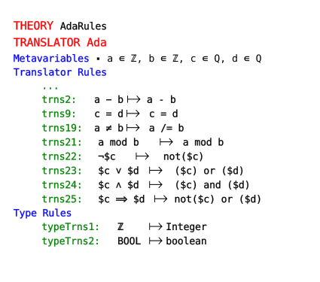
Defining a Translator:
From Event-B to a 'new' Target Language

Slide 25
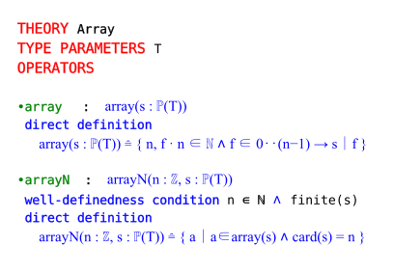
Adding new Types

Slide 26
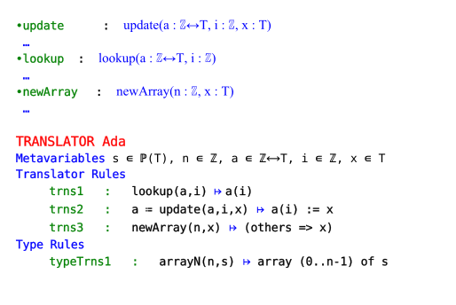
Adding a Translation for the new Type
(In a theory)

Slide 27
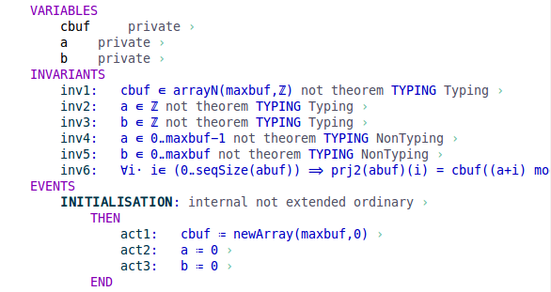
Using a new Type

Slide 28
Tasking Event-B - restrictions
- AutoTasks do not communicate with each other.
- Communicate through Shared Machines.
- No nesting, in the Tasking Event-B syntax.
- One machine per 'Object'.
...

Slide 29
And finally … (almost)
- Writing code for Safety Critical Systems is hard.
- The existing code can be augmented by additional
notations for extended static-checking (JML),
static checking + proof (SPARKAda)
- Use safe language subsets.
- Place restrictions on the implementation.
- esp. for timing, and concurrency.
- Use Formal Modelling with automatic code gen.
- also, use Model-checking, SAT/SMT etc.
to help discover errors.

Slide 30
… and finally (actually)
If you write code manually
- much of the development effort is invested in
eliminating coding errors.
With automatic code generation
- The modelling process helps to eliminate
systemic errors.
- If the translator is 'trusted', coding errors should
be absent.
- Certifying a translator is possible, but expensive.

