Slide 1
UML-B State Machine Diagrams

Slide 2
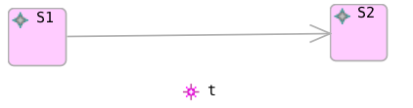
State Machines
State machines provide a way to model behaviour (transitions)
Constrained by some data (source state)
The transition’s behaviour is to change the data (to target state)
Transition t can only fire when the state is S1
when t fires it changes the state to S2
How could we represent this in Event-B?

Slide 3
State Machines to Events
EVENTS
t ≙ WHEN <in S1> THEN <becomes S2> END
where, <in S1> and <becomes S2> depend on the data that represents state

Slide 4
State machine as a type
We could treat the whole statemachine as an enumerated type
the current state is given by a variable
(called state_function translation in UML-B)
VARIABLES SETS
sm ∈ sm_STATES sm_STATES = {S1,S2}
EVENTS
t ≙ WHEN <in S1> THEN <becomes S2> END
what are <in S1> and <becomes S2> in this case?

Slide 5
State machine as a type
VARIABLES SETS
sm ∈ sm_STATES sm_STATES = {S1,S2}
EVENTS
t ≙ WHEN sm = S1 THEN sm := S2 END

Slide 6
State machine collection of variables
Or we could treat each state as a separate variable
(called state_sets translation in UML-B)
VARIABLES
S1 ∈ BOOL
S2 ∈ BOOL where, one of S1, S2 is TRUE at any moment
EVENTS
t ≙ WHEN <in S1> THEN <becomes S2> END
what are <in S1> and <becomes S2> in this case?

Slide 7
State machine collection of variables
VARIABLES
S1 ∈ BOOL
S2 ∈ BOOL
EVENTS
t ≙ WHEN S1 = TRUE
THEN S1 := FALSE
S2 := TRUE
END

Slide 8
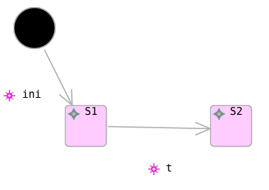
Initial transition
Statemachine as type
INITIALISATION
sm := S1
States as variables
INITIALISATION
S1 := TRUE
S2 := FALSE
or

Slide 9
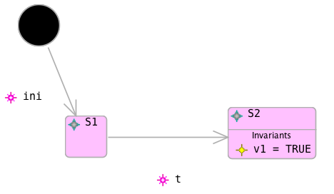
State Invariant
Something that must be true whenever the system is in that state.
Translations:
(sm = S2) ⇒ (v1 = TRUE)
or
(S2=TRUE) ⇒ (v1 = TRUE)

Slide 10
Transition parameters, guards and actions
Transitions are events.
So you can give them parameters, guards and actions etc.
parameter: b ∈ BOOL
guard: b = TRUE
action: v1 := b

Slide 11
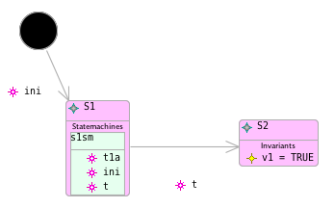

Nested Statemachines
Statemachines can be nested inside states
Entry and Exit transitions must align with parent state using Elaborates property

Slide 12
Example
A factory machine can be switched on and off.
When it is on it can then be started and becomes active.
When it is active it can run repeatedly until it is stopped.
A separately controlled safety shield can be opened and closed.
The shield is opened automatically when the machine is stopped.
Safety Requirement:
The machine should never be in the active state (where runs can occur) with the shield in the open position.
Model the machine and shield as separate statemachines.
Add an invariant to model the safety requirement.
Determine the transition guards needed to represent the interlocks between the machine and the shield controller.
Use the Pro-B model checker/Animator to ensure that the safety invariant is never violated

Slide 13
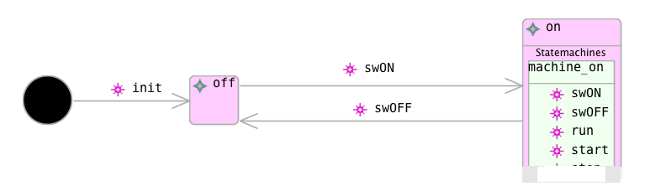
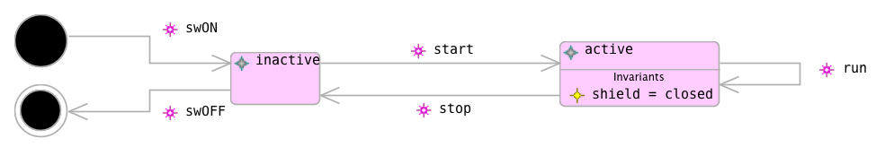
Example – Factory Machine
guard: shield = closed

Slide 14
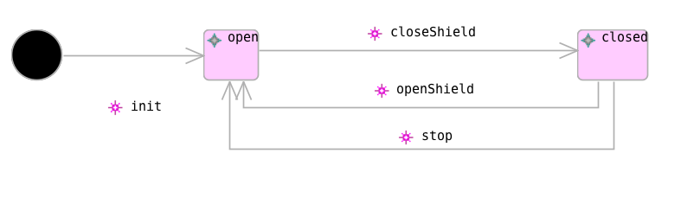
Example – Factory Machine Safety Guard
guard: machine_on ≠ active
omitted for model checking demo on next page

Slide 15
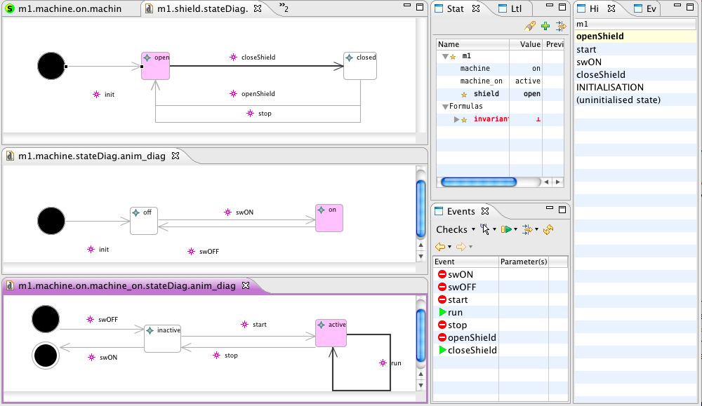
Statemachine Animation showing invariant violation

Slide 16
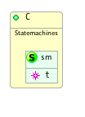
Statemachines in Classes
Statemachines can be added to classes.
Effectively, each class instance has a ‘’copy’’ of the statemachine

Slide 17
State machines in Classes State machine as a type (state_function)
VARIABLES SETS
sm ∈ C → sm_STATES sm_STATES = {S1,S2}
EVENTS
t (self) ≙ WHERE sm(self) = S1
THEN sm(self) := S2
END

Slide 18
State machines in Classes States as variables (state_sets)
VARIABLES
S1 ∈ ℙ (C)
S2 ∈ ℙ (C) where S1 and S2 (and….) are disjoint
partition(C, S1, S2, …)
EVENTS
t (self) ≙ WHERE self ∈ S1
THEN S1 := S1 \ {self}
S2 := S2 ∪ {self}
END

Slide 19
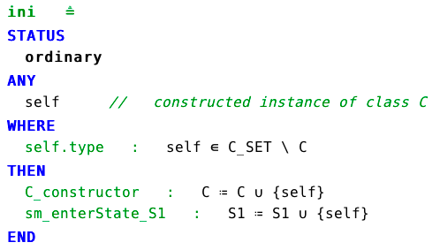
Initial transition (state_sets)
For variable instance classes, initial transition is treated as a constructor
States as variables

Slide 20
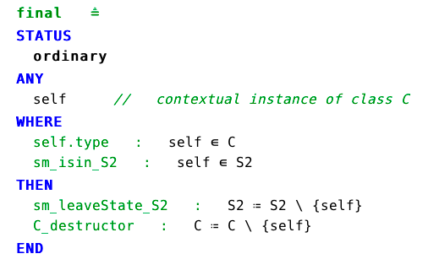
Final transition (state_sets)
For variable instance classes, final transition is treated as a destructor

Slide 21
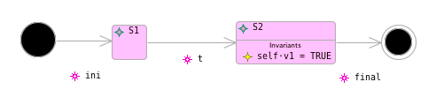
State Invariant (state_sets)
Something that must be true whenever an instance of the class is in that state.
Translation:
∀self·((self∈C)⇒ ((self∈S2)⇒ (v1(self) = TRUE)))

Slide 22
Summary
Statemachines for modelling behaviour
nested – statemachines in states
invariants in states
transitions are events (with parameters, guards, actions)
Choice of 2 translations
Can be lifted to classes
initial/final transition as constructor/destructor (variable instance classes)
State-machines can be animated and model checked
(front-end for Pro-B)

