Slide 1
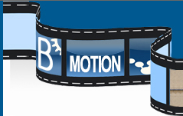
Graphical Visualisation
Using Bmotion Studio

Slide 2
BMotion Studio plug-in (from Duesseldorf)
Developed by:
Lukas Ladenberger,
Heinrich Heine University, Duesseldorf
http://www.stups.uni-duesseldorf.de/bmotionstudio/index.php/Main_Page
N.B. Activate CLP(FD)solver in the ProB settings
Window -> Preferences -> ProB

Slide 3
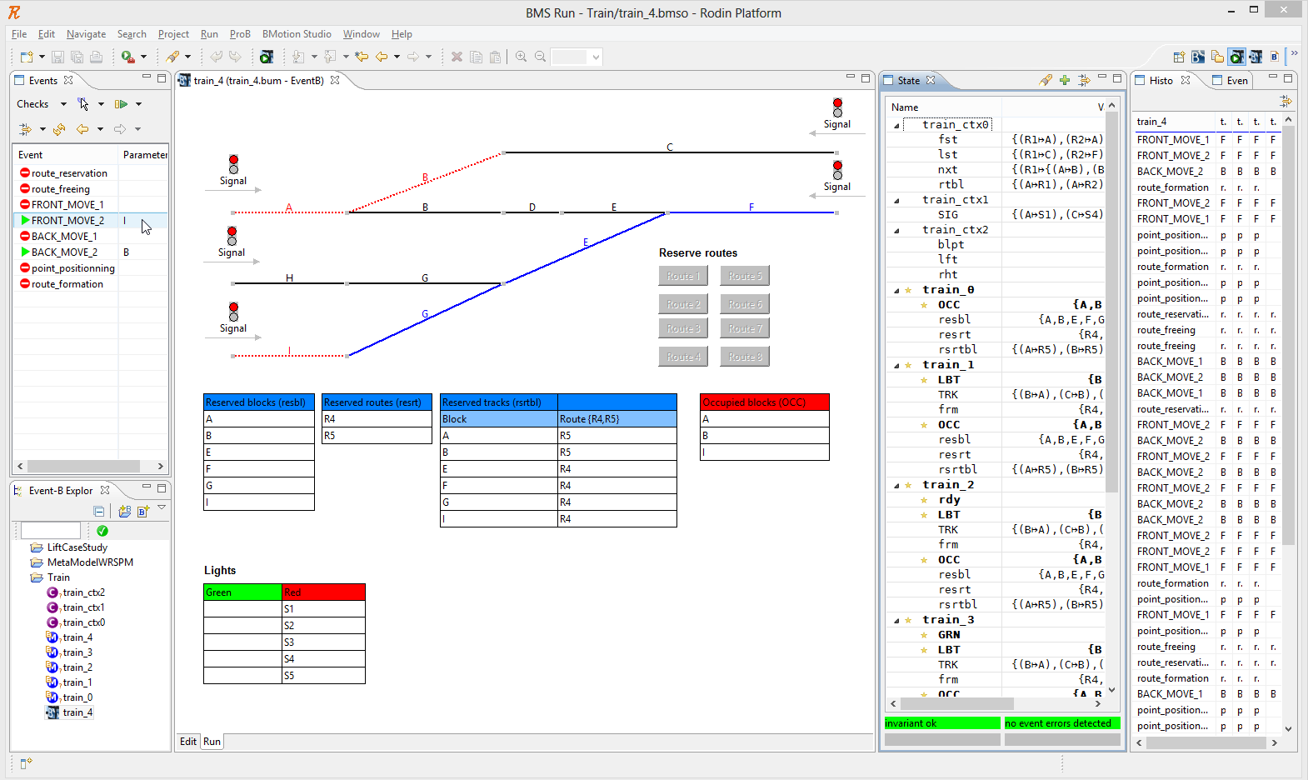
Example – IXL

Slide 4
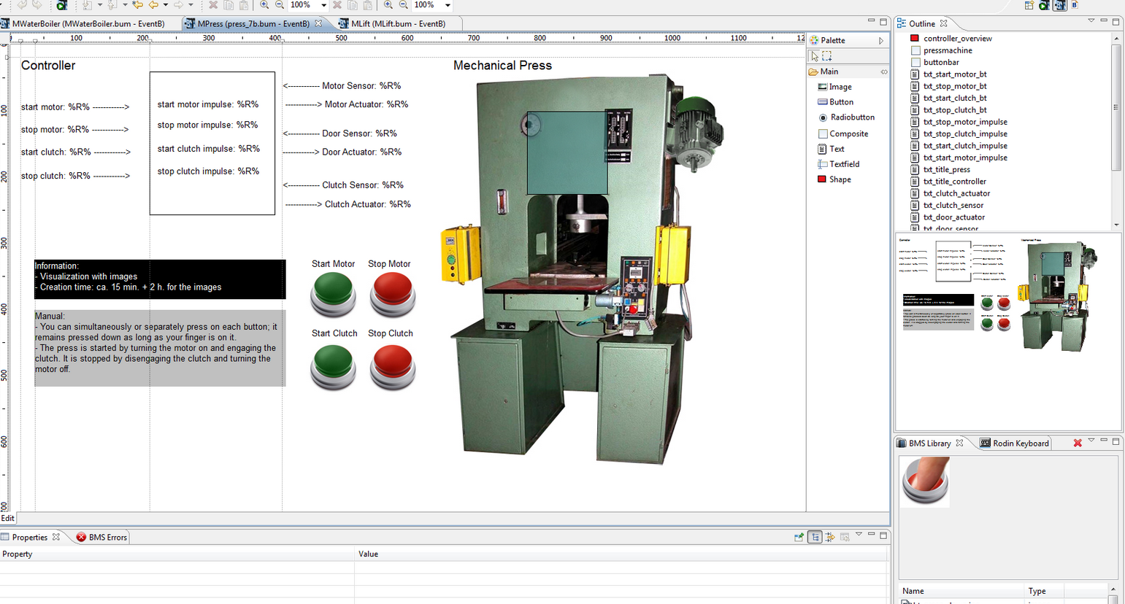
Example – mechanical press

Slide 5
Waterboiler Tutorial (taken from BMotion Studio website)
Download and import the waterboiler example from
http://www.stups.uni-duesseldorf.de/bmotionstudio/index.php/User_Guide/Examples
The waterboiler has functions to
open/close its cap cap = open/closed
fill/effuse water fill_height = 0..maximum (3)
switch on/off. switcher = on/off

Slide 6
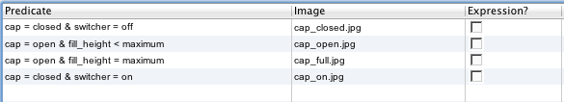
Waterboiler Tutorial
Add a new Bmotion studio visualisation
R click on Event-B project – new other…
(can leave the old one there for reference)
Add images for kettle bottle and cap
Add observer-switch image for cap

Slide 7
Waterboiler Tutorial
Add text field for setting fill/pour rate
In properties, set id = rate (for ease of reference)
Set text = 1
Nearby, add a title (text) Rate:
Add text to display fill_height
set text = Fill: %F%
(%F% is a placeholder for the value)
Add a simple value display observer
Expression = fill_height
Replacement String = %F%

Slide 8
Waterboiler Tutorial
Add buttons: open/close, pour/fill, on/off
Set suitable button labels
Add event-execute operations
Select appropriate event for button
For pour/fill need to specify predicate for parameter value: yy=rate/xx=rate
Add listen operation for button enablement
Select appropriate event to listen for
Select Attribute = Enabled and value = true
For pour/fill need to specify predicate for parameter value yy=rate/xx=rate
in properties, initialise Enabled = false

Slide 9
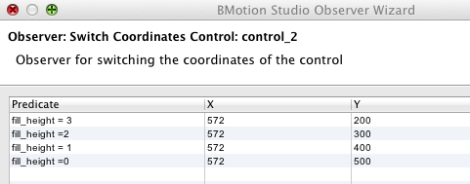
Waterboiler Tutorial
Add a moving block to indicate fill height
Add observer–switch coordinates
Set different Y values against predicates for each possible value of fill_height:

Slide 10
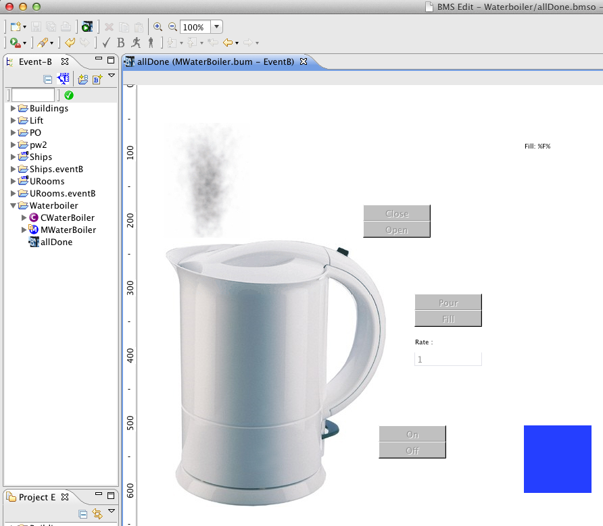
Run visualisation

Slide 11
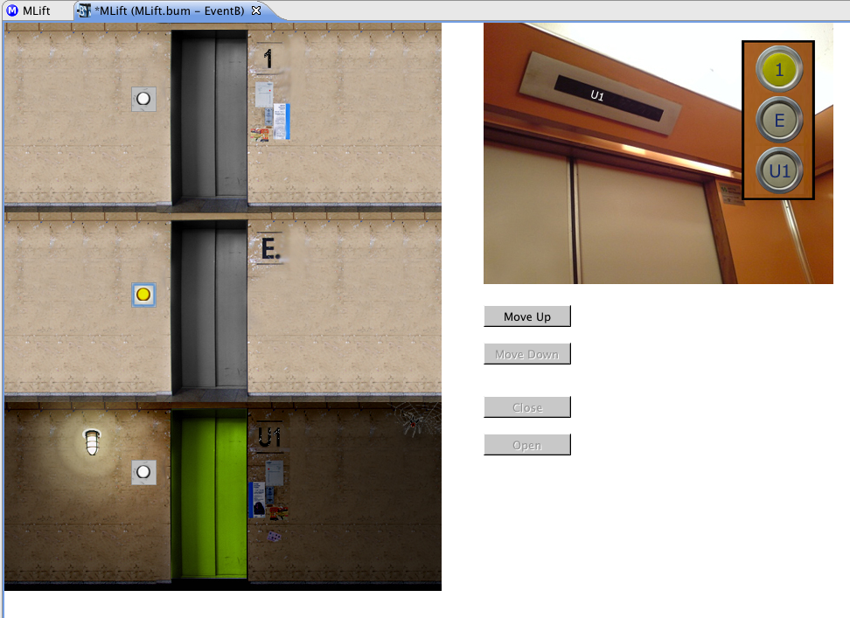
Exercise - Lift example
Download and import the lift example from
http://www.stups.uni-duesseldorf.de/bmotionstudio/index.php/User_Guide/Examples
Run the visualisation to explore how it works.
In the edit mode, explore how it is constructed.
Note that the green/open door is moved up and down by an observer (switch child coordinates) that belonging to the background image
Attempt to replicate the visualisation

