Slide 1

Avoiding Programming in Safety Critical Systems
Andy Edmunds
ae2@ecs.soton.ac.uk

Slide 2
In the last Session ...
- We have highlighted ways to address
program correctness, where errors are
introduced by the programming activity.
- If we use automatic code generation we could
improve this situation.
- Using Event-B tools (Tasking Event-B) we can generate code automatically.
- and formal modelling can also help to
highlight/remove systematic errors.

Slide 3
How to do this ...
- Event-B; it is modelling, not programming.
- But eventually we can produce code, and use a well trusted compiler to generate executables.
- Since we generate code automatically
- developers focus on the design, not code.
- We could still verify the code with
- SPARKAda
- JML
- …. and so on, if required.

Slide 4
Event-B at the implementation level
- Tasking Event-B
- Event-B models:
- Controller Tasks (AutoTask Machine)
- Shared Protected Objects (Shared Machine)
- Environment Tasks (Environ Machine)
- Use Decomposition to partition the system.
- Shared Event Style
- Shared Events model communication, between - Controller tasks and Environment tasks.
- Controller tasks and Protected Objects.
- Environment tasks and Protected Objects.

Slide 5
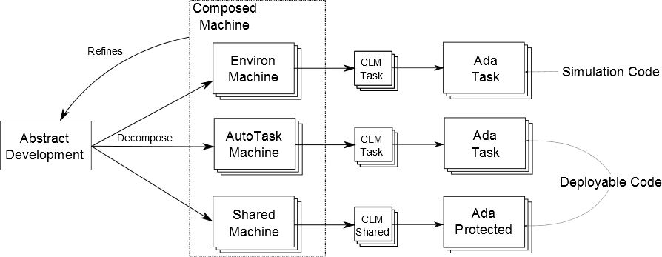
Common Language Metamodel (CLM)
Simulation code from the Environ Machines.
Deployable Code from AutoTask and Shared Machines.

Slide 6
What the User Sees!

Slide 7
Targets for Translation ...
Targets: Ada, OpenMP C, FMI C, Java ….
- The approach is suitable for
- single threaded implementations.
- multi-tasking implementations (using decomposition).
- not currently OO, but can be coded.
- Implementable controller code environment simulation.
New Language Extensions
- specify mathematical language translation in a theory.
- hard code other parts in a new plug-in.

Slide 8
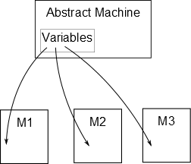
Shared Event Decomposition
Tool-driven decomposition

Slide 9
Preparing for Decomposition
A Problematic Decomposition
Machine
M0
Cannot
Decompose !!
Vars A: x, B: x
Evt =
A := B
Refines
Composed Machine
Machine
M1
Machine
M2
Vars A: x
Evt =
A := ?
Vars B: x
Evt =
? := B

Slide 10
Preparing for Decomposition
Introduce Parameters
Machine M1
Refines M0
Vars A: x, B: x
Evt = ANY p
WHEN p = B
THEN A := p
Was A := B

Slide 11
A Model of Communication
Machine M1
Vars A: x, B: x
Evt = ANY p
WHEN p = B
THEN A := p
Decompose
Refines
Composed Machine
Machine M2
Machine M3
Vars A: x
Evt = ANY p
WHEN p = B & p: x
THEN A := p
Vars B: x
Evt = ANY p
WHEN p = B & p: x
THEN SKIP

Slide 12
A Model of Communication
Incoming parameter
Outgoing parameter
Composed Machine
Machine M2
Machine M3
Vars A: x
Evt = ANY p?
WHEN p = B & p: x
THEN A := p
Vars B: x
Evt = ANY p!
WHEN p = B & p: x
THEN SKIP

Slide 13
An Implementation of the Communication
Incoming parameter
Outgoing parameter
Machine M2
Machine M3
Vars A: x
Evt = ANY p?
WHEN p = B & p: x
THEN A := p
Vars B: x
Evt = ANY p!
WHEN p = B & p: x
THEN SKIP
subroutine
call
Evt(p: x){
A := p
}
Evt(B);

Slide 14
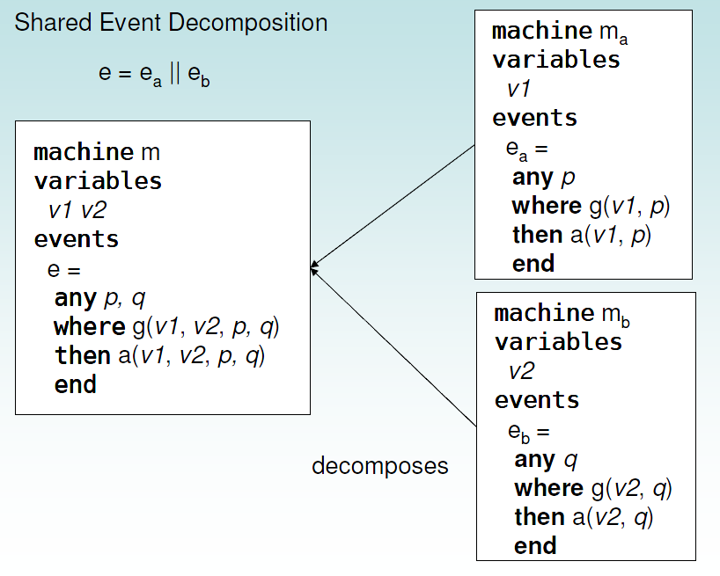
Event 'Synchronization'

Slide 15
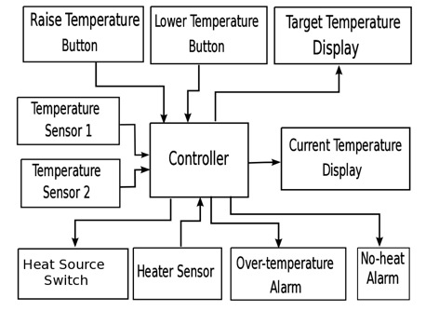
Heater Controller Example
Controller vs Environment

Slide 16
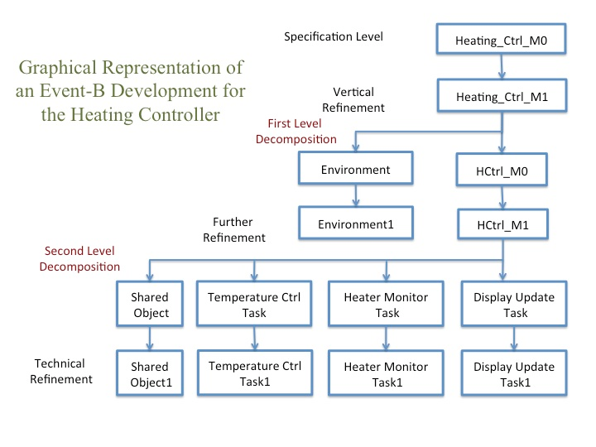
Heater Controller Example
Another View

Slide 17
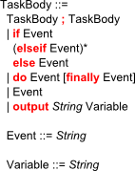
Tasking Event-B
Adds 'Tasking' Implementation Information to Event-B
Task Body Syntax:
- Allows use of Branches, Sequence and Loops.
- Has an 'Output' to console.

Slide 18
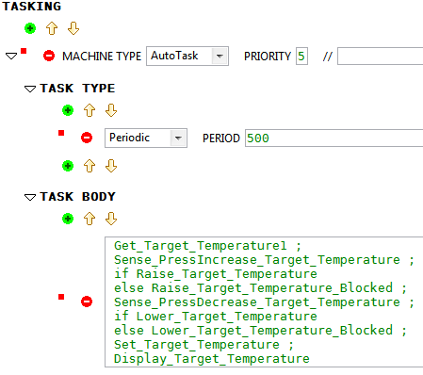
A Tasking Machine
Implementation level Specification
AutoTasks Machines and Environ Machines
Events:
Used in a
Sequence,
Branch,
Loop,
Output

Slide 19
Tasking Event-B
restrictions
AutoTasks do not communicate with each other.
Communicate through Shared Machines.
No nesting in the Tasking Event-B syntax.
One machine per 'Object'.
...

Slide 20
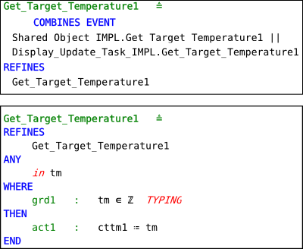
'in'/ 'out' annotations
synchronization
Parameter
direction

Slide 21
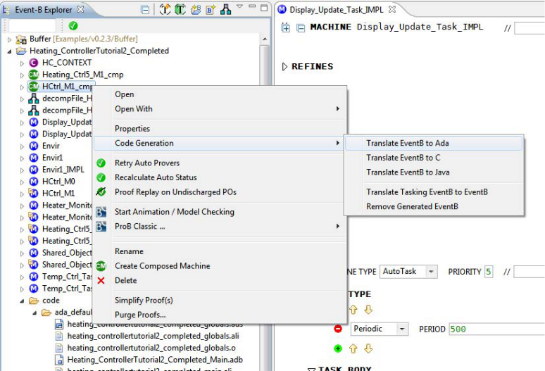
Code Generation

Slide 22
Generated Code
In the Display Task:
Shared_Object: Shared_Object_IMPL; ...
task body Display_Update_Task_IMPL is
cttm1 : Integer := 0;
period: constant Time_Span := To_Time_Span(0.5);
nextTime: Time := clock + period;
begin
loop
delay until nextTime;
Shared_Object.Get_Temperature1(cttm1);
...
In the Protected Object:
procedure Get_Temperature1(tm: out Integer) is
begin
tm := cttm;
end Get_Temperature1;

Slide 23
Extending Event-B: Adding new types
and Translations.
Extend the Event-B mathematical language
- using the Theory Plug-in
Theories are used to define new
- datatypes
- operators
- rewrite rules
- inference rules
We also use it for code generation,
- to translate predicates and expressions.

Slide 24
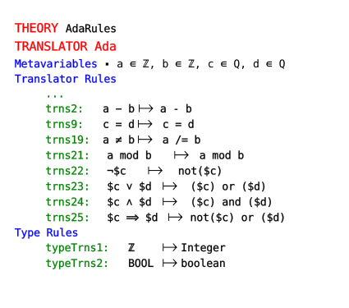
Defining a Translator:
From Event-B to a 'new' Target Language

Slide 25
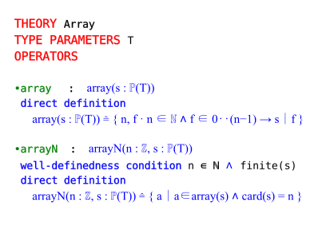
Adding new Types

Slide 26
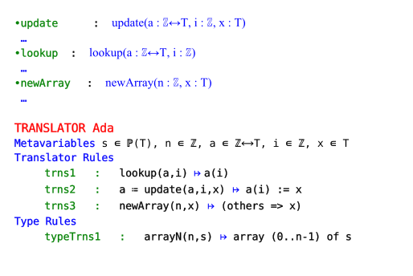
Adding a Translation for the new Type
(In a theory)

Slide 27
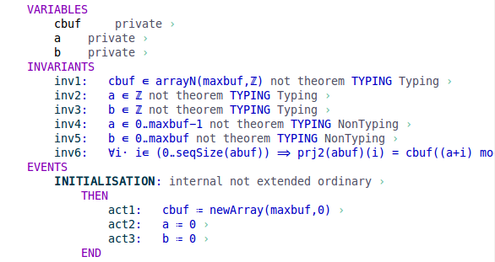
Using a new Type

Slide 28
And finally … (almost)
- Writing code for Safety Critical Systems is hard
- Coding is complemented with extended
static-checking, comprehensive testing, FMs,
model-checking, SAT/SMT etc …
- Use safe language subsets.
- Place restrictions on the implementation.
- esp. for timing, and concurrency.
- Employ a rigorous engineering process.
Certification is a gating factor !

Slide 29
… Summing Up
If you write code manually
- much of the development effort is invested in
eliminating coding errors.
With automatic code generation
- The modelling process helps to eliminate
systemic errors.
- If the translator is 'trusted', coding errors should
be absent.
- Certifying a translator is possible, but expensive.

