Slide 1
Refinement in UML-B

Slide 2
Extending Context Diagrams

Slide 3
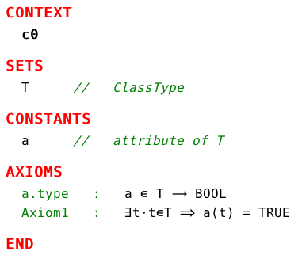
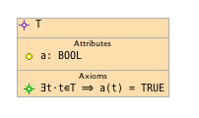
Starting from a Context Diagram with a Class Type

Slide 4
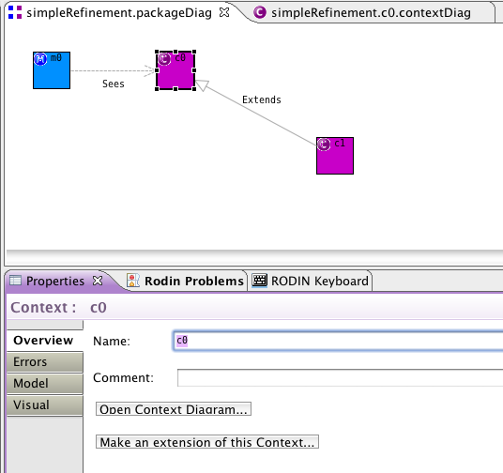
Make an Extension of this Context
1) Select context,
2) Click Button in Properties,
3) Makes a starting point
for extending

Slide 5
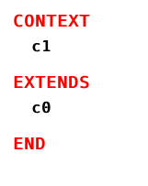
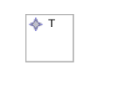
Provides a basis for extending classtypes
An empty ExtendedClassType

Slide 6
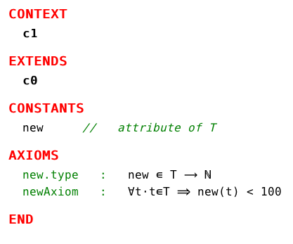
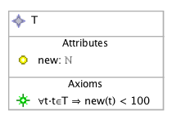
Add Attributes and Axioms to Extend ClassType

Slide 7
Refining Class Diagrams

Slide 8
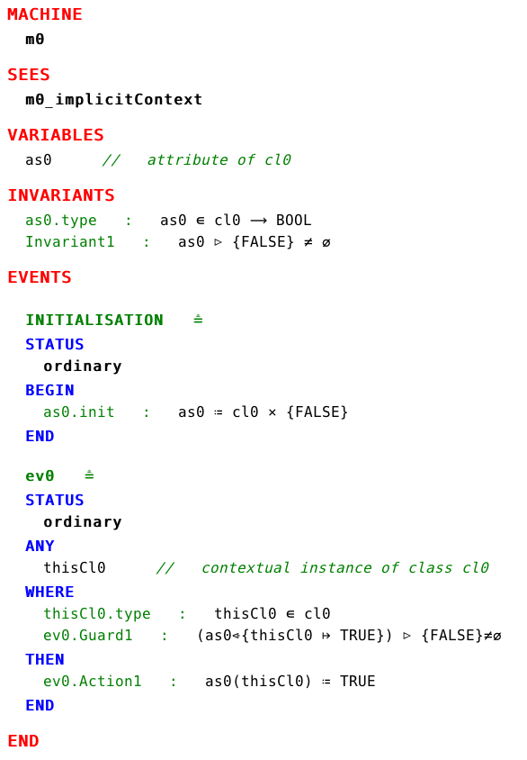
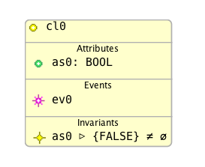
Starting from a Class Diagram

Slide 9
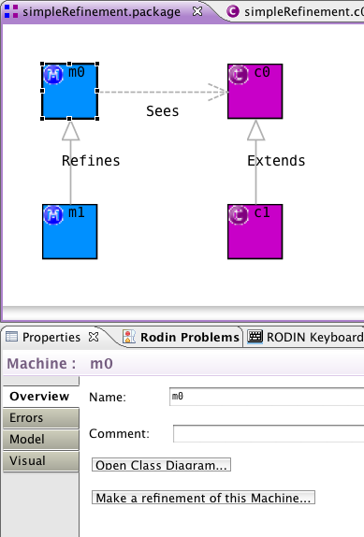
“Make a refinement of this Machine”
Select Machine,
click Button in Properties,
Makes a starting point
for refinement

Slide 10
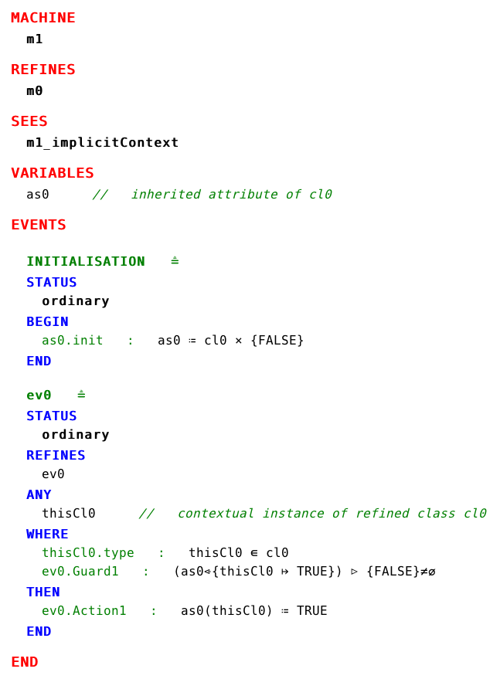
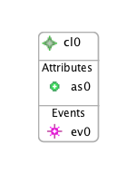
Basis for refinement
Refined Class
Inherited Attribute
Copies of abstract Events are
retained for refinement
Statemachines are copied
ready for refinement (not shown)

Slide 11
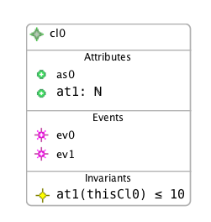
Refine a Class
add new attributes/associations
refine existing events
(strengthen guards, add actions,
split, merge)
add new events
(can only alter new variables)
add new invariants

Slide 12
Example – Bank Accounts and ATMs
ABSTRACT
Bank accounts have a balance which is zero when the account is opened.
Money may then be deposited in the account, increasing the balance by some amount,
or withdrawn, depleting the balance by some amount.
REFINEMENT
A card is associated with an account and withdrawls are made via an ATM machine.
The card is inserted into the ATM and either a successful withdrawl is completed and the card is ejected or the transaction fails.
(based on a case study by Mar Yah Said)

Slide 13
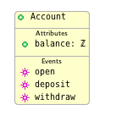

Example – Abstract
Note: for this example it is necessary to rename the contextual class instance from self to thisAccount so that it can be disambiguated when the event withdraw is moved to a different class.
parameter: amount ∈ ℕ1
action: balance(thisAccount) ≔
balance(thisAccount) − amount

Slide 14
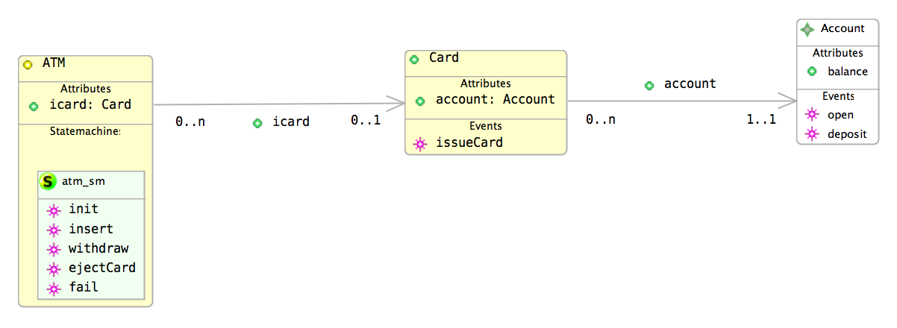
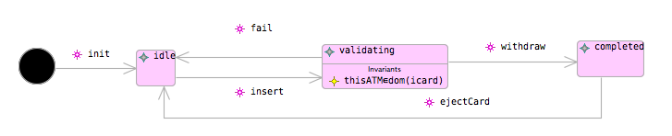
Example – Refinement
New Classes and Statemachines are added that represent an ATM and Card. withdraw becomes a transition in the ATM class.
parameter: cd ∈ Card
action: icard(thisATM) := cd
action: icard ≔ {thisATM} ⩤ icard

Slide 15
Example – Refinement
parameter: amount ∈ ℕ1
witness: thisAccount = account(icard(thisATM))
action: balance(account(icard(thisATM))) ≔
balance(account(icard(thisATM))) − amount
A witness shows the relationship with the old class instance

Slide 16
Example – Refinement
parameter: amount ∈ ℕ1
witness: thisAccount = account(icard(thisATM))
action: balance(account(icard(thisATM))) ≔
balance(account(icard(thisATM))) − amount
A state invariant is needed to help the well-definedness proof of the use of icard in withdraw (because it’s a partial function)

Slide 17
Refining Statemachines
Slides show state sets translation.
Also works using state function translation

Slide 18
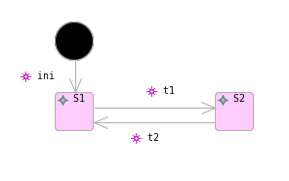
Starting from a Simple Statemachine

Slide 19
“Make a refinement of this Machine”
Same as for Class Refinement
Select Machine,
click Button in Properties,
Makes a starting point
for refinement

Slide 20
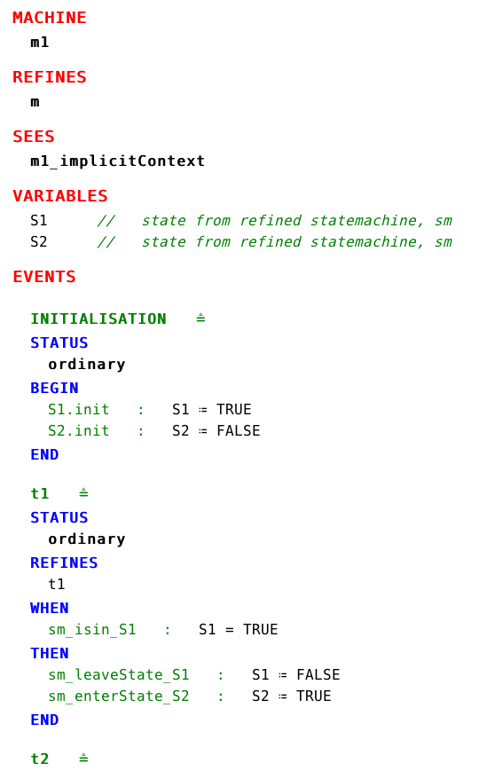
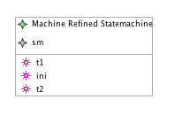
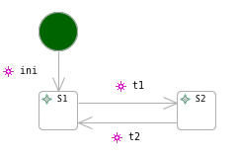
gives us..
Refined Statemachine
contains
RefinedStates

Slide 21
What can we do?
Refine the existing transitions
strengthen guards
add actions to alter any new variables
split transitions (as long as they have same source and target state)
Can add things to a state
Invariants
Nested State-machines

Slide 22
What we can’t do (when refining statemachines)
Cannot add new states
state sets – would contradict the existing partition invariant
state function – would alter the exisiting enumerated type
Cannot add completely new transitions
new events must not alter old variables (e.g. state change would)

Slide 23
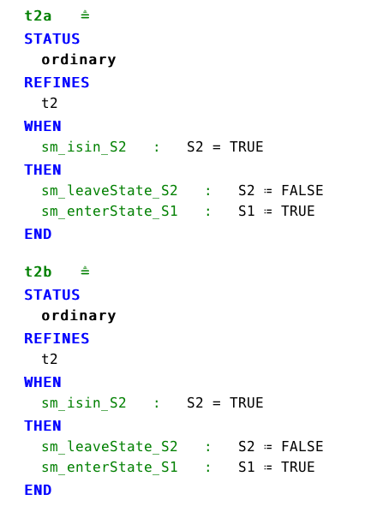
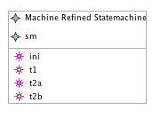
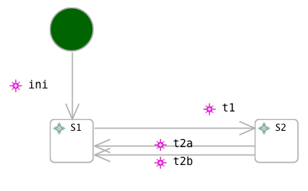
Transition Splitting – Preparing for a Nested Statemachine
t2 has been split into 2 ‘cases’
(both refine t2)

Slide 24
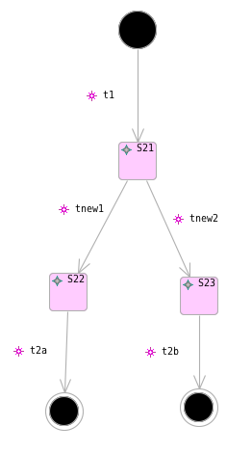
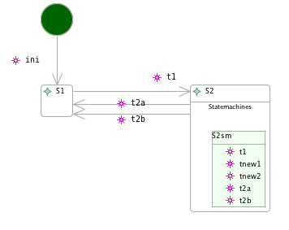
Adding a Nested Statemachine
elaborates

Slide 25
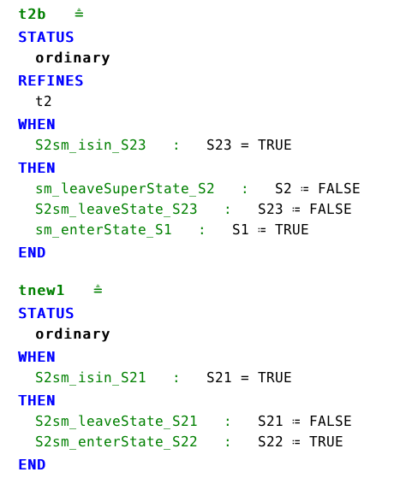
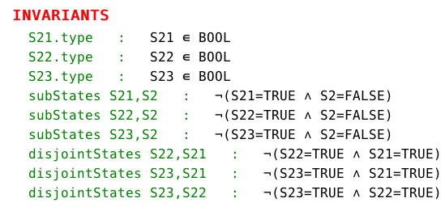
Translation of Refinement

Slide 26
Example – Card Validation by PIN
In the ATM example, add a refinement to explain how card validation works.
There is a PIN number associated with a card.
A number is entered at the ATM.
If the number matches the inserted cards PIN the validation succeeds.
If the number doesn’t match the PIN the validation fails.

Slide 27
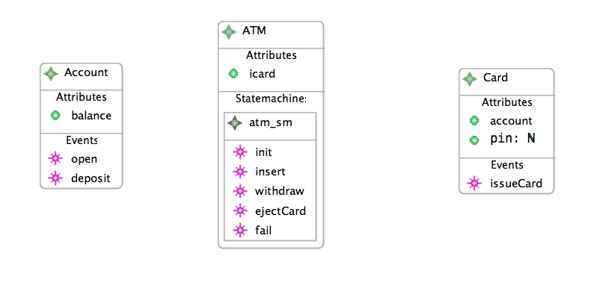
Refined Class Diagram
parameter: n ∈ ℕ
action: pin(thisCard) := n

Slide 28
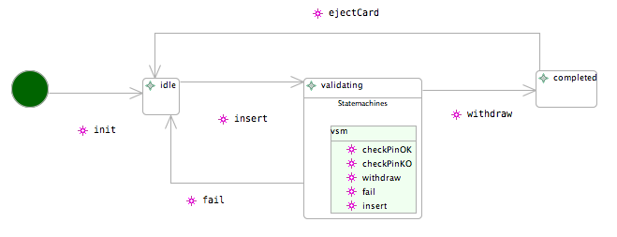
Refined Statemachine

Slide 29
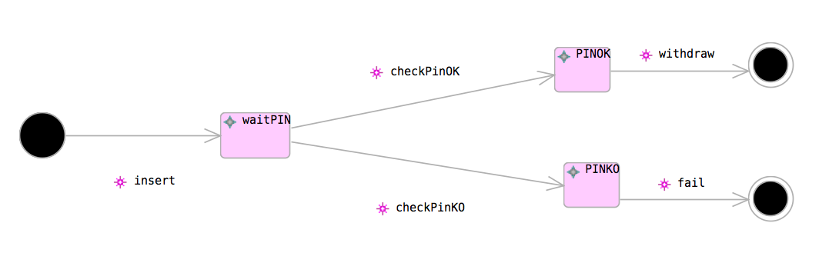
New nested statemachine
parameter: n ∈ ℕ
guard: n = pin(icard(thisATM))
parameter: n ∈ ℕ
guard: n ≠ pin (icard(thisATM))

Slide 30
New nested statemachine – transition elaboration

Slide 31
Summary
Extended Class Types
Refined Classes & Inherited Attributes
Moving events between classes
Statemachine refinement
transition splitting
nested statemachines

