Slide 1

Introduction to Modelling (with Event-B)
www.event-b.org

Slide 2
Cost of fixing requirements errors
“Extra Time Saves Money”
Warren Kuffel
Computer Language
December 1990
Notes:
Investment opportunity

Slide 3
Cost of error fixes grows - difficult to change this
Cost
of fix
Reqs
Spec
Design
Impl
Test
& fix
Accept
testing
Deploy
Time of error discovery

Slide 4
Rate of error discovery
Error
discovery
rate
Reqs
Spec
Design
Impl
Test
& fix
Accept
testing
Deploy
Time of error discovery

Slide 5
Invert error identification rate?
Error
discovery
rate
Reqs
Spec
Design
Impl
Test
& fix
Accept
testing
Deploy
Time of error discovery

Slide 6
Why is it difficult to identify errors?
Lack of precision
ambiguities
inconsistencies
Too much complexity
complexity of requirements
complexity of operating environment
complexity of designs

Slide 7
Need for precision and abstraction at early stages (front-loading)
Precision through early stage models
Amenable to analysis by tools
Identify and fix ambiguities and inconsistencies as early as possible
Mastering complexity through abstraction
Focus on what a system does (its purpose)
Incremental analysis and design

Slide 8
Rational design, by example
Example: access control system
Example intended to give a feeling for:
problem abstraction
modelling language
model refinement
role of verification and Rodin tool

Slide 9
Access control requirements
Users are authorised to engage in activities
User authorisation may be added or revoked
Activities take place in rooms
Users gain access to a room using a one-time token provided they have authority to engage in the room activities
Tokens are issued by a central authority
Tokens are time stamped
A room gateway allows access with a token provided the token is valid

Slide 10
Access control requirements
Users are authorised to engage in activities
User authorisation may be added or revoked
Activities take place in rooms
Users gain access to a room using a one-time token provided they have authority to engage in the room activities
Tokens are issued by a central authority
Tokens are time stamped
A room gateway allows access with a token provided the token is valid

Slide 11
Entities and relationships
USER
authorised
ACTIVITY
ROOM
takeplace
location
holder
room
TOKEN
manage
guards
authorise
manage
GATEWAY
read
issuer
AUTHORITY
trust
Notes:
Satisfies precision but what about complexity?
Who thinks this is not too complex?
Who thinks this is too complex?
In what sense might this be too complex?
Number of edges is potentially polynomial.
Graph with N nodes has (N.(N+1)) / 2

Slide 12
Entities and relationships
USER
authorised
ACTIVITY
ROOM
takeplace
location
holder
room
This model is unnecessarily complex to specify the main access control policy
TOKEN
manage
guards
authorise
manage
GATEWAY
read
issuer
AUTHORITY
trust

Slide 13
Extracting the essence
Purpose of our system is to enforce an access control policy
Access Control Policy: Users may only be in a room if they are authorised to engage in all activities that may take place in that room
To express this we only require Users, Rooms, Activities and relationships between them
Abstraction: focus on key entities in the problem domain related to the purpose of the system

Slide 14
Entities and relationships
USER
authorised
ACTIVITY
ROOM
takeplace
location
holder
room
TOKEN
manage
guards
authorise
manage
GATEWAY
read
issuer
AUTHORITY
trust

Slide 15
Abstract by removing entities
USER
authorised
ACTIVITY
ROOM
takeplace
location
Relationships represented in Event-B
authorised ∈ USER ↔ ACTIVITY // relation
takeplace ∈ ROOM ↔ ACTIVITY // relation
location ∈ USER ⇸ ROOM // partial function
Notes:
Diagram is a ‘natural’ way to construct (and present) this data model.

Slide 16
Access control invariant
∀u,r . u ∈ dom(location) ∧
location( u ) = r
⇒
takeplace[ r ] ⊆ authorised[ u ]
if user u is in room r,
then u must be authorised to engaged in
all activities that can take place in r

Slide 17
State snapshot as tables
USER | ACTIVITY
u1 | a1
u1 | a2
u2 | a1
ROOM | ACTIVITY
r1 | a1
r1 | a2
r2 | a1
authorised
takeplace
USER | ROOM
u1 | r1
u2 | r2
u3
location
Notes:
Easy to check individual snapshots satisfy invariants
But we want to reason about all reachable snapshots
So we need to consider whether the events that cause transitions maintain invariants

Slide 18
Event for entering a room
Enter(u,r) ≙
when
grd1 : u ∈ USER
grd2 : r ∈ ROOM
grd3 : takeplace[ r ] ⊆ authorised[ u ]
then
act1 : location(u) := r
end
Does this event maintain the access control invariant?

Slide 19
Role of invariants and guards
Invariants: specify properties of model variables that should always remain true
violation of invariant is undesirable (safety)
use (automated) proof to verify invariant preservation
Guards: specify enabling conditions under which events may occur
should be strong enough to ensure invariants are maintained by event actions
but not so strong that they prevent desirable behaviour (liveness)

Slide 20
Remove authorisation
RemoveAuth(u,a) ≙
when
grd1 : u ∈ USER
grd2 : a ∈ ACTIVITY
grd3 : u ↦ a ∈ authorised
then
act1 : authorised := authorised ∖ { u ↦ a }
end
Does this event maintain the access control invariant?

Slide 21
Counter-example from model checking

Slide 23
Failing proof

Slide 24
Strengthen guard of RemAuth

Slide 25
Early stage analysis
We constructed a simple abstract model
Already using verification technology we were able to identify errors in our conceptual model of the desired behaviour
we found a solution to these early on
verified the “correctness” of the solution
Now, lets proceed to another stage of analysis…

Slide 26
We construct a new model (refinement)
USER
authorised
ACTIVITY
location
holder
ROOM
takeplace
TOKEN
room
Guard of abstract Enter event:
grd3: takeplace[ r ] ⊆ authorised[ u ]
is replaced by a guard on a token:
grd3b: t ∈ valid ∧ room(t) = r ∧ holder(t) = u
Notes:
Akin to Manfred’s air bag example:
Abstract: crash => activate airbag
Concrete: crash sensor signal => activate bag

Slide 27
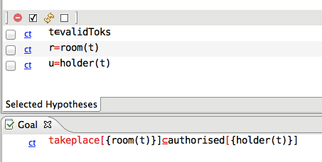
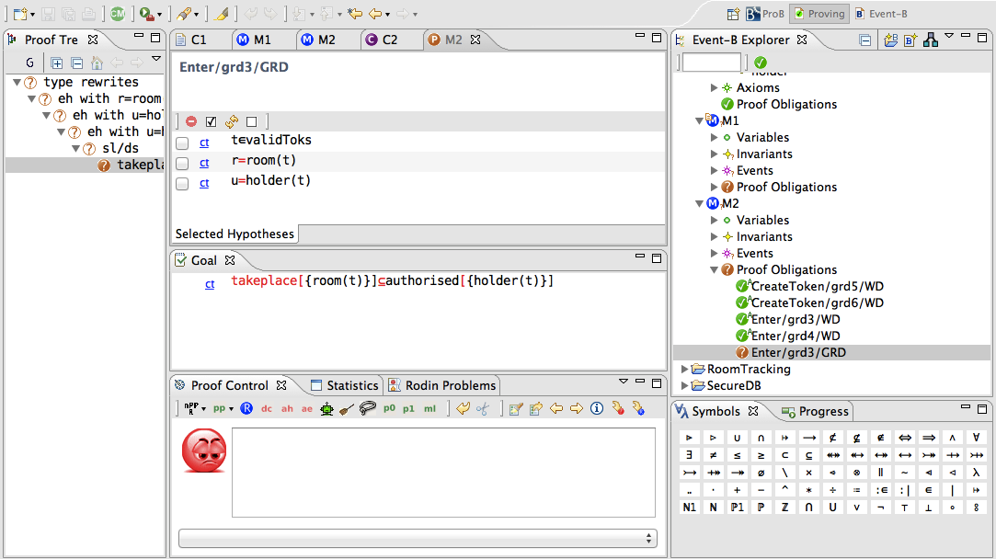
Failing refinement proof
Notes:
What to do: cf Ernie: ask Hillel, Talmundic scholar

Slide 28
Gluing invariant
USER
authorised
ACTIVITY
location
holder
ROOM
takeplace
TOKEN
room
To ensure consistency of the refinement we need invariant:
inv 6: t ∈ valid
⇒
takeplace [ room(t) ] ⊆ authorised[ holder(t) ]

Slide 29
Invariant enables PO discharge

Slide 30
But get new failing PO

Slide 31
Strengthen guard of refined RemAuth

Slide 32
Requirements revisited
Users are authorised to engage in activities
User authorisation may be added or revoked
Activities take place in rooms
…
Question: was it obvious initially that revocation of authorisation was going to be problematic?
Notes:
Formal modelling + verification allows you to become a domain expert quite quickly

Slide 33
Rational design – what, how, why
What does it achieve?
if user u is in room r,
then u must be authorised to engaged in
all activities that can take place in r
How does it work?
Check that a user has a valid token
Why does it work?
For any valid token t, the holder of t must be authorised to engage in all activities that can take place in the room associated with t

Slide 34
What, how, why written in B
What does it achieve?
inv1: u∈dom(location) ∧ location( u ) = r
⇒
takeplace[ r ] ⊆ authorised[ u ]
How does it work?
grd3b: t ∈ valid ∧ r = room(t) ∧ u = holder(t)
Why does it work?
inv2: t ∈ valid
⇒
takeplace [ room(t) ] ⊆ authorised[ holder(t) ]
Notes:
Formal modelling literature tends to focus on what and how – why is important as well
NB inv2 was uncovered through proof

Slide 35
System level reasoning
Examples of systems modelled in Event-B:
Train signalling system
Mechanical press system
Access control system
Air traffic information system
Electronic purse system
Distributed database system
Cruise control system
Processor Instruction Set Architecture
…
System level reasoning:
Involves abstractions of overall system not just software components

Slide 36
Problem Abstraction
Abstraction can be viewed as a process of simplifying our understanding of a system.
The simplification should
focus on the intended purpose of the system
ignore details of how that purpose is achieved.
The modeller/analyst should make judgements about what they believe to be the key features of the system.

Slide 37
Abstraction (continued)
If the purpose is to provide some service, then
model what a system does from the perspective of the service users
‘users’ might be computing agents as well as humans.
If the purpose is to control, monitor or protect some phenomenon, then
the abstraction should focus on those phenomenon
in what way should they be controlled, monitored or protected?

Slide 38
Refinement
Refinement is a process of enriching or modifying a model in order to
augment the functionality being modelled, or
explain how some purpose is achieved
Facilitates abstraction: we can postpone treatment of some system features to later reﬁnement steps
Event-B provides a notion of consistency of a reﬁnement:
Use proof to verify the consistency of a reﬁnement step
Failing proof can help us identify inconsistencies

