Slide 1
iUML-B Statemachines, a new approach to UML-B

Slide 2
(old) UML-B Architecture
GMF
UML-B
Proj Diag.
generates a separate Event-B project
All modelling has to be done in diagrams
Context Diag.
Rodin Database
Event-B
Rodin Database
Class Diag.
Marker
*.bum, *.buc, …
Marker
State Diag.
StaticChecker
*.umlb
UML-B EMF
Event-B
static checked
*.bcm, *.bcc, …
EMF

Slide 3
Motivation for (new) iUML-B
Experienced Event-B users
would like diagrams
without being distanced from Event-B
Integrated UI
Mix notations within one machine
Event-B Text editor +
Class diagrams +
State machine diagrams +
… and others
Solution:
Re-implement UML-B as an extension to Event-B
e.g. a state machine is an element inside an Event-B machine
Contributes guards an actions to hand written events

Slide 4
iUML-B Tool demo

Slide 5
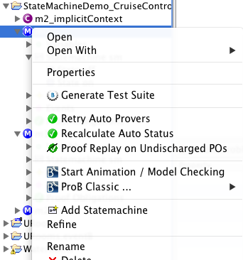
Adding a statemachine to an Event-B machine

Slide 6
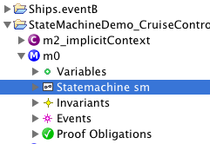
Open state machine diagram editor
Double click to open

Slide 7
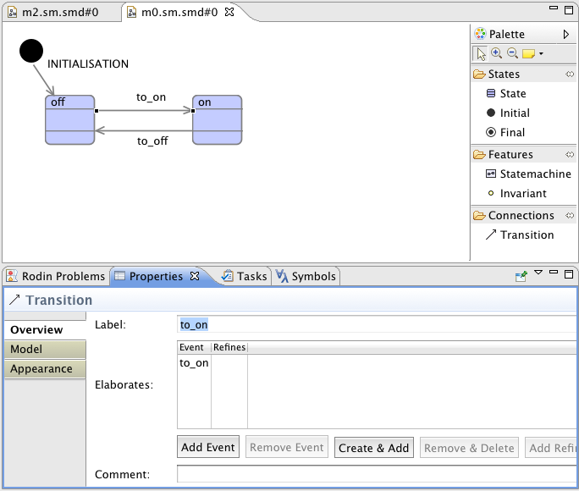
Editor i/f
Draw diagram,
Link to existing events using properties sheet add event button
Create new events and and link to them using create & add button

Slide 8
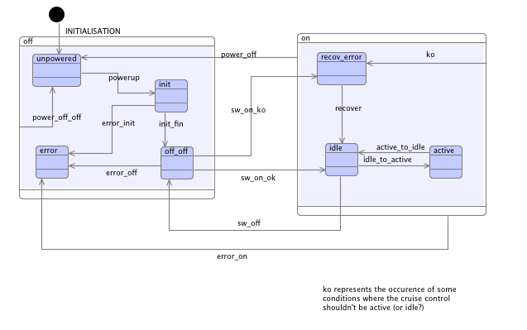
Refinement – add nested statemachines

Slide 9
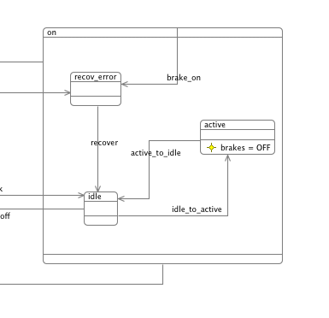
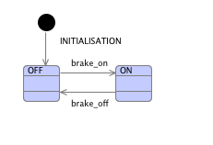
Synchronise state machines via event elaboration

Slide 10
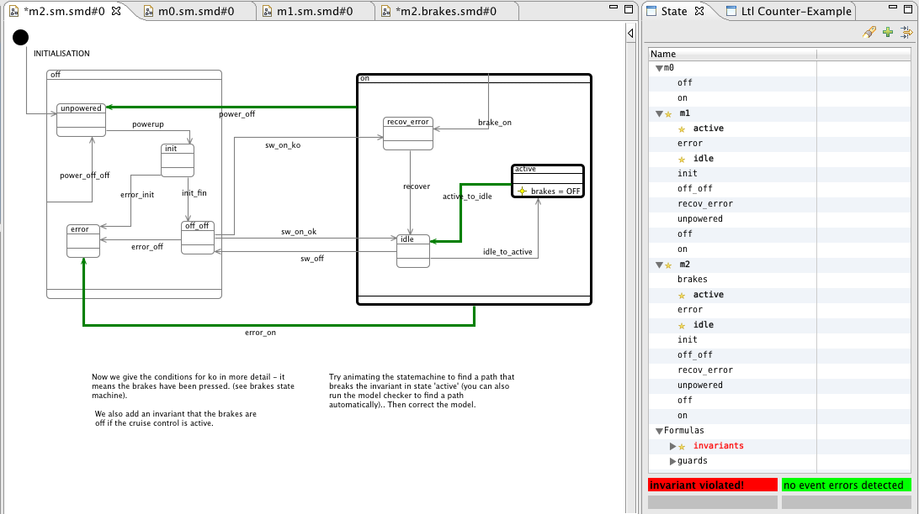
Animation/model checker

Slide 11
Multiple Diagrams
Another Diagram
Statemachine Diagram
Event-B Machine
???s
statemachines
???
transitions
<another aspect>
event sequencing
guards and actions
events
variables
invariants
user guards and actions +
generated guards and actions

Slide 12
Architecture/persistence
iUML-B
GMF
Proj Diag.
State Diag.
Class Diag.
…
Event-B EMF
generate
State Machine EMF
Class Diagram EMF
EMF
generate
Persistence
Rodin Database
Event-B
Rodin Database
State Machine XMI
Class Diagram XMI
*.bum, *.buc, …
Rodin
Event-B
static checked
*.bcm, *.bcc, …

